Slide 1
Welcome!
By Peds SIG Board

Slide 2
Introductions
Jillian Joyner - President
Madeline Heil - Vice President
Milana Atwood - Secretary
Autumn Harless - Treasurer
Kerry Kiser- Social Media Chair
Dr. Goins - Faculty Advisor
*If you are interested in a Board Position, please send an email to jctutterrow0305@email.campbell.edu with your name and position you are interested in.

Slide 3
Our Goals

Slide 4
Gain exposure to different pediatric diagnoses and interventions
Give back to organizations associated with pediatrics
Have hands on experience with working with kids
Make t-shirts :)
Have you filled out our form?
https://forms.gle/s5i3e1NUAW2eagLx7

Slide 5
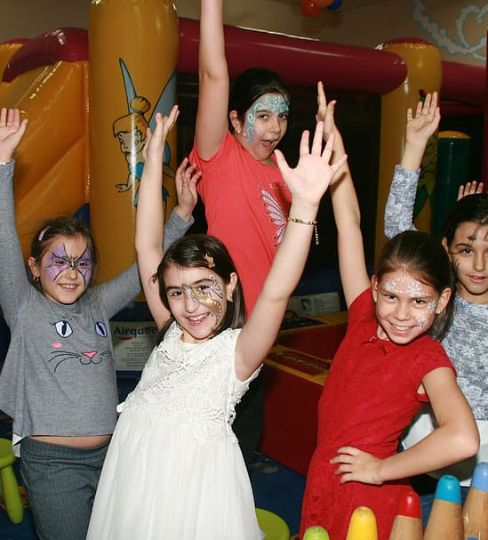
Upcoming Events

Slide 6
Buddy Break
Shadowing: June 10th
Training: After initial shadowing
Expectations: Shadowing a volunteer with a child with or without a diagnosis
Hours: 3-4
Location: Greystone Baptist Church
7059 Lead Mine Rd, Raleigh, NC, 27615

Slide 7
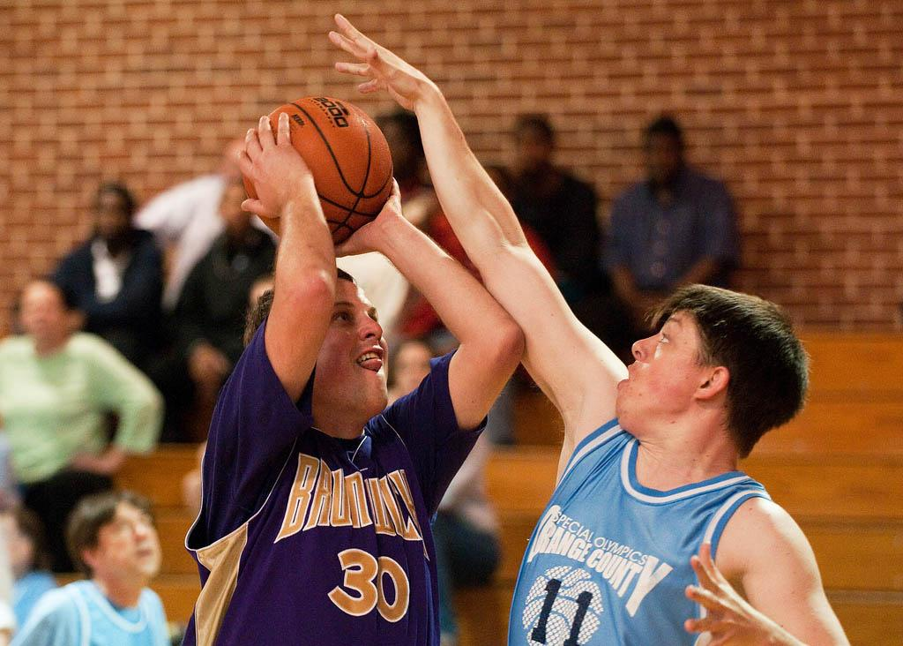
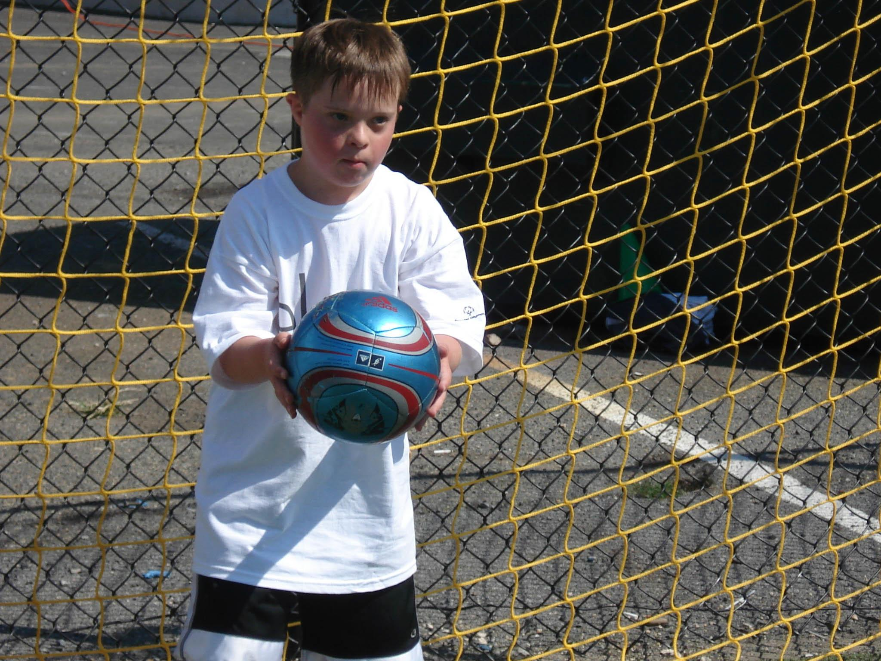
Special Olympics
June 3rd, 10a-5:30p at NC State
NC Summer Games
Dr. Eubank’s email sent on Monday 5/22
FUNfitness physical therapy screening

Slide 8
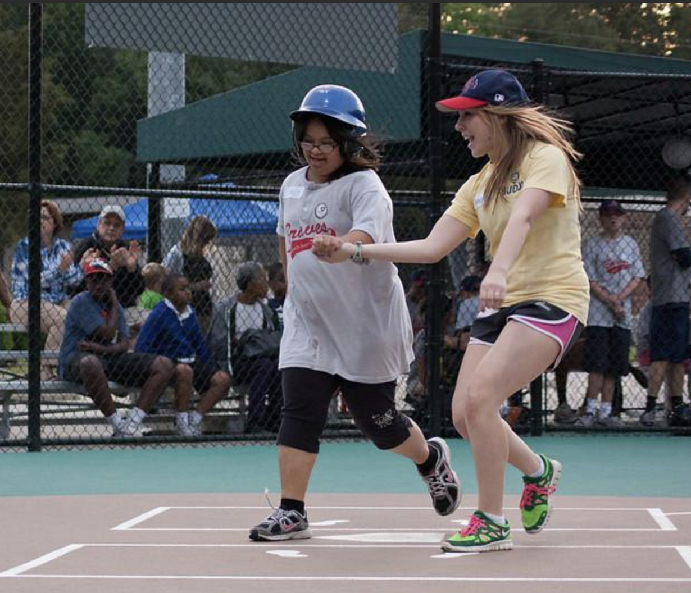
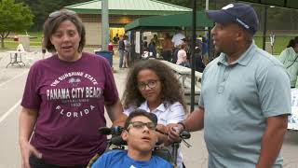
Miracle League
Miracle League in the Triangle is based in North Raleigh
Allows children with special needs to be able to play Baseball
https://www.mltriangle.com/volunteer/

Slide 9
Lunch & Learn Topics
Following pediatric diagnoses throughout the lifespan
Serial Casting
Any other suggestions?

Slide 10
Contact
Jillian Joyner
jctutterrow0305@email.campbell.edu

