Slide 1
SLIPS
Student Leaders in Professional School
March 30, 2023
KT Staffaroni, Director of Student Affairs
Sarah Barefoot, Student Affairs Coordinator

Slide 2
Agenda
WELCOME!
Fundraising
Event Planning
Leadership Skills
Creating engaging relationships

Slide 3
Fundraising
Popular sources
  Bake Sale/Jeans Days (Pharmacy must sign up through PSEB)
  Apparel (We will discuss regulations!)
  Grams (Boo Grams, Valentines Day Grams, etc)
  50/50 Raffles
  Baskets
  Percentage nights (Chipotle, Creek Coffee, Panera, etc)
  5K races, chicken dinners, etc

Slide 4
List Serv- mass email for each class
We use List Serv to contact an entire class.
When you send an email to that class's list serv, it goes to the program manager, or to Student Affairs and must get approved.
How fast it gets approved depends on when you send it.
What will/will not get approved?
  Approved- Upcoming events
  Not approved- Most often, study guides created by someone other than the class president

Slide 5
Blackboard > Student Affairs > Fundraising Event Forms
Forms Page
Fundraising Event Request Form
Fundraising/Event Evaluation Form
Weekly Announcements Submission Request Form
Payment Link Request Form
*See the Student Org
  Purchase Order Procedures page*
  Purchase Order Request for items page*
  Purchase Order for Contracts

Slide 6
How to get funds?
Funds are donated onto the payment link that I provide you, via GiveSmart/Mobile Cause
Within the first two weeks of every month, funds are transferred into your account via your budget code. If you don't know if you have an account, ask me. I contact Julie Byrd to confirm.

Slide 7
Regulations for Licensing and Branding
The University is in partnership with Barnes & Noble
Licensing Authorization Form must be completed at the very beginning of your planning!
Process:
Design your artwork. Be sure to include the name of your organization on the product. The use of university trademarks must follow brand standards and guidelines.
Select an approved licensed vendor for your product.
Complete and submit the departmental Trademark Use Request Form for use review and approval prior to production. Licensing representatives will inform you if any changes are required.
Upon approval, place your order with the vendor.
Submit the completed authorized Trademark Use Request Form along with the invoice to the Purchasing Office for purchase orders.

Slide 8
Guidelines
Student groups must have prior approval to use the licensed marks on products from their Student Life Representative.
Student groups must use an authorized licensed vendor.
The Item MUST include the name of their organization on the product, so as not to compete with the retail options within the bookstore. Permission to use the mark is under the assumption you are promoting your organization, not the college, department or university. The student organization name must not interfere with the University marks or logos.
Licensed marks must not be altered or changed in any way. (ie. adding a stethoscope to the running camel).
Registered student groups should use the word “Club”, “at Campbell” or similar identifier in the naming of the organization.
Unless affiliated with Athletics, student groups may not use the official athletics marks. They may use the CU, Running Camel, and the Athletics block name.
Designs must not include references to alcohol, illegal substances, weapons or suggestive or explicit graphics or language.

Slide 9
Contracts for Events
**CONTRACTS SHOULD BE INITIATED MONTHS IN ADVANCE!**
We use a program called IntelAgree. It connects Student Affairs, the general council and the procurement offices.
Items you will need to present
  Contract
  Estimate
  Purchase Order for Contracts, completed (all vendors)
  Company's (all vendors) W9
  Company's (all vendors) Proof of Liability insurance

Slide 10
What not to do
Initiate a large event, especially if there are multiple vendors, less than 1 month out. General Council and Procurement work according to the que.
Not taking all stakeholders opinions into consideration
Decide to change something within the last two weeks leading up to the event
The University will not sign any agreement that expects student funds to go toward alcohol. -Liability-

Slide 11
Where do we go from here...
Business Office
Incoming funds
Deposits
Reserving laptops for online payments
Accounting Office
Outgoing Funds
Check Request
Reimbursements
Checking Balance
Account Numbers
Student Affairs
Payments & Signatures
Green Warrants
Purchase Orders
CPHS Credit Card
Contracts*

Slide 12
What is Leadership?
Leadership is not a rank.
Leadership is not a position.
Leadership is a decision.
Leadership is a choice.
–Simon Sinek

Slide 13
What is a Leader is Not…
Defensive
Self-Centered
Limitless
Micro-managing
A lone-rider
A leader is not the head of a group. They are the hands and feet. They are the eyes and ears. They are everyone, and they are anyone.

Slide 14
What a Leader Is…
Is Humble
Is Accountable
Is Open to Feedback
Is Watchful
Is Mindful
Is a helper and asks for help
Is willing to be a follower

Slide 15
Building Relationships
Be willing to talk last.
Make the commitment and stay consistent when you may not see the immediate outcome.
Be devoted to people more than a cause.
Find common beliefs and common values to work towards and work for that create togetherness.

Slide 16



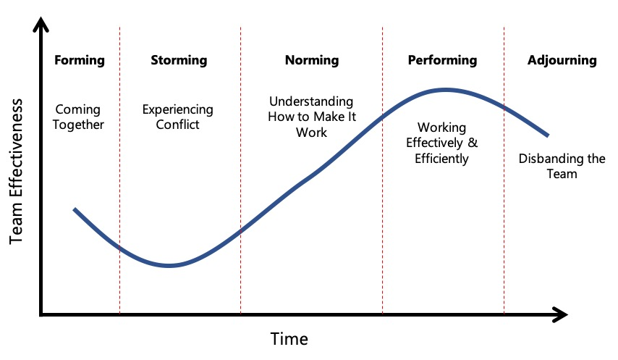


What to Expect

Slide 17
Mental Health resources
FREE
CUSOM Behavioral Health
MyGroup
  Mental health counseling
  Financial Counseling
  Legal Counseling

Slide 18
Academic Services
FREE
Via CU Succeed
1:1 Tutoring
Academic Coaching
Career Services
FREE
Via Student Affairs Coordinator, Ms. Sarah Barefoot
Guidance on resume, CV, Cover letters
Mock Interviews

Slide 19
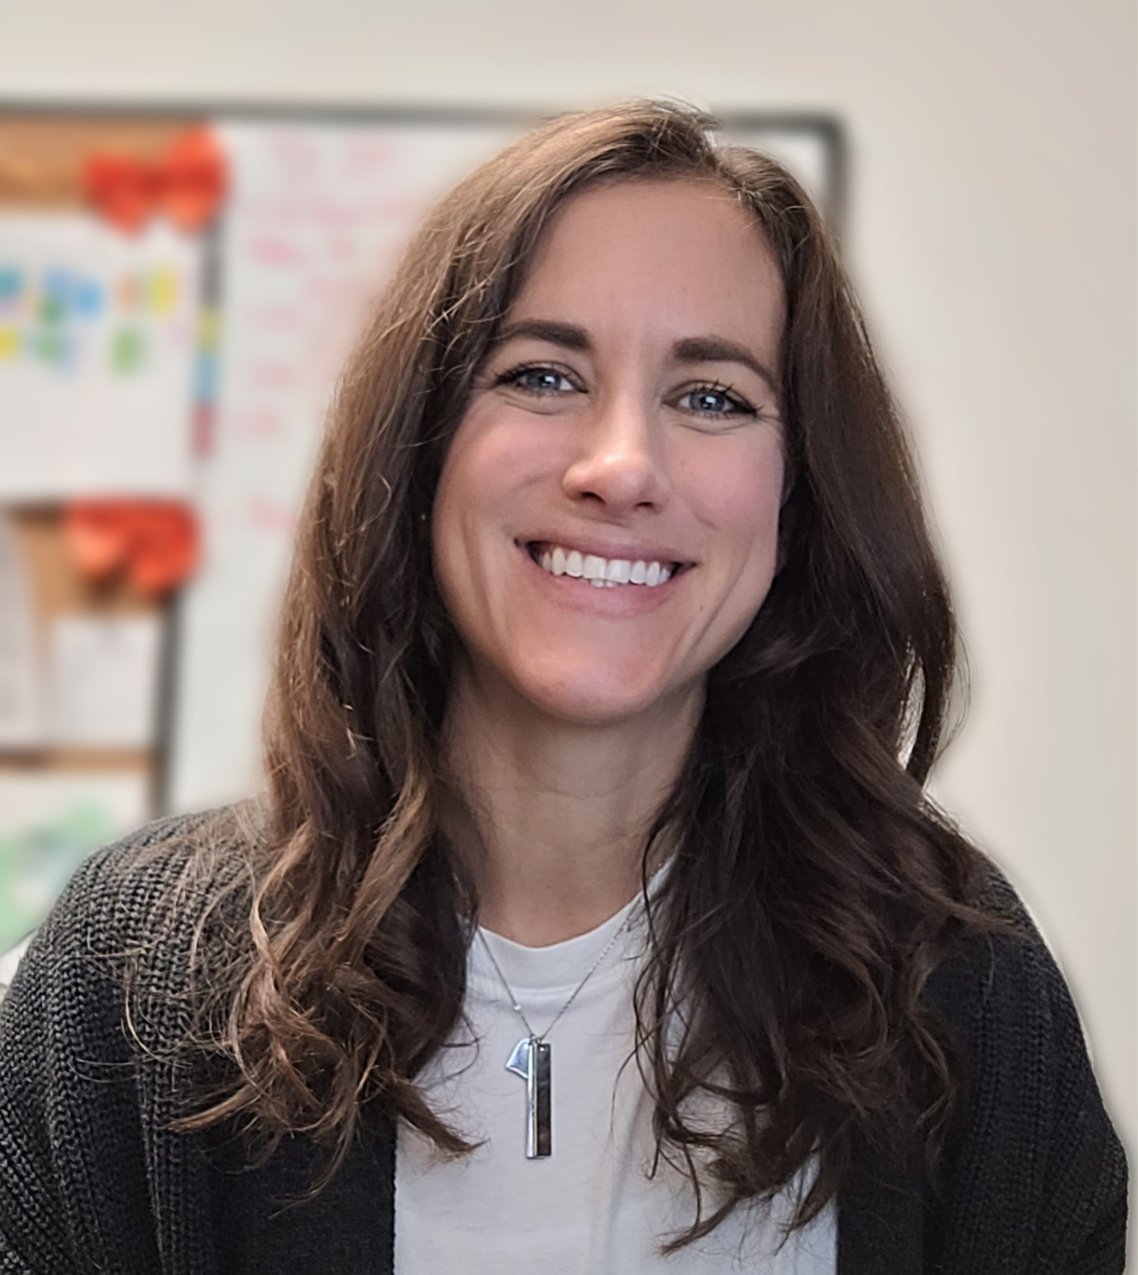
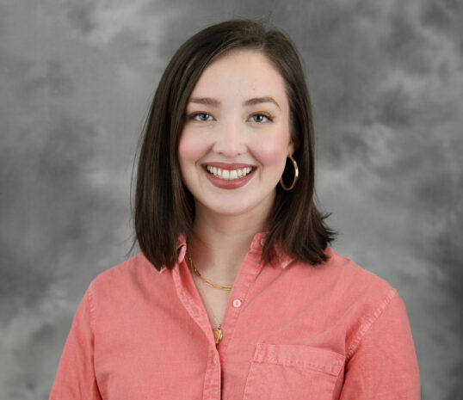
Contacts
Director of Student Affairs- Kathleen "KT" Staffaroni
  Staffaroni@campbell.edu
Student Affairs Coordinator- Sarah Barefoot
  Sbarefoot@campbell.edu

