Slide 1
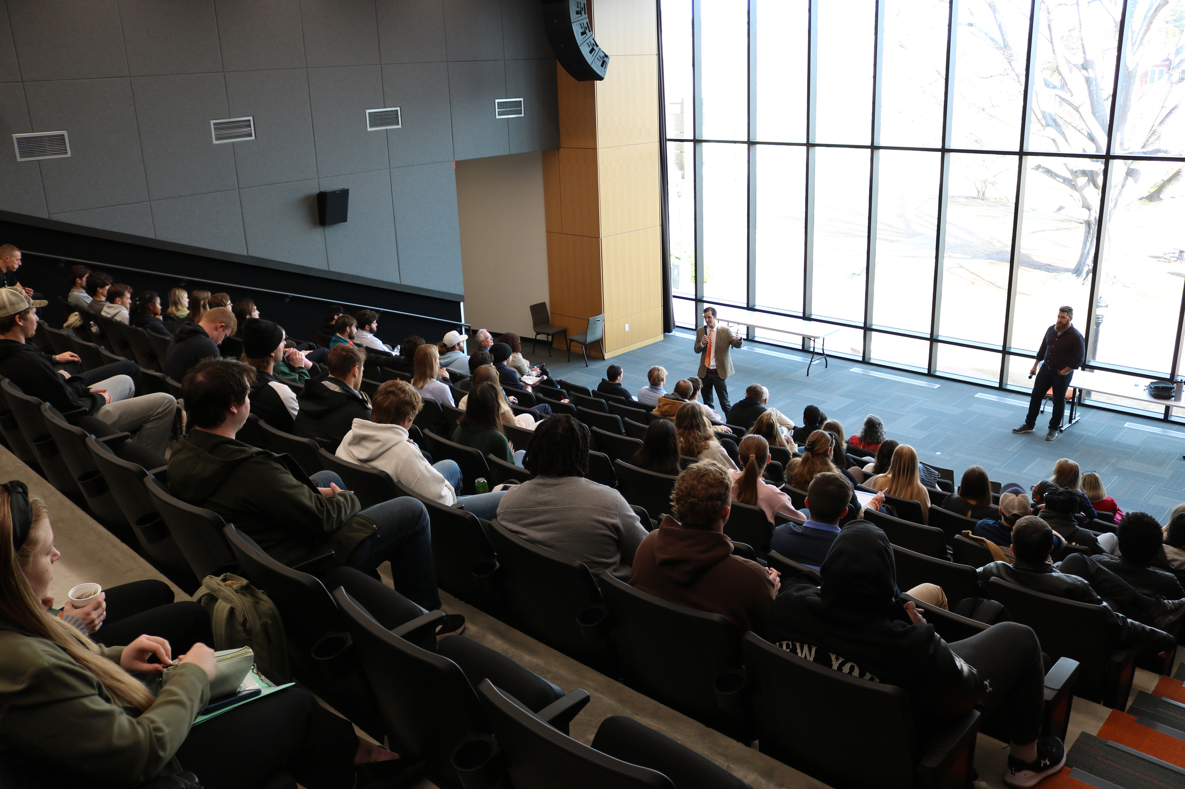

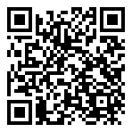
CAMPBELL
INNOVATION CHALLENGE
Have a GREAT IDEA?
November 12th 9:30am & 11:00am
Two Tracks, Double the Prizes
Campus & Community Prizes
1st Prize: $1000
2nd Prize: $500
3rd Prize: $250
All winners will lunch with President Creed
*Prizes will be awarded for both tracks
Register Here:
Any Questions?
Contact Scott Kelly at Skelly@campbell.edu

Slide 2
Campbell Innovation Challenge
The “Pitch”
Example of Submissions
Idea for Campus or Community
3-minute “pitch”
Judging Criteria
* potential impact * showing others want it (Empathy Stage)
* consider implementation issues
Quality of Presentation
* slides clarity/look * evidence of preparation
Student Tailgate on Academic Circle
Flower Gardens
Healthy Food in Gaylord’s
CU Service Organization
Teach Chess to Area Students
Student-led AI Conference
Campus Parking Initiative
“Athletic” food section in Gaylord’s
Campus Clean-up Program

