Slide 1
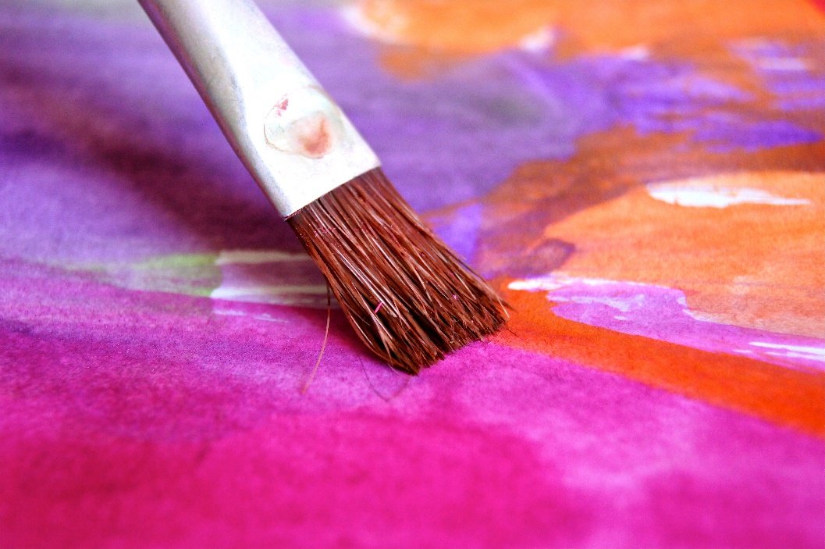
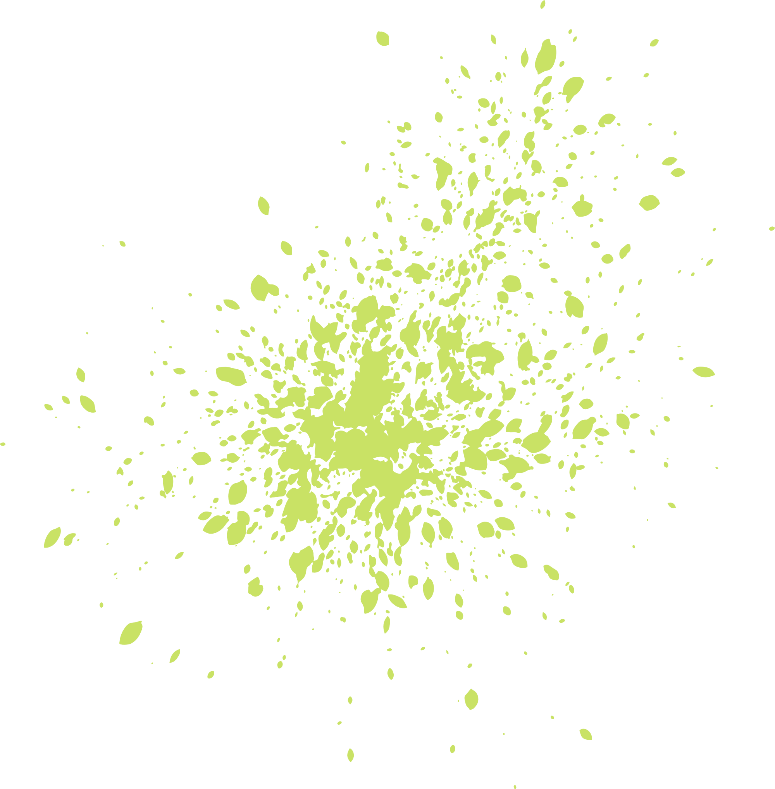
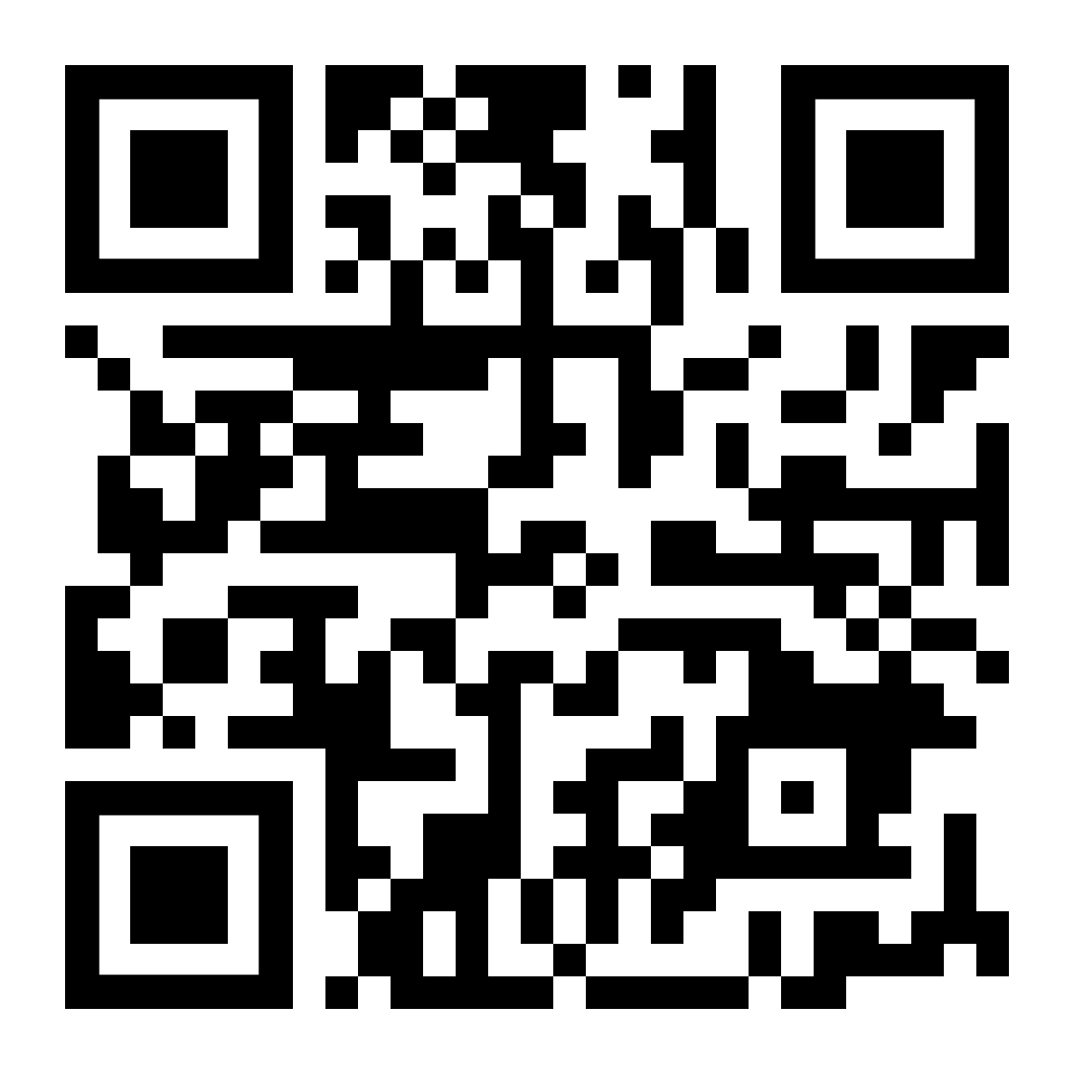
CELEBRATE PAINT
&
24 FEBRUARY, 2023 | 12:30 PM
Members: Free
Non Members: $5
Maddox Hall Room 117
Enjoy an afternoon of canvas painting and fellowship with diverse CPHS Students

