Slide 1
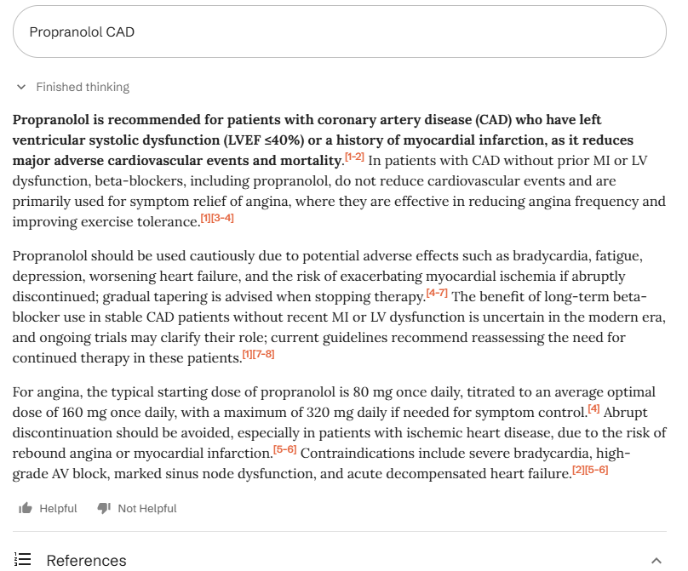
Patient with CAD and essential tremor taking metoprolol succinate. There are essential tremor data with propranolol,but not metoprolol, so are there any data supporting use of propranolol in CAD patients? Tried searching OpenEvidence AI.
Unfortunately, it stated using propranolol in CAD patients with an EF <40% reduces MACE and mortality. Please be careful folks! As we know, using propranolol in patients with an EF <40% is not supported by data or used in practice as SOC since it can worsen clinical outcomes.

Slide 2
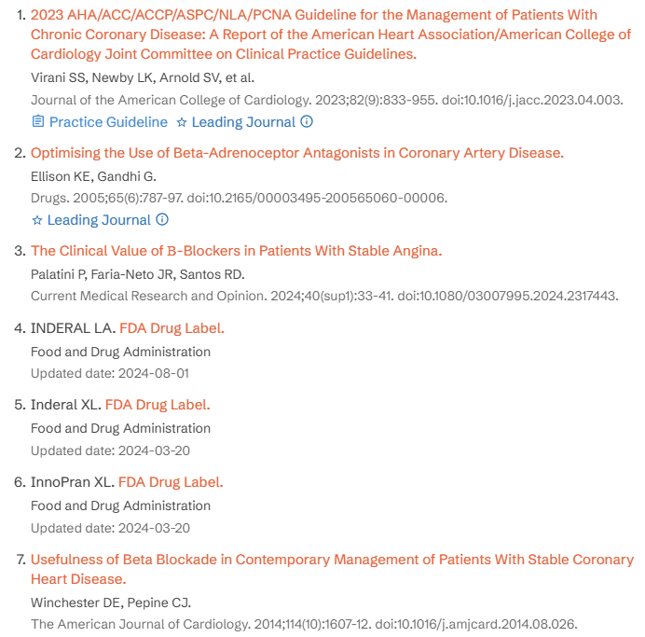

References that OpenEvidence provided

