Slide 1

Wellness on the Railroad
Service Chair: Kameron Lee
C/o 2027

Slide 2
The Rundown
The Underground Railroad (UGRR)
Nonprofit organization
Where: located in Lillington
Who: Melanie Stewart “Mama Moses”
What: offers short term housing, food and clothing to those in need
Fun facts: have given away multiple donated cars to families in need

Slide 3
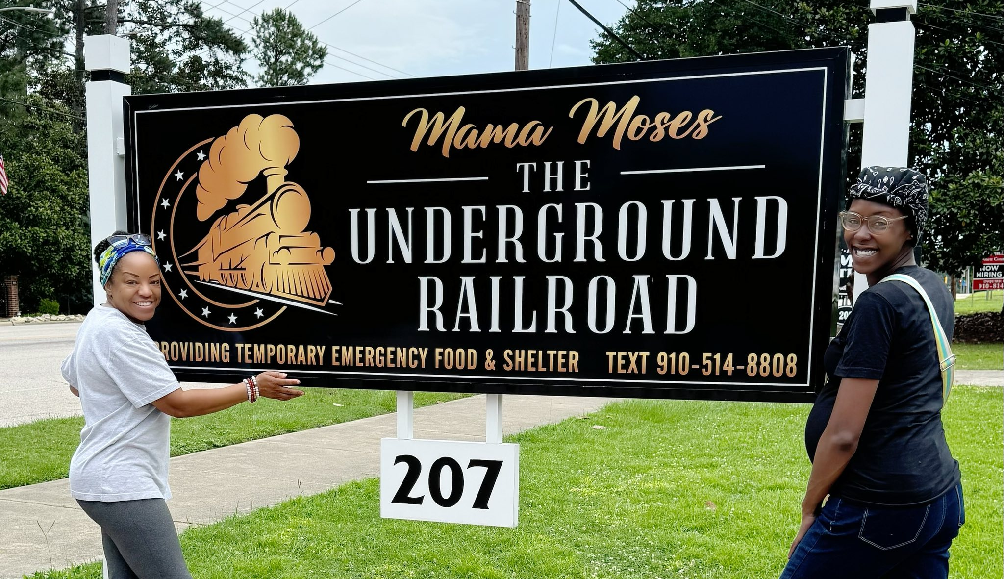

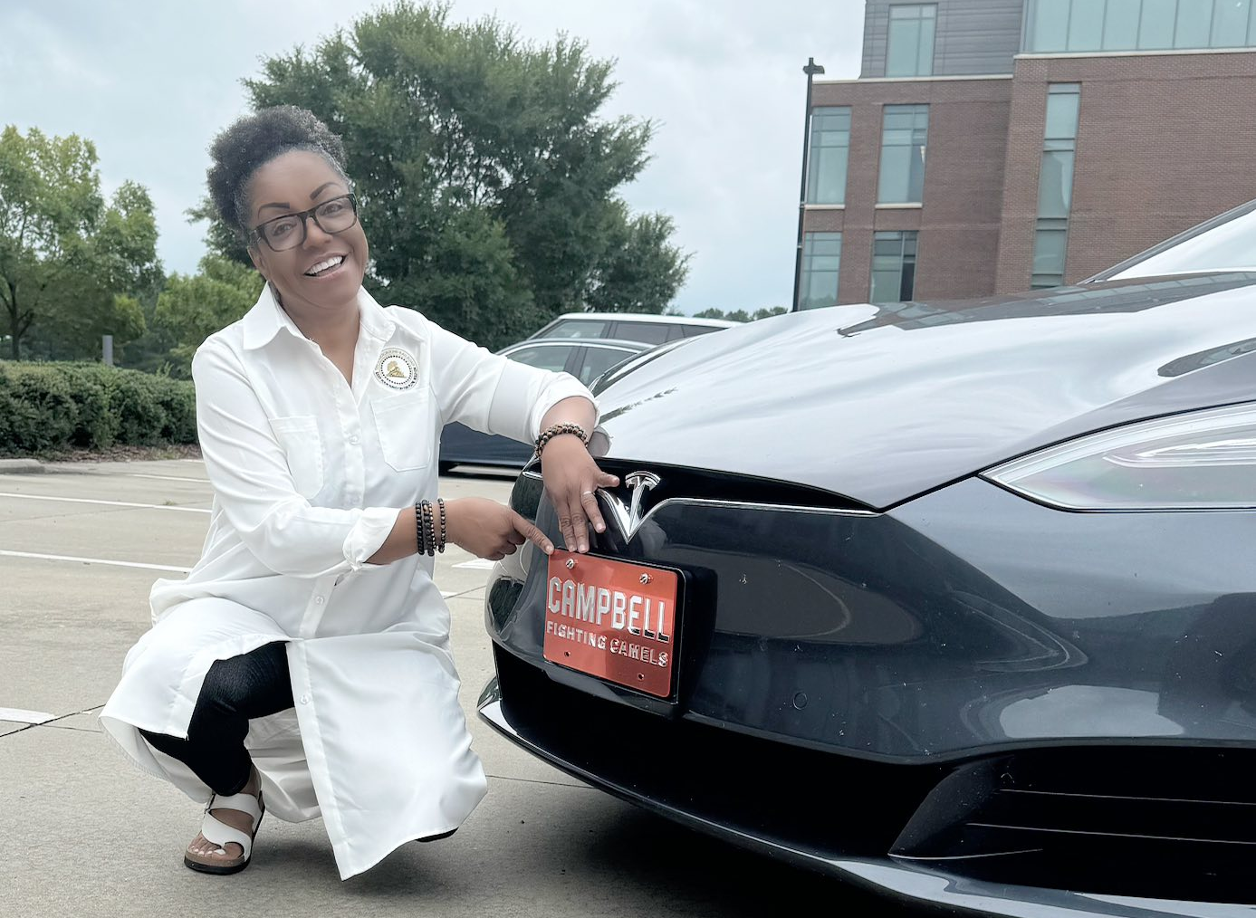
Programs
Stop the Bleed
Stopping court evictions
Food Pantry
White Flag House
Free Giveaways
Christmas Toy Drive
UGRR Medical Team
CUCCC Street Medicine

Slide 4
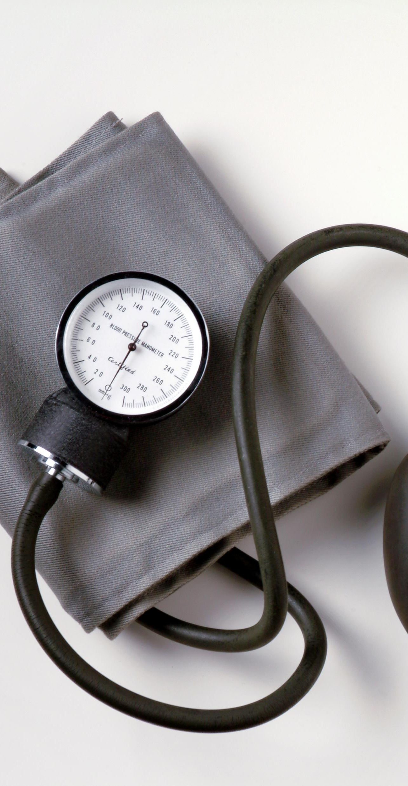
Wellness on the Railroad
Mama Moses Toy Drive
Giving away toys, clothes, and bicycles so every kid has something on Christmas!
When: December 20th, 2025
Time: 8 - 12 PM
Our Role: Offer Health Screenings
Blood pressure
Blood glucose
OTC medication education

Slide 5
Service Hours
SPRING HOURS!
December 20th

Slide 6
Service Hours
Also counts for PLS Service hours!!!
“Students who complete either 30, 50, or 100 service hours for the academic school year will be awarded a bronze, silver, or gold lapel pin to wear on their white coats.”
FALL
November 14th
SPRING
December 20th

Slide 7

Join Me
If you are interested in being a part of the PSEB Service Committee, please come see me!
Someone will need to take over next year!

