Slide 1

Wellness on the Railroad
Service Chair: Kameron Lee
C/o 2027

Slide 2
The Rundown
The Underground Railroad (UGRR)
Nonprofit organization
Where: located in Lillington
Who: Melanie Stewart “Mama Moses”
What: offers short term housing, food and clothing to those in need
  Fun facts: have given away multiple donated cars to families in need

Slide 3
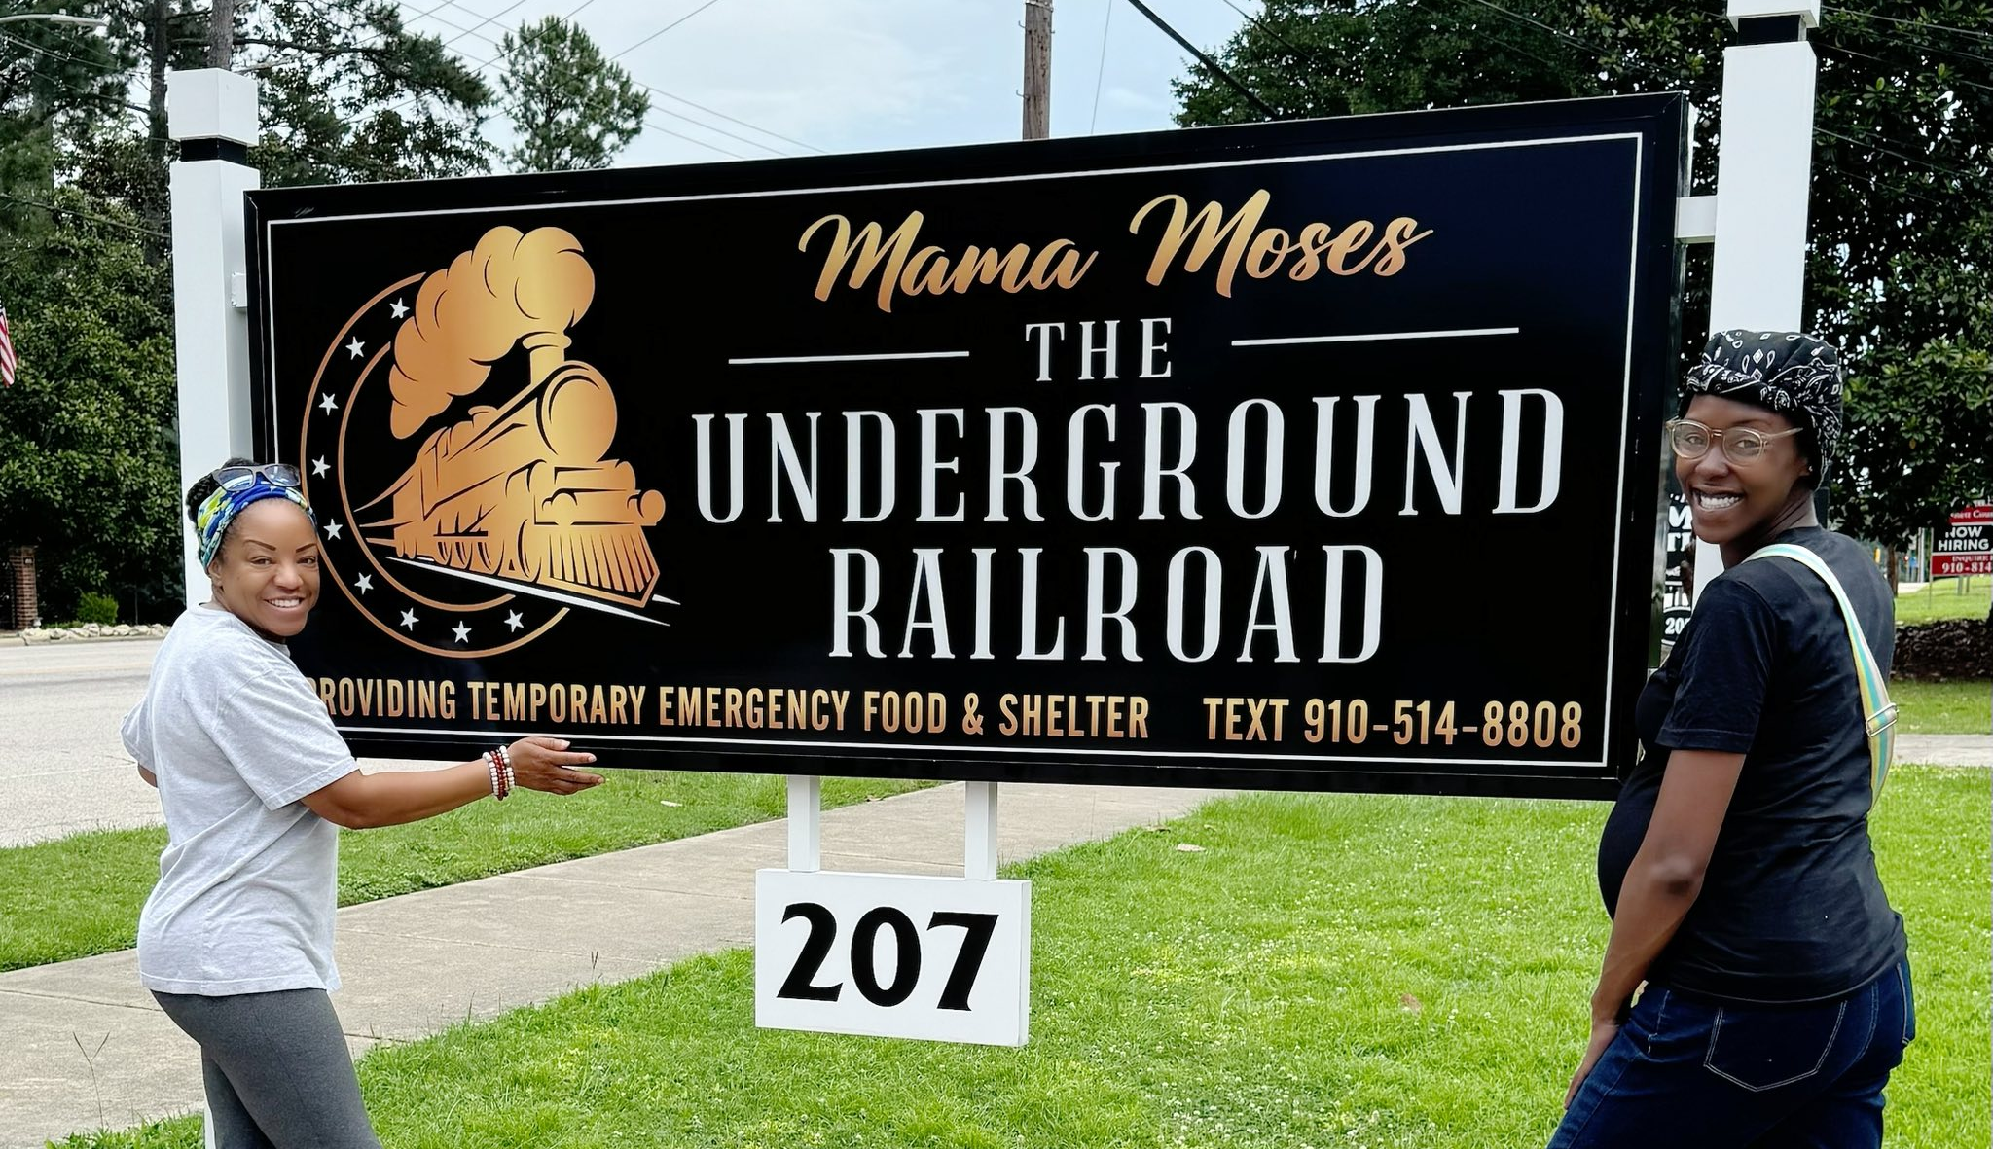

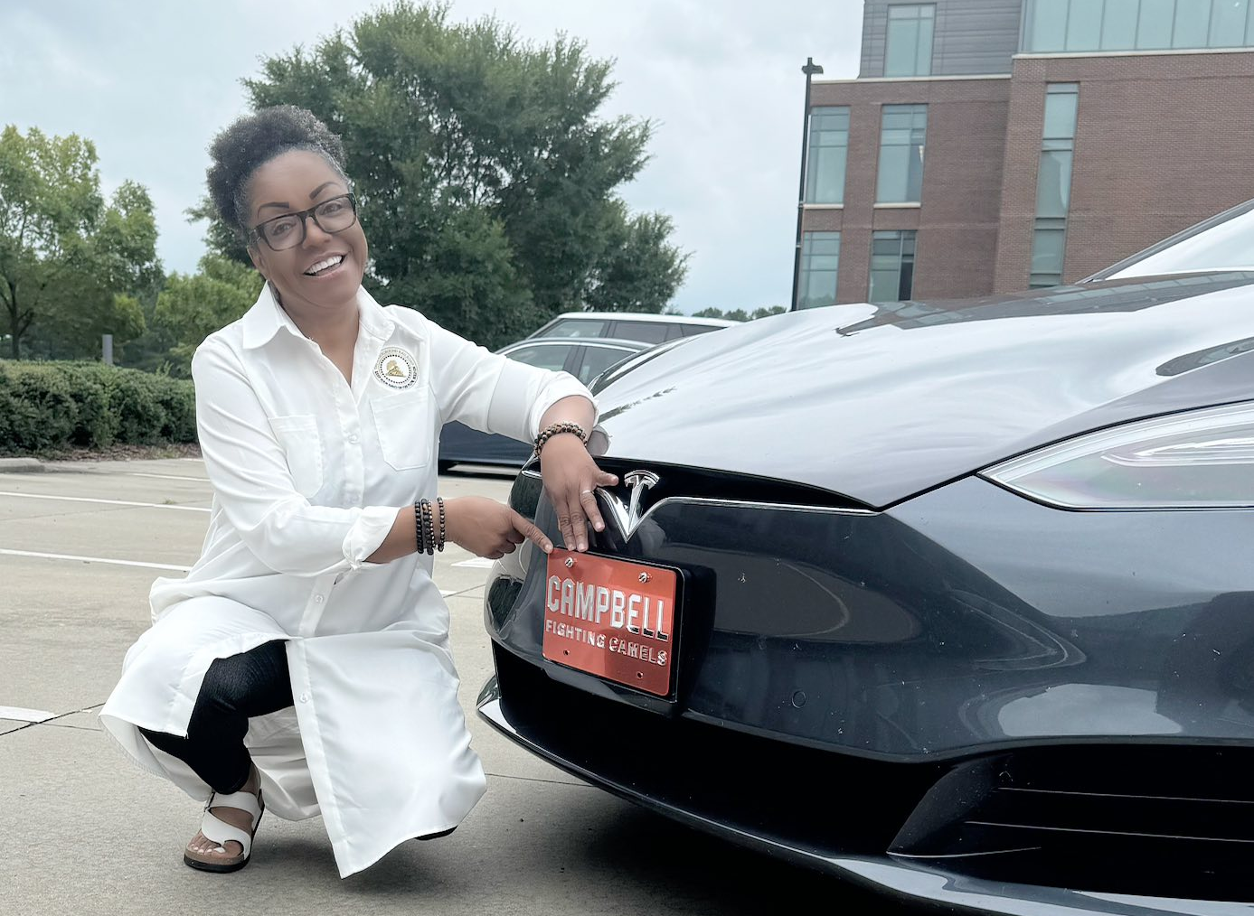
Programs
Stop the Bleed
  Stopping court evictions
Food Pantry
White Flag House
Free Giveaways
Christmas Toy Drive
UGRR Medical Team
  CUCCC Street Medicine

Slide 4
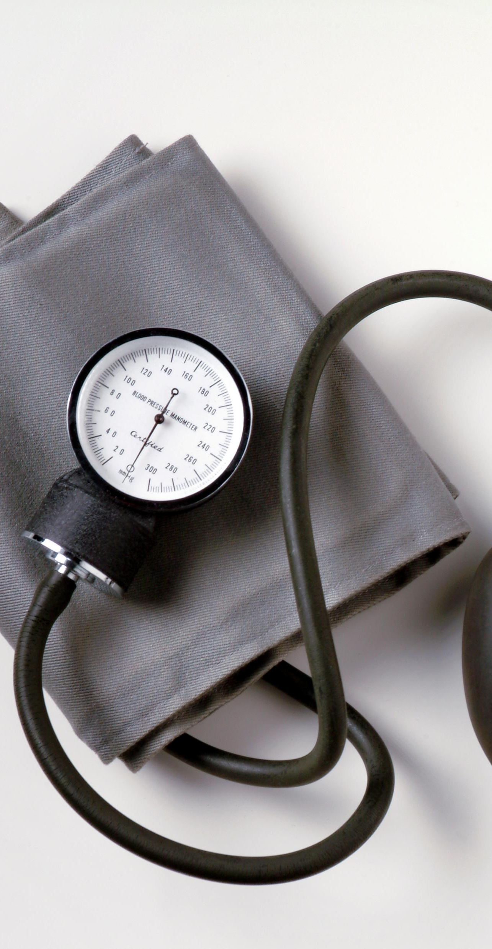
Wellness on the Railroad
Mama Moses Giveaway
  Giving away clothing, toiletries & household items
When: November 14th, 2025
  Time: 1 - 4 PM
    1 – 2 PM: Obtain your training certificate
Our Role: Health Screening Fair
  Blood pressure
  Blood glucose
  OTC medication education

Slide 5
Becoming a Certified Advocate
To volunteer at this event AND future events you must become certified with UGRR
Future Events:
Health Fair at the UGRR Toy Drive: December 20th
We will be offering a shortened (1 hour) version of the training directly prior to this event, starting promptly at 1 pm
Be there at 12:45 pm

Slide 6
Reasons to Become Certified
One time training, no recertification required
CV booster
↑ volunteer opportunities for you in the future
Even if you are unable to stay for the health fair, you can still attend to earn your certification

Slide 7
Service Hours
FALL
November 14th
SPRING
December 20th

Slide 8
Service Hours
BOTH count for PLS Service hours!!!
Students who complete either 30, 50, or 100 service hours for the academic school year will be awarded a bronze, silver, or gold lapel pin to wear on their white coats.
FALL
November 14th
SPRING
December 20th

Slide 9
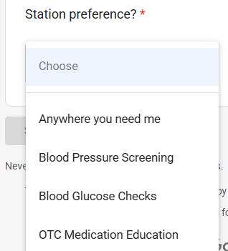
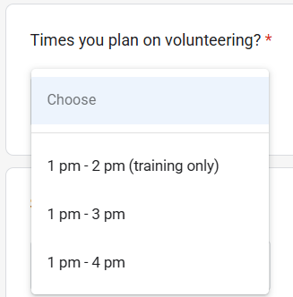
Sign Up Options

Slide 10

Join Me
If you are interested in being apart of the PSEB Service Committee, please come see me!
Some one will need to take over next year

