Slide 1
Academy of Managed Care Pharmacy
AMCP
Wednesday, September 4th

Slide 2
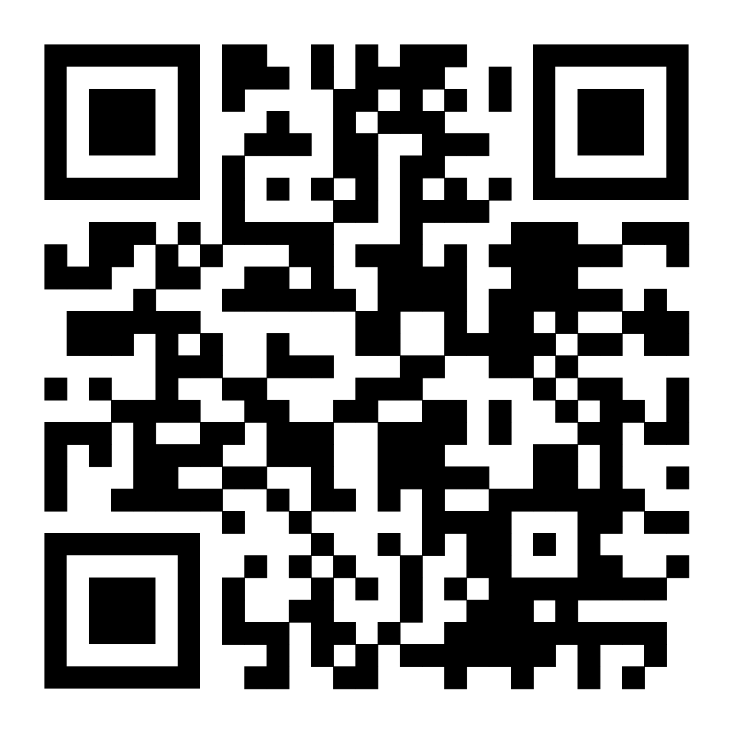
Attendance
Wednesday, September 4th

Slide 3
Notes:
And since our founding, AMCP continues to be the hub for health plans, manufacturers, PBMs, and other health care decision makers to catalyze meaningful conversation and create actionable solutions to get patients the medications they need at a cost they can afford.
This is an important niche health care profession.
AMCP’s diverse membership of pharmacists, physicians, nurses, biopharmaceutical professionals, and other stakeholders leverage their specialized expertise in clinical evidence and economics to optimize benefit of medicines, population health management, and patient access to cost-effective, safe medications.
And student pharmacists are in important part of our membership as we build the pipeline for the next generation. AMCP offers many opportunities for you to learn more about managed care pharmacy as well as how to launch your career.
AMCP supports university chapters across the country for you to join, network, and learn

Slide 4

AMCP Strategic
INITIATIVES
Optimize Value & Access
Address Disparities in Medication Use and Access
Enhance Member Value
Improve formulary decision-making and tools to help patients obtain the medications and other therapies they need
Address barriers to access and the effective use of medications and other therapies
Grow our membership and make AMCP essential to those involved in managed care pharmacy
Notes:
AMCP has 3 strategic initiatives to guide its work. It convenes industry leaders and develops guidelines and tools for members on these key issues.
Focus areas for each one (You do not need to go into these – just in case you are asked)
Optimize Value & Access:
Provide resources to help payers evaluate digital therapeutics
Promote the adoption of biosimilars
Incorporate the patient voice into formulary decision making
Address Disparities in Medication Use and Access
Create awareness and identify opportunities to mitigate disparities in medication use from a managed care perspective
Seek partnerships to assist AMCP with addressing health disparities
Expand research opportunities to support managed care professionals regarding disparities in medication use
Enhance Member Value
Evaluate emerging sectors for incorporation into AMCP member growth strategy
Define and enhance value proposition for key stakeholder groups
Grow corporate membership and involvement
Build an organization that is #Member1st

Slide 5
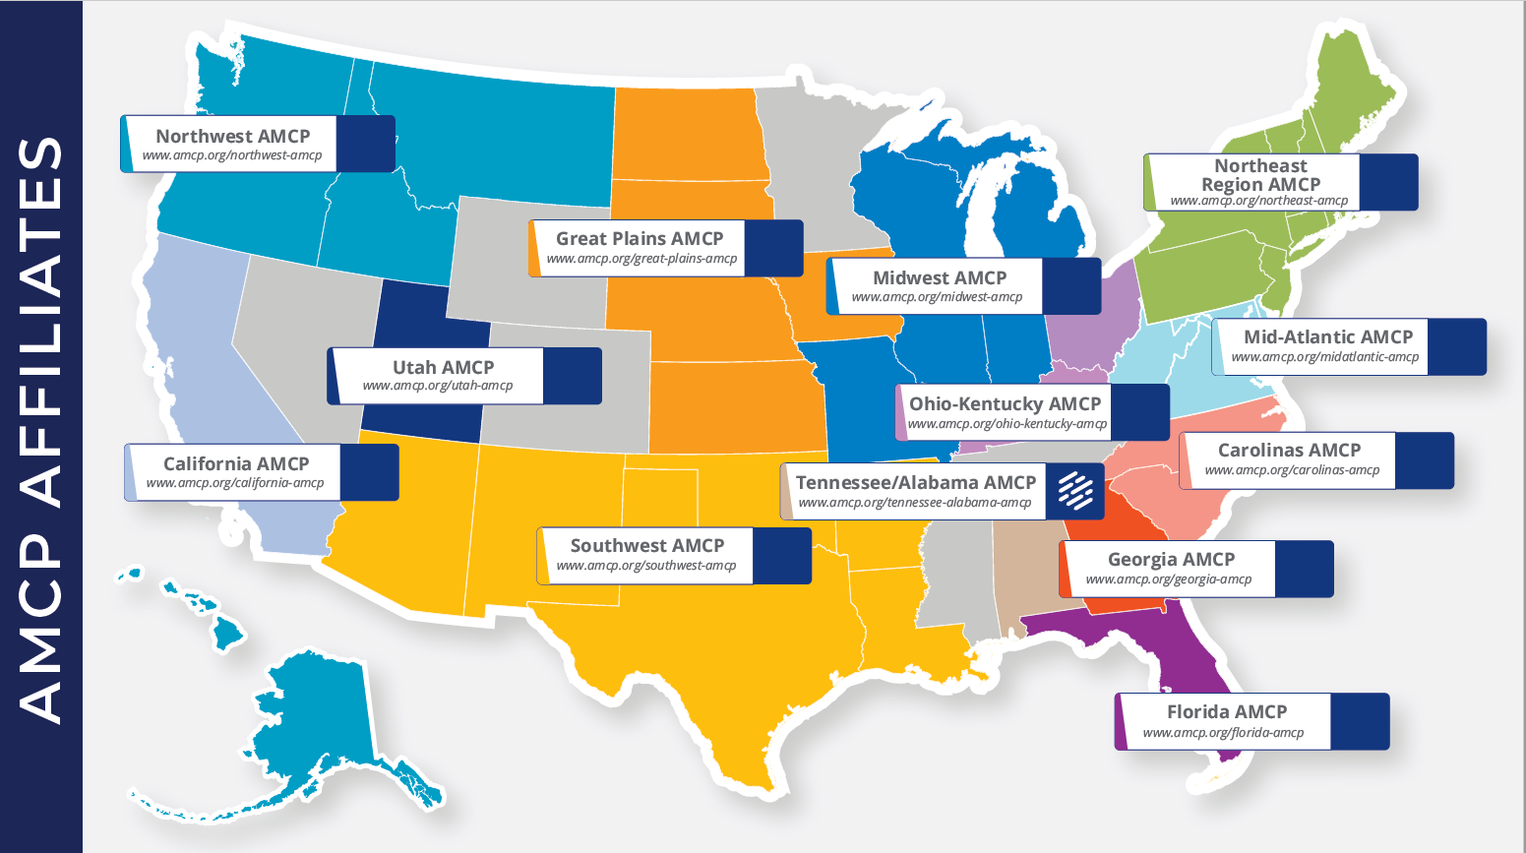

Slide 6
Annual Events
Nexus (October)
Carolinas Affiliate Day
of Education (November)
Annual Conference (March)

Slide 7
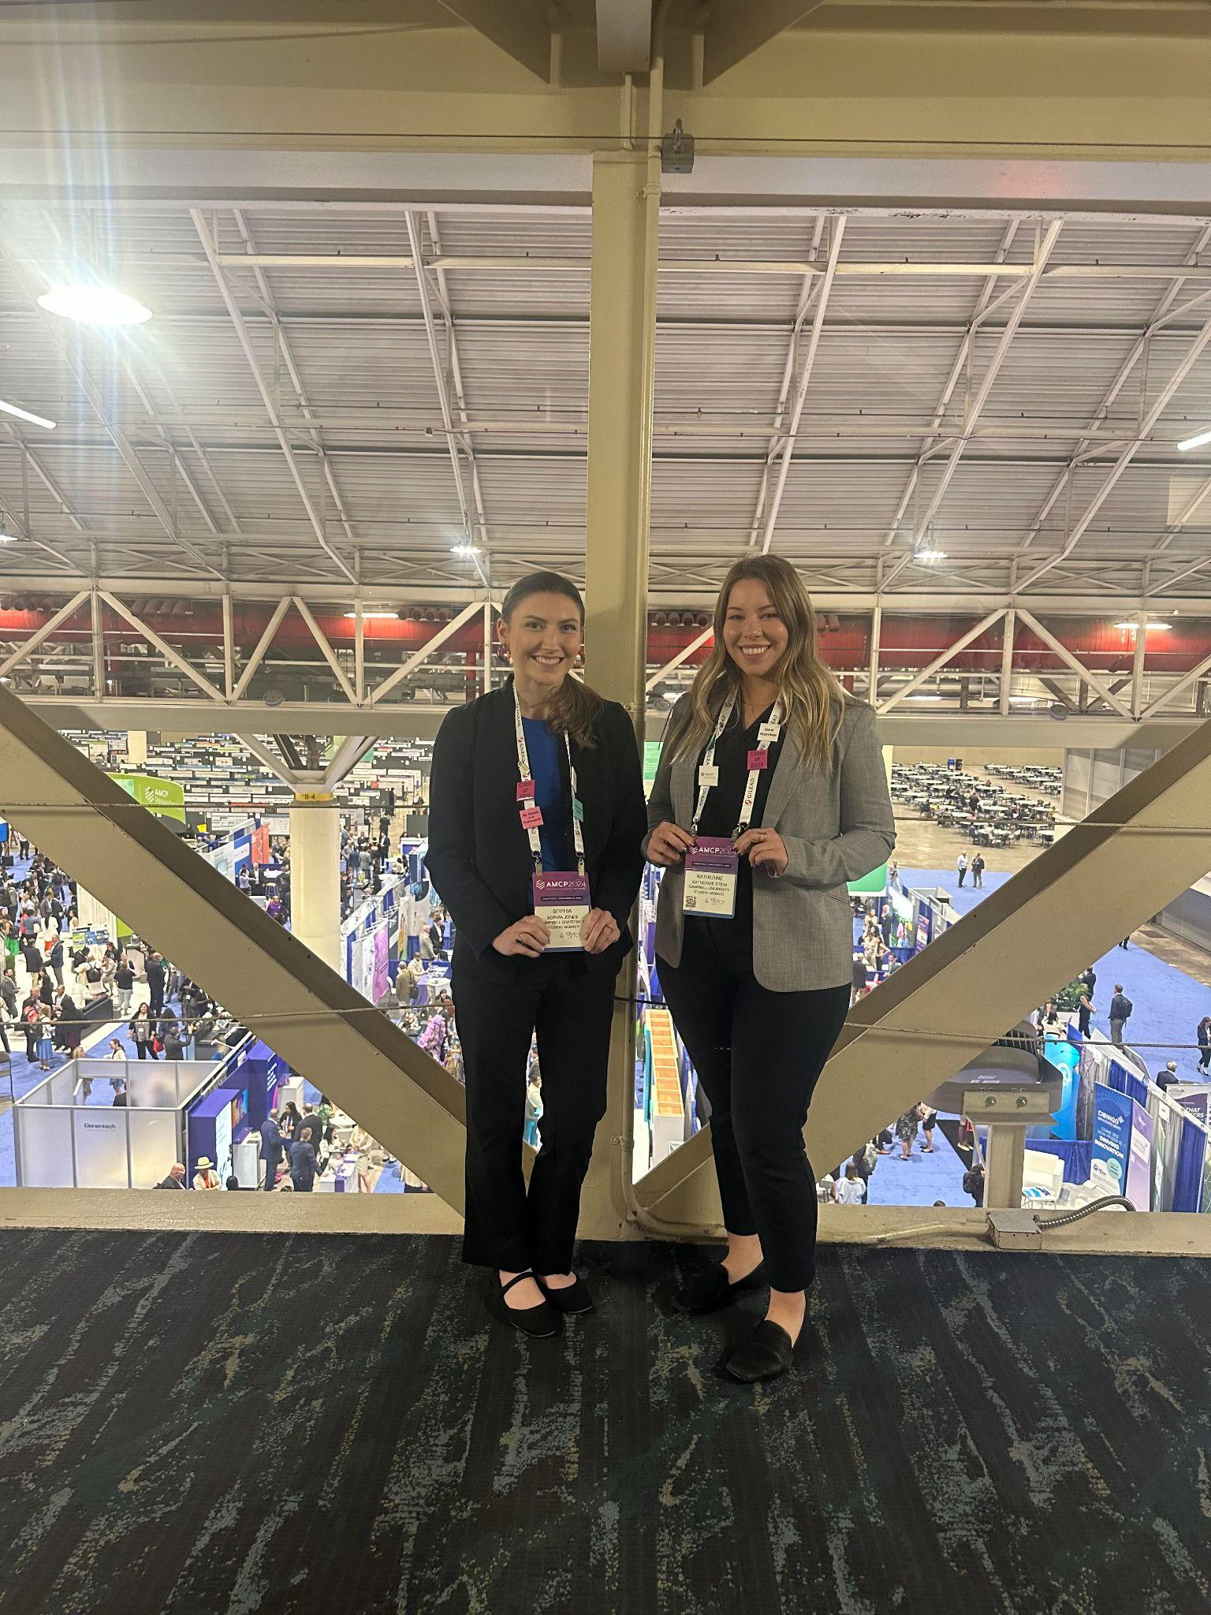
Nexus

Slide 8
Annual Events Scholarships
Nexus Scholarships
Annual Conference Scholarships
$1500 for travel/registration
Recognition at the conference

Slide 9
Carolinas Day of Education
Thursday November 14, 2024 from 8am to 4pm ET

Slide 10
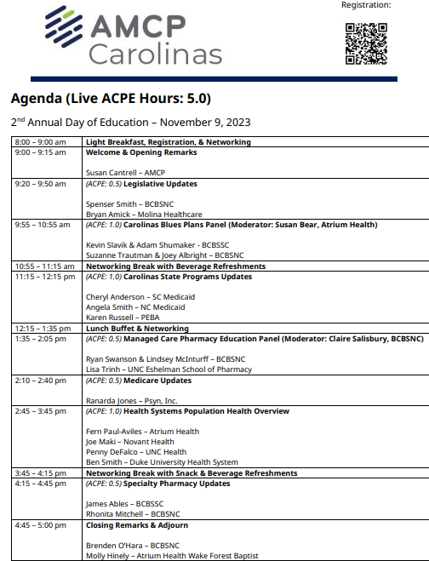

Slide 11
Mentorship Programs
Carolinas Affiliate 1:1 Mentorship
  Monthly Meetings with specific topics
AMCP Foundation Conference Buddy
  meet informally at AMCP national meetings to discuss the industry, career pathways, and AMCP resources available to help student pharmacists and new practitioners grow
AMCP Foundation Poster Presentation Mentor Program
  onsite feedback at national conferences
Mock Fellowship and Residency Interview Program
  P4s interested in pursuing a fellowship with a volunteer to conduct a mock interview and review their CV

Slide 12
Pharmaceutical Shadowing Days
Leo Pharma (1 student)
Gilead Pharma (2 students)

Slide 13
Managed Care Elective
Ryan Swanson
  Blue Cross Blue Shield NC
Brenden O’Hara
  Previous AMCP Carolians President
Others with experience in many areas of managed care
  PBM’s
  Consulting
  Payers
  Formulary Management
  Retail
  Industry

Slide 14
APPE Rotation (Virtual)
AMCP Experiential Program in Association & Leadership Management
  policy and advocacy
  professional affairs
  education
  business development
  the Journal of Managed Care and Specialty Pharmacy
  the Biologics and Biosimilars Collective Intelligence Consortium (BBCIC)
  membership

Slide 15
Other Managed Care APPE Rotations
Blue Cross Blue Shield NC
  Virtual
Cencora (previously Xcenda) Health Outcomes Research/Consulting
Pharmacy Quality Alliance

Slide 16

(1) a written drug monograph evaluating the competition study drug, with recommendations for formulary placement and any associated utilization management strategies
(2) narrated PowerPoint slides for a P&T Committee presentation
P&T
Competition

Slide 17
Designed to provide an immersive experience in the skills necessary for effective formulary review and management
The study drug for the 2025 P&T Competition is VELSIPITY™ (estrasimod). Velsipity is a sphingosine 1-phosphate receptor modulator indicated for the treatment of moderately to severely active ulcerative colitis (UC) in adults.
The deadline for entries to the 2025 National P&T Competition (one entry per pharmacy school) is 11:59 pm EST on Monday, January 20, 2025.

Slide 18
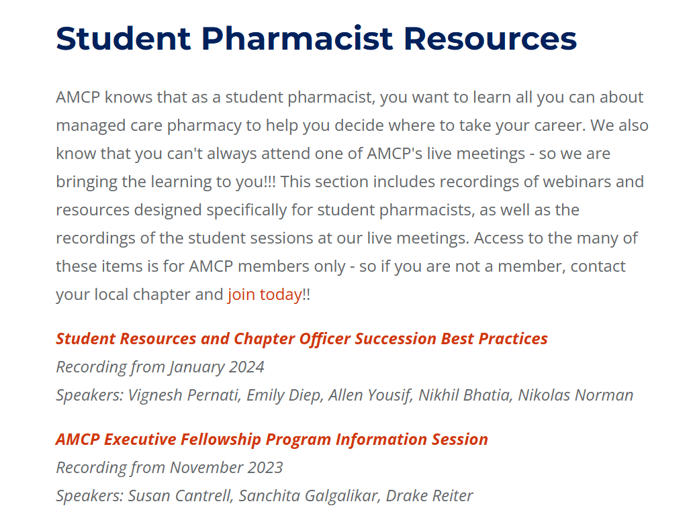
Webinar Recordings

Slide 19
Upcoming Webinar Recordings
P&T Competition Best Practices Webinar
Tuesday, Sept. 10, 7–8pm ET
Join us for this unique opportunity to learn directly from the experts and enhance your competitive edge. Sign up now!
Introduction to Association Management
Thursday, Sept. 26, 8–9pm ET
AMCP and the Pharmacy Quality Alliance (PQA) are excited to host a webinar introducing association management. During the webinar, representatives from both organizations will share insights and experiences from their fellowship programs. A meeting link will be sent for this event in the coming weeks!
The “What is Managed Care Pharmacy” Webinar
Tuesday, Sept, 24, 7–8pm ET

Slide 20
Our goals at Campbell
Expand the knowledge base of opportunities in Managed Care to current and future students
Collaboration with IPhO
Community Service/Outreach
  Possible events
    Medicare Information - partner with local health departments
P&T Competition

Slide 21
Officers
President - Mason Prieve
President Elect - Ni Penn-Henry
Secretary - Melissa Growney
Treasurer - Brandon Cook
Special Events Coordinator - William Reynolds
Advisors - Dr. Taylor, Dr. Moore

Slide 22
Upcoming Events
Managed Care Elective Meet and Greet
Monday September 23rd, 12-1 pm
General Body Meeting
- Wednesday October 9th, 1-2pm
- PQA Guest Speaker

Slide 23

Questions?

Slide 24
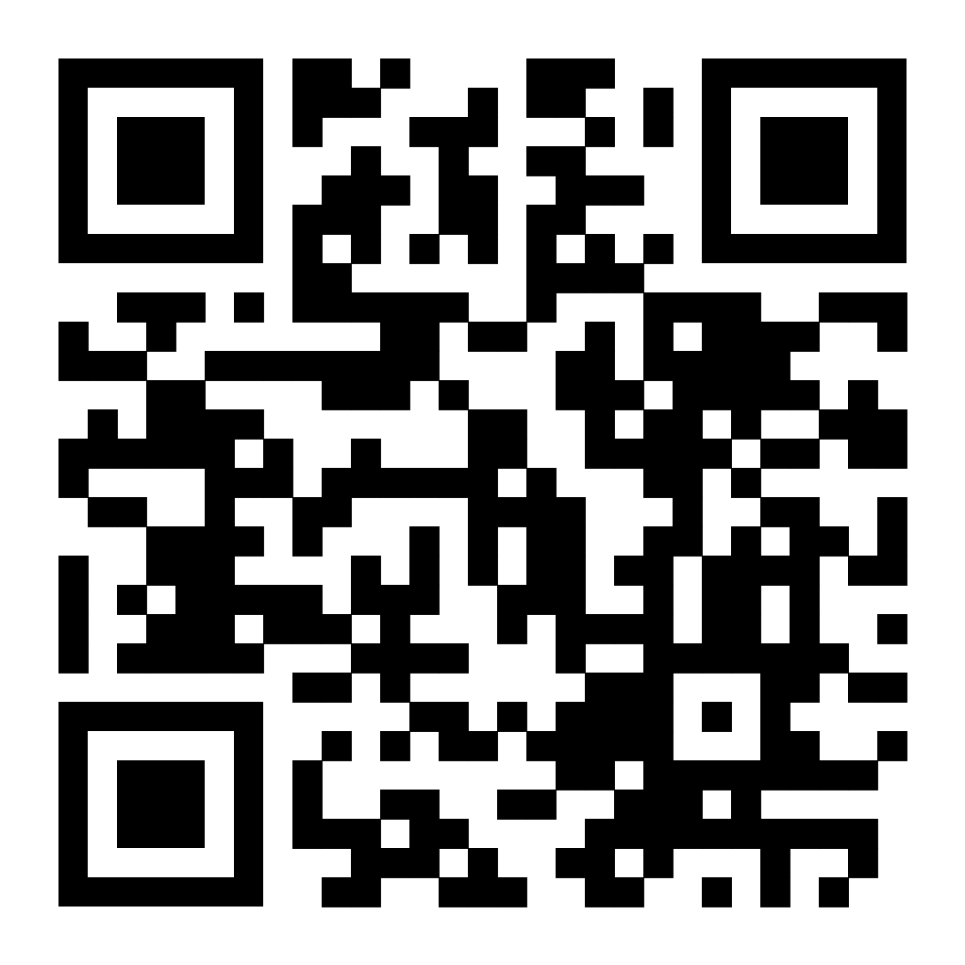
Become a Member

