Slide 1







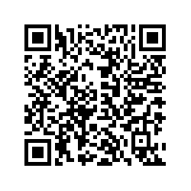
Holiday
Basket Raffle
Kappa Epsilon
November 18- 22
1 Ticket $5
3 Tickets $10
Basket includes drink tumbler, amazon ﬁrestick, snacks, gift cards, and much more!!!!
Purchase tickets via QR code:
OR
Via link in email

