Slide 1

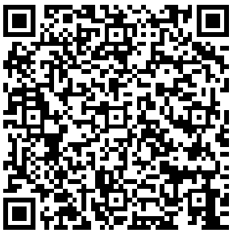
Membership Dues
The first 10 members to pay their dues will receive a complimentary Creek Coffee gift card On our next chapter Meeting
Amount: $10 per semester, $20 per year
igfn.us/form/zOtjmQ

