Slide 1

Interest in Industry
IPhO Welcome Meeting
August 22, 2024
Natalie Hollon, PharmD
Post-Doctoral Fellow
UNC/PPD Clinical Research & Drug Development

Slide 2
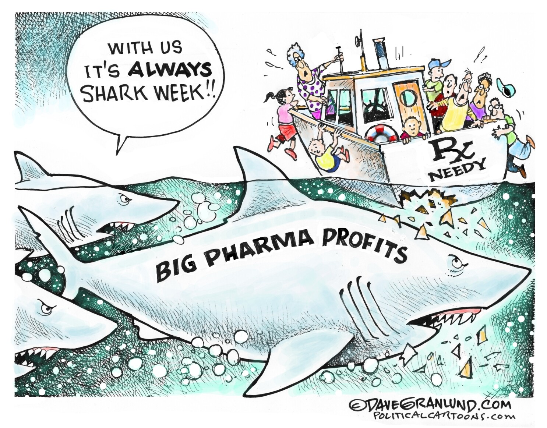
Agenda
The Role of a Pharmacist in Industry
Why Industry?
Where do I start?
What is IPhO?
Campbell's Chapter
VIP Case Competition
Annual meeting
Fellowship catalog
Internship opportunities
My Personal Experience

Slide 3
Pharmacists Role in Industry
Functional Areas
Medical Affairs
Medical Information
Medical Science Liaison (MSL)
Health Economics & Outcomes Research (HEOR)
Scientific Communications
Clinical Research & Development
Regulatory Affairs
Pharmacovigilance
Marketing
Market Access
Business Development & Licensing
Notes:
FocusRx Youtube video: https://www.youtube.com/watch?v=csymHO6o_E8
Industry Pathfinder on IPhO website: https://www.industrypharmacist.org/functional_areas.php

Slide 4
Why Industry?
Pharmacy reasons
Personal reasons
Interested in research
Enjoy improving patient outcomes
Team collaboration
Creative mindset
Passionate for therapeutic area
We know these drugs!!!
Work life balance
Job stability
Career advancement
Earning potential
Opportunity for growth
Extensive learning
Notes:
Browse the new drug approvals on the FDA's website. They were all made possible by the industry.

Slide 5















Where do I start?
Join IPhO
Networking
Shadowing
Internships
Rotations
Fellowship
    1-year vs. 2-year
    Pharmaceutical Company vs.
    Academia
Direct industry role

Slide 6

What is Industry Pharmacists Organization (IPhO) ?
Organization for:
Students
Fellows
Industry pharmacists
Practicing pharmacists
"IPhO National Student Members are recognized as the best prepared among all student pharmacists to pursue pharmaceutical industry-focused career opportunities. National Student Members have an excellent working knowledge of common industry pharmacist roles and key pharmaceutical industry driving forces, as well as an understanding of the skills and experiences necessary to become a successful industry pharmacist."

Slide 7

Campbell's IPhO Chapter
What is offered:
Speakers
Networking
Events
VIP Case Competition
Mentorship
What you will gain:
Professional development
Communication skills
Leadership opportunities
Understand each functional area

Slide 8
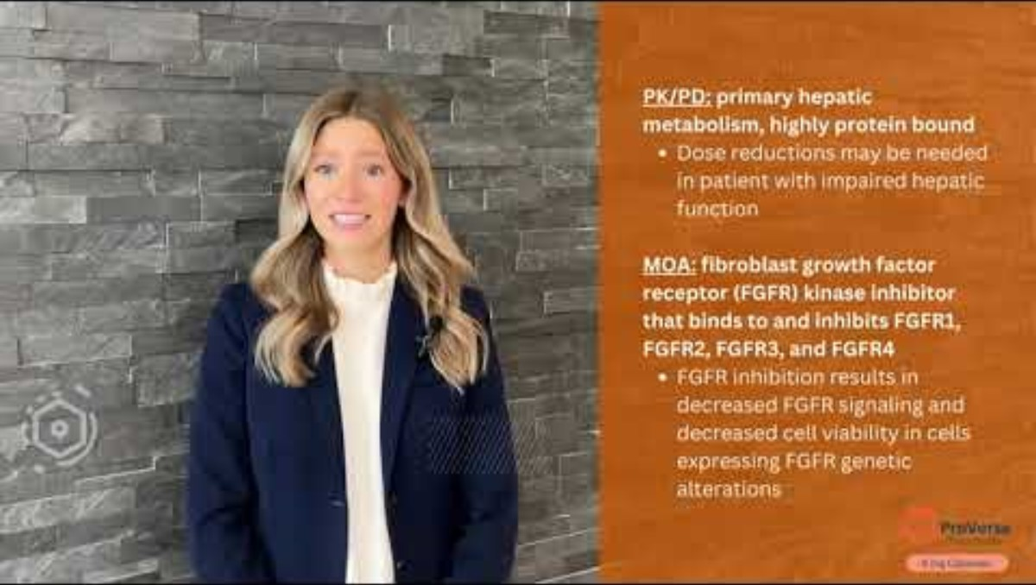
VIP Case Competition
"This signature IPhO professional development program and annual competition is offered to all chapters in good standing to challenge students to design a cohesive drug development and commercialization plan for a theoretical new molecular entity."
Four key functional areas:
Clinical Development
Regulatory Affairs
Medical Affairs
Marketing/Market Access

Slide 9
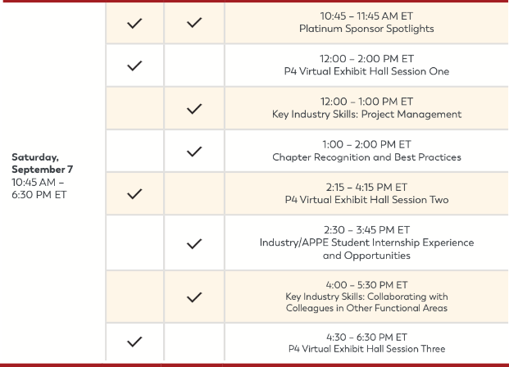
IPhO Annual Meeting
Network with fellows
Learn about fellowship programs
Learn about opportunities within IPhO
Registration closes Aug 31st

Slide 10
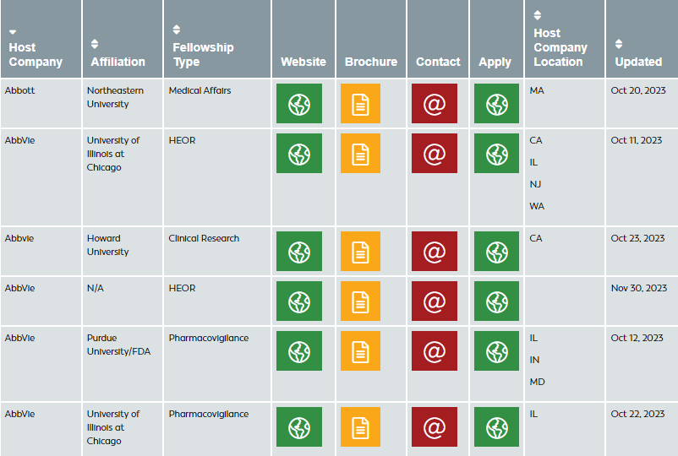
Fellowship Catalog
Found under fellowship central
Exposure to fellowships offered
Helps create your list of where to apply

Slide 11

Internship Opportunities
IPhO Student Leadership Roles
Industry internship feed
IPhO National Leadership Program
    Offered Fall, Spring, Summer
Guides
    Industry Internship Guide
    LinkedIn Guide to Industry Internships

Slide 12
Personal Experience
Leadership experience
    VIP Case Competition Regulatory Affairs Manager
    Director of Professional Programing
Mentorship
Networking at Annual Conference
Spoke about my experience with IPhO in every fellowship interview
Built my knowledge of each functional area
Serving as a mentor for UNC's IPhO chapter

Slide 13

Questions?
nhollon@unc.edu
Connect with me on LinkedIn

