Slide 1

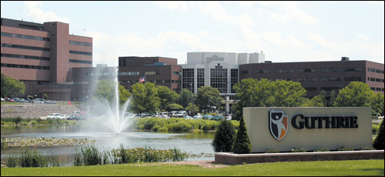
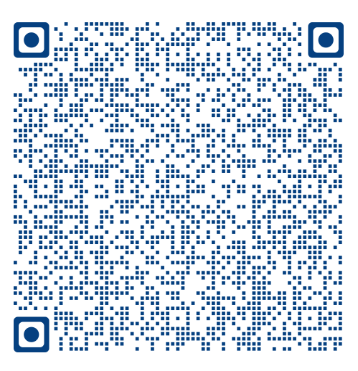
Guthrie Robert Packer Hospital
PGY1 Pharmacy Residency
Please sign in
www.guthrie.org/pharmacy-residency

Slide 2
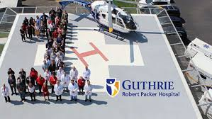
Robert Packer Hospital
Please sign in
267-bed hospital located in Northeast Pennsylvania
Level 1 Regional Trauma Center
20 pharmacist staff, 25 non-pharmacist staff
Academic teaching center
Layered learning environment – many health care students
>150 residents/fellows on site in 12 graduate education programs
The Guthrie Clinic serves 29 communities spanning 11,000 square miles with 77 regional offices, 6 hospitals
Physician-led organization
Core values drive everything
Patient centeredness
Teamwork
Excellence

Slide 3
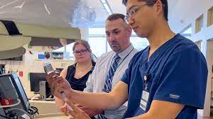
About Our Program
ASHP accredited
Preceptors:Residents: 20:3
11 Board/Specialty-Certified preceptors
First graduating class: 2017
Innovative, flexible, friendly
Various learning experiences and opportunities – including creation of rotations based on resident interests
Rigorous program balanced with intentional focus on resident well-being
Use of well-being coupons such as block project time, leave early, split staffing shift, ‘get out of busy work,’ and more
Please sign in
Notes:
relocation allowance, educational funds, and meal vouchers are allocated to offset costs to residents

Slide 4
Required Learning Experiences
Required Block Rotations:
Orientation
Antimicrobial Stewardship
Internal Medicine
Ambulatory Infusion Center
Cardiology
Critical Care I
Required Longitudinal Rotations:
Pharmacy practice (Staffing)
Every 3rd weekend
2 evening shifts every 3 weeks (flexible scheduling)
Medication Safety
Pharmacy Leadership
Project
Teaching and Learning
Please sign in

Slide 5
Elective Learning Experiences
Elective Block Rotations (choose 4)
Adult Medicine (off-site, Corning Hospital)
Ambulatory Psychiatry
Hematology/Oncology
Ambulatory and Inpatient
Community Hospital Pharmacy (off-site, Cortland Medical Center)
Critical Care II
Emergency Medicine
Infectious Diseases
Nutrition Support Pharmacy
Pain Management (off site, Binghamton Pain clinic)
Palliative Care
Primary Care (PACT) (off site, Finger Lakes VA)
Transitions of Care
Elective Longitudinal Rotations:
Emergency Medical Response
Teaching Certificate (ASHP)
Clinical Research Microcredential (virtual didactics with SUNY Upstate)
Please sign in

Slide 6
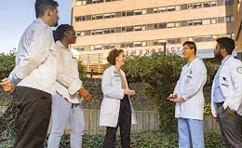
Program Pearls
Precepting
Ability to precept students from 3+ different schools of pharmacy
Project/Research
Clinical Research/Guthrie Foundation - IRB approved project(s), QI/MUE
Teaching
Teaching certificate available, optional
Classroom/skills at BUSOPPS, 3 program preceptors are faculty
Interdisciplinary at RPH – informally and formally
CME and ACPE-accredited presentations
Adjunct faculty appointments at BUSOPPS
Financial
Paid healthcare, relocation support, educational fund, and meal vouchers are allocated to offset costs to residents
Attending national meeting is part of the curriculum (we pay for you to attend)
Guthrie may support J-1 and H-1B visas, but reserves the right to withdraw or limit sponsorship if costs associated with sponsorship are, or become, prohibitive.
Please sign in
BUSOPPS = Binghamton University School of Pharmacy and Pharmaceutical Sciences

Slide 7
Guthrie Robert Packer Hospital
PGY1 Pharmacy Residency
www.guthrie.org/pharmacy-residency
Contact: Karen.Williams@guthrie.org
Sign in with the QR code
(we'll email you information)

