Slide 1

Academic Coaching
Spring Semester Refresh
February 1, 2023

Slide 2
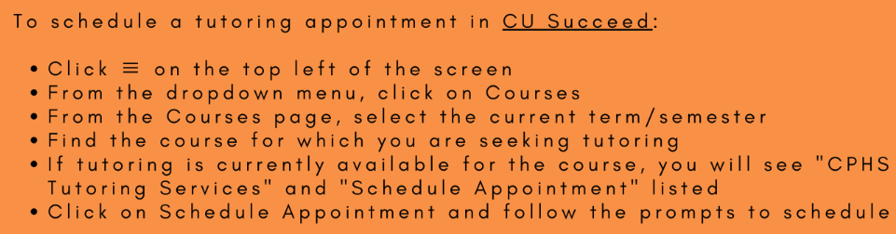
Tutoring Services
Referrals are no longer required
One-on-one or group sessions available
Meetings may be in person or virtual
Rho Chi walk-in hours sent weekly

Slide 3
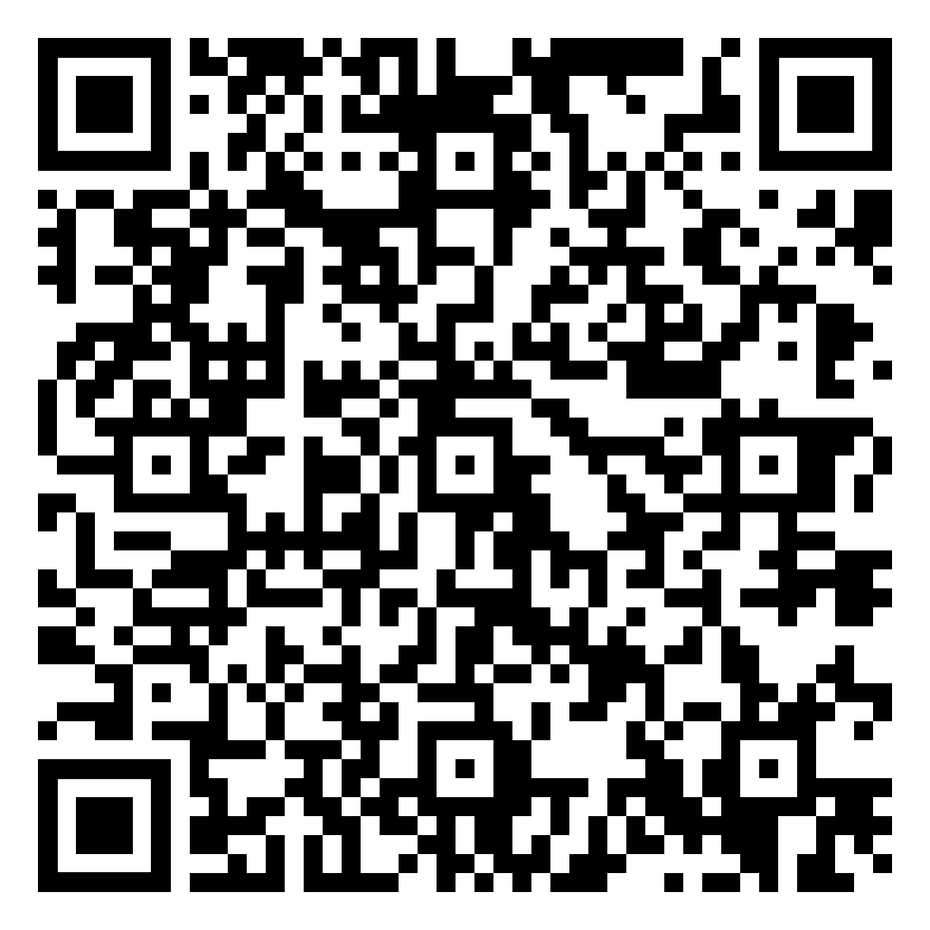
Academic Coaching
Group setting conversations on study skills
Please reach out to us individually if you would like an individual session on study skills
Use the QR code to submit Academic Coaching topics!
Notes:
https://docs.google.com/forms/d/e/1FAIpQLSemjDFHCS474qacXk3ZgB7hbfVKzTHiL9Y0xcp5NUWgBDV25Q/viewform?usp=sf_link

Slide 4
Classroom Tips
Have your powerpoints and notes set up prior to class
Silence your phone
Breaks are a good time to ask your peers or the professor if you have any questions
Avoid distractions like other assignments, online shopping, email, etc.

Slide 5
Studying Strategies
Have a study schedule with breaks
  Set a timer or alarm to set aside studying time with minimal distractions
  Prioritize your to do list
Stay organized
  Google calendar, planner, group message/GroupMe
Try different study methods
  Making a study guide utilizing the objectives
  Writing out topics you are struggling to remember
  Reviewing practice cases/clicker questions WITHOUT using your notes
  Talking things out loud with classmates or in tutoring
Stay hydrated

Slide 6
Motivation
One day at a time/the next day will come
Think about how relieved you will feel once you complete that assignment, project, exam, OSCE, etc.
Set realistic study goals and do not be afraid to start small
Compartmentalize assignments from quizzes/exams

Slide 7
Contact Information
Kathryn Henrikson
kmhenrikson0124@email.campbell.edu
Kristin Lanier
kmlanier1116@email.campbell.edu
Alexa Vargas
aavargas1012@email.campbell.edu

