Slide 1
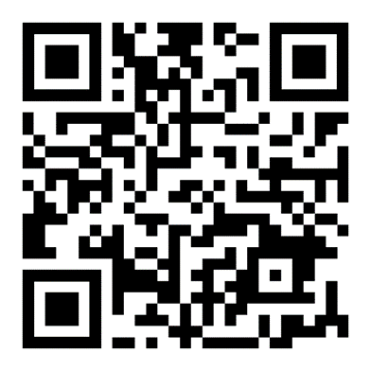
Bake
SALE
Jan
Tues
17
2023
UNTIL
FRI
20
2023
USE QR LINK TO PAY OR PAY WITH CASH
AT THE MADDOX TABLE
$5 FOR JEANS DAY + 2 ITEMS

