Slide 1


All About IPhO
Campbell University IPhO 2023-2024

Slide 2
Meet the
Executive Board

Slide 3

President
Lindsey Davis

Slide 4
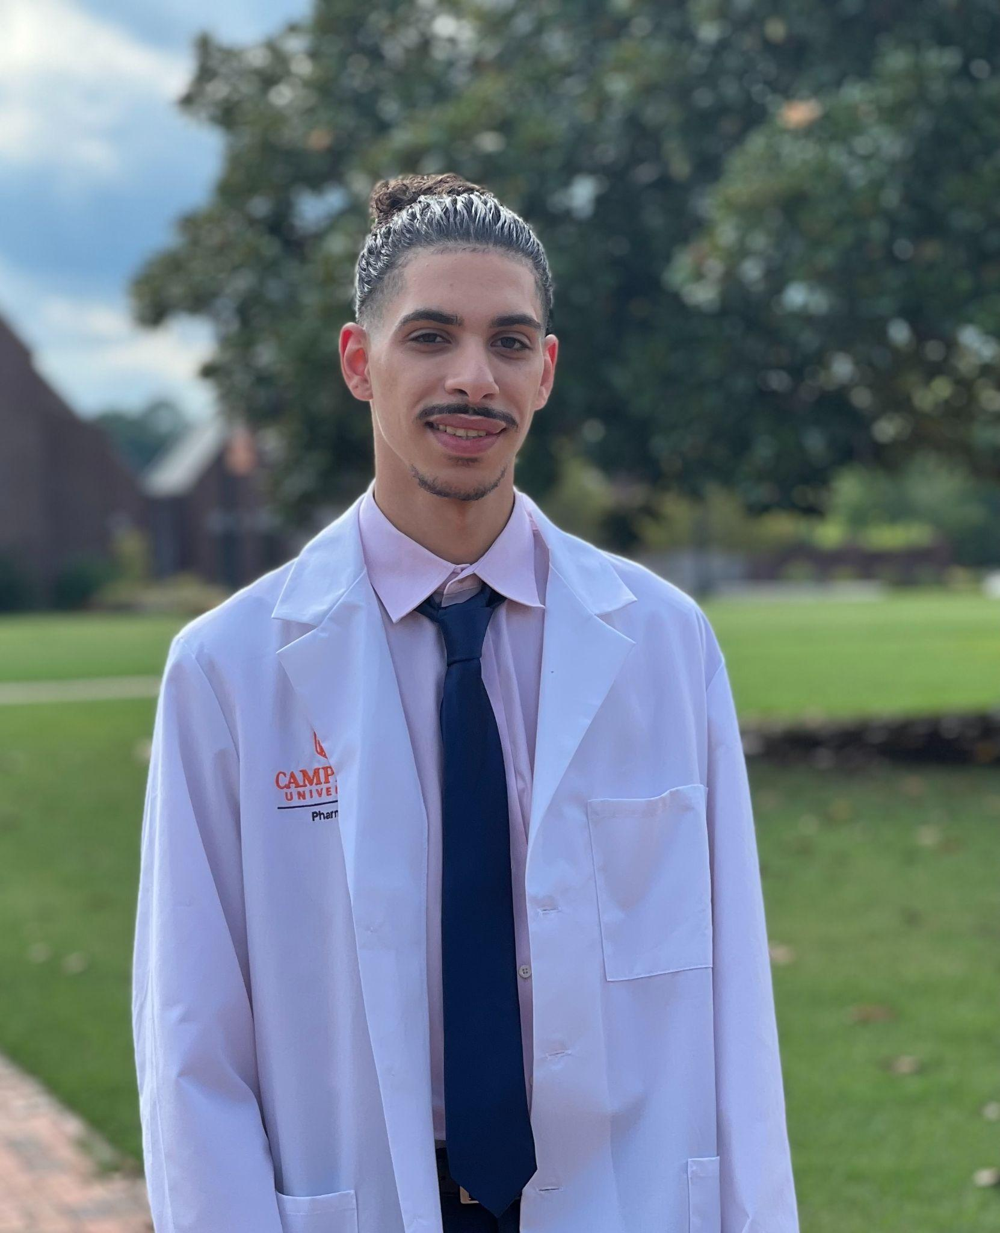
President Elect
Martin Aziz

Slide 5
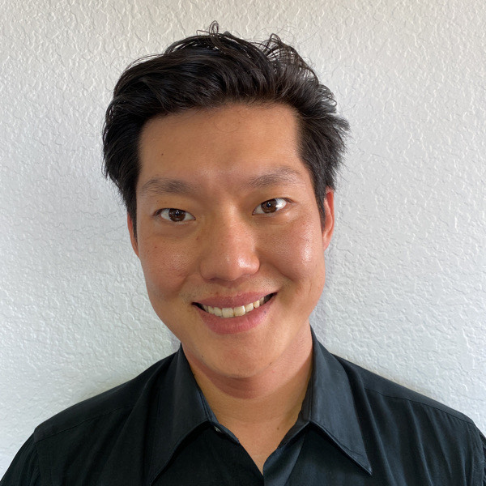
Director of Finance & Fundraising
Brian Kim

Slide 6
Director of Communications
Melissa Growney

Slide 7
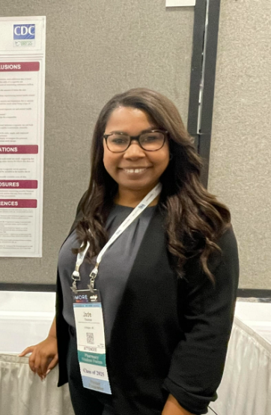
Director of Member Engagement
Jade Thomas

Slide 8
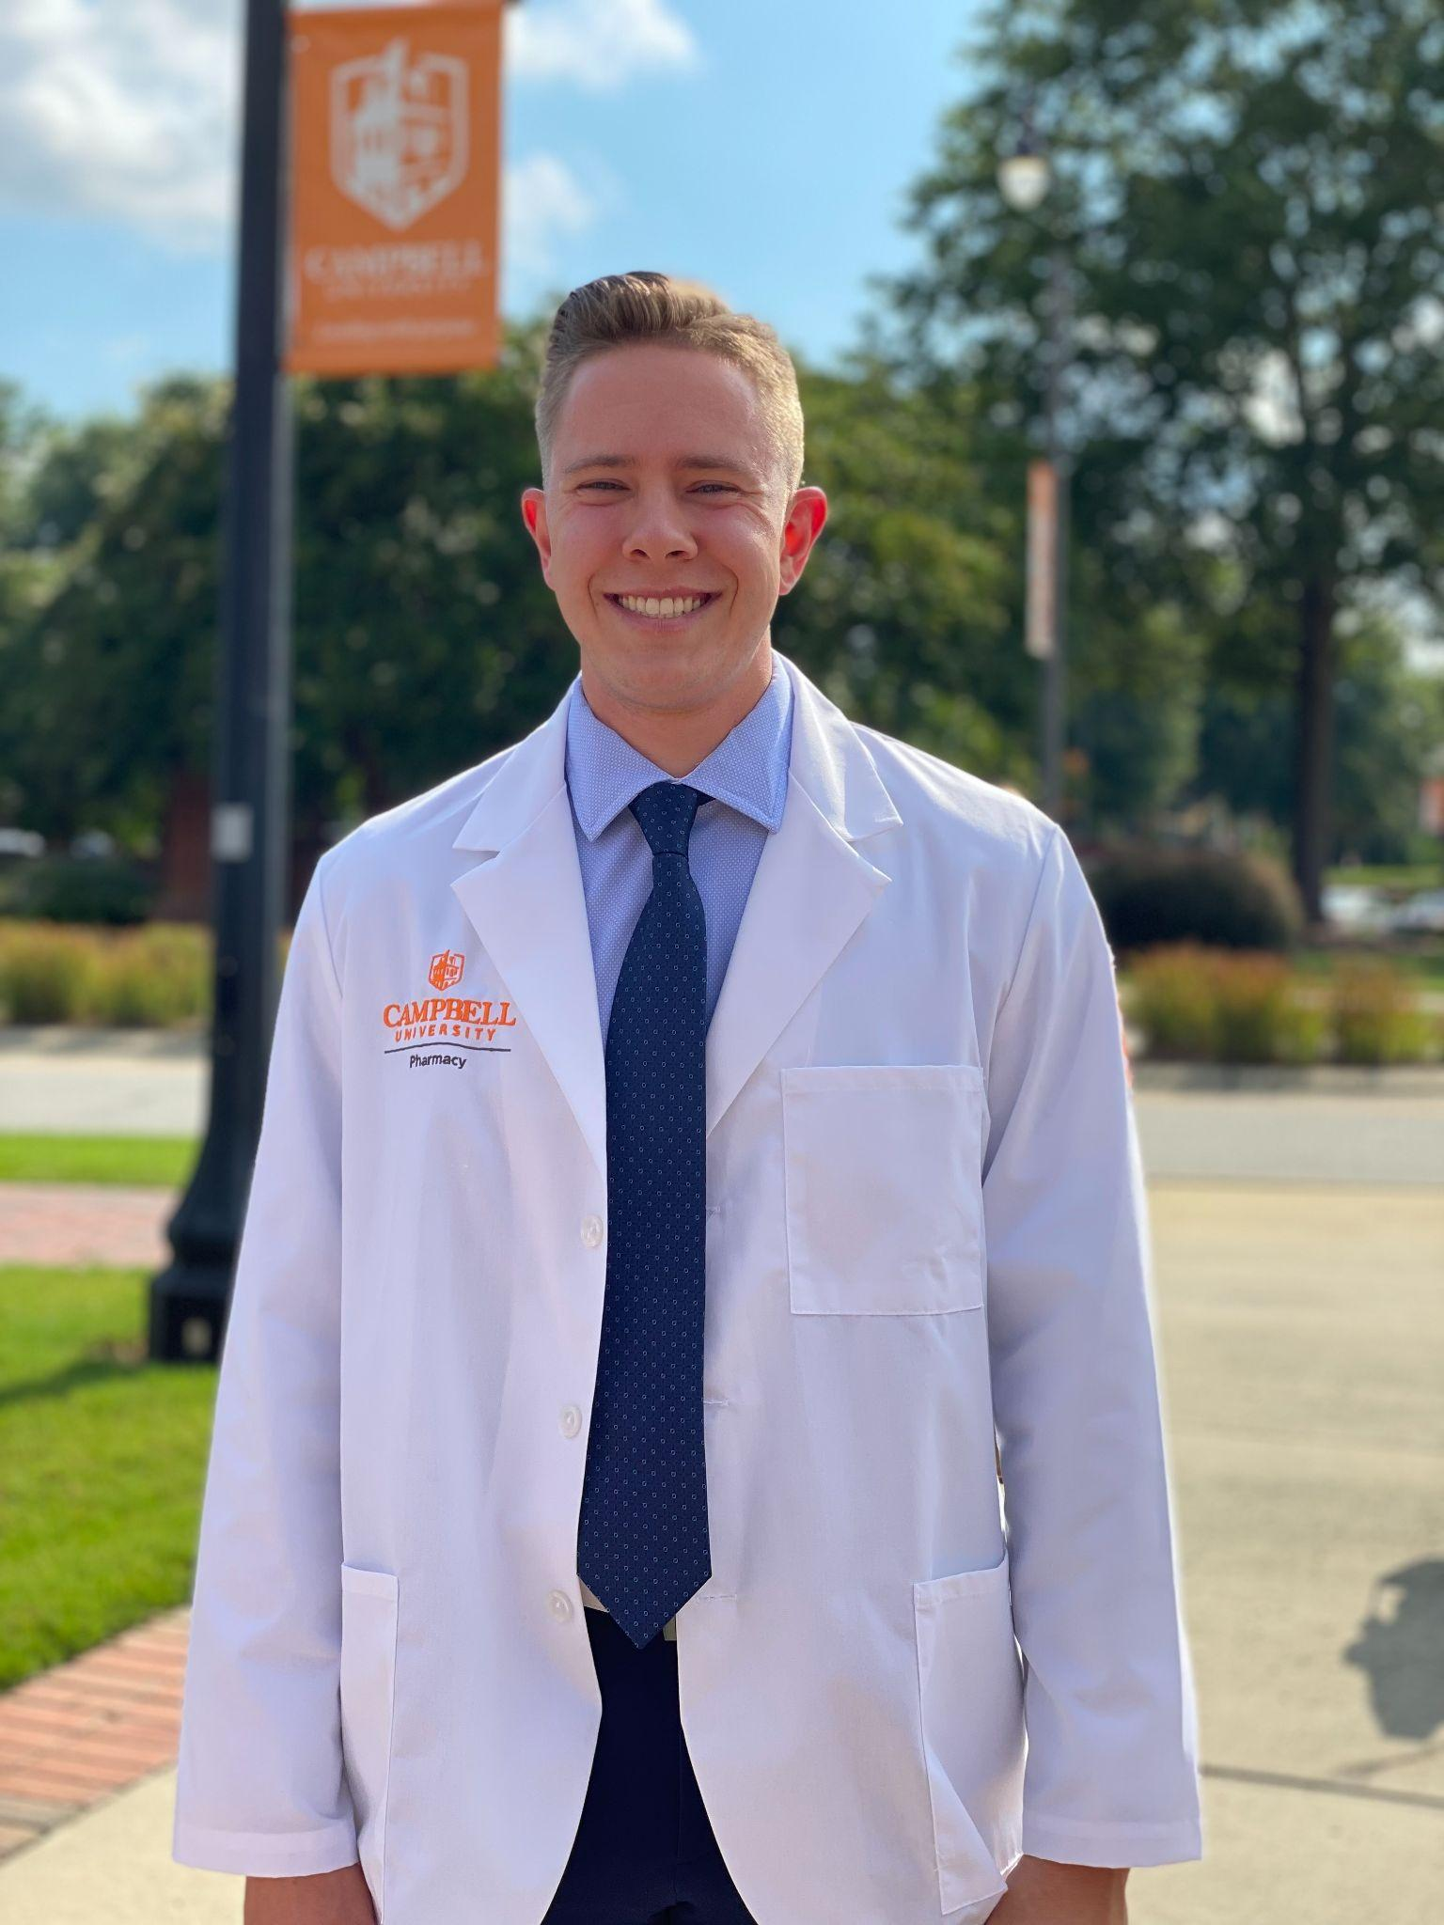
Director of Professional Programming
Chase Webb

Slide 9
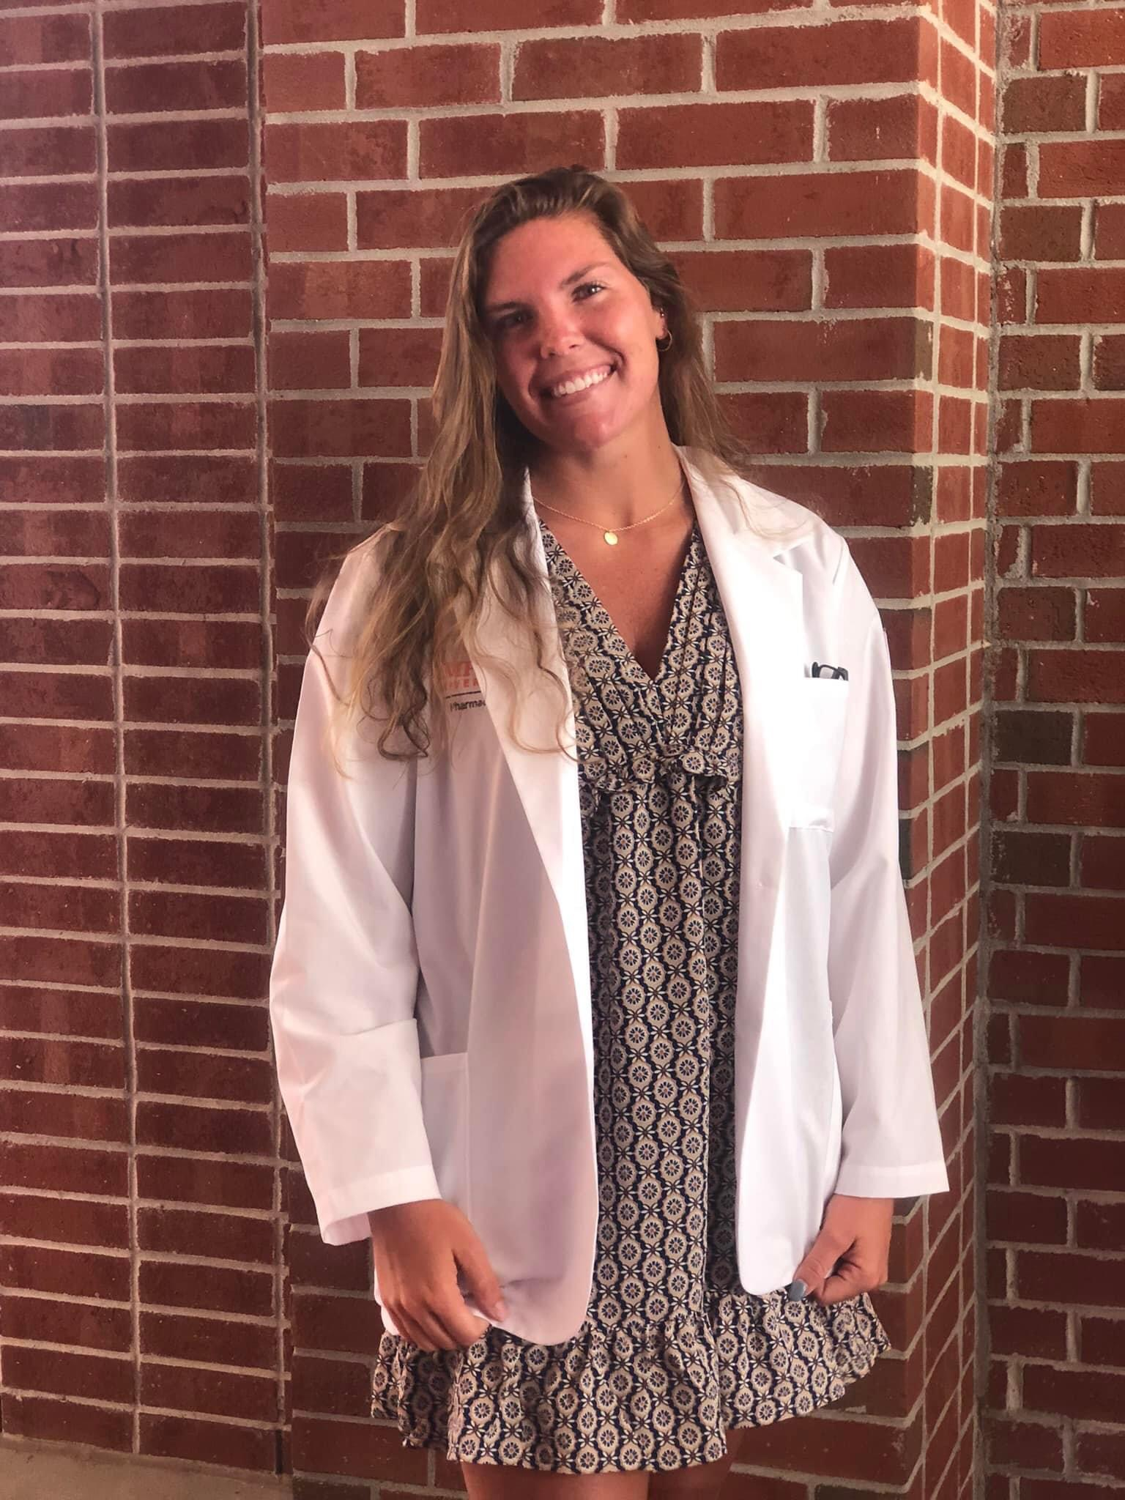
Director of Social Media & Marketing
Makenzie Hester

Slide 10
Add our Instagram!!
campbell_ipho

Slide 11


Slide 12
Objectives of the VIP Case Competition
Demonstrate the value of industry pharmacists
Create a cohesive drug development plan, engaging several of the key functions where pharmacists most frequently contribute
Provide diverse exposure to student pharmacists and allow them to explore new areas, think critically, and expand their network
Provide student chapters with the opportunity to network and liaise with a current industry fellows and industry pharmacists.

Slide 13
Case Topic
TBD
at IPhO Annual Meeting
9/8-9/10

Slide 14
Categories in the Case
We are learning the process of bringing a drug to market
An overarching goal in this competition is for participants to demonstrate the Value of Industry Pharmacists by highlighting the many key roles and contributions of industry pharmacists within the drug development process.
We will cover in this project drug development from many perspectives:
  Clinical sciences
  Regulatory affairs
  Commercial/marketing and medical affairs.
These key tenants may be expanded on by including other areas, such as health economics or clinical pharmacology, but are not mandated per competition requirements.
Clinical development
Regulatory affairs
Medical affairs
Marketing Research and Marketing/Commercial

Slide 15
Clinical Development
Main objective: Design a high-level clinical development plan (CDP) that supports your drug candidate through all four phases of clinical trials. You will need to generate sufficient safety and efficacy data to support approval from health authorities.
What is the primary indication for which you are seeking US regulatory approval?
As a clinical scientist, what types of clinical trials will you conduct, what are your safety and efficacy endpoints, and what are the objectives of each study? What is your patient population? What is the timeline?
What difficulties do you foresee in the development process and what steps can you take to avoid them?
What are other potential indications that can be investigated after approval?
How will you engage and collaborate with the regulatory and medical affairs teams?
Notes:
Leader: Aubrey

Slide 16
Regulatory Affairs
Main objective: Develop a US-focused regulatory strategy that will maximize your probability of success in achieving approval, while also utilizing regulatory pathways that will accelerate drug development and differentiation.
Develop an IND or NDA filing strategy (i.e. what are your internal filing timelines to enable “First- Patient-In (FPI)” from summary document drafting to IND submission to IND clearance?) and what are the key messages of your IND package?
How and when will health authority (FDA) interactions be utilized?
Will you try to utilize any expedited programs? If so, which ones?
What is your filing strategy? (i.e. indicate what pivotal and supportive trials will be used to support approval, indicate timelines in relation to the CDP, etc...)
Notes:
Leader: Natalie

Slide 17
Medical Affairs
Main objective: Develop evidence-based information regarding your company’s drug, both pre and post-launch, to optimize product utilization. Establish and maintain relationships with prominent experts in the field.
What resources or training will you provide to internal stakeholders?
When will your company start disseminating medical information to external stakeholders?
Who can receive off-label information about a medication?
Who are your key opinion leaders (KOLs), and how would you go about identifying them nationally, regionally, and locally? What methods will you use to reach them?
At what points during the drug development process will the company need to consult Medical Affairs for review?
Notes:
Leader: Heather

Slide 18
Marketing Research and Marketing/Commercial
Main objective: Create a commercial strategy that will position your product as a highly valuable addition/option for the treatment of the disease and the features/benefits that will be used to promote your product in the marketplace.
What is the competitive landscape? What are the unmet needs of physicians and patients that may need further exploration through conducting market research with these customers?
Develop a brand strategy
  Who is your target audience? (customer segmentation model, treatment naive, 2nd line dissatisfied vs satisfied, PCPs vs Specialists, allied healthcare professionals (IE. Pharmacists, nurses, PAs)
  What are the customer’s needs? Patients? Providers? Payers?
  What customer insight would you use to drive your strategy?
  What is the product positioning statement?
  What are the core messages? Core messages are derived from clinical trials results, brand’s features and benefits, and any competitive advantages
  What key strategies and tactics will be used to advocate and promote your product? Including advertising and direct field force representation?
  What materials/ special programs will you develop to support your product positioning and core messages?
Notes:
Leader: Kayla

Slide 19
Midpoint Submission
November 12th
Accounts for 15% of the final case grade
Must answer all questions in Competition Description for each subtopic
Include in Midpoint Submission:
  PowerPoint that provides a high-level overview of your drug’s clinical development plan
  answering all questions given in the Competition Description section
  any questions, comments, or concerns regarding the competition
  indicate if there is any risk to your chapter’s completion of the competition deliverable by the due date.

Slide 20
Challenge Point
This ‘Challenge Point’ will be revealed TBD and is due as part of the final submission.

Slide 21
Final Submission
February 25, 2023 → video + powerpoint
  Video submission length is limited to 45 mins max
This submission should provide details on your entire drug development plan, including the four areas discussed, and highlight the value of industry pharmacists in their many diverse roles.
Final submission → 80%
Midpoint evaluation → 15%
Professionalism → 5%
  (Completing the chapter competition evaluation survey at the time of the final submission is included the professionalism score.)
Extra points will be provided for teams who submit earlier than the deadline (1 point if one week early, 2 points if two weeks early).
Winner announced in March 2023

Slide 22
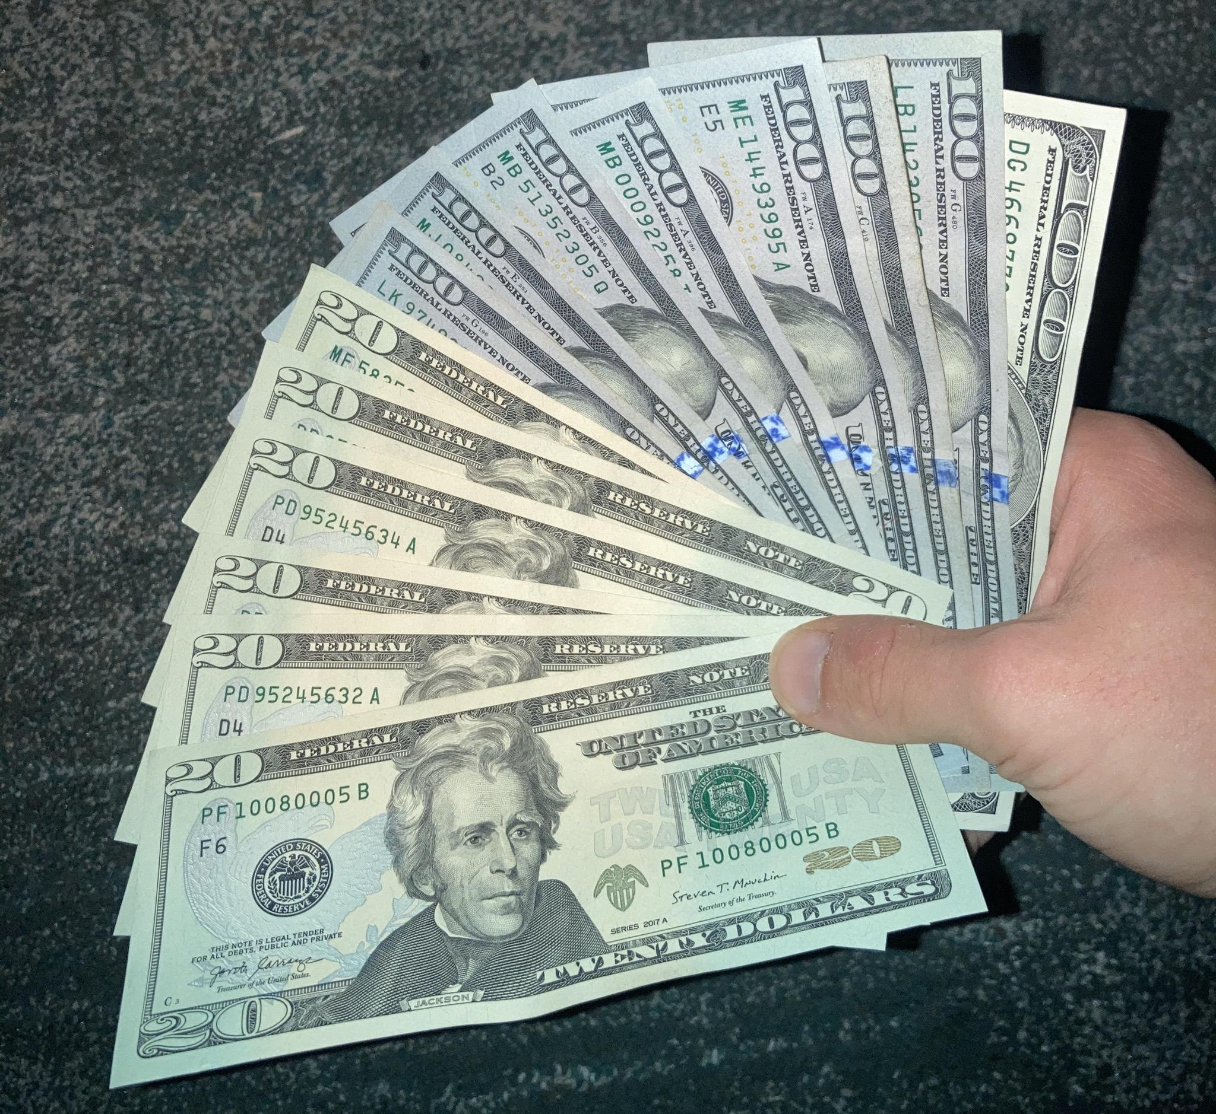

Awards
First Place: $1000
Second Place: $500
Third Place: $250

Slide 23

Student Involvement
Every student who is involved with the VIP Case Project must be a local Campbell IPhO Member → $10/year
IPhO National Member → $99/year
  Includes complimentary MAPS Membership
IPhO Annual Meeting 9/8-9/10
  IPhO National Members → $149
  IPhO Non-National Members → $199
↓ PAY DUES HERE ↓

Slide 24

Sign up for the VIP Case Competition

Slide 25
Upcoming IPhO Events
Mid-September: Clinical Research and Drug Development Fellow Speaker (TBD)
October 2: Dr. Katherine Adams (Medical Science Liaison - Sanofi Vaccines) Speaking at 5-6 pm (Location TBD)
October 9: Medical Science Liaison Speaker (Date and Time TBD)
November: Medical Affairs (MAPS) Guest Speaker (Date TBD)

Slide 26
Opportunities for PharmDs in the Industry
Research & Development
Medical Affairs
Commercial
Regulatory Affairs
Clinical pharmacology
Pre-clinical
Early phase development
Clinical Operations
Medical strategy
Medical information
MSL
Publications
Medical education
HEOR
Marketing
Market Research
Business Intelligence
Market Access
Business Development
Advertising & Promotion
Regulatory strategy
Drug Safety
Risk Management
Advocacy & Policy

