Slide 1
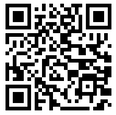
TALKING
TUESDAY
STUDENT WELLNESS AMBASSADORS
EMOTIONAL WELLNESS
HOSTED BY MARISA PADRONAGGIO
TUESDAY
04.18.2023
7PM-8PM
ZOOM MEETING ID:
951 8282 6688
QUESTIONS?
MAPADRONAGGI1008@EMAIL.CAMPBELL.EDU

