Slide 1

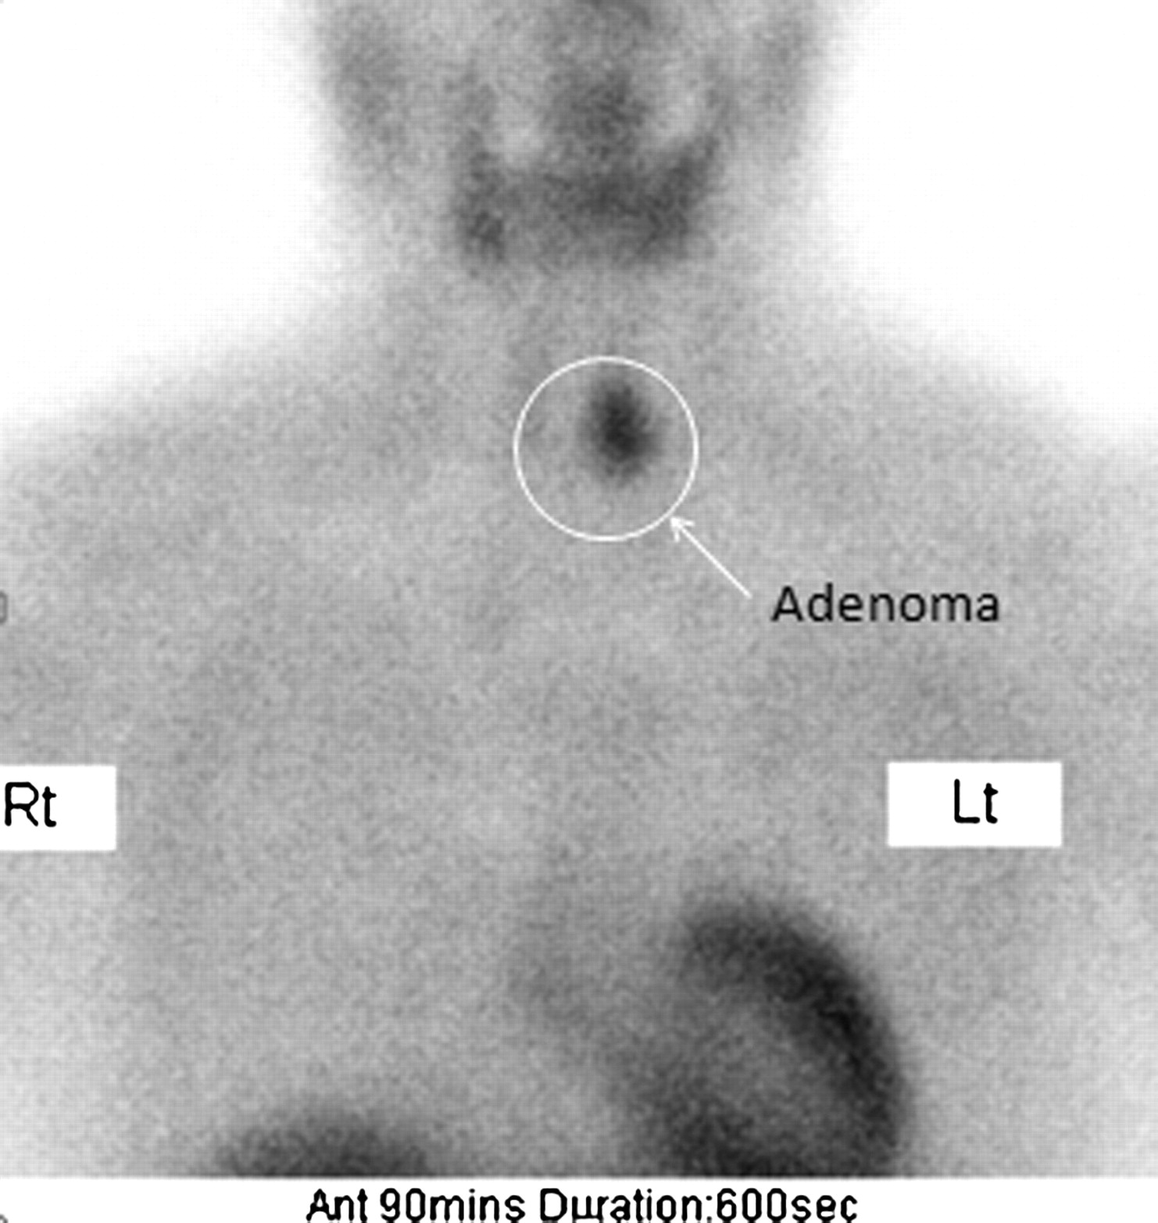
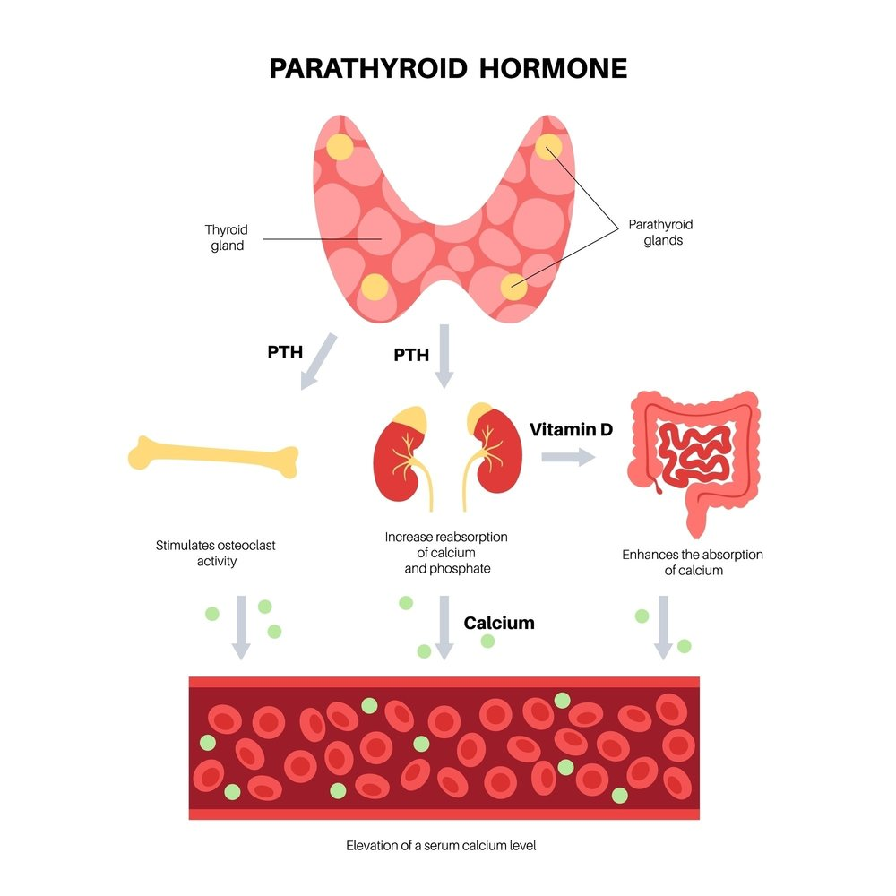
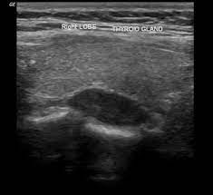
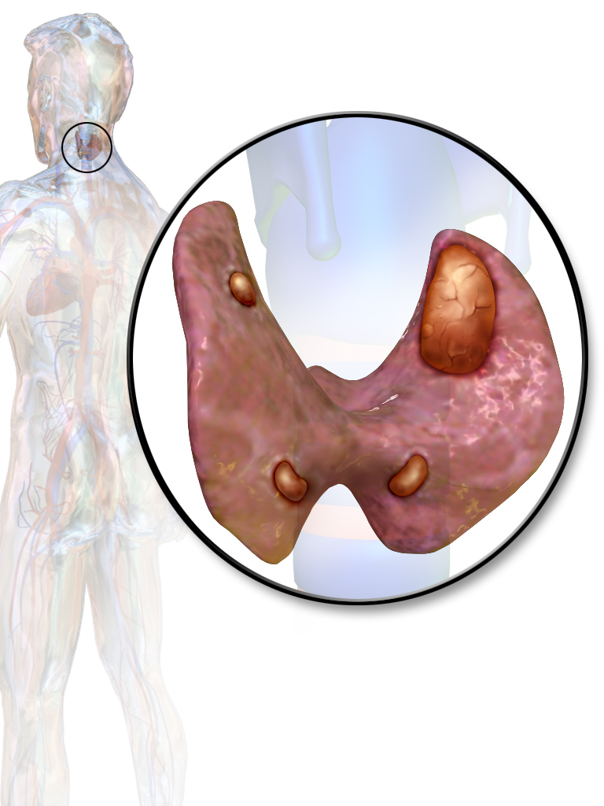
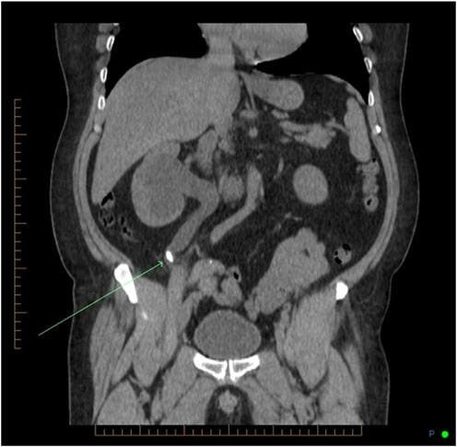
Parathyroid Puzzle: Cracking the Code to Calcium Control
Eboni Gadson, PA-S, Brittany Wiley, PA-S, Kelsey Morgan, PA-S, Jamie Harding, MPAP, PA-C
Campbell University Physician Assistant Program, Buies Creek, North Carolina
Introduction Case Description: 34-year-old female presenting with hematuria Outcome and Follow-Up
Primary hyperparathyroidism is one of the most common endocrine disorders. An overactive parathyroid gland releases excess parathyroid hormone (PTH), stimulating increased secretion of calcitriol (Vitamin D) and calcium into the blood. This results in hypercalcemia and hypophosphatemia. In many cases, surgery may be required, as the most common cause is a solitary adenoma.
Patient treated with aggressive IV fluids, Cinacalcet, and lithotripsy with ureteral stent
Calcium levels checked weekly
Parathyroidectomy scheduled
Referral for outpatient DEXA scan
History:
Presented to the ED with a 1-day history of suprapubic pain, dysuria, and hematuria
Medical history includes chronic nephrolithiasis and urinary tract infections
ROS: (+) Suprapubic pain, dysuria, and gross hematuria; (-) Nausea, vomiting, flank pain, abdominal pain, or abdominal trauma
Physical Exam:
BP elevated at 164/105
Afebrile, SpO2 99% on room air
Tender to palpation in suprapubic area. Regular, active bowel sounds. Soft, nondistended abdomen. No CVA tenderness, guarding or rebound. Negative Murphy's and McBurney's sign. No hernia present.
Day 1: Suprapubic pain, dysuria, hematuria
Day 2: Admission, hypercalcemia and urology work-up
Day 3: Right ureteral stent placement
Day 4: Discharged
Figure 4.
Sestamibi scan.
Showing parathyroid adenoma (arrow) in left inferior gland with high radiotracer uptake and persistent activity.
Figure 5. Ultrasound of thyroid gland. Showing parathyroid adenoma that is homogeneously hypoechoic compared to the overlying thyroid gland.
Conclusions
Consider checking PTH levels in patients presenting with nephrolithiasis.
Common findings of hyperparathyroidism include elevated calcium and PTH levels, leading to the classic hypercalcemia symptoms of “stones, bones, abdominal groans and psychiatric moans.” More specifically: kidney stones, osteopenia and osteoporosis, abdominal cramping, nausea, and peptic ulcers, and depression, anxiety, insomnia, confusion, and personality changes.
While Sestamibi scan and thyroid ultrasound are useful tools in evaluating for parathyroid gland abnormalities, additional modalities include MRI and Doppler U/S.
Figure 1. Physiology of parathyroid gland. Obtained from Parathyroid.com
Labs & Imaging Results
Total Calcium | 14.1 (H)
PTH | 212 (H)
Urinalysis | Calcium oxalate crystals ˃ 50 RBCs No bacteria or nitrites
CT scan | 4-5mm calculi in the right distal ureter
Sestamibi scan | Likely parathyroid adenoma
Thyroid ultrasound
References
Blausen.com staff (2014). "Medical gallery of Blausen Medical 2014". WikiJournal of Medicine 1 (2). DOI:10.15347/wjm/2014.010. ISSN 2002-4436.
Kowalski, G. J., Buła, G., Żądło, D., Gawrychowska, A., & Gawrychowski, J. (2020). Primary hyperparathyroidism. Endokrynologia Polska, 71(3), 260–270. https://doi.org/10.5603/EP.a2020.0028
Miyauchi, R., Yamada, T., Kumano, R., Aida, Y., & Takagi, M. (2020). Recurrent hyperparathyroidism due to parathyroid and pulmonary tumors showing features of parathyroid adenoma. Radiology case reports, 15(8), 1289–1294. https://doi.org/10.1016/j.radcr.2020.05.024
Parks, K. A., Parks, C. G., Onwuameze, O. E., & Shrestha, S. (2017). Psychiatric Complications of Primary Hyperparathyroidism and Mild Hypercalcemia. The American journal of psychiatry, 174(7), 620–622. https://doi.org/10.1176/appi.ajp.2017.16111226
https://www.researchgate.net/figure/Initial-coronal-noncontrast-CT-scan-image-showing-a-18-cm-midureteral-stone-right_fig2_325355888
https://radiopaedia.org/cases/parathyroid-adenoma-2
https://www.parathyroid.com/blog/secondary-hyperparathyroidism-what-is-it-and-how-is-it-treated
Figure 2. Parathyroid glands. Showing parathyroid adenoma (top, right) in comparison to normal parathyroid glands.
Figure 3. CT scan of the abdomen. Showing kidney stone (arrow) in the right mid-ureter.
Notes:
Here's a good resource and where i got the template at → https://guides.lib.campbell.edu/c.php?g=397612&p=2702754

