Slide 1


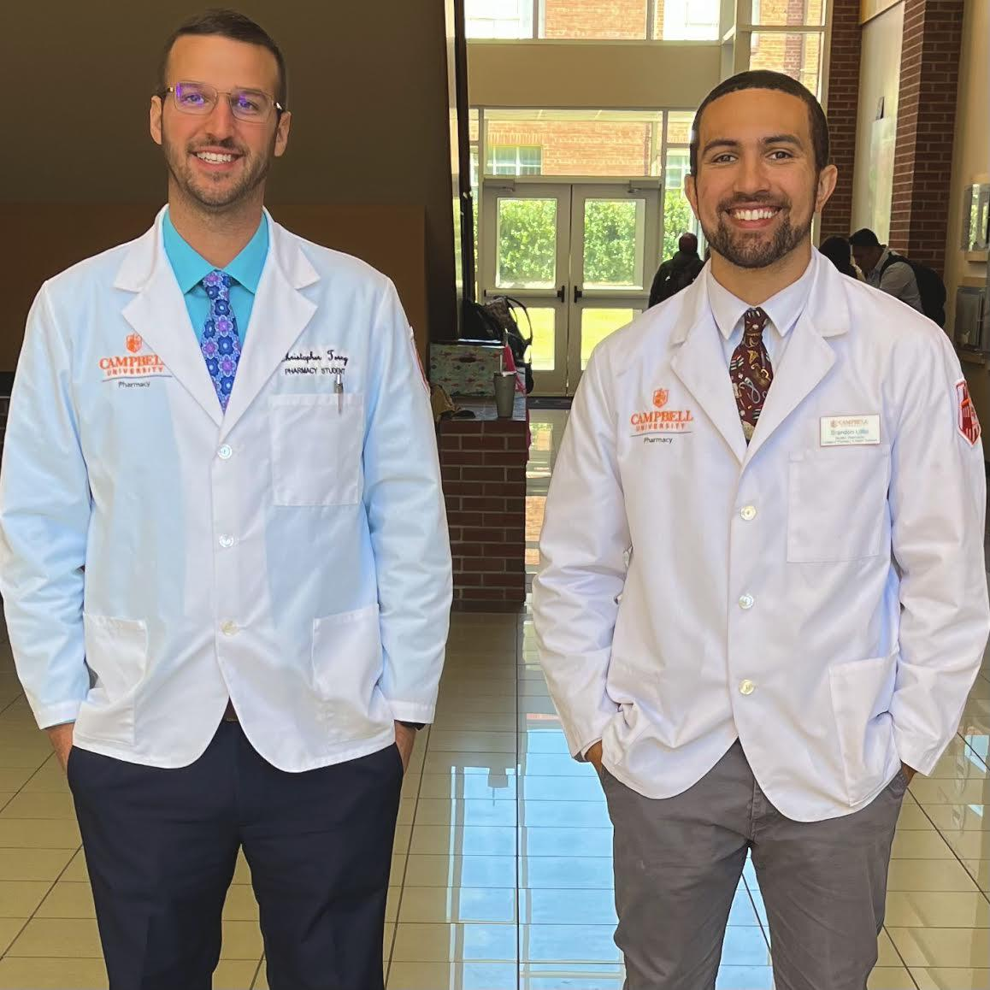

Student Wellness Day
Join Christopher Terry and Brandon Little in an open conversation about Academic Health April 11th between 7:00pm-8:00pm
https://campbell-edu.zoom.us/j/91090811222?pwd=UnVMRnd0aXhmUHNKRXdDNDAzdTh5dz09
Meeting ID: 910 9081 1222
Passcode: 680238

