Slide 1
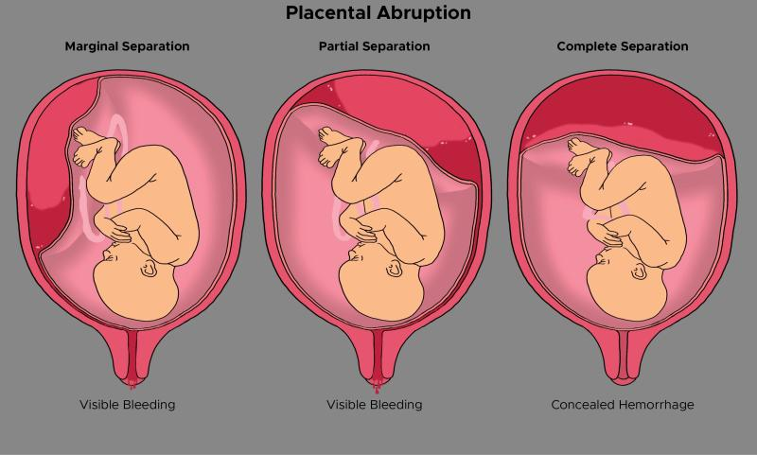
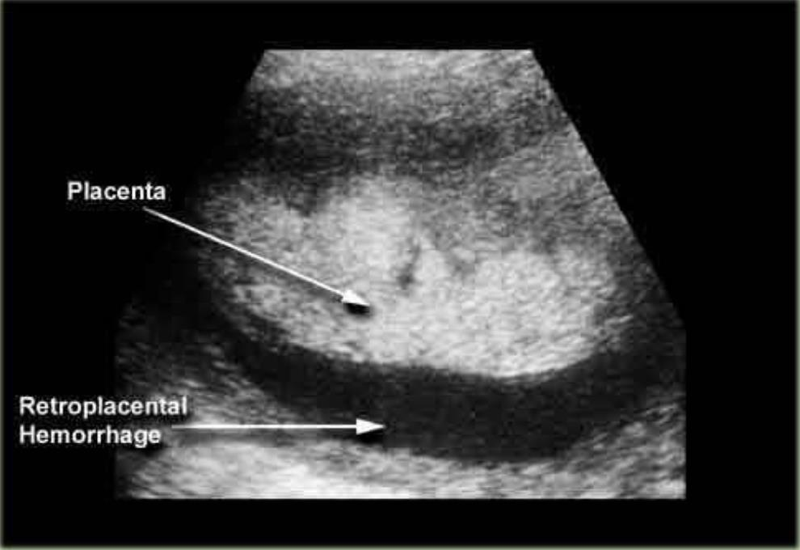
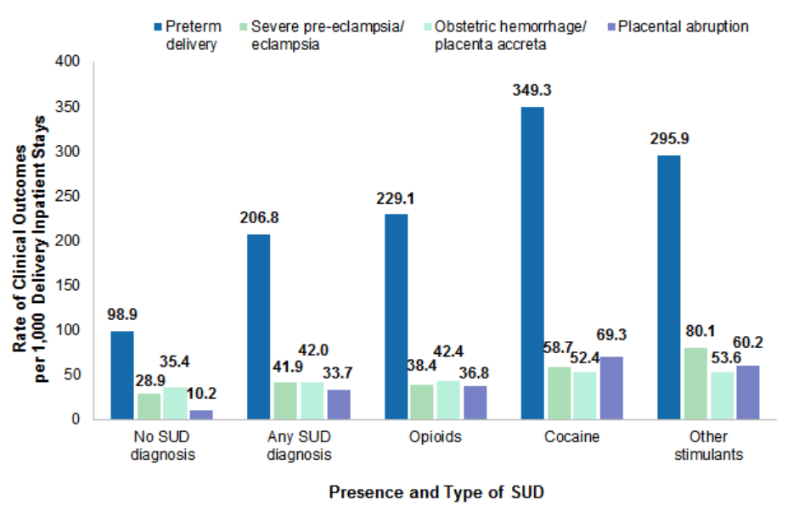
Placental Abruption: A Near-Deadly Outcome of Cocaine Usage During Pregnancy
Heather Moore, PA-S, Clarissa Bartolac, PA-S, Abigail Avery, PA-S, Ashley Nordan, MSCR, MPAP, PA-C
Campbell University Physician Assistant Program
Introduction
Case Description
Discussion
Placental abruption (PA) is the premature separation of the placenta from the lining of the uterus.
PA is the leading cause of maternal morbidity and mortality.
Risk factors include prior history of PA, cocaine use, hypertension, and advanced maternal age.
Cocaine is the second most common illicit substance used in pregnancy and can lead to negative clinical outcomes due to altered blood flow to the uterus and placenta.
A 37-year-old G6P1132 female at 31 weeks gestation with a history of cocaine use in pregnancy presented to the Emergency Department with painful vaginal bleeding.
Despite its rising prevalence and deleterious outcomes, cocaine usage in pregnancy has been underrecognized by health care providers.
In order to prevent negative outcomes like PA, health care providers must be vigilant in screening for substance use in pregnancy.
Appropriate early intervention, and utilization of community resources can all help to prevent poor outcomes.
Intervention after PA in one pregnancy, such as in the case of this patient, is vital, as there is a 10% chance of PA in future pregnancies.
Community Resources:
The NC Perinatal Substance Use Specialist
Provides information and referral to alcohol and drug treatment for pregnant and parenting women
Services range from outpatient care to long-term residential programs
Past Medical History:
Placental abruption in a previous pregnancy
Fetal intrauterine growth restriction
Oligohydramnios
Substance use disorder
Hypertension
Barriers to Care:
Limited prenatal care
Financial limitations and low socioeconomic status
Pertinent Exam Findings:
Diagnostic Workup:
Urine drug screen positive for cocaine
Ultrasonography revealed premature separation of the placental wall
Post-Discharge/Follow-Up:
Patient resided at sober living facility where she had access to parenting classes and substance use disorder counseling
Close follow up with OBGYN and PCP and patient education to include risk of PA in subsequent pregnancies
.
Figure 1: Placental Abruption
Vitals | HR 132, BP 168/102, RR 20, SpO2 96%
Skin | Pale, diaphoretic
Abdomen | Gravid; Diffusely tender to palpation
OB | Fundal Height 29cm; FHR 150bpm
Pelvic | Moderate bright red bleeding from the cervical os, cervix 1cm dilated and 0% effaced
Figure 3: Ultrasound of placental hemorrhage
References
1. Smid MC, Metz TD, Gordon AJ. Stimulant Use in Pregnancy: An Under-recognized Epidemic Among Pregnant Women. Clin Obstet Gynecol. 2019;62(1):168-184.
2. NIDA. What are the effects of maternal cocaine use?. National Institute on Drug Abuse website.
https://nida.nih.gov/publications/research-reports/cocaine/what-are-effects-maternal-cocaine-use. July 9, 2021
3. Jarlenski MP, Paul NC, Krans EE. Polysubstance Use Among Pregnant Women With Opioid Use Disorder in the United States, 2007-2016. Obstet Gynecol. 2020;136(3):556-564.
4. Schmidt P, Skelly CL, Raines DA. Placental Abruption. In: StatPearls [Internet]. Treasure Island (FL): StatPearls Publishing; 2022 Jan-. Available from:https://www-ncbi-nlm-nih-gov.proxy.campbell.edu/books/NBK482335/.
5. Soni, A., Fingar, K. R., & Reid, L. D. (2019, October). User support. Obstetric Delivery Inpatient Stays Involving Substance Use Disorders and Related Clinical Outcomes, 2016 #254. Retrieved March 6, 2023, from https://hcup-us.ahrq.gov/reports/statbriefs/sb254-Delivery-Hospitalizations-Substance-Use-Clinical-Outcomes-2016.jsp
Hospital Course:
Patient presented to the ED with painful vaginal bleeding
Ultrasound confirmed placental abruption
Patient underwent emergency cesarean section
Neonate admitted to NICU for 6 weeks
Patient was discharged to sober living facility
Figure 2: Negative Clinical Outcomes of Substance Use in Pregnancy
Figure 4: Timeline of hospital course for patient and neonate

