Slide 1








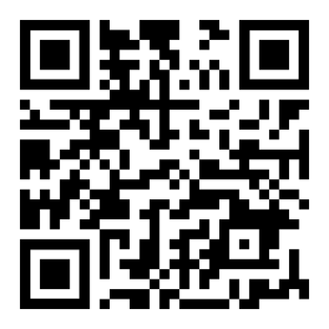
&
Present
Plant Your Future
Friday, March 31st @ 4pm
Maddox Hall, room 117
Members: FREE
New members: $5
All it takes is a seed of faith to come and plant your future!

