Slide 1
Campbell Law SBA
‘25 - ‘26

Slide 2
Duties of SBA Executive Board
President
  Appoint committees
  Represent Campbell at school functions + outside events
  Direct + oversee SBA activities
Vice President
  Set meeting agenda
  Preside over meetings
  Direct + oversee SBA activities
Treasurer
  Maintain budget
  Record transactions
  Disburse funds to student organizations
Secretary
  Oversee SBA public relations
  Maintain SBA records
  Draft and send SBA correspondence

Slide 3
Duties of SBA Representatives
Responsibilities
2025 Committees
Appropriations
Diversity Affairs
Internal Affairs
Public Relations
SBA Cares
Student Life
Traditions
Serve on SBA committees
Voice student concerns to SBA
Generate ideas for student engagement and school-wide improvement
Vote on SBA + student organization funding
Required attendance: SBA Meetings

Slide 4
Appropriations
Each student organization gets $1,000 per semester to spend on events. The appropriations committee votes on supplemental requests (additional funding beyond $1,000) and handles whatever other financial issues may arise.

Slide 5
Internal Affairs
Responsibilities: Internal Affairs conducts elections for SBA and Honor Court. It runs the fall elections for 1L reps, 1L honor court justices, and our flex rep and spring elections for 2L and 3L reps, 2L and 3L honor court justices, SBA exec board, and honor court chief justice and attorney general.
  Internal Affairs ensures that everyone follows election rules.

Slide 6
Public Relations
Responsibilities:
  Designs and prepares SBA merch (If you have a fun idea for a shirt, let us know!)
  Runs the SBA Instagram account
  Notifies students of events happening at school

Slide 7
Student Life
Responsibilities:
  Plan bi-weekly bar reviews or other social events
  Plan the Thanksgiving Day Lunch
  Plan the annual SBA Classic Golf Tournament
  Plan the LDOC BBQ Lunch

Slide 8
Diversity Affairs
Responsibilities:
  Plans events that bring students together and encourage inclusion and support in our school
  Diversity Affairs will often collaborate with student organizations to put on events and bring guest speakers to campus.

Slide 9
SBA Cares
Responsibilities:
  Plans events that encourage wellness among the student body.
  Examples include yoga in the lobby, donut days, and organizing resources like the wellness room.

Slide 10
Traditions
Responsibilities:
  Plans large school event such as the Halloween party, Barrister’s Ball, Family Day, and Graduation.

Slide 11
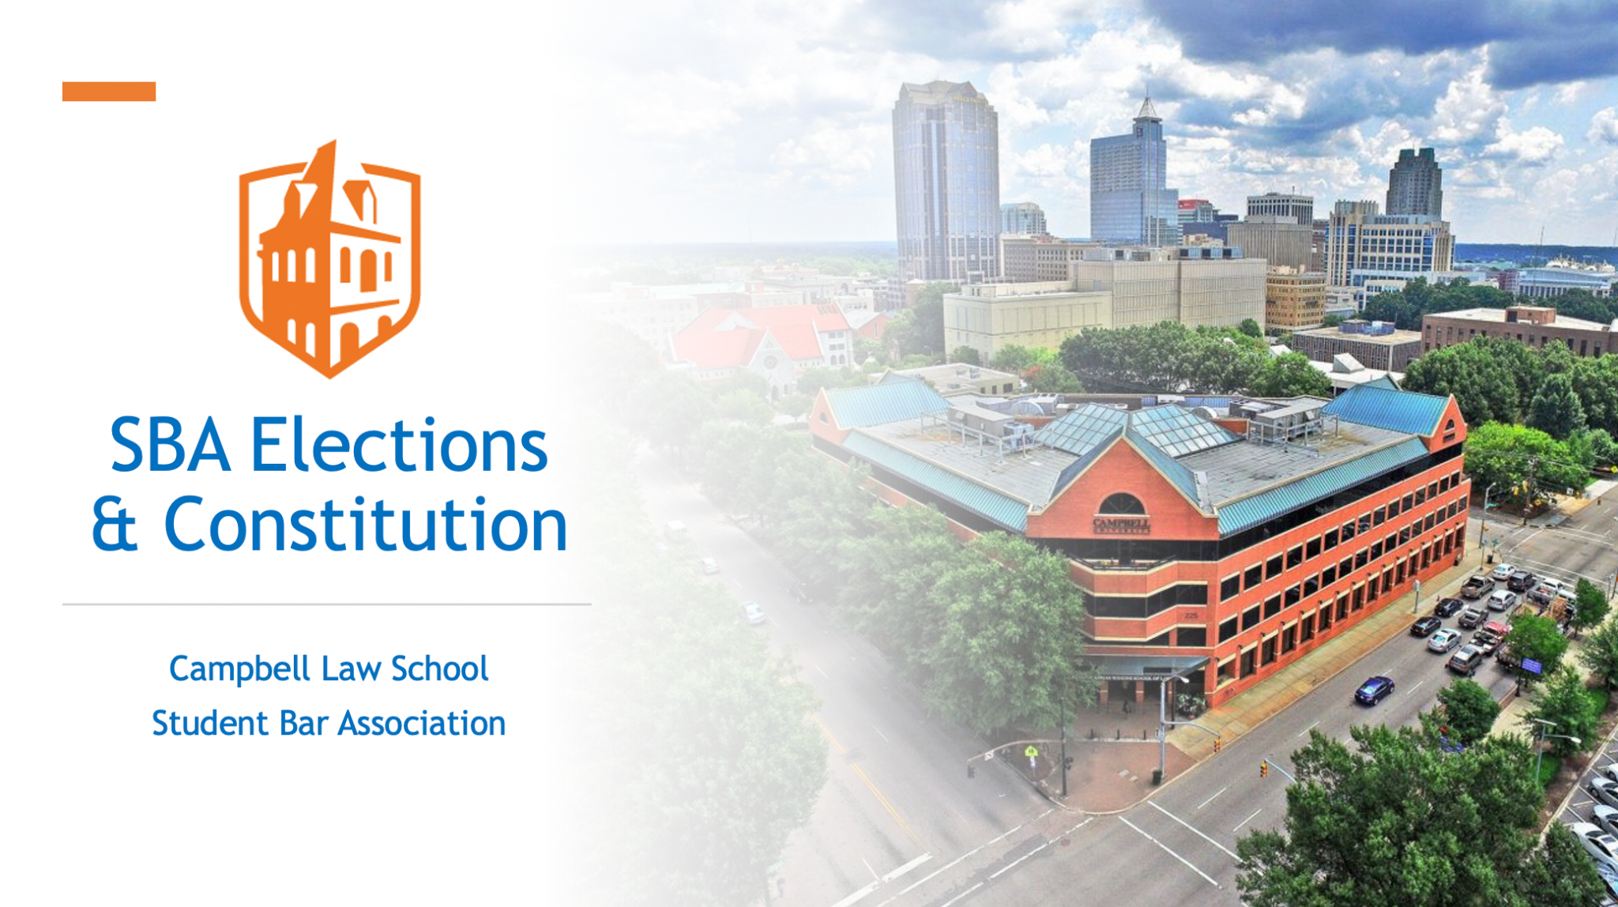

SBA Elections + Constitution

Slide 12
First and foremost…
Congratulations on starting your first week of law school!
Remember to take care of yourself, it’s a marathon not a sprint.
Sleep, eat, and general self care.
Ask for help when you need it.

Slide 13
Meetings & Retreat
SBA Meetings
SBA Retreat
Once every two weeks
Mondays 12pm-12:50pm
  September 8, 2025
  September 22, 2025
  October 6, 2025
  October 20, 2025
  November 3, 2025
  November 17, 2025
REQUIRED: Sunday, September 7th.

Slide 14
SBA Eligibility
Must be in “good standing”
  No Honor Code violations
  Not on academic probation or warning

Slide 15
Election Rules + Procedures
Nominations
  Form must be completed by TWO people (the candidate + person nominating him or her)
  Students may only be nominated for one position per ballot
Campaigns
  No campaign materials may be hung up on school walls, doors, lockers, whiteboards, etc.
  Campaign Statement: 500 words or less describing candidate’s goals, experience, campaign philosophy or other relevant information; uploaded as part of nomination form. A candidate photo may be submitted as well.
  Spending limit: $100
  You may not send electronic communications in Campbell affiliated group messages (ex. GroupMe) until candidate nominations end.
  There is no limit on the number of messages you are allowed to send in Campbell affiliated group chats, however, you are only allowed to send them following the close of nominations until the end of elections.

Slide 16
Important Dates
Nominations
Voting
An election email will be sent tomorrow.
Nominations open on Friday, August 22nd at 9am and close on Sunday, August 24th at 5pm.
Late submissions will not be considered nor appear on the ballot.
Voting will open at 8am on Thursday, August 28th.
Voting will close at 5pm on Friday, August 29th.

