Slide 1
TouchNet Portal
Secure online portal with real-time account activity
View your current student account balance and recent statements
Set up a payment plan
Make a payment
Set up e-Refunds
Add Authorized Users

Slide 2
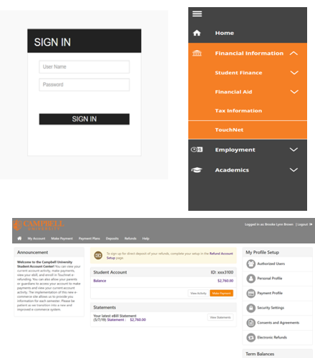
Where is TouchNet located?
Go to the Student Self-Service Portal & login (ss.campbell.edu)
Click the drop-down tab on the left side of the screen
Click “Financial Information”
At the bottom of the list, choose “TouchNet” to be redirected to the site

Slide 3
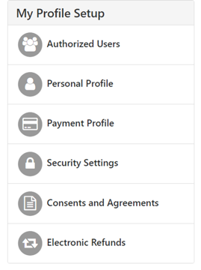
My Profile Setup Tabs
• Authorized Users: Give others access to view your account and make payments. They will have their own username/password to log in.
• Personal Profile: Contains student ID & name on the account.
• Payment Profile: Gives option to add a saved payment method.
• Security Settings: Enroll in the Two-Step Verification to further protect your account.
• Consents & Agreements: Contains any “Promise to Pay” forms.
• Electronic Refunds: Add bank account info and consent to a direct deposit method of refunding.

Slide 4
Enrolling in e-Refunds
To ensure your refund is processed electronically, enroll in TouchNet eRefunds on or before the first day of class.
Students not enrolled in eRefunds by the deadline are subject to receive a paper check by mail to the address we have on file.
Financial aid does not disburse until AFTER the first day of class and refunds cannot be processed until after day 5 of classes.
Refunds are processed within 14 days from the date aid is disbursed and a credit balance is created on a student account.

