Slide 1
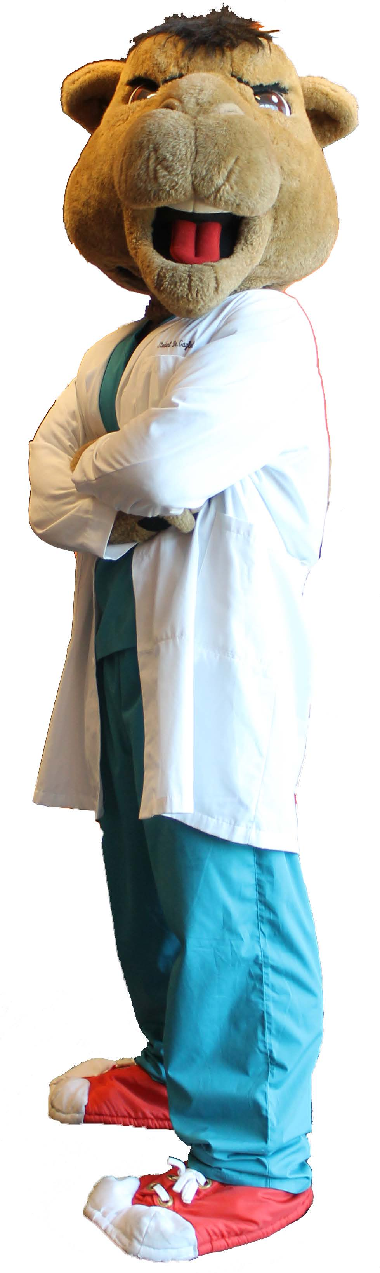
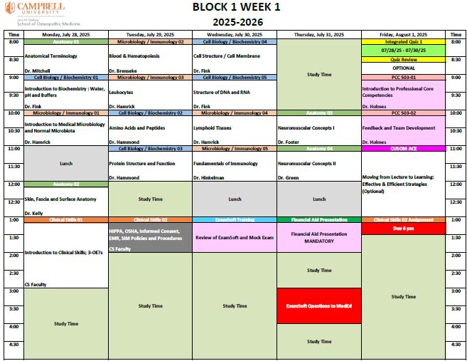
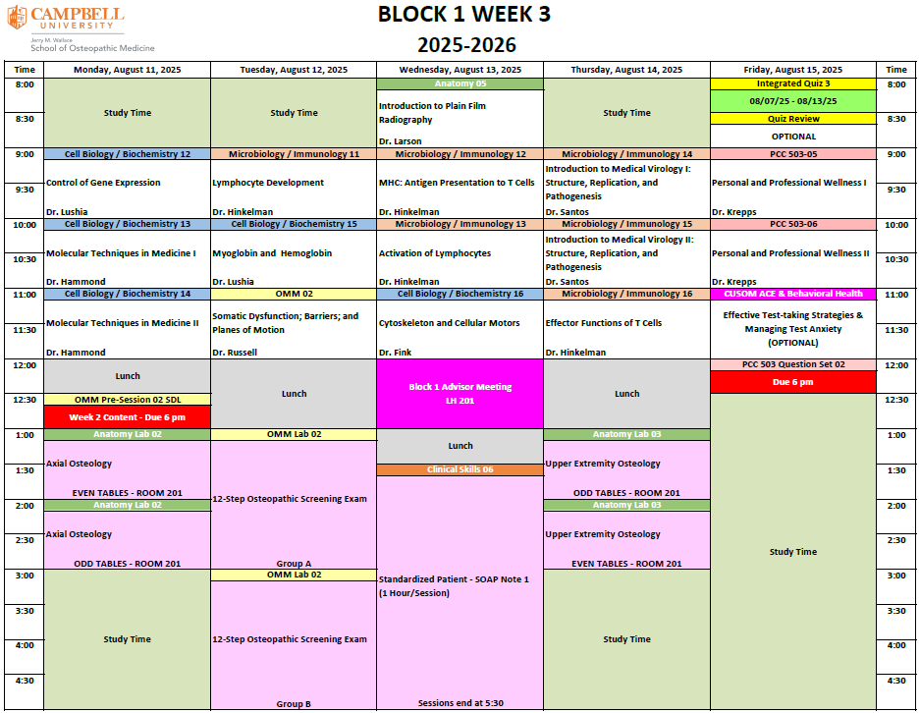
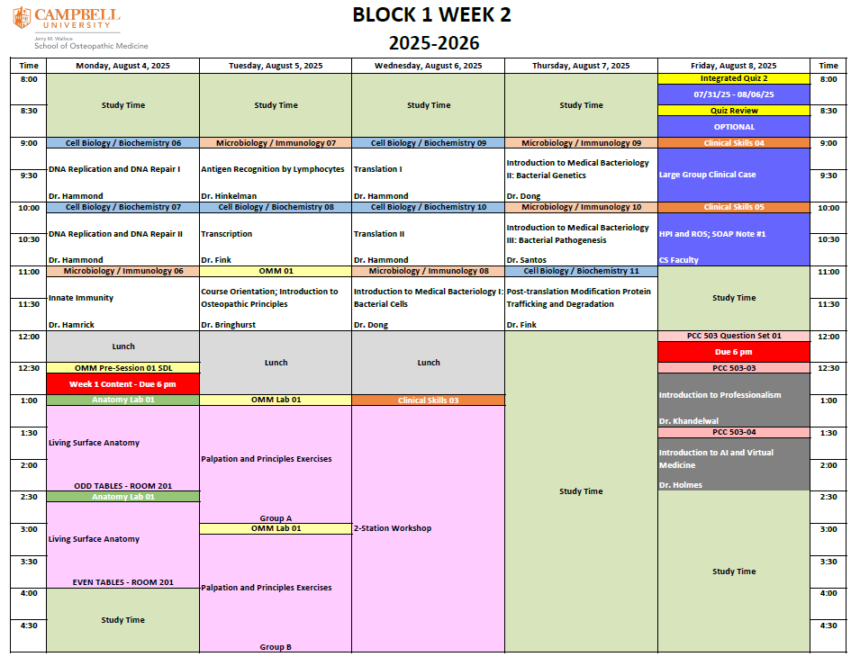
Class of 2029 Orientation
“Breaking Down the Blocks”
July 24, 2025
Robert R. Terreberry, PhD
Senior Associate Dean for Biomedical Affairs
Office: Room 188 South Building
Office hours: “Open door” but appointment preferred
Phone: (910) 893-1767
E-mail: terreberry@campbell.edu
Notes:
Good afternoon, Welcome and Congratulations to the Class of 2029.
This is GAYLORD the CU Mascot and he is here for numerous activities – hopefully you will have plenty of opportunities to meet him. GLADYS too.
I want to go over the Block schedule with you and answer any questions you may have at this time.
Share these schedules with your family and loved ones so they know what you are doing at any time, get them involved to some extent, especially if you have family with you (spouse and children).
I need a volunteer not from NC and who has never put together a jigsaw puzzle.

Slide 2
Attendance
CUSOM believes attendance is an important part of providing structure to the curriculum and contributing to student well-being and development as a professional.
Lectures provide students the opportunity to engage with their professors and fellow students, to participate in active learning exercises, and ask questions to clarify difficult concepts. Students will establish and grow meaningful relationships with fellow students and the broader CUSOM community.
With this Attendance Policy the curricular and educational expectations remain the same. THE BAR IS VERY HIGH !
Notes:
Emphasize student involvement, really helps with well-being, don’t isolate yourselves.
Your faculty enjoy meeting with you and seeing the lightbulbs go off when you learn – make attendance a positive aspect of school.

Slide 3
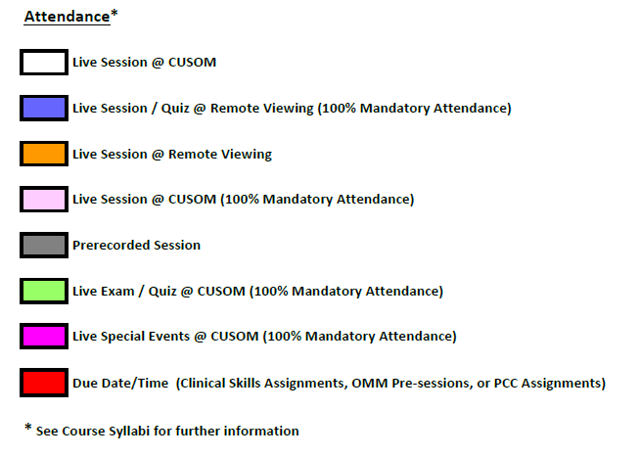
Attendance
The current attendance policy has eight (8) components which are easily identified on the Block schedules with the following color scheme:
Notes:
This is on the cover of the Block Schedules and these components are fully explained in the course syllabi.
8 different categories and expectations.
We will go through each of them now.

Slide 4
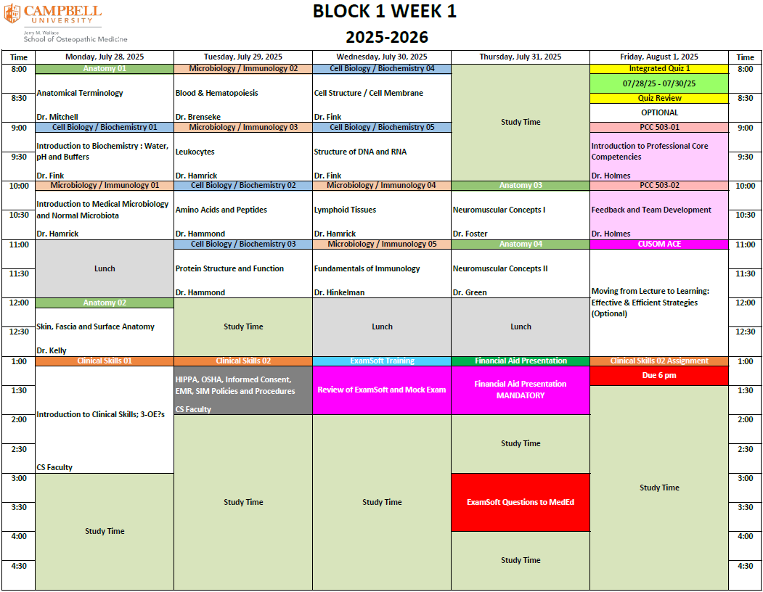
Attendance
Live Session @ CUSOM
Primarily lectures or small group discussions
NO attendance requirement
No form or notification needed
Notes:
I strongly encourage you to attend lectures to help figure out what approach works best for you.
Not undergrad and most courses are team taught and the schedule varies from day-to-day.
Dress code in AB is in effect – business casual, helps with professionalism aspect.
How many of you were impacted by the COVID shutdown?
How many of you enjoyed the COVID shutdown?
Who wants to go back to the COVID shutdown?

Slide 5
COVID Impacts
As an out-of-state student without any connections to state/town X, isolation was exceptionally difficult.
…experiencing isolation emphasized the irreplaceable significance of in-person interactions on campus; this adversity taught me perseverance and enriched my gratitude for the privilege of face-to-face connections.
Attending classes over Zoom felt significantly different because I could not connect with my professors or peers.
Academically, I did struggle a lot more to focus since I did not have that separation between home and school to keep me on track. I found it challenging to create and maintain relationships with professors.
Notes:
Remember school during COVID shutdown – all virtual classes!
Your AACOMAS application had a COVID-19 Impact Essay – many of you said it was difficult to connect to with faculty and other classmates due to isolation – don’t go back to that model by not attending class.

Slide 6
COVID Impacts
Since being on campus was optional at the time as classes moved fully online, what was supposed to be a Big-10 school experience with endless opportunities to meet and connect with others ended up being quite lonely.
My classes were conducted through video lectures or slides, and I struggled to connect with my professors, which highlighted the significance of support from my classmates.
Traditional face-to-face interactions with professors were replaced with virtual meetings, and the intimate classroom dynamic was lost.
Having to do school online also made it difficult to form close bonds with my professors.
Notes:
Many of you said it was difficult to connect to with faculty and other classmates due to isolation – don’t go back to that model by not attending class.

Slide 7
Attendance
Live Session @ Remote Viewing
Primarily small group Clinical Skills discussions
100% Mandatory attendance requirement
Student log in confirms attendance to these sessions
Zoom platform; LEAVE CAMERAS ON for duration
Students must submit Course-specific Excused Absence form on Course/Community Blackboard to Course Director
If Excused, what make-up session(s) required
Notes:
Dress code – must be dressed. Use common sense – nothing offensive or excessively revealing – would your mother be proud or not?
When I was in Graduate school = look good – feel good.
Suggest routine as though coming to campus everyday! Awake, breakfast, shower then class – suggest this on days not coming to class in the morning too = routine!

Slide 8
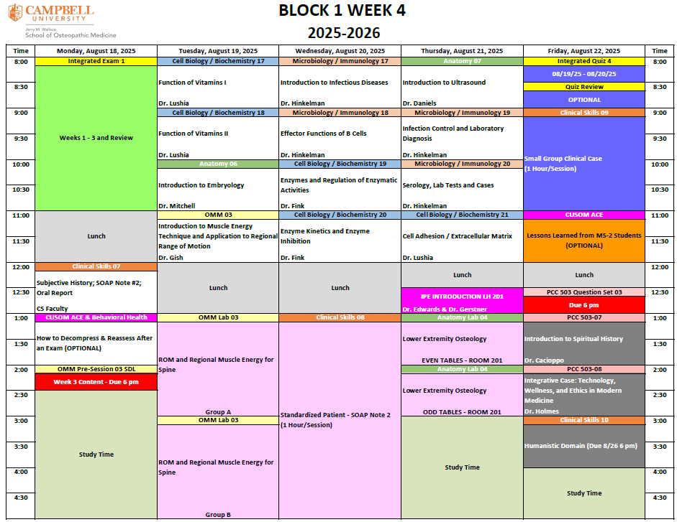
Attendance
Live Session @ Remote Viewing
Primarily extracurricular sessions; student support; select lectures (none in Block 1)
NO attendance requirement

Slide 9
Attendance
Live Session @ CUSOM
Select PCC lectures
Primarily labs or small group exercises
100% Mandatory attendance requirement
Course-specific Excused Absence form on Course/Community to CD
If Excused, what make-up session(s) required
Course Syllabi contain the detailed specific course-related policies and procedures

Slide 10
Attendance
Live Session @ CUSOM
Lab Groups
OMM uses Groups A and B
Anatomy uses Odd/Even Tables early and then Groups A and B (same as OMM Groups)
Clinical Skills (CS) uses variety of groups – see Course Blackboard page for more information
CS Sessions vary in length of time for each student - remaining time is free time
Notes:
Anatomy, Clinical Skills and OMM labs – dress code per the Course Syllabi.
Groups are located on course Blackboard pages

Slide 11
Attendance
Pre-recorded Session
Primarily pre-recorded lectures and OMM Pre-session modules
NO attendance requirement
Students will view these sessions on their own
Listed in Block schedules in a manner which best reflects overall course content and flow
Recommended students try to follow the schedule as closely as possible
Quiz and Exam sessions are fixed elements
Notes:
Work hard, early on to develop a ROUTINE to include these sessions – Quizzes and exams do not change.
OMM Pre-sessions / Clinical Skills SDLs must be completed prior to lab and are a part of the overall course grade.

Slide 12
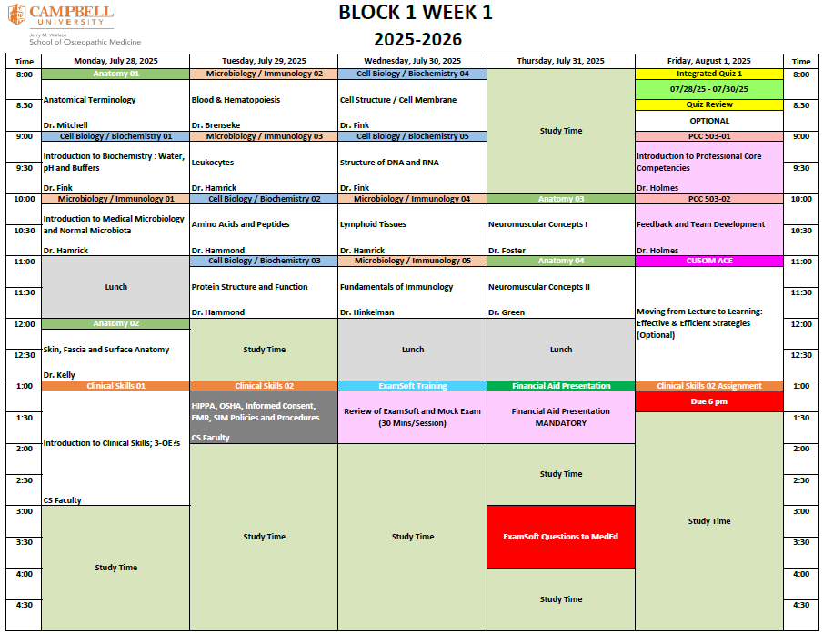
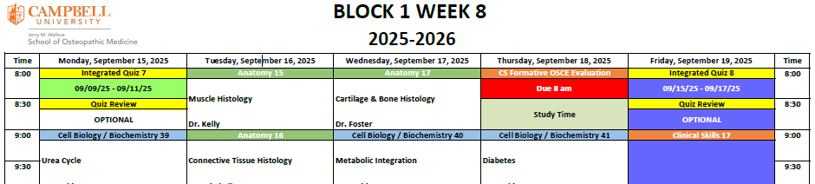
Attendance
Quizzes
All quiz sessions have Mandatory attendance
Student must submit Excused Absence form on Class Community Blackboard page directly to the Director of Medical Education (DME)
DME determines whether Excused or not
If Excused, will schedule a make-up session
Quiz Reviews are OPTIONAL – NO attendance requirement
Quizzes are Friday mornings, except in Week 8 – Quiz 7/Review is on Monday due to IPE event previous Friday and Quiz 8/Review is on Friday as usual
Notes:
Excused Absence to Director of Med Ed – Elizabeth Lewis.
Meet Med Ed tomorrow – you, as well as faculty will work closely with them.

Slide 13
Alternating Fridays
In an effort to offer some flexibility in the schedule, Fridays will alternate between live, in-the-building sessions and remote viewing sessions
Block 1 Weeks 1, 3, 5, and 9 will be live, in-the-building Quiz and Review followed by live PCC Lectures
Block 1 Weeks 2, 4, 6, and 8 will be live, remote Quiz and Review followed by remote (Zoom) CS viewing followed by 2 PCC SDLs

Slide 14
Attendance
Exams
All exam sessions and reviews have Mandatory attendance
Student must submit Excused Absence form on Class Community Blackboard page directly to the Director of Medical Education (DME)
DME determines whether Excused or not
If Excused, will schedule a make-up session
Notes:
Excused Absence to Director of Med Ed – Elizabeth Lewis
Just because you have an assessment, the curriculum does not stop – routine is key to establish early.

Slide 15
Attendance
Special Events
Various events
Exam Soft Training
Financial Aid session
Advisor Meetings
Mandatory attendance
ACE sessions – Optional

Slide 16
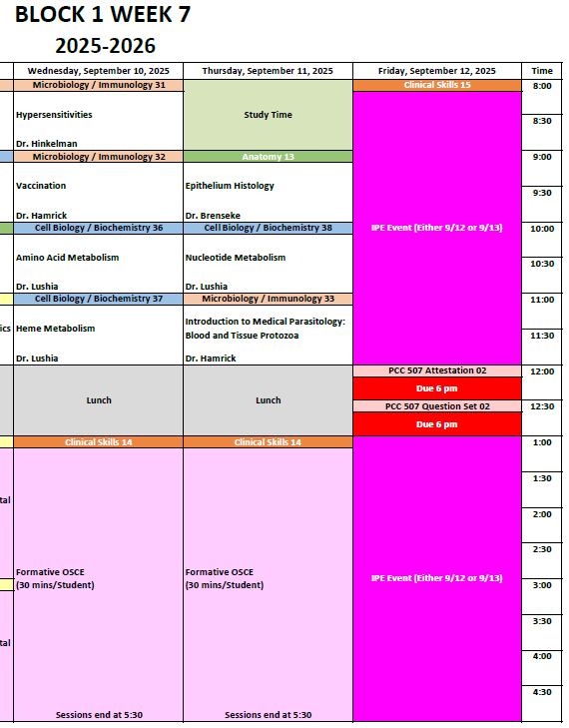
Attendance
Special Events - IPE
IPE events in Blocks 1, 4, 6 and 7 = COCA requirement
In Block 1 - Either Friday or Saturday of Week 7; more information in Week 4 Session
Part of Clinical Skills Course
Mandatory attendance

Slide 17
Attendance
Anatomy, OMM and Clinical Skills labs will be open and available to use during the times lectures are scheduled.
If there is another activity taking place, these labs will not be available for study, and you may be asked to leave. Clean up after you are finished.
Faculty and Staff will not be present.

Slide 18
Attendance
Due Dates/Times
OMM Lab Pre-sessions
Clinical Skills SDLs
PCC Assignments
Not all inclusive, see Course Syllabi for additional information

Slide 19
Student Hours
Student-faculty interactions are an important aspect of CUSOM and students are encouraged to schedule a personal meeting with faculty/advisor or contact CUSOM ACE for additional help with addressing academic/course-related questions.
Faculty will schedule formal office hours during Study Time on the schedule, not during scheduled class/lab time, to avoid conflicts with in-person class participation.
Notes:
Again, faculty are an important resource – utilize them and remember they are writing the assessment questions, not some Youtuber. Can waste a lot of time watching content not responsible for and who knows the accuracy of the content.

Slide 20
Student Hours
Come prepared with very specific questions related to course content, as well as questions or concerns about how to approach the material or study skills.
These are NOT review sessions. It is not the responsibility of the faculty to provide activities or any type of review material.

Slide 21
Attendance
Are there any questions related to Attendance?
Notes:
Emphasize student involvement and very high standards are still the expectation.

Slide 22
General Study Strategies
Set daily and weekly academic goals
Interchange subjects after 1.0-1.5h
Three R’s
Choose appropriate study space
Know yourself
Spaced Repetition
Active Recall
Interleave Subjects
Notes:
Strategies of an Effective & Successful DO Student
Peer Learning Partners' Tips for Incoming DO Students
Documents sent to you by CUSOM ACE

Slide 23
The 3 R’s for Success
Routine
Repetition
Rest
Notes:
I counsel many students and Debi will attest to the series of questions I ask each student the first time we meet. I am happy to meet with any of you at any time to discuss study strategies.
Take me through a typical day…

Slide 24
R¹ - Routine
Must establish early
Studying
Somewhat of trial & error at first
Where to study, when to study, who to study with (3) or alone
Associate environment with learning – don’t study in bed
Set daily & weekly goals
Avoid cramming – it does not work for long-term (life-long) learning
Notes:
Don’t need to know everything – no one does!
Check in on PUZZLE – give the box top!
168 hours in a week – your schedule amounts to about 30 hours per week = 18%.
50 minutes of every hour of the week is yours!
Think about this for a moment – that is a lot of time, in my opinion.

Slide 25
R¹ - Routine
Eating, grooming, and self-care
Sleep
Social & personal time
Important not to forget or neglect
“All work and no play…”
MUST BE IN MODERATION
Notes:
Those 50 minutes must include:
Include in your routine time for self and family/loved ones with out guilt.

Slide 26
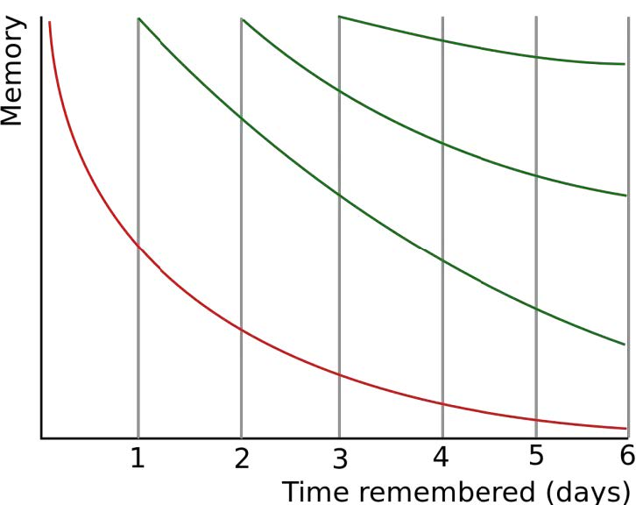
R² - Repetition
Ebbinghauss’s “Forgetting Curve”
Notes:
Strategies of an Effective & Successful DO Student – ACE document
Students often say they need to master Monday’s lectures by end of Monday, Tuesday on Tuesday, etc..
Why? Do you have a quiz or exam on Tuesday or Wednesday?
Piece-by-piece, day-by-day build the puzzle. Add more pieces and you will get through most of the content and be solid with what you know.

Slide 27
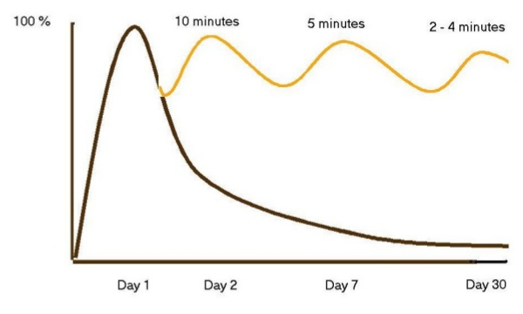
R² - Repetition
Notes:
Slightly different Forgetting Curve
Study each subject each day – even if just for 30 minutes
What is most important course? As a DO, I would say OMM and CS, but students historically only study OMM/CS the night before the exam… Good break from basic science courses and helps with interleaving content.
Piece-by-piece, day-by-day build the puzzle. Add more pieces and you will get through most of the content and be solid with what you know. The pieces are where they should be – no questions – confidence!

Slide 28
R³ - Rest
Do not pull all-nighter’s
Can easily tell who has not slept much or at all
Will be fatigued, make senseless errors, forget what you did know
Same sleep pattern every night
Do not change night before exam
Must have REM sleep to consolidate memories to long term storage
Notes:
Strategies of an Effective & Successful DO Student
YouTube video – Worst Study Strategies = Cramming is #1 of 9
You may pass the quiz or exam, but you won’t retain the content very long – life-long learning
How many of you pulled an all-nighter?
Do you remember the specifics, how about the general content or even the course = the point of this.

Slide 29
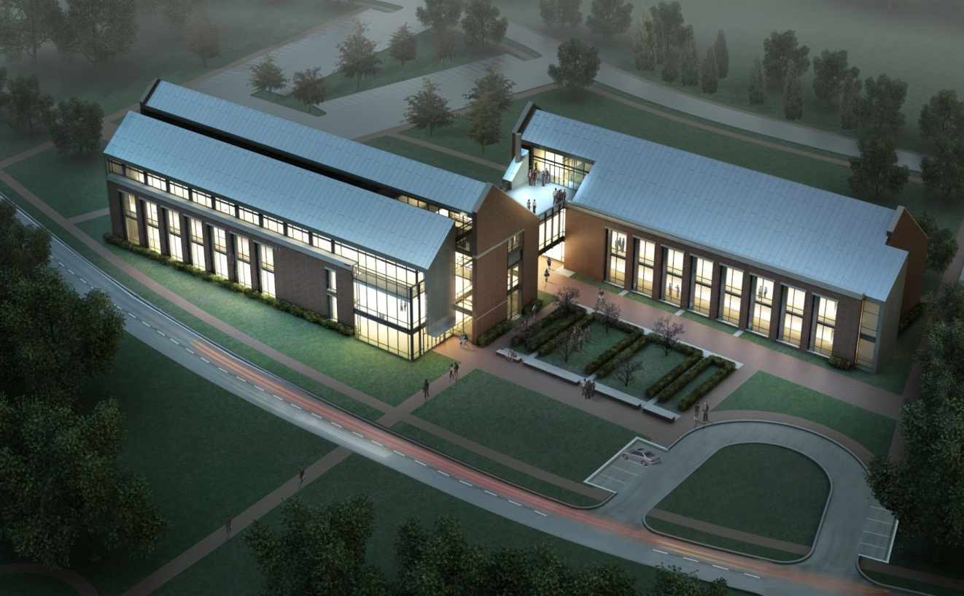
Thank you.
Are there any Questions?
Notes:
Check in puzzle, thank student and give puzzle to them with request to let me know when you finish it!
Don’t hesitate to contact me about anything in year 1 – happy to meet and discuss.
Congratulations, welcome and I wish you nothing but success in the upcoming year and beyond.

