Slide 2
FERPA
Family Educational Rights and Privacy Act
Campbell can only provide account details to persons student authorizes to receive information
Students are able to submit the FERPA form online
https://www.campbell.edu/registrar/family-education-rights-and-privacy-act-ferpa/

Slide 3
Student Email & Self-Service
Access or login information is sent from the
ITS Team (via personal email provided at time
of acceptance)
Email is the primary communication platform used by Student Financial Services
Students should check email weekly

Slide 4
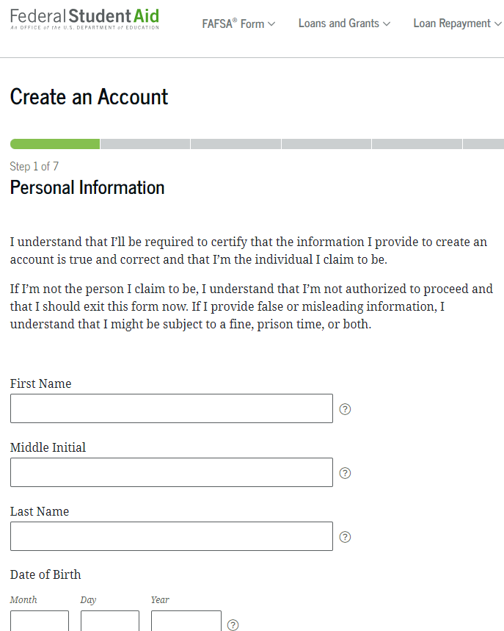
Step 1 – Create an Account!
Create an Account
https://studentaid.gov/fsa-id/create-account/launch
We encourage you to use a permanent e-mail address as well as your phone number for account recovery
Never share your FSA ID
Invite contributors

Slide 5
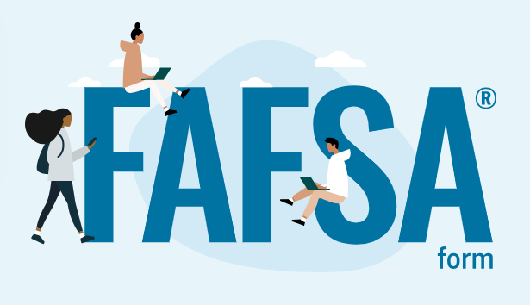
Applying For Financial Aid
Complete the Free Application for Federal Student Aid (FAFSA)
https://studentaid.gov/h/apply-for-aid/fafsa
The FAFSA is free
Apply as early as October 1
Must be completed each academic year

Slide 6
Who is a Contributor?
Anyone who is required to provide consent and approval to have federal tax information transferred directly from IRS into the FAFSA form.
Student is a contributor. Another contributor would be a spouse if applicable.
Data needed to invite a contributor:
Legal name (from their Social Security Card);
Date of birth;
Social Security Number (SSN) if they have one;
Mailing address if they don't have an SSN; and
Email address.

Slide 7
What else can I do with StudentAid.gov?
Complete your FAFSA
Complete Entrance Loan Counseling
Sign a Master Promissory Note
Explore repayment plans
Identify who is my loan servicer
Many more resources!

Slide 8
Financial Aid Process
1
Submit FAFSA
4
Student accepts or rejects financial aid
2
School receives FAFSA
5
Student completes requirements
3
School determines aid eligibility
6
Aid disburses to Student Account

Slide 9
Graduate & Professional Students Loans
Federal Unsubsidized Loans
Accrues interest while enrolled
Repayment begins 6 months after you leave or drop below half-time
Accept unsubsidized loan prior to graduate plus
*24/25 rate is 8.08%
Federal Graduate PLUS Loan
Accrues interest while enrolled
Can request in school deferment
Credit based loan
*24/25 rate was 9.08%
Alternative Loans
Rates and terms vary
https://www.campbell.edu/financial-aid/available-aid/student-loan-options/
*Interest rates update July 1st each year.*

Slide 10
Annual and Aggregate Federal Loan Limits
Unsubsidized Annual Loan Limits:
DO1 & DO2 - $40,500
DO3 & DO4 - $47,167
Aggregate loan limits:
The aggregate amount for the Unsubsidized loan is $224,000 and includes subsidized and unsubsidized loans for undergraduate study.
The Graduate Plus loan does not have a limit but the school cannot award eligibility over the COA (cost of attendance) per academic year.

Slide 11
Financial Aid Offered
You will receive an email notification once an aid offer has been determined.
To view award package:
◦ Login to the self-service portal
° Open the menu in top left corner (3 bars)
◦ Financial Information > Financial Aid > My Awards
◦ Once on My Awards, you may accept or decline financial aid offers.

Slide 12
Accepting Financial Aid Tips
Utilize unsubsidized loan eligibility before accepting the Graduate Plus loan
Credit freeze?
Use our Federal Loan Calculator found on Financial Aid/Loans webpage to factor processing fees on federal loans
First time borrowers at Campbell must complete Direct Loan Entrance Counseling and Master Promissory Note (MPN) for the Direct Unsubsidized Loan as well as the Graduate Plus Loan on www.studentaid.gov

Slide 13
Disbursement of Financial Aid
As long as all requirements are met, FA disburses to student’s Campbell account on/around the first day of class
Students will receive an email notification of disbursement
Once charges are paid, any remaining credit will be sent as a refund by the Bursar’s Office within 14 days
It is recommended that students sign up for the electronic refund on TouchNet for refunds to be sent directly to their personal checking account

Slide 14
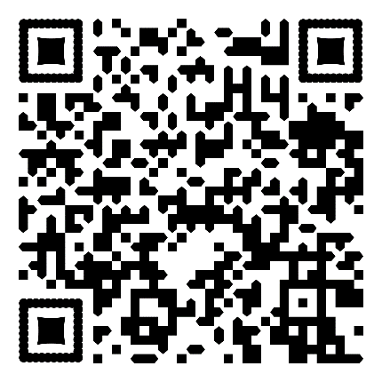
Student Account Highlights
Financial Responsibility Agreement each semester
Acknowledgement of your responsibility to pay all account balances
Read and e-sign EACH semester
Located in your Self-Service portal under the Student Finance tab
Waive/Enroll in Student Health Insurance each year
All CUSOM students are required to have health insurance
A charge for student insurance is billed to the account at the beginning of the academic year which is only removed if the student completes an insurance waiver through the online portal.
If health insurance is needed, students can enroll and the charge will remain on the account.
Sign up for eRefund
The fastest and most secure option to receive your refund is to enroll in TouchNet eRefunds.
Refunds are processed within 14 days from the date of disbursement.
Log in to your TouchNet portal through self-service to enroll in Electronic Refunds

Slide 15
Student Financial Services
(910) 893-1244
Student Financial Services
Campbell University
P.O. Box 36
Buies Creek, NC 27506
(910) 814-5788
(910) 407-1512
sfs@campbell.edu
loanteam@campbell.edu

