Slide 1
OMM Block 6 06 PreSession and Lab Upper Respiratory Adapted from Chapter 24: Lymphatic Techniques https://essentialomm.substack.com/p/chapter-24-lymphatic-techniques

Slide 2
CUSOM Notice and Agreement
Class materials (hereafter including PowerPoints, Handouts and Lecture Recordings) are distributed for the exclusive use of students in the Jerry M Wallace School of Osteopathic Medicine. Student access to and use of materials are conditioned on agreement with the terms and conditions set out below. Any student who does not agree to them is prohibited from accessing or making any use of such materials.
Any student accessing materials (1) acknowledges the faculty members’ intellectual property rights and that distribution of the materials violates the CUSOM Copyright Policy; (2) recognizes the privacy rights of fellow students who speak in class; (3) accepts that distributing, posting, or uploading materials to students or any other third party not authorized to receive them or to those outside CUSOM is an Honor Code violation; and (4) agrees that the materials are to be accessed and used only as directed by the faculty member(s) teaching the course. Students are not permitted to take photographs or screenshots of any screens or projected materials during lectures, exams or quizzes. Audio recording are also not permitted outside of what is provided through the recorded Tegrity sessions.

Slide 3
Learning Objectives
By the end of this session, you should be able to:
Obtain informed consent for treating URI with OMT
Apply lymphatic technique principles to upper respiratory infection
Recognize and locate URI-related Chapman points.
Implement appropriate treatments in a proper sequence for URI complaints

Slide 4
Lab Plan
Technique/Exercise | Timing (Minutes)
Consent and rationale to treat URI with OMT | 4
Diagnose and treat cervical spine and thoracic cage with BLT | 16
Diagnose and treat respiratory diaphragm | 6
Screen and treat URI related Chapman points | 5
Anterior Cervical Arches | 6
Cervical Chain Drainage | 6
Submandibular Release | 6
Mandibular Drainage (Galbreath Technique) | 6
Auricular Drainage | 6
Alternating Nasal Pressure | 6
Trigeminal Stimulation/Inhibition | 6
Facial Effleurage | 6
Thoracic Lymphatic Pump | 6
Bilateral Pectoral Traction | 6
Application Exercise 1 – Otitis media | 8
Application Exercise 2 – Frontal sinusitis | 8

Slide 5
Rationale and Consent for Examination
Student Doctor 1: Assume that your partner has viral rhinitis. Explain to your partner your rationale for performing an osteopathic examination and treatment. Include rationale related to mechanical, circulatory, lymphatic, and neurologic factors. (1 minute maximum)
Ask for your partner’s consent to perform the examination and treatment.
Student Doctor 2: give feedback regarding the explanation and consent. (1 minute maximum)

Slide 6
Elements of Consent for a Procedure
Nature of procedure
Identity of operator
Benefits
Material risks
Alternatives
Witness not required
Not required to list every conceivable risk
Not required to list your qualifications but patients may ask
Patient verbalized understanding (+/-)

Slide 7
Rationale and Consent for Examination
Student Doctor 2: Assume that your partner has bacterial sinusitis. Explain to your partner your rationale for performing an osteopathic examination and treatment. Include rationale related to mechanical, circulatory, lymphatic, and neurologic factors. (1 minute maximum)
Ask for your partner’s consent to perform the examination and treatment.
Student Doctor 1: give feedback regarding the explanation and consent. (1 minute maximum)

Slide 8
Examination and Preliminary Treatment
Student Doctor 1: perform a screening and segmental examination of the head, neck, and thorax. Note any SD.
Student Doctor 2: give feedback regarding the examination.
Treat any dysfunctions found in cervical, thoracic, and rib regions with your choice of technique
Repeat with roles reversed.
Discuss

Slide 9
Lymphatic Techniques for Upper Respiratory Infection

Slide 10
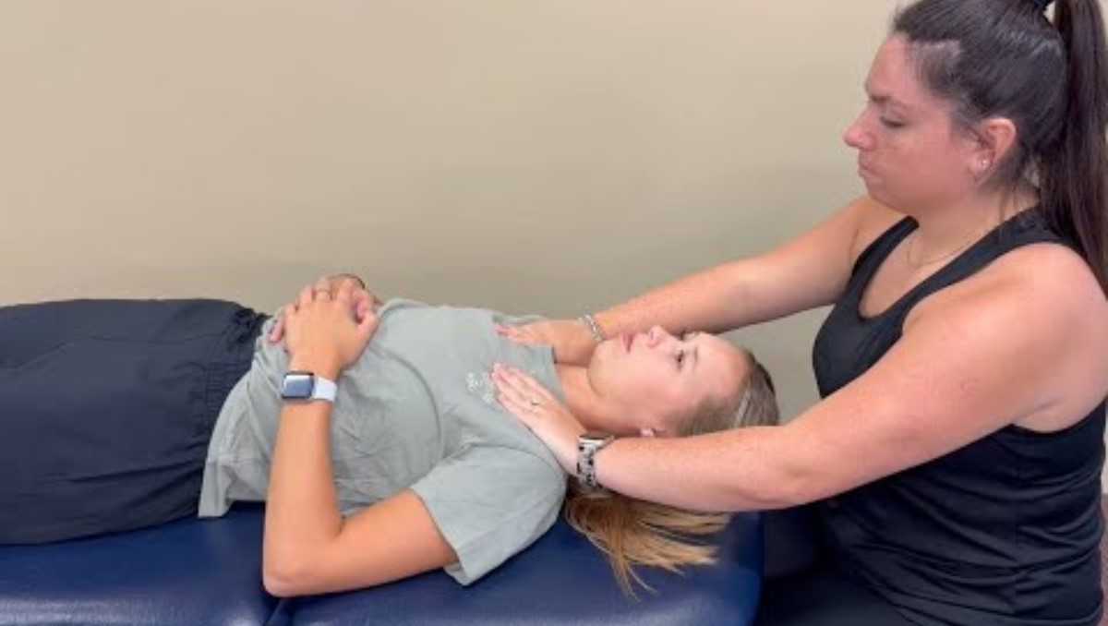
Thoracic Inlet Release
Improves lymphatic drainage, reduces fascial restriction
Pt supine; physician at head, hands on clavicles/manubrium, thumbs on 1st ribs
Direct/indirect myofascial release until softening
Add respiratory cooperation

Slide 11
Thoracic Inlet Release
Purpose To improve motion at the thoracic inlet, reduce fascial restriction, and ensure the primary drainage pathway's patency for both the thoracic and right lymphatic duct.
Patient Positioning The patient lies supine.
Physician Positioning and Hand Placement The physician sits at the head of the table, contacting the thoracic inlet bilaterally. Thumbs rest posteriorly over the first ribs, and the fingers curve anteriorly around the clavicles and manubrium.
Technique Application The physician assesses tissue compliance in flexion, extension, sidebending, and rotation. Direct or indirect myofascial release is then applied, engaging either the barrier or the ease. Pressure is sustained until a release is palpated. Respiratory cooperation may be added by asking the patient to take deep breaths or hold briefly at the phase of respiration that promotes greater softening.
Duration Continue until tissue softening is noted, usually 1 to 2 minutes.
Reassessment Recheck motion of the thoracic inlet and confirm that central drainage is improved.

Slide 12
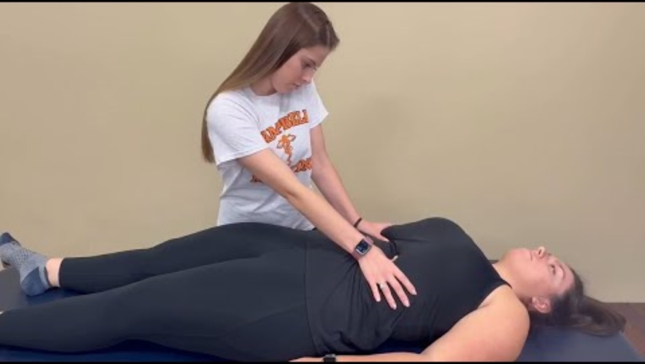
Doming the Diaphragm
Restores diaphragmatic excursion and pressure differentials
Pt supine, hips/knees flexed
Hands under the costal margin
Resist descent on inhalation, follow up on exhalation
Repeat until motion improves

Slide 13
Doming the Diaphragm
Purpose To improve diaphragmatic excursion and restore the pressure differentials essential for lymphatic and venous return.
Patient Positioning The patient lies supine with hips and knees flexed to relax the abdominal wall.
Physician Positioning and Hand Placement The physician stands or sits at the patient’s side. Fingertips are placed just inferior to the costal margin, pointing cephalad beneath the rib cage.
Technique Application As the patient exhales, the physician gently follows the diaphragm superiorly. During inhalation, resistance is maintained, limiting diaphragmatic descent. This doming motion is repeated in rhythm with the patient’s breathing until increased compliance is noted.
Duration Continue for 1 to 2 minutes, or until diaphragmatic motion becomes freer and more symmetrical.
Reassessment Recheck diaphragmatic excursion and abdominal motion with respiration.

Slide 14
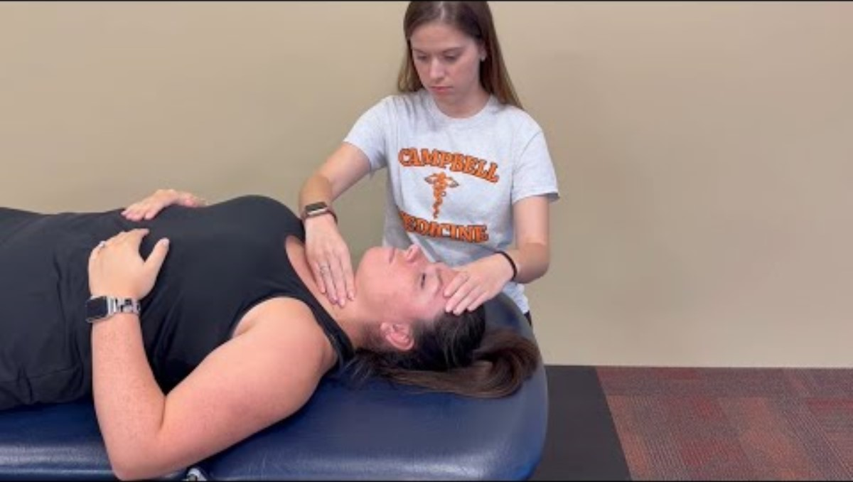
Anterior Cervical Myofascial Release
Reduces fascial restriction around the hyoid, thyroid, and cricoid
Pt supine; cephalad hand stabilizes head, caudad hand contacts cartilages
Direct or indirect pressure
Use neck motion or breathing to facilitate release

Slide 15
Anterior Cervical Myofascial Release
Purpose To reduce fascial restriction around the hyoid, thyroid, and cricoid regions and support lymphatic and venous drainage from the head and neck.
Patient Positioning The patient lies supine.
Physician Positioning and Hand Placement The physician stabilizes the head with the cephalad hand at the occiput or forehead. The caudad hand uses the thumb and fingers to contact each side of the hyoid, thyroid, and cricoid cartilages sequentially.
Technique Application The physician assesses the fascial tissues for directions of ease and restriction. The structures are then engaged either directly into the barrier or indirectly toward ease, with gentle sustained pressure. Neck flexion or extension may be incorporated to facilitate release and reduce crepitus.
Duration Continue at each level until tissue softening or improved mobility is perceived.
Reassessment Recheck fascial mobility and tissue compliance across the anterior cervical region.

Slide 16
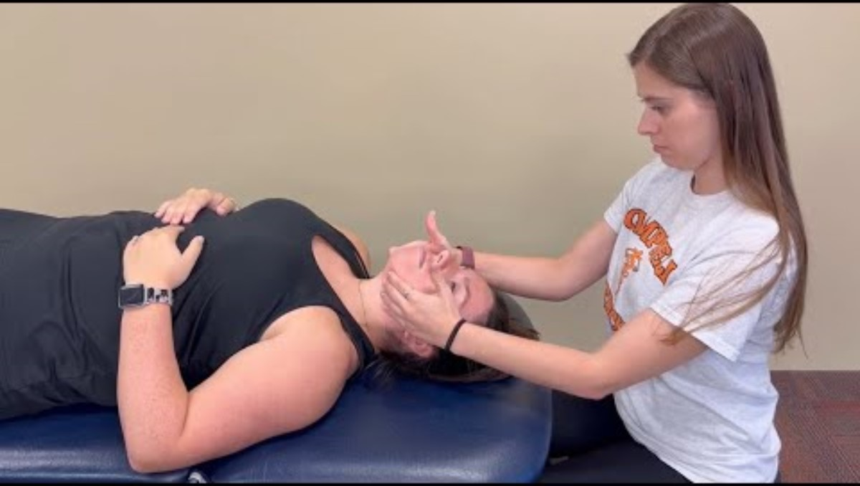
Submandibular Release
Enhances lymphatic outflow from oral cavity, jaw, face
Pt supine; physician’s fingertips medial/inferior to mandible
Gentle superior pressure, test mobility in all planes
Hold indirect or direct, until tissue softens

Slide 17
Submandibular Release
Purpose To reduce fascial restriction in the submandibular region and enhance lymphatic outflow from the oral cavity, jaw, and face.
Patient Positioning The patient lies supine.
Physician Positioning and Hand Placement The physician sits at the head of the table and places fingertips bilaterally along the soft tissues just medial and inferior to the mandible.
Technique Application Gentle superior pressure is applied while assessing tissue mobility. Motion is tested in transverse, anterior–posterior, and lateral directions. The physician may move into restriction (direct) or into ease (indirect) until tissue softens or releases.
Duration Continue for 1 to 2 minutes, or until improved tissue mobility is palpated.
Reassessment Recheck mobility and drainage in the submandibular tissues. Improvement may be noted as decreased fascial drag or reduction in submandibular fullness.

Slide 18
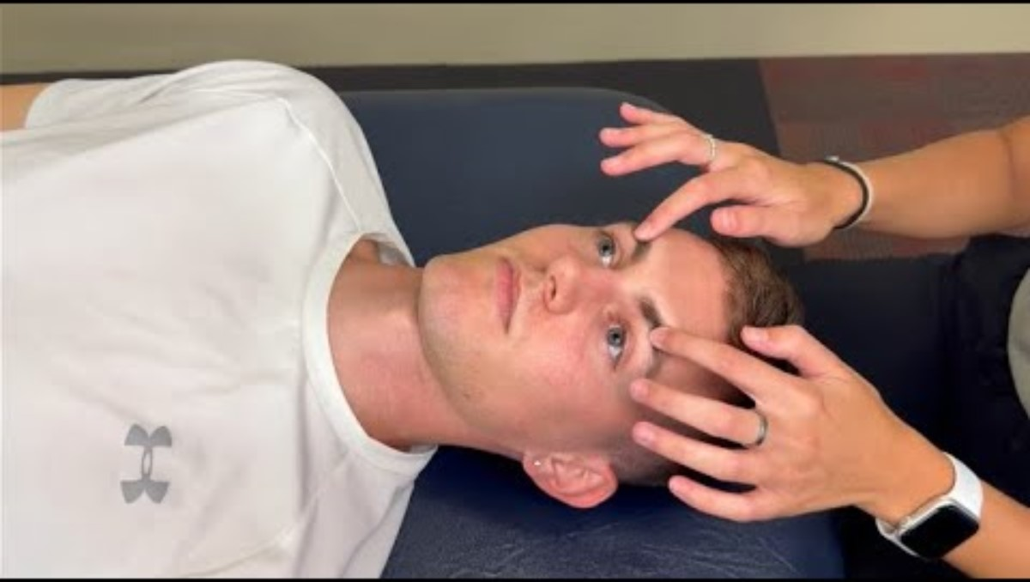
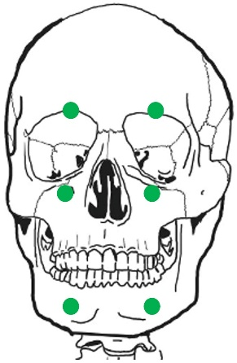
Trigeminal Nerve Inhibition
Reduces inflammation, edema, congestion, sinus pain
Pt supine; fingers on supraorbital, infraorbital, mental foramina
Gentle inhibitory pressure or small circles
Hold 30s–2 min until tenderness decreases

Slide 19
Trigeminal Nerve Inhibition
Purpose To decrease edema, congestion, and tenderness in areas innervated by the trigeminal nerve, particularly in the face and sinuses. This technique can also reduce pain associated with trigeminal distribution.
Patient Positioning The patient lies supine with the head in a neutral position.
Physician Positioning and Hand Placement The physician sits at the head of the table and identifies the supraorbital, infraorbital, and mental foramina bilaterally. Fingertip pads are placed gently over these points.
Technique Application Slow, gentle inhibitory pressure is applied at one or more foramina. The pressure may be sustained or combined with small circular motions. Points may be treated sequentially or simultaneously, depending on patient tolerance and findings.
Duration Pressure is maintained for 30 seconds to 2 minutes at each site, or until a release or decrease in tenderness is palpated.
Reassessment Recheck for reduction in tissue tenderness, facial congestion, and sinus-related discomfort. Patients may also report decreased pain or pressure sensations in the trigeminal distribution.

Slide 20
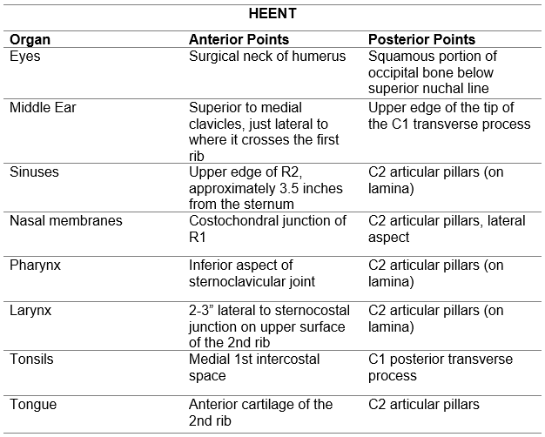
URI Related Chapman Points

Slide 21
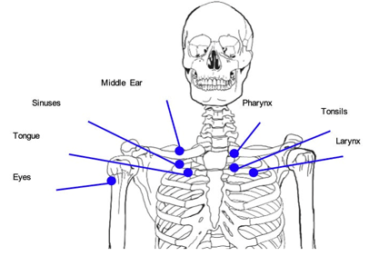
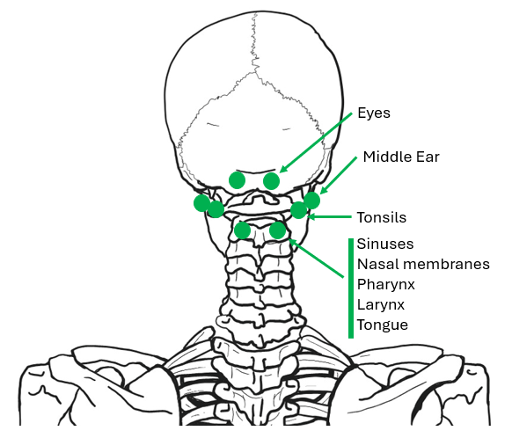
URI Related Chapman Points

Slide 22
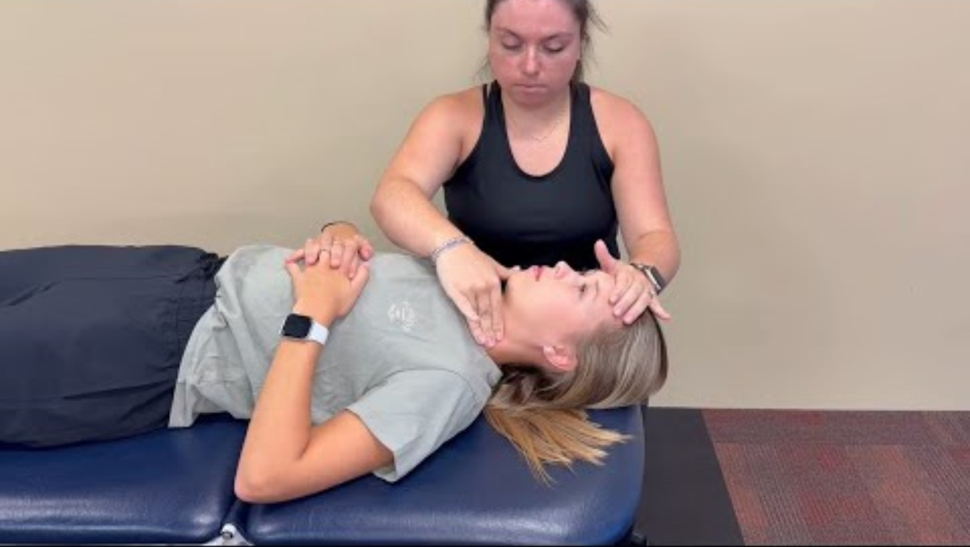
Anterior Cervical Lymphatic Drainage (Effleurage)
Mobilizes lymph from the head/neck after central restrictions are cleared
Pt supine, head turned slightly away
Transverse glide of midline structures, then gentle inferior strokes along cervical chains
Repeat bilaterally for 30s–2 min

Slide 23
Anterior Cervical Lymphatic Drainage (Effleurage)
Purpose To directly mobilize lymphatic fluid in the anterior and posterior cervical chains after central restrictions have been treated. This technique is often used for head and neck congestion.
Patient Positioning The patient lies supine with the head slightly turned away from the side being treated.
Physician Positioning and Hand Placement The physician sits beside the patient’s head. The cephalad hand stabilizes the head while the caudad hand applies gentle contact with the fingertips along the cervical lymphatic chains.
Technique Application Effleurage strokes are performed inferiorly along the anterior and posterior cervical chains. Movements are repeated sequentially on inferior, middle, and superior levels, and applied bilaterally as needed. As a preparatory step, the anterior cervical arches may be mobilized with gentle rhythmic motion back and forth to promote drainage from central structures into the cervical chains when infection, inflammation, or edema is present.
Duration Continue for 30 seconds to 2 minutes, or until lymphatic flow improves and congestion lessens.
Reassessment Reevaluate cervical tissue compliance and drainage, noting any reduction in fullness or tenderness.

Slide 24
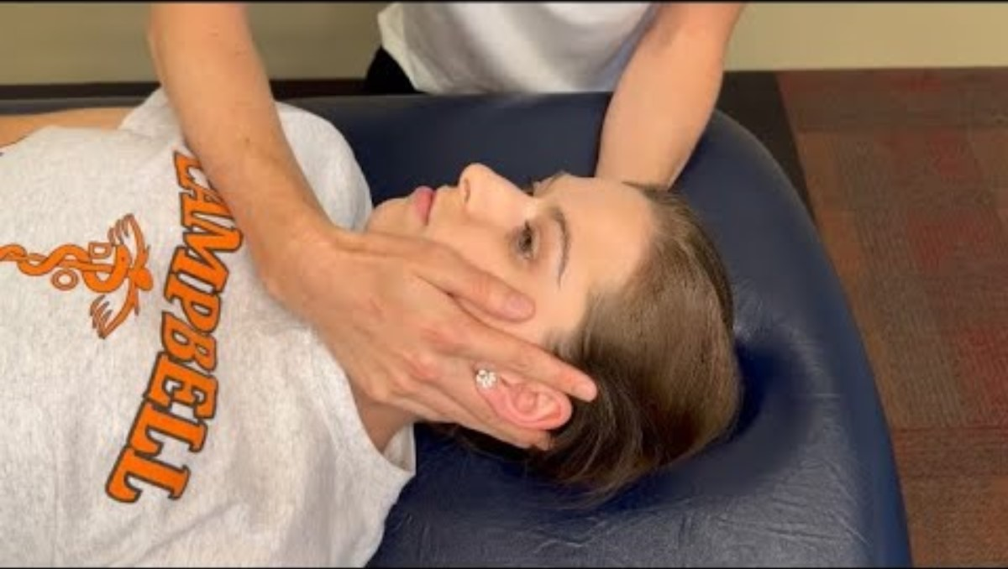
Auricular Drainage Technique
Drains periauricular tissues (e.g., otitis externa, scalp infection)
Pt supine; physician cups auricle between fingers
Gentle circular motions and/or myofascial release
Continue 30–90s until release noted

Slide 25
Auricular Drainage Technique
Purpose To reduce tissue restriction and facilitate lymphatic drainage of the periauricular region and adjacent scalp, often used in cases of otitis media, sinus congestion, or post-upper respiratory infection swelling.
Patient Positioning The patient lies supine with the head turned slightly away from the side being treated.
Physician Positioning and Hand Placement The physician sits beside the patient’s head. The cephalad hand supports the occiput. The caudad hand gently cups the external ear, positioning the auricle between the second and third or third and fourth fingers.
Technique Application Gentle circular motions are applied to mobilize both superficial and deeper fascial layers of the auricular and periauricular tissues. The motion may be bidirectional and can be combined with light effleurage strokes directed toward regional drainage pathways. The physician may also use a direct or indirect myofascial release approach depending on tissue response.
Duration Treatment is continued for 30 to 90 seconds, or until a palpable release or softening of the tissues is perceived.
Reassessment After the technique, re-evaluate tissue mobility and lymphatic drainage in the auricular and surrounding regions. Clinical improvement may be noted as decreased fullness, warmth, or tenderness.

Slide 26
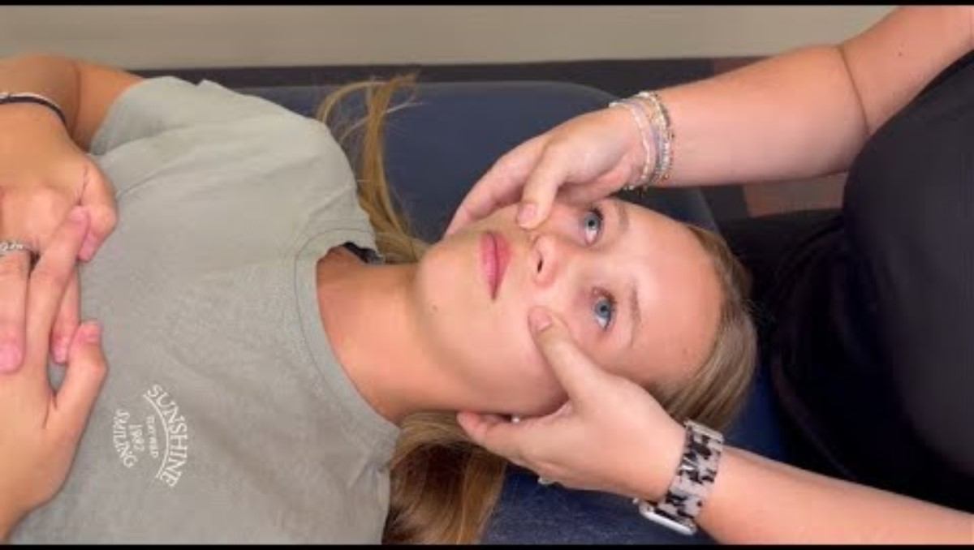
Maxillary Drainage (Effleurage)
Facilitates sinus/venous drainage of maxilla, face
Pt supine; fingers lateral to nose along maxilla
Gentle downward/lateral strokes toward masseter
Repeat until congestion lessens

Slide 27
Maxillary Drainage (Effleurage)
Purpose To facilitate lymphatic and venous drainage of the maxillary and facial regions, reduce sinus congestion, and support improved sinus function.
Patient Positioning The patient lies supine with the head in a neutral midline position.
Physician Positioning and Hand Placement The physician sits at the head of the table. Fingertips or thumbs are placed just lateral to the nose and along the superior border of the maxilla.
Technique Application Gentle effleurage strokes are applied inferiorly, then swept laterally and posteriorly along the anterior maxilla toward the anterior border of the masseter muscle. Movements are light, slow, and superficial, following the natural drainage pathways.
Duration Continue for 30 seconds to 2 minutes, or until tissues soften and local congestion improves.
Reassessment Reevaluate maxillary and periorbital tissue mobility. Clinical improvement may be noted as reduced fullness, decreased tenderness, or easier nasal airflow.

Slide 28
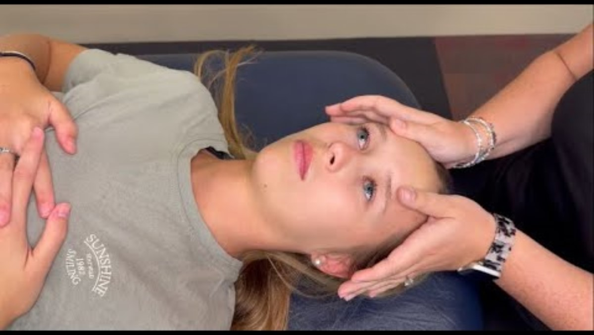
Frontal Temporomandibular Drainage (Effleurage)
Drains frontal, temporal, zygomatic, and mandibular regions
Pt supine; fingers sweep laterally from glabella across face/TMJ, superior ramus or mandible
Light rhythmic strokes
Continue 30s–2 min

Slide 29
Frontal Temporomandibular Drainage (Effleurage)
Purpose To assist lymphatic and venous drainage of the frontal, temporal, zygomatic, and mandibular regions. This technique also indirectly supports sinus drainage.
Patient Positioning The patient lies supine with the head in a neutral position.
Physician Positioning and Hand Placement The physician sits at the head of the table. Fingertips or thumbs contact the glabella, moving laterally across the forehead, over the zygomatic arch, the temporomandibular joint (TMJ), and along the mandibular ramus.
Technique Application Gentle effleurage is applied in a continuous sweeping pattern laterally and posteriorly across the frontal and temporal regions, continuing over the zygomatic arch and TMJ, and finishing along the mandible. The strokes are light, rhythmic, and superficial, supporting physiologic drainage.
Duration Continue for 30 seconds to 2 minutes, or until improved tissue mobility and softening are palpated.
Reassessment Recheck tissue compliance in the frontal, temporal, and mandibular regions. Patients may report decreased pressure, less tenderness, or improved sinus comfort.

Slide 30
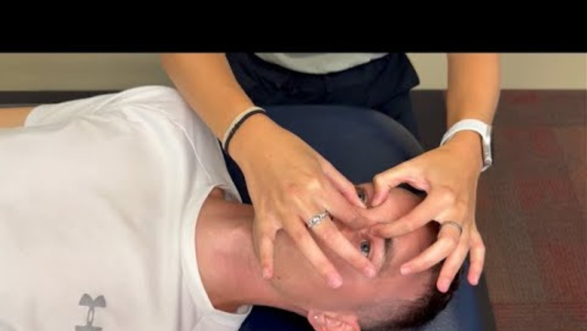
Alternating Nasal Pressure Technique
Mobilizes nasal sutures, aids sinus drainage
Pt supine; cephalad hand on frontal bone, caudad hand on nasal/maxillabones
Gentle alternating diagonal pressure
Continue 30–90s until motion improves

Slide 31
Alternating Nasal Pressure
Purpose To mobilize the frontal–nasal and maxillofrontal sutures and facilitate sinus and nasal drainage, supporting improved lymphatic and venous outflow.
Patient Positioning The patient lies supine with the head in a neutral midline position.
Physician Positioning and Hand Placement The physician sits at the head or side of the table. The cephalad hand’s thumb and index finger contact the frontal bone just above the frontonasal suture. The caudad hand’s thumb and index finger contact the superior area of the nasal bones, inferior to the frontonasal suture.
Technique Application Gentle alternating diagonal pressure is applied so that when the cephalad hand exerts pressure in one direction, the caudad hand provides counterpressure in the opposite direction. The motion is rhythmic and sustained, intending to mobilize the sutural region and enhance sinus drainage.
Duration Treatment lasts 30 to 90 seconds, or until the tissues soften and motion improves.
Reassessment Reevaluate sinus and nasal tissue mobility and drainage. Improvement may be noted as reduced fullness or increased ease of breathing through the nasal passages.

Slide 32
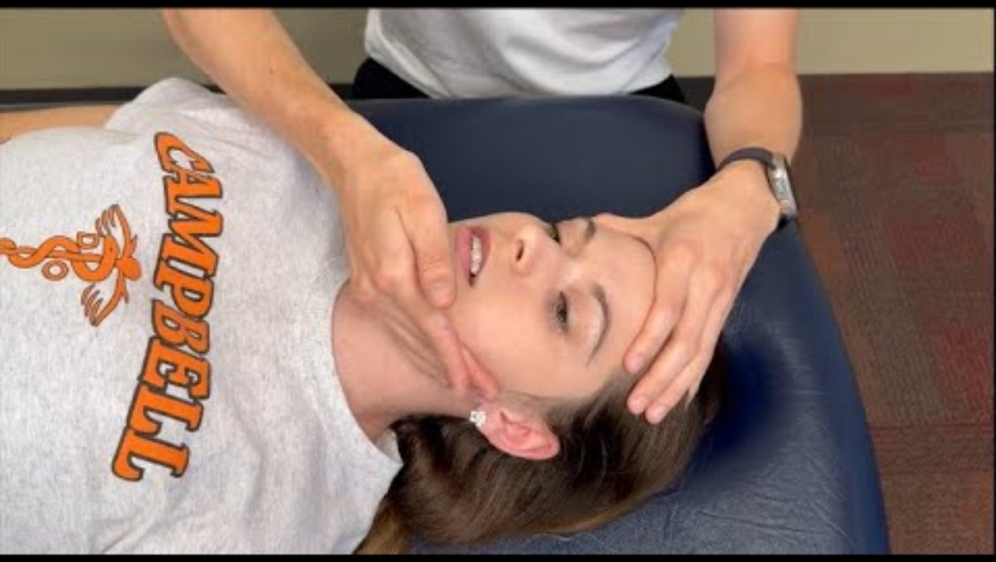
Mandibular Drainage (Galbreath Technique)
Improves drainage of eustachian tube, middle ear
Pt supine, head slightly turned, jaw open/relaxed
Hand contacts mandible, apply rhythmic lateral/anterior springing
Continue 1–2 min

Slide 33
Mandibular Drainage (Galbreath Technique)
Purpose To promote lymphatic and venous drainage of the eustachian tube, middle ear, and surrounding oropharyngeal tissues. This technique is often used in cases of otitis media, sinus congestion, or upper respiratory infection.
Patient Positioning The patient lies supine with the head slightly turned away from the side being treated. The jaw is relaxed and slightly open.
Physician Positioning and Hand Placement The physician sits beside the patient at the head of the table. The cephalad hand supports the head. The caudad hand contacts the mandible with the hypothenar eminence along the body of the mandible and fingertips resting along the ramus.
Technique Application Gentle lateral and slightly anterior pressure is applied to the mandible, moving it away from the midline. The pressure is then released, allowing passive return. This is repeated as a rhythmic springing motion.
Duration Continue for 1 to 2 minutes, or until improved mandibular mobility and softening of surrounding tissues is noted.
Reassessment Reevaluate mandibular motion and middle ear or sinus congestion. Patients may report decreased ear fullness, less discomfort, or improved ability to equalize ear pressure.

Slide 34
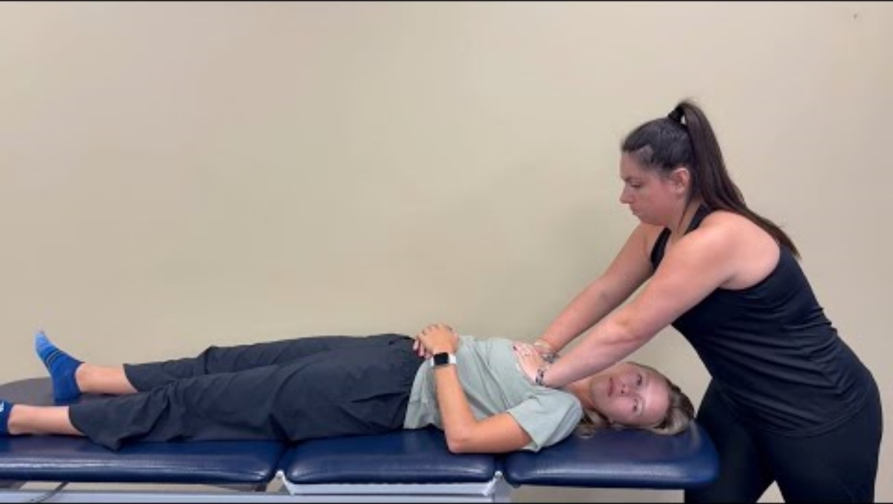
Thoracic Pump
Mobilizes lymph from lungs, chest, entire body
Pt supine; hands inferior to clavicles; position varies
Rhythmic compressions with respiration; optional recoil at inhalation
30s–2 min

Slide 35
Thoracic Pump
Purpose To mobilize lymph from the lungs, chest wall, and upper extremities; to enhance venous return; and to support immune function.
Patient Positioning The patient lies supine with the head turned to one side for comfort.
Physician Positioning and Hand Placement The physician stands at the head of the table, placing both hands inferior to the clavicles on the anterior chest wall.
Technique Application Gentle rhythmic compressions are applied to the chest wall in coordination with the patient’s respiration. Pressure is exerted during exhalation and released during inhalation. Frequency is typically 100–120 cycles per minute. The recoil variation includes a rapid release of pressure at the end of inhalation to create a brief negative intrathoracic pressure and augment lymphatic return.
Duration Apply for 30 seconds to 2 minutes, or longer if tolerated.
Reassessment Reevaluate chest wall excursion, ease of breathing, and tissue compliance of the thorax.

Slide 36
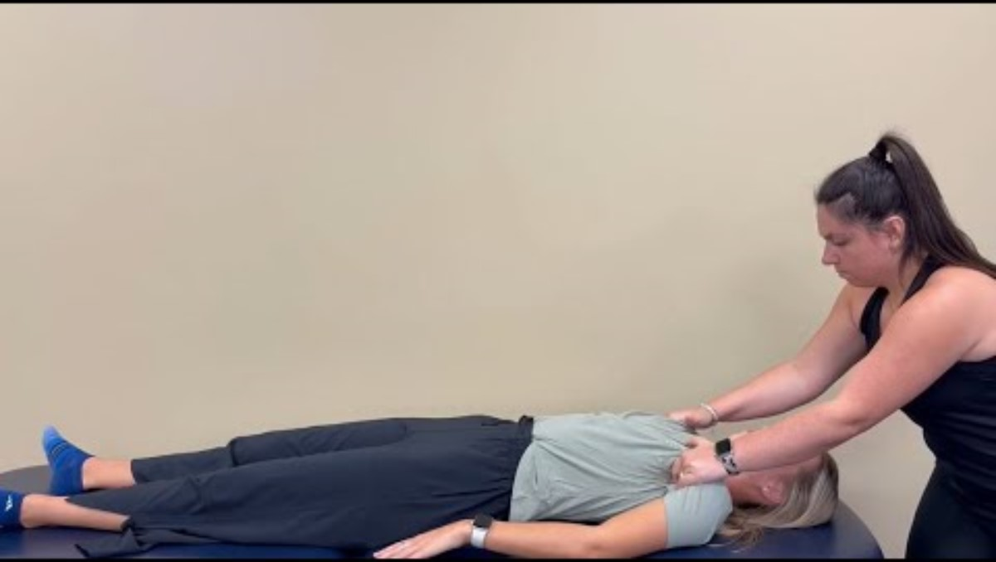
Bilateral Pectoral Traction
Stretches pectoral fascia, enhances thoracic mobility/lymph return
Pt supine; physician fingers under axillae
Gentle superior/anterior traction, coordinated with respiration
Repeat for 5–7 deep breaths

Slide 37
Bilateral Pectoral Traction
Purpose To stretch the pectoral region and upper thoracic fascia, enhancing lymphatic return and thoracic mobility.
Patient Positioning The patient lies supine.
Physician Positioning and Hand Placement The physician sits or stands at the head of the table and places the fingers or hands under the patient’s axillary folds bilaterally.
Technique Application The physician applies a gentle superior and anterior traction by leaning back while holding the axillary folds. Traction is coordinated with the patient’s respiration, following inhalation and resisting exhalation for several cycles.
Duration Continue for 5 to 7 deep breaths, or until tissue softening and improved fascial mobility are palpated.
Reassessment Recheck thoracic fascial tone, respiratory excursion, and regional lymphatic drainage.

Slide 38
Application Exercise 1 - Otitis Media
Work in groups of four.
List the one technique from today that most directly addresses otitis media.
List five techniques from today in a logical order for treating otitis media. (excluding thoracic pump).
List all the techniques from today that are unlikely to benefit in treating otitis media.
Practice performing the selected sequence in pairs.

Slide 39
Application Exercise 2 – Frontal Sinusitis
Work in groups of four.
List the two techniques from today that most directly address frontal sinus drainage.
List five head and neck techniques from today in a logical order for treating frontal sinusitis.
List all the techniques from today that are unlikely to be beneficial in treating frontal sinusitis.
Practice performing the selected sequence.

Slide 40
Quiz Questions

Slide 41
End of Session

