Slide 1
OMED 579
SDL: Recap of pertinent information for Neuro aka, last season on medical school…
Dr. Maxx Toler
Levine Hall 412
toler@campbell.edu

Slide 2
> Lecturers in the neuro course will assume you know things from Blocks 1-3!
Medical school is inherently cumulative; this probably doesn’t come as a surprise for any of you, but some things bear repeating! There is a knowledge base that your faculty will assume you have going into lectures (especially ones like pharmacology and pathology). Most faculty will refresh and reteach the most important bits, so don’t be too worried (e.g. I will review your important reflex and strength testing sites), but there just isn’t enough time to stop down and review everything.
To facilitate a strong start in the Neuroscience course, I’ve put together a brief recap document containing some of the most essential information from lectures you’ve already had. Yes, the PowerPoint deck has 40 informational slides, but it is a recap of 8 medical school lectures!
This review is intended to refresh, not to teach. If you feel very lost or a complete lack of recognition looking at any part of this document, I strongly suggest returning to the source material and doing a deeper review. A good target is to make sure you have refamiliarized yourself with these points by the end of Week 1 at the latest.
To be very clear, this is not a lecture and there are no points that will be assessed directly from this document! It is being provided to you to ensure that you’re as ready as possible for Block 4.

Slide 3
OMED 530 (Block 1, Anatomy)
A14: Nervous Tissue Histology

Slide 4
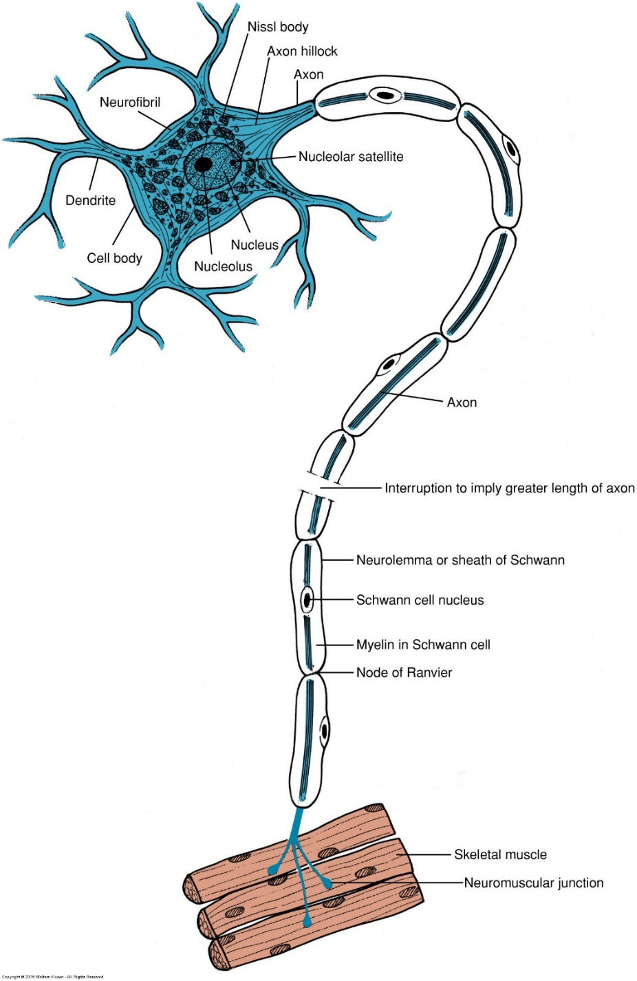
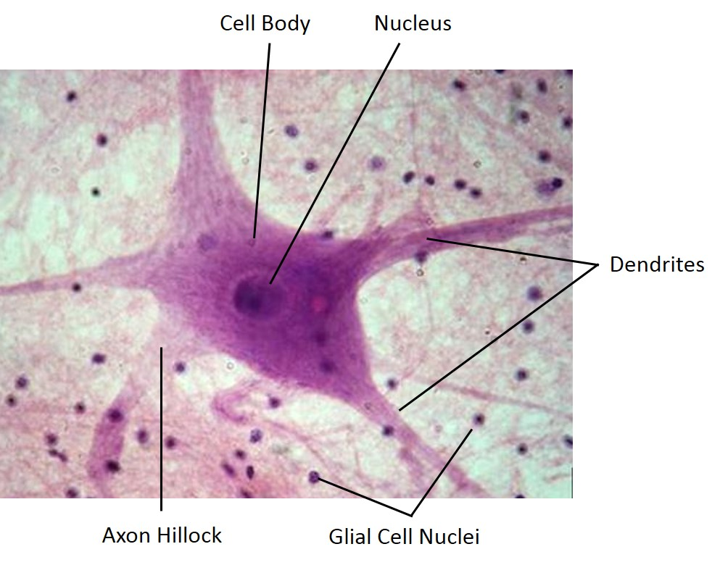
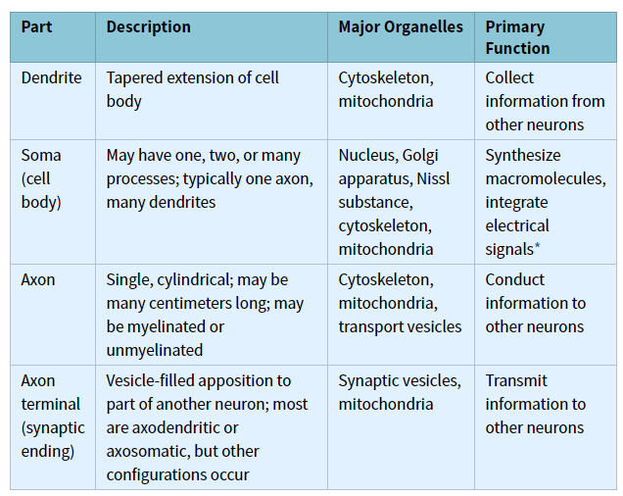
Parts of a Neuron
Nissl substance (Nissl bodies): variously-sized clumps of ribosomes in rough endoplasmic reticulum and free ribosomes

Slide 5
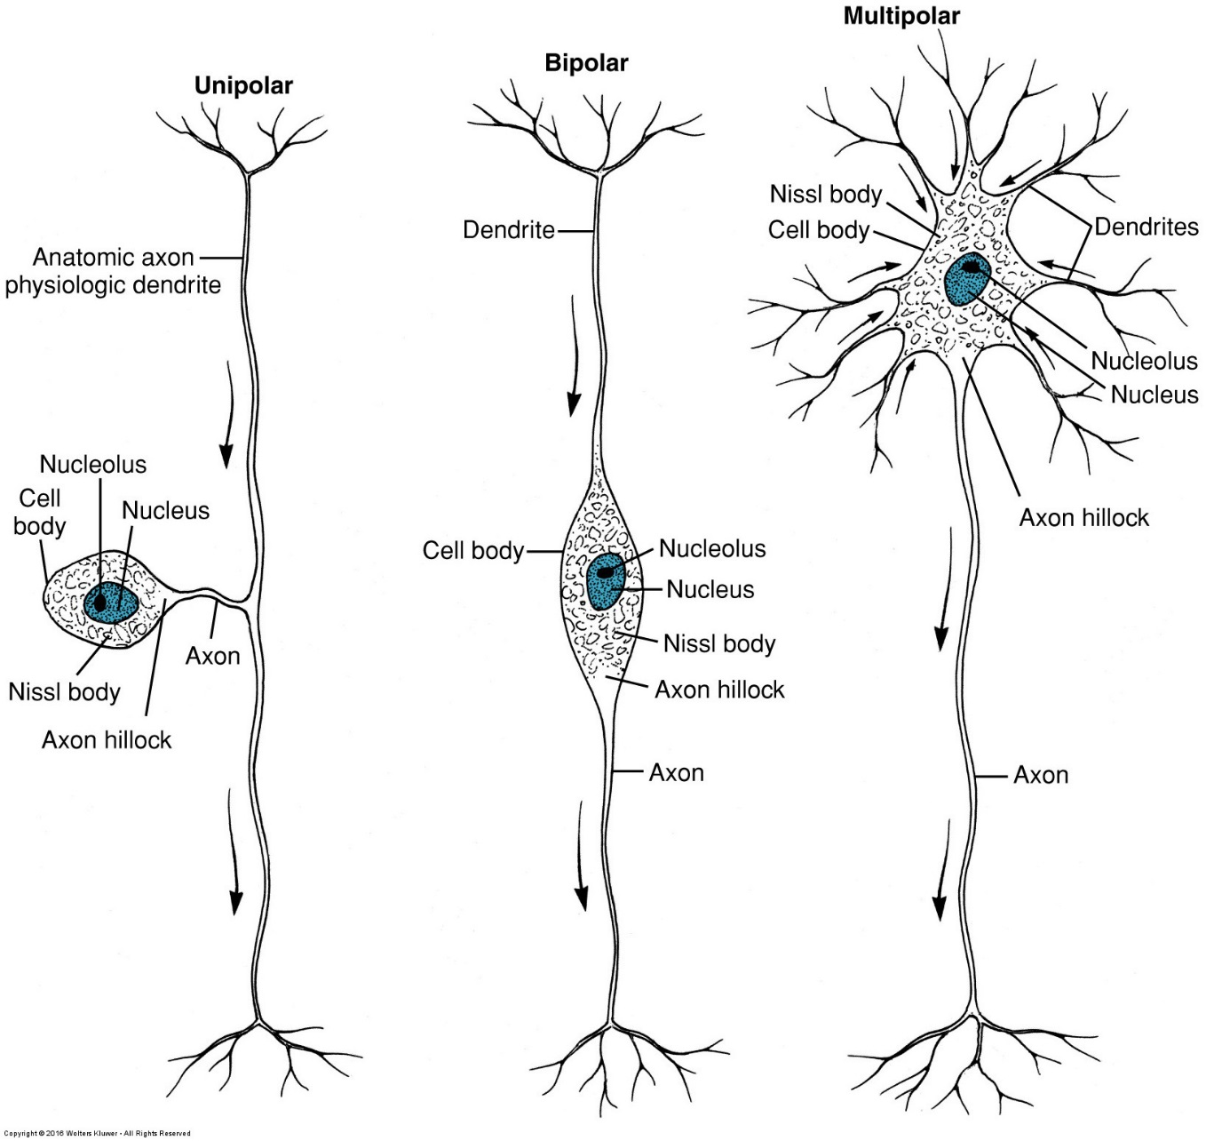
Neuron classifications by # of protoplasmic processes
Pseudounipolar (unipolar)
Single process is an axon
Cell bodies located almost exclusively in sensory ganglia (spinal nerves and cranial nerves)
Bipolar
1 axon, 1 dendrite
Limited to visual, olfactory, auditory, and vestibular pathways
Multipolar
1 axon
Commonly 2-12 dendrites
All other neurons (all motor neurons are multipolar)

Slide 6
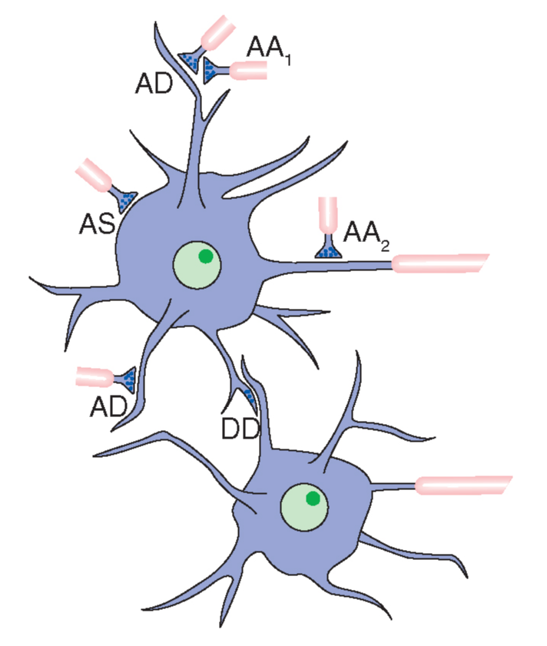
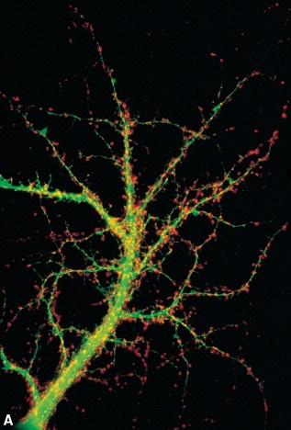
Synapses mediate information transfer between neurons
Information is conveyed between neurons at contact sites called synapses which vary in morphology but stick to common elements:
Presynaptic Element
-Normally an enlargement of a distal axonal branch
-Contains vesicles holding neurotransmitter molecules
-Responsible for neurotransmitter release
Postsynaptic Element
-Can be in a variety of locations (see figure to right)
-Has embedded proteins that bind neurotransmitter and create an electrical impulse on the postsynaptic neuron
Synaptic Cleft
-A 10-20 nm gap between the pre- and postsynaptic elements.
-Neurotransmitter diffuses here
The number of synapses on a single neuron can range from a few dozen on a small neuron to hundreds of thousands (Purkinje cells)
Estimated 125 trillion synapses in the cerebral cortex alone!
Synapses can be formed by any part of a neuron and contact any part of another neuron. Axodendritic synapses are the most common type.
Synapses (red & yellow) on a dendrite of a hippocampal neuron.

Slide 7
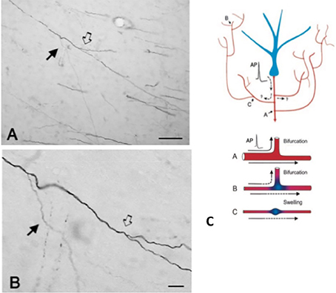
> Axon Collaterals
Axons can branch (Figures A, B) and a single neuron can send messages to multiple locations simultaneously.
Action potentials spread in a lossless fashion down collaterals.

Slide 8
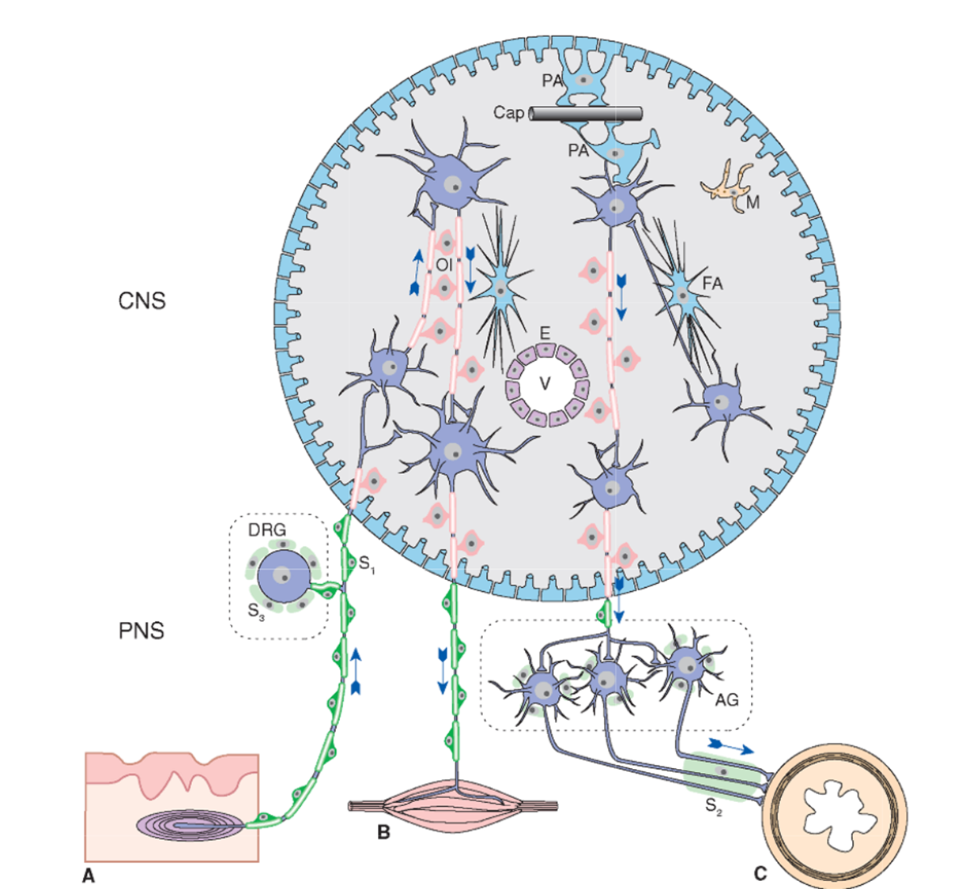
Glia: Refresher
PNS Glia:
Schwann cells (S₁₋₃): each myelinate and/or protect 1 section of 1 axons in PNS, provide route for axonal regrowth
CNS Glia (forms neuropil):
Protoplasmic astrocytes (PA): form external surface of CNS, control permeability of blood vessels in CNS
Fibrous astrocytes (FA): located in white matter, form scar tissue in response to injury
Oligodendrocytes (Ol): myelinated wrappings of axons in CNS, 1 cell can provide wrappings for multiple axons.
Microglia (M): macrophages of CNS
Notes:
PNS
Protect and help repair PNS neurons
Provide myelination
CNS
Non-neuronal tissue.
Glia are NOT connective tissue – the CNS contains no connective tissue.
Outnumber neurons ≈ 10:1; therefore ≈ 900 billion glial cells in CNS.
40% of CNS volume.
Supports and provides nutrition to neurons.
Maintains ionic milieu.
Constitutes much of the neuropil between neurons.
Provides myelination

Slide 9
OMED 540 (Block 2, Physiology)
Lecture 1

Slide 10
> Functional Categories of Innervation
 | SOMATIC | VISCERAL | SPECIAL
SENSORY (Afferent) | Somatic Sensory Discrete sensations from skin, muscles, and joints | Visceral Sensory Diffuse sensations from internal organs and chemical sensation (especially from arteries) | Special Sensory Smell, Sight, Hearing, Vestibular sense -only cranial nn.-
MOTOR (Efferent) | Somatic Motor Voluntary control over skeletal muscle | Autonomic N.S. Involuntary control over smooth muscle, cardiac muscle, and glandular tissues Has 3 Functional Subdivisions | X
Sympathetic (SNS)
Parasympathetic (PSNS)
Enteric (ENS)

Slide 11
> Functional Categories of Innervation: neuron type overlay
 | SOMATIC | VISCERAL | SPECIAL
SENSORY (Afferent) | Somatic Sensory Discrete sensations from skin, muscles, and joints | Visceral Sensory Diffuse sensations from internal organs and chemical sensation (especially from arteries) | Special Sensory Smell, Sight, Hearing, Vestibular sense -only cranial nn.-
MOTOR (Efferent) | Somatic Motor Voluntary control over skeletal muscle | Autonomic N.S. Involuntary control over smooth muscle, cardiac muscle, and glandular tissues Has 3 Functional Subdivisions | X
PSEUDOUNIPOLAR NEURONS
Cell bodies in sensory ganglia
BIPOLAR NEURONS
Cell bodies in sensory ganglia/ retina
MULTIPOLAR NEURONS
Cell bodies inside CNS or in autonomic ganglia
Sympathetic (SNS)
Parasympathetic (PSNS)
Enteric (ENS)

Slide 12
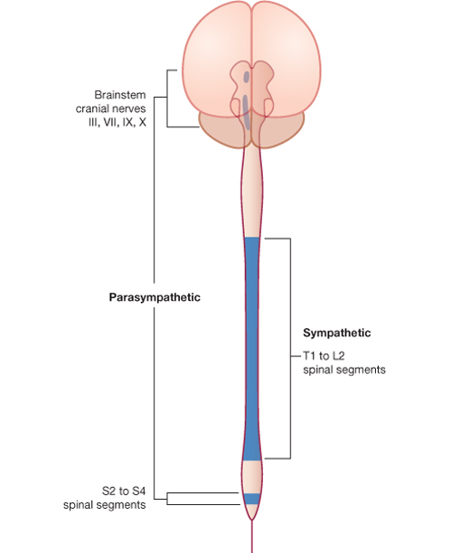
> The Autonomic Nervous System has two Divisions that arise from specific regions of the CNS
PARASYMPATHETIC DIVISION
“rest and digest”
Craniosacral system
Arises from:
  Brainstem nuclei (4 Cranial nerves: III, VII, IX, X)
  Neurons in lateral spinal cord grey matter from S2-S4
Generally slows body functions, heart rate, breathing
Stimulates digestive and urinary systems by opening sphincters and dilating vasculature to GI tract
SYMPATHETIC DIVISION
Arouses body for action; “fight or flight”
Thoracolumbar system
Neurons in lateral spinal cord grey matter distributed from segments T1 to L2
Accelerate heart and respiratory rate, inhibit digestive and urinary system by constricting blood vessels to the GI system and closing sphincters, increase sweating, increase blood flow to CNS and muscle

Slide 13
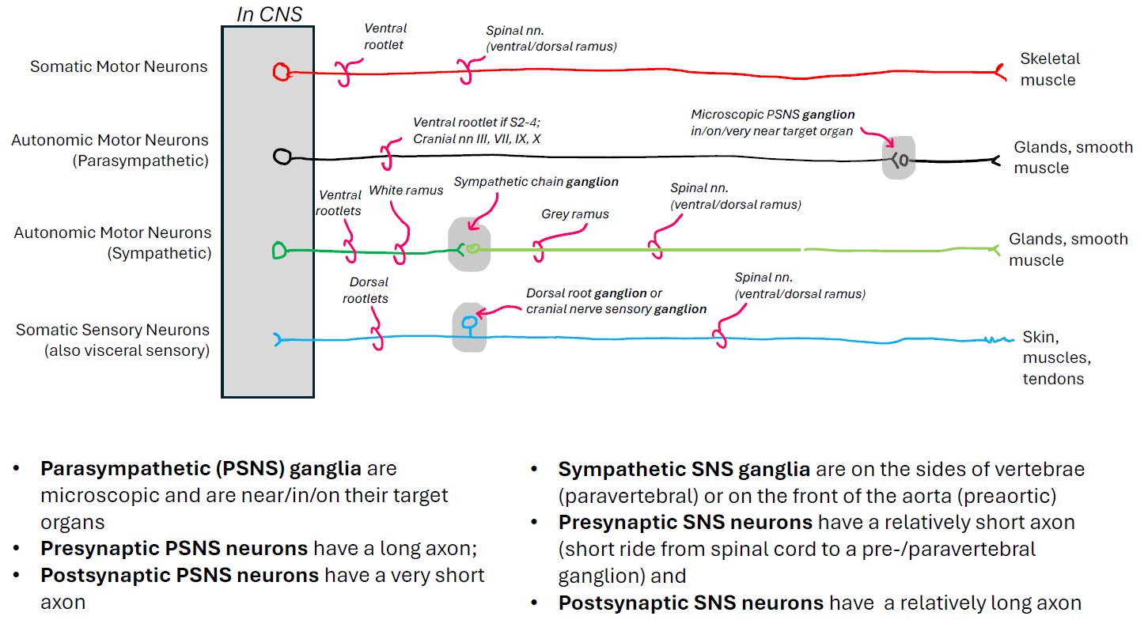
> Summary of Peripheral Nervous System

Slide 14
OMED 590 (Block 3, Anatomy)
A1: Spinal Cord, Dermomyotome, Cutaneous Nerves

Slide 15
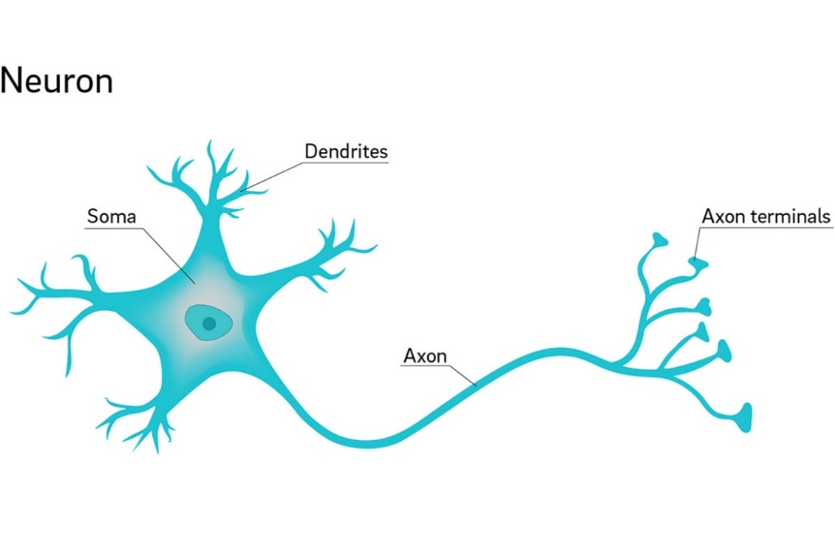
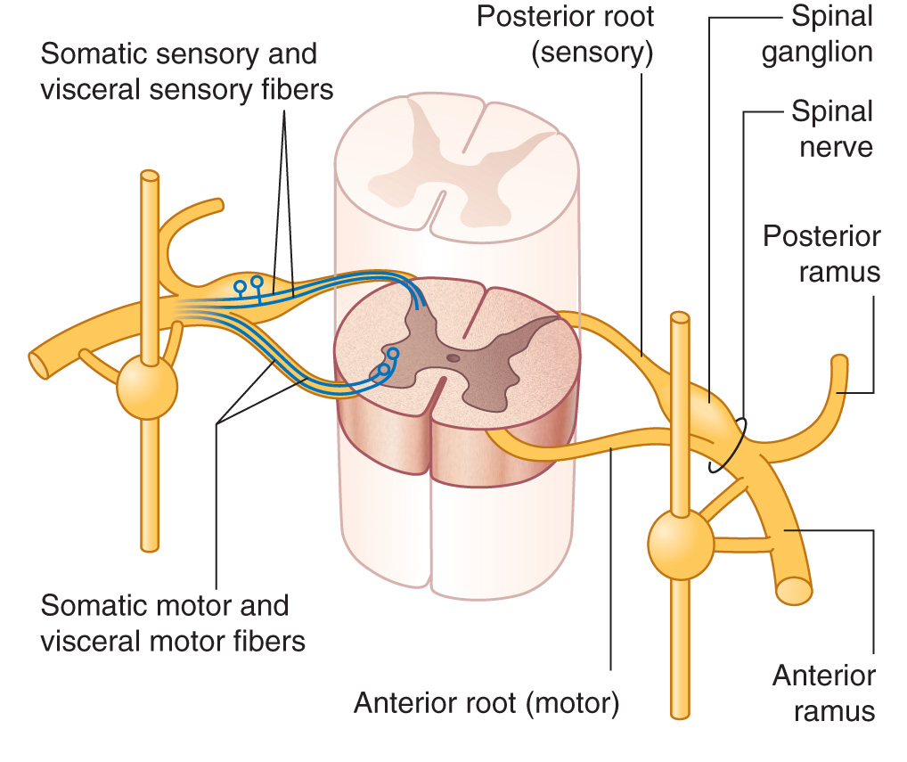
Neuronal cell bodies are located in ganglia and dorsal and ventral horns
Dorsal root
Dorsal horn
Dorsal
ramus
Neuronal cells have different functions, including:
Somatic sensory
Somatic motor
The spinal (dorsal root) ganglion contains cell bodies for afferent (going towards CNS) sensory nerves
Ventral horn
Ventral root
Ventral ramus
Notes:
https://www.researchgate.net/figure/Cross-section-of-4-of-the-spinal-cords-31-segments-Source-Pearson-Education-Inc-C-2011_fig1_326246333

Slide 16
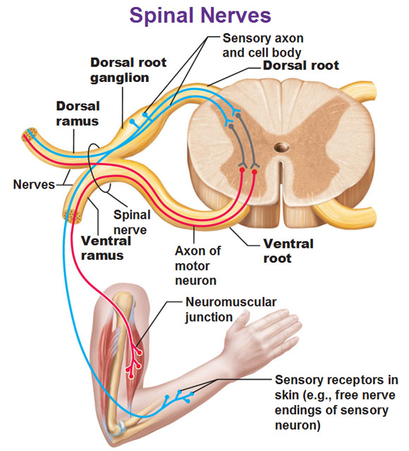
Spinal Nerve
Dorsal (Posterior) Gray Horn & Dorsal Roots
→ Sensory: Somatic & Visceral
Ventral (Anterior) Gray Horn & Ventral Roots
→ Motor: Somatic & Visceral
Spinal Nerve = Sensory & Motor (Mixed)
Dorsal & Ventral Primary Rami = Mixed
Notes:
C1 dorsal ramus = suboccipital nerve

Slide 17
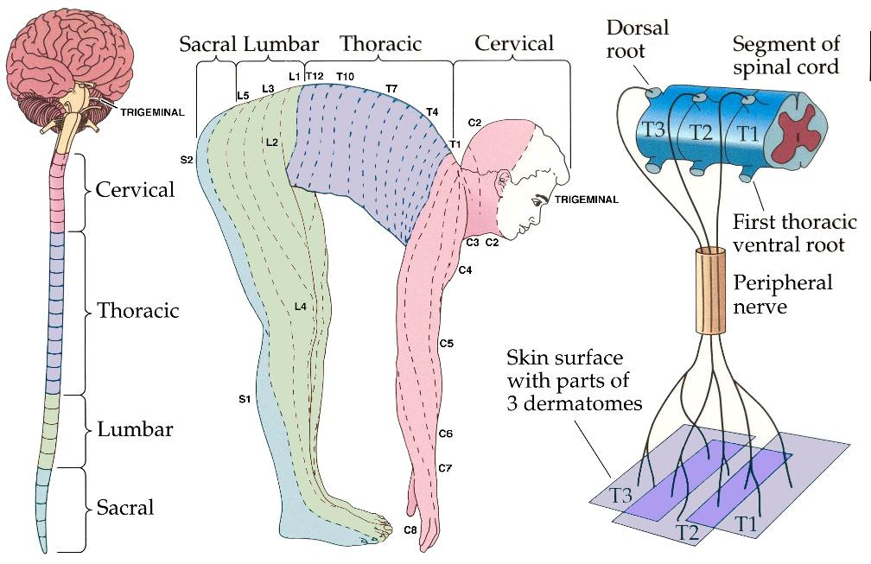
> Dermatome
Def: strip of skin whose sensory information travels back to a single spinal cord segment
Peripheral nerves to the body wall do not cross the midline. Dermatomes are divided into left and right regions by the midsagittal plane and travel back on the left and right spinal nerves respectively.
Example: The T4 dermatome includes the nipple line. The left nipple is innervated by the left T4 spinal nerve and the right nipple is innervated by the right T4 spinal nerve.

Slide 18
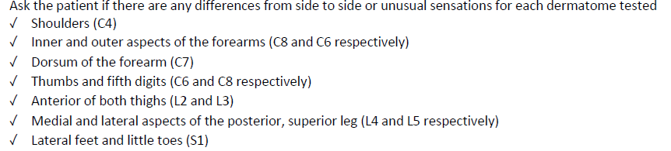
> Dermatomes you are expected to know, according to Clinical Skills!

Slide 19
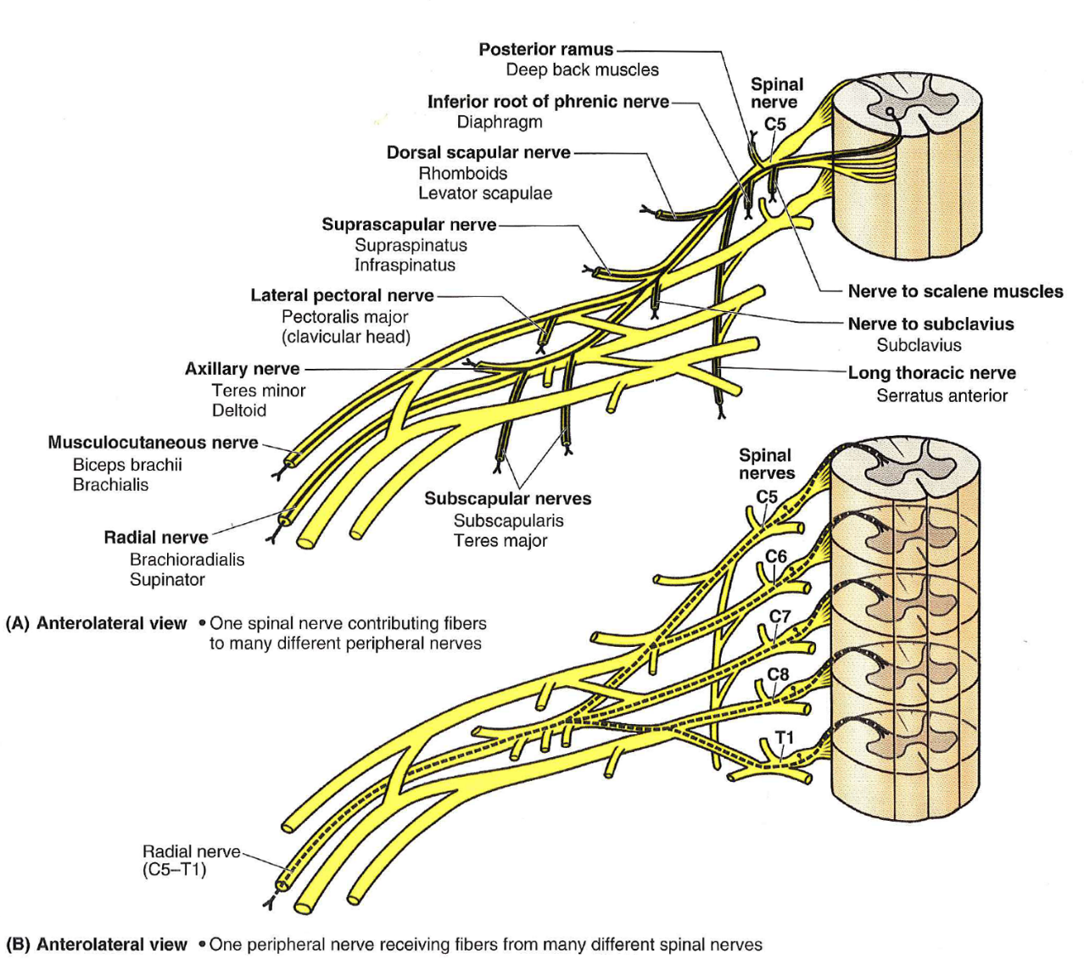
> Myotome
Defined: the group of skeletal muscle fibers that receive their motor innervation from a single spinal cord segment
Figure A in the figure to the right highlights the C5 myotome.
There are usually a 1-3 crucial myotomes for a gross muscle. Damage to the motor neurons of those myotomes will cause weakness or flaccid paralysis in that muscle.

Slide 20
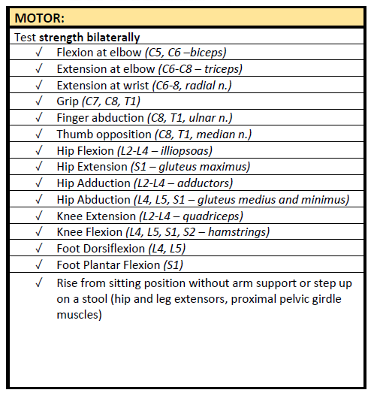
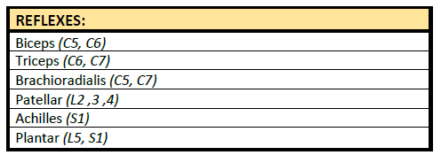
> Myotomes you are expected to know, according to Clinical Skills!
Reflex and strength testing rely on myotomes.

Slide 21
OMED 540 (Block 2, Physiology)
Lecture 2-3: Electrophysiology

Slide 22
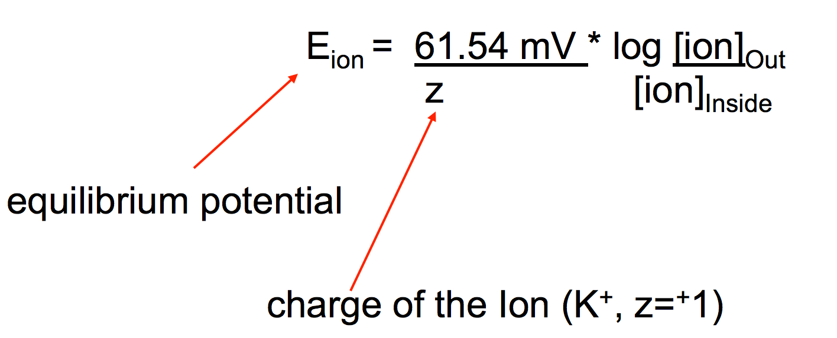
Lecture Recap
Membrane potential is the charge difference across cell membrane generated by diffusion of ions. So membrane potential is diffusion potential which needs two conditions to establish: ion’s membrane permeability and chemical gradient.
Equilibrium potential is an individual ion’s diffusion potential at which there is no net diffusion of that ion across cell membrane.
The equilibrium potential is reached when the two opposing driving forces (chemical and electrical gradients) for ion diffusion are equal. Individual ion’s equilibrium potential is calculated by Nernst equation.
C_{i}
E = + 61 log
Z
C_{e}

Slide 23
Lecture Recap
Resting membrane potential is the diffusion potential generated by the diffusion of multiple ions across cell membrane when cells are not stimulated. The ion with highest membrane permeability contributes the most to resting membrane potential.
Because at resting state, K⁺ ions have the highest membrane permeability, K⁺ efflux is the primary determinant of resting membrane potential.
Resting membrane potential is very close to K⁺ equilibrium potential but not equal because of slight Na⁺ influx and electrogenic action of membrane Na⁺-K⁺ ATPase.
Changes in K⁺ permeability and/or K⁺ chemical gradient affect resting membrane potential
↑ K⁺ permeability → more negative membrane potential
↓ K⁺ permeability → less negative membrane potential
↑ plasma [K⁺] → less negative membrane potential
↓ plasma [K⁺] → more negative membrane potential

Slide 24
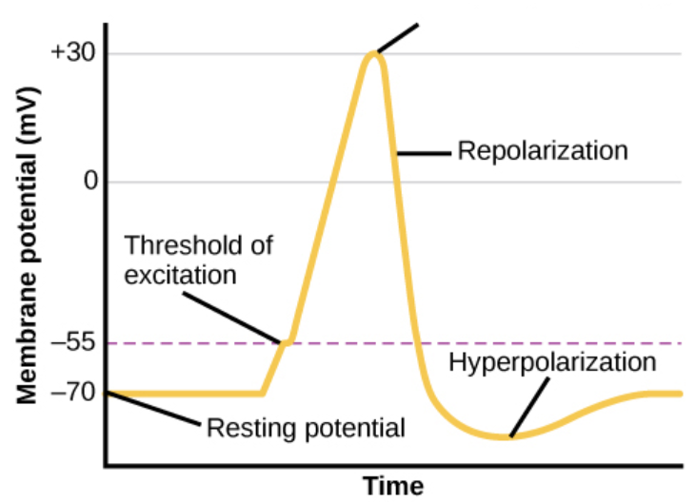
Lecture Recap
Action Potential has depolarization, repolarization and hyperpolarization phases, each with different ionic bases
Depolarization:
Begins when threshold potential is reached
Opening of voltage-gated Na⁺ channels (activation gate opens) → rapid Na⁺ influx (inward current) → membrane potential becomes less negative or even positive
Repolarization:
Closure of Na⁺ channels (closure of inactivation gate) → Na⁺ influx or inward current stops
Opening of voltage-gated K⁺ channels → K⁺ efflux or outward current begins → membrane potential returns to polarized state
Hyperpolarization:
Continuous high K⁺ permeability and K⁺ efflux → membrane potential is more negative than resting potential
Overshoot
Depolarization

Slide 25
Lecture Recap
Blockage of voltage-gated Na⁺ channels by various blockers including Tetrodotoxin (TTX), Saxitoxin (STX) and Local anesthetics (lidocaine, procaine) inhibits action potential generation and conduction, reducing the excitability of neurons and skeletal muscle fibers.
Refractory periods of action potential
Absolute refractory period:
  Period of an action potential during which a second action potential cannot be fired regardless of stimulus’ strength
  Insufficient Na⁺ channels available during rising phase; inability of Na⁺ channels to reopen due to closure of inactivation gate during falling phase
Relative refractory period:
  Period of an action potential during which a second action potential can be fired with a stronger than normal stimulus
  High K⁺ conductance opposes membrane depolarization

Slide 26
Lecture Recap
Accommodation: when excitable cells are persistently depolarized, the threshold potential may be reached without triggering an action potential.
Accommodation is largely due to the closure of inactivation gate of Na⁺ channels by persistent membrane depolarization. Accommodation reduces the excitability of neurons and skeletal muscle.
Hyperkalemia causes sustained membrane depolarization, which closes the inactivation gate of Na⁺ channels, leading to muscle weakness and even paralysis.

Slide 27
Lecture Recap
Action potential is propagated by the spread of local current along the nerve fibers or muscle cell membrane. It is self-regenerated and has none-or-all property.
Action potential conduction velocity in nerve fibers is mainly affected by the diameter and the types of nerve fibers (myelinated or unmyelinated). Myelination forces action potential to conduct in a saltatory manner and greatly enhances the conduction velocity.
Demyelination of nerve fibers compromises sensory and motor function by affecting action potential conduction:
    Slow conduction of action potential
    Unreliable conduction of action potential
    Total blockage of conduction
Multiple sclerosis: most common CNS demyelination disorder due to production of antibodies against myelin or oligodendrocytes; is characterized by abnormal sensory and motor function, decreased visual acuity (optic neuritis), double vision
Guillain-Barré syndrome: most common peripheral nerve demyelination disorder due to inflammation and often occurs after a respiratory or gastrointestinal viral infection; is characterized by abnormal sensation and motor function

Slide 28
OMED 540 (Block 2, Physiology)
Lecture 4: ANS Physiology

Slide 29
Autonomic Innervation of the Organ Systems—important table
Organ | Sympathetic Action Receptor | Parasympathetic Action Receptor
Heart SA node, heart rate AV nodal conduction Cardiac contractility | ↑ β₁ ↑ β₁ ↑ β₁ | ↓ M₂ ↓ M₂ ↓ (atrial only) M₂
Vascular Smooth Muscle Skin; splanchnic; skeletal muscle Skeletal muscle | Contraction (vasoconstriction) α₁ Relaxation (vasodilation) β₂ | None None
Vascular endothelium |  | Vasodilation (via NO) M₃
Bronchioles | Dilation β₂ | Constriction M₃
Gastrointestinal Tract Smooth muscle, walls Smooth muscle, sphincters Saliva secretion Gastric acid secretion Pancreatic secretion | Relaxation α₂, β₂ Contraction α₁ ↑ β₁ | Contraction M₃ Relaxation M₃ ↑ M₃ ↑ M₃ ↑ M_{3,} M₁
Male Genitalia | Ejaculation α₁ | Erection M₃

Slide 30
Autonomic Innervation of the Organ Systems
Organ | Sympathetic Action Receptor | Parasympathetic Action Receptor
Bladder Wall, detrusor muscle Sphincter | Relaxation β₂ Contraction α₁ | Contraction M₃ Relaxation M₃
Eye Radial muscle, iris Circular sphincter muscle, iris Ciliary muscle | Pupil dilation α₁ (mydriasis) None Relaxation (far vision) β₂ | None Pupil constriction M₃ (miosis) Contraction (near vision) M₃
Skin Sweat glands Pilomotor muscle (goose bumps) | ↑ M₃ Contraction α₁ | None None
Lacrimal Glands | None | Secretion M₃
Liver | Gluconeogenesis; β₂ glycogenolysis | None
Adipose tissue | Lipolysis β_{1,} β₃ | None
Kidney | Renin secretion β₁ | None

Slide 31
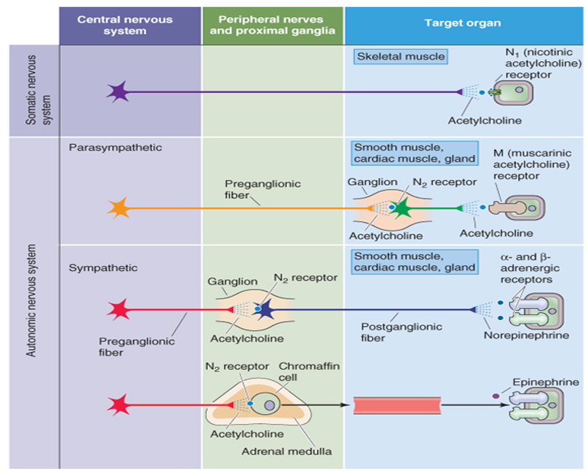
Lecture Recap
Autonomic nerve system (ANS) neurotransmission has two synapses: autonomic ganglia and neuroeffector junction.
Neurotransmission at autonomic ganglia is cholinergic for both SNS and PSNS, with preganglionic nerve fibers releasing acetylcholine (Ach) and postganglionic neurons expressing nicotinic type Ach receptors.
Neurotransmission at neuroeffector junction is different for SNS and PSNS.
Notes:
SNS: sympathetic nerve system; PSNS: parasympathetic nerve system

Slide 32
Lecture Recap
SNS: most postganglionic fibers release NE which binds to adrenergic receptors in target tissues
α1 receptors
  Activation engages Gq protein→↑ PLC →↑ IP₃, DAG, Ca²⁺→ smooth muscle contraction
  α1 activation in vascular smooth muscle → vasoconstriction (increase in blood pressure)
α2 receptors
  Activation engages G_{i} protein → inhibition of adenylyl cyclase/cAMP pathway →inhibitory effects
  α2 receptor activation in CNS reduces sympathetic output → decrease of blood pressure
β1 receptors
  Expressed mainly in heart: SA node, AV node, ventricular muscle
  Activation engages Gs protein → stimulation of adenylyl cyclase/cAMP pathway → ↑ heart rate, contractility and action potential conduction velocity
β2 receptors
  Expressed in vascular smooth muscle of skeletal muscle, bronchioles, wall of GI tract and bladder
  Activation engages Gs protein → stimulation of adenylyl cyclase/cAMP pathway → dilation of blood vessels and bronchioles, relaxation of GI and bladder wall

Slide 33
Lecture Recap
PSNS: Most postganglionic fibers release Ach which acts on muscarinic receptors in target tissues. There are five types of muscarinic receptors with M₂ and M₃ most important
M2 receptor
  Expressed in SA and AV nodes in the heart
  Activation engages Gi protein → opening of G protein-coupled inward-rectifier K⁺ channels → increased K⁺ efflux → membrane hyperpolarization → reduced heart rate and action potential conduction velocity
M3 receptors
  Expressed in smooth muscle cells (e.g. GI, bladder; not in vasculature) and secretory glands
  Activation engages Gq protein → activation of PLC → increased IP3/Ca²⁺ and DAG → smooth muscle contraction and increased gland secretion

Slide 34
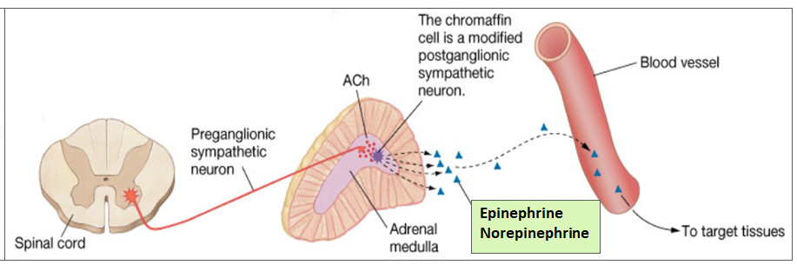
Lecture Recap
Adrenal medulla: a special sympathetic ganglion
Innervated by preganglionic sympathetic nerve which synapses with chromaffin cells (analogous to sympathetic postganglionic neurons)
Chromaffin cells release epinephrine (Epi) and norepinephrine (NE) into blood, acting on all the tissues with adrenergic receptor expression
Epi and NE released from adrenal medulla have more extensive and long-lasting actions than NE released by sympathetic postganglionic neurons
Pheochromocytoma: most cases are chromaffin cells tumor in adrenal medulla → excessive Epi and NE production. Patients have presentations of overt sympathetic activation: headache, tachycardia, palpitations, hypertension, diaphoresis; elevated blood/urine levels of catecholamine metabolites: metanephrine, VMA

Slide 35
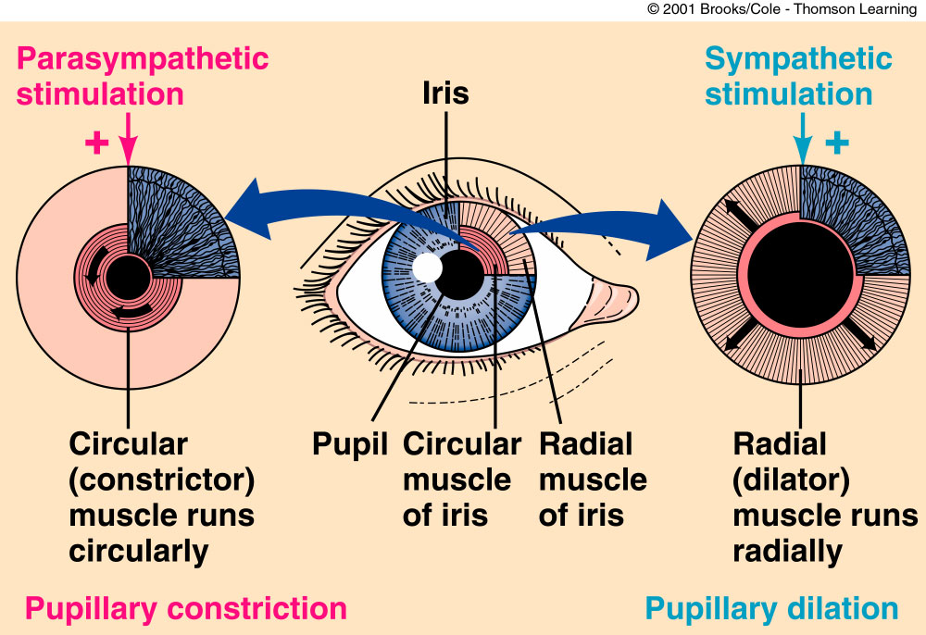
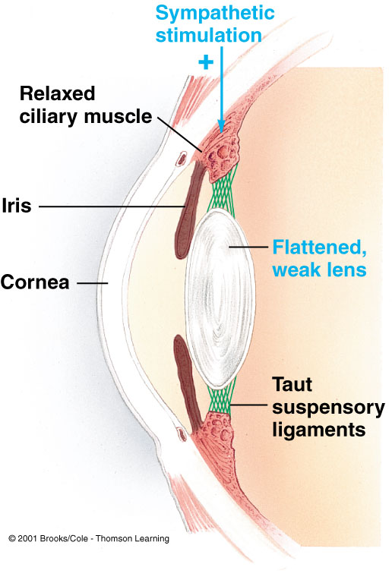
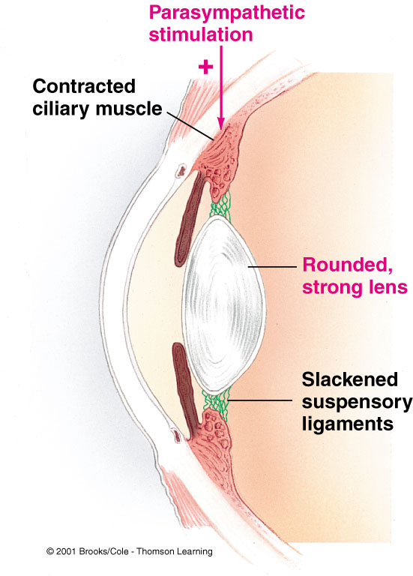
Lecture Recap
ANS innervation of the eyes -- ANS innervates eye muscles that control pupil size and the shape of the lens
Adrenergic stimulation:
Mydriasis (contraction of pupillary radial muscle which expresses α₁ receptors)
Accommodation for far vision (ciliary muscle relaxation due to activation of β₂ receptors → more flattened lens)
Muscarinic stimulation:
Miosis (contraction of pupillary circular muscle which expresses M₃ receptors)
Accommodation for near vision (ciliary muscle contraction due to activation of M₃ receptors→ more rounded lens)
Muscarinic antagonism:
Mydriasis (unopposed SNS action in eye muscles controlling pupil size)
Cycloplegia (inability to focus on near objects due to paralysis of ciliary muscle)

Slide 36
Lecture Recap
ANS innervation of the heart
SNS stimulation: ↑ overall heart activity via activating β₁ receptors
  Increased heart rate, velocity of AV action potential conduction, contractility
PSNS stimulation: ↓ overall heart activity via activating M₂ receptors
  Decreased heart rate, velocity of AV action potential conduction
ANS innervation of the systemic blood vessels
SNS stimulation: activation of receptors on vascular smooth muscle
  constricts most systemic blood vessels via α₁ receptor→ ↑ total peripheral resistance/BP
  dilates blood vessels in skeletal muscle during exercise via β₂ receptors→ ↑blood flow to muscle
PSNS stimulation: activation of M₃ receptors on vascular endothelium → NO → vasodilation
ANS innervation of bronchiole
SNS stimulation: bronchial dilation via activating β₂ receptors in smooth muscle
PSNS stimulation: bronchial constriction via activating M₃ receptors in smooth muscle
Notes:
PSNS only innervates blood vessels in a few limited organs such as male genital erectile tissue, GI system and salivary glands. PSNS effect on vasculature in these organs are largely due to the release of NO by endothelial cells, and maybe some other vasoactive substances such as bradykinin and substance P.

Slide 37
Lecture Recap
ANS innervation of the GI system
PSNS stimulation:↑ overall GI activity via activating M₃ receptors
  Muscle contraction in GI wall; Relaxation of sphincters; Secretion of GI glands
SNS stimulation: ↓GI activity via activating various receptors (α₂, β_{2,} α₁)
  Relaxation of GI wall via activating α₂, β_{2;} contraction of sphincter via activating α₁ receptors
ANS innervation of bladder
PSNS stimulation:↑ urination via activating M₃ receptors
  Contraction of bladder wall, detrusor muscle; Relaxation of Sphincter
SNS stimulation: ↓ urination
  Relaxation of bladder wall and detrusor muscle via activating β₂ receptors
  Contraction of sphincter via activating α₁ receptors

Slide 38
OMED 540 (Block 2, Physiology)
Lecture 5-6: Synaptic Transmission

Slide 39
Lecture Recap
Two types of synapses:
Electrical synapse: fast and bidirectional signal transmission with minimal synaptic delay
Chemical synapse: generally unidirectional, slow and involving multiple steps
1. Steps of chemical synapses in sequential order:
Action potential arrival on presynaptic membrane → open of voltage-gated Ca²⁺ channels → Ca²⁺ influx → elevation of intracellular [Ca²⁺] → release of neurotransmitter from presynaptic terminal
→ binding of neurotransmitter to postsynaptic receptors → open or closure of ions channels, or 2nd messenger levels changes → postsynaptic cell membrane potential change (depolarization-EPSP, or hyperpolarization-IPSP) or other responses → termination of transmission via clearance of neurotransmitters

Slide 40
Lecture Recap
Chemical synapse-continued
2. Ca²⁺ entry via voltage-gated Ca²⁺ channels is required for neurotransmitter release
Lambert-Eaton myasthenic syndrome: caused by loss of voltage-gated Ca²⁺ channels
Production of auto-antibodies against presynaptic voltage-gated Ca²⁺ channels
Symptoms:
Muscle weakness in legs and arms
Dry mouth, constipation, blurred vision due to disruption of ANS neurotransmission
Occurrence of lung cancer in ~40% patients
Note: botulinum toxin inhibits neurotransmitter release without affecting Ca²⁺ entry
Blocking fusion of vesicles with presynaptic membrane → reduced acetylcholine release at skeletal neuromuscular junction → muscle paralysis

Slide 41
Lecture Recap
Chemical synapse-continued
4. Two types of postsynaptic receptors:
Ionotropic receptors (ligand-gated ion channels)
Metabotropic receptors (G-protein coupled receptors)
5. Binding of neurotransmitter to receptors generates postsynaptic potential (PSP)
Positive PSP = depolarizing PSP = excitatory postsynaptic potential (EPSP)
Due to the opening of Na⁺ or Ca²⁺ channels, or inhibition of K⁺ or Cl⁻ channels
Negative = hyperpolarizing PSP = inhibitory postsynaptic potential (IPSP)
Due to the opening of K⁺ or Cl⁻ channels, or inhibition of Ca²⁺ channels

Slide 42
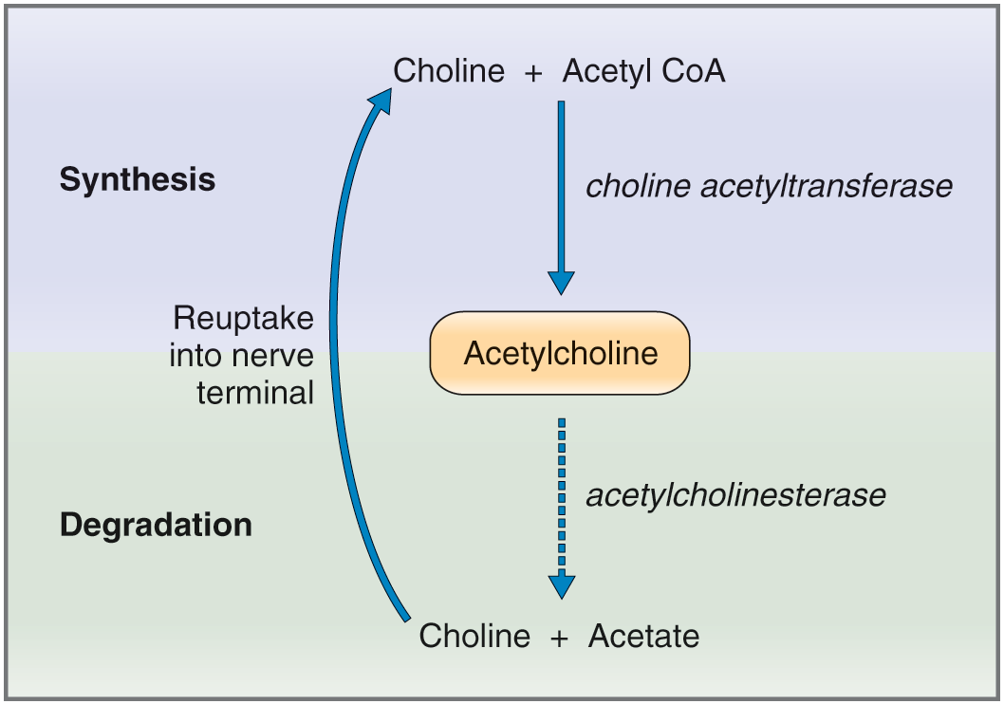
Lecture Recap
Acetylcholine (Ach)
Cholinergic neurons in CNS are implicated in modulating memory, learning and cognition functions.
Cholinergic deficit in CNS contributes to the pathogenesis of Alzheimer disease and other neurodegenerative dementias.
Ach in peripheral nerves controls ANS function and skeletal muscle contraction
Released Ach is degraded by acetylcholinesterase (AchE).
AchE inhibition → Ach accumulation → prolonged Ach action (has pharmacologic significance)
Ach receptors:
Muscarinic receptors: M1-M5, all G protein-coupled receptors
M2 and M3: mainly expressed in peripheral targets, regulating heart, smooth muscle and glands activity
M1, M4 and M5: expressed in CNS, modulating brain activity
Nicotinic receptors: N_{N} and N_{m,} all ligand-gated cation channels
N_{N} type: expressed in autonomic ganglia, CNS, adrenal medulla
N_{m} type: expressed in skeletal neuromuscular junction

Slide 43
Lecture Recap
Glutamate
Major excitatory neurotransmitter in CNS
High levels of glutamate cause neuronal injury and even death-excitotoxicity
Glutamate receptors
Include ionotropic and metabotropic classes. Most important are AMPA ad NMDA type ionotropic receptors
AMPA receptors: AMPA- or glutamate-gated cation channels → open upon ligand binding → Na⁺ and K⁺ moving through channels → EPSP on postsynaptic cell
NMDA receptors:
NMDA- or glutamate-gated cation channels→ open upon ligand binding → Na⁺, K⁺ and Ca²⁺ moving through channels → EPSP on postsynaptic cell
Have voltage-dependency in addition to ligand dependency: channels physically clogged by Mg²⁺ at resting membrane potential. Mg²⁺ ions pop out with sufficient membrane depolarization caused by the faster opening of AMPA receptors
MgSO4 is used for preventing seizures in women with preeclampsia. Why?
Mg²⁺ ions block NMDA receptors → reduction of CNS neuronal excitability

Slide 44
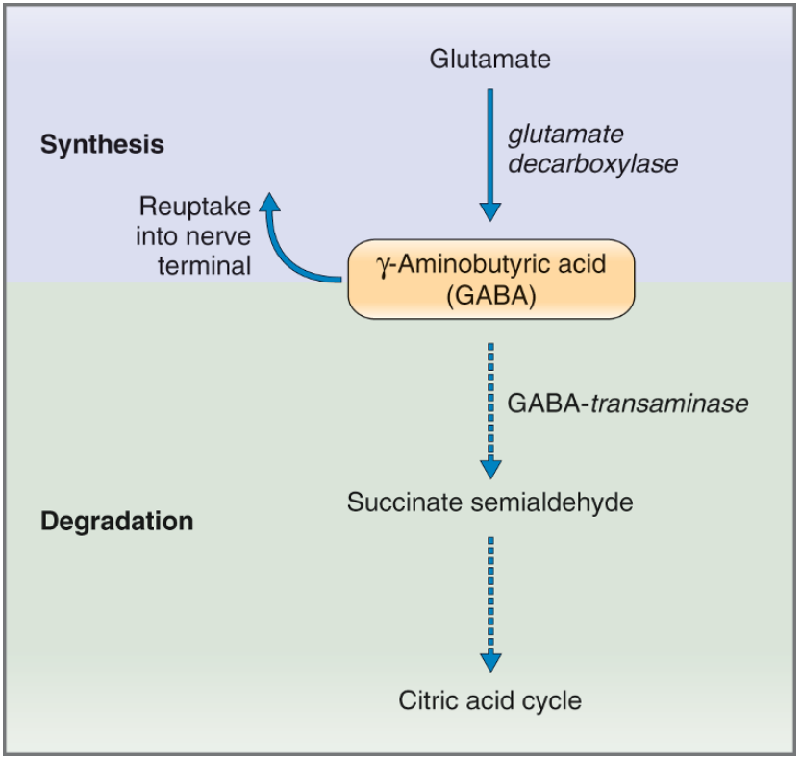
Lecture Recap
GABA and Glycine
Major inhibitory neurotransmitters in CNS, balancing out the action of excitatory neurotransmitters
GABA
Synthesized from glutamate
Released GABA is cleared by enzymatic degradation and reuptake into presynaptic terminal
Reduction in GABA-ergic neuronal activities increases CNS excitability, contributing to the pathogenesis of epilepsy, schizophrenia, anxiety, etc.
Drugs used for managing these disorders increase CNS GABA levels by
inhibiting GABA transaminase or GABA reuptake
GABA and glycine receptors
GABA_{A} and GABA_{C}: GABA gated Cl⁻ channels → postsynaptic IPSP
GABA_{B} receptors: metabotropic receptors
  GABA binding opens postsynaptic K⁺ channels, generating IPSP, or suppresses presynaptic Ca²⁺ channels, reducing excitatory neurotransmitter release
  Glycine receptor: glycine gated Cl⁻ channels

Slide 45
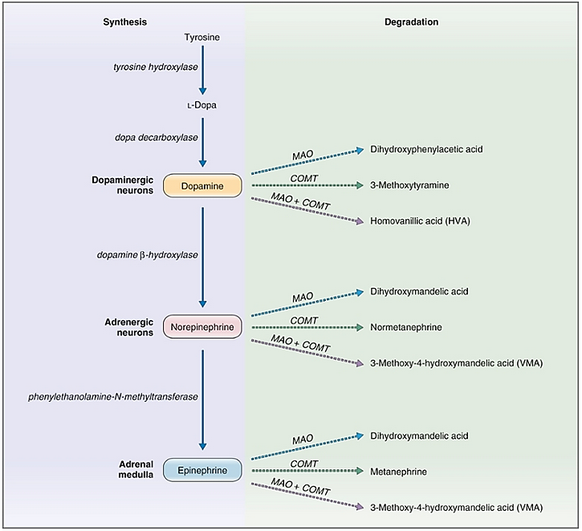
Lecture Recap
Catecholamine (Dopamine, NE and Epi)
Synthesis and metabolism
Precursor: tyrosine
Rate-limiting enzyme: tyrosine hydroxylase
Removal via two ways:
Reuptake by presynaptic terminal
Enzyme degradation by COMT and MAO
Excess production of NE and Epi elevates their metabolite levels in blood and urine: metanephrine, VMA, etc. (e.g. pheochromocytoma)

Slide 46
Lecture Recap
Catecholamine (Dopamine, NE and Epi)-continued
Receptors for Epi and NE (adrenergic receptors): expressed in both CNS and peripheral target cells. Best-known are their actions in peripheral tissues (sympathetic division-innervated tissues. Also see ANS physiology)
Receptors | Primary locations | Signaling pathways | Effects
α1 | Vascular smooth muscle, Genitourinary smooth muscle, GI and bladder sphincters, | ↑ phospholipase C-IP₃/DAG-Ca²⁺ signaling | Contraction
α2 | CNS, platelets, pancreatic β-cells, GI smooth muscle | ↓adenylyl cyclase-cAMP signaling | ↓Sympathetic outflow, ↑Platelets aggregation, ↓ Insulin release GI smooth muscle relaxation
β1 | SA node, AV node, ventricular muscle of heart | ↑adenylyl cyclase-cAMP pathway | ↑ Heart rate, contractility and conduction velocity
β2 | Vascular smooth muscle of skeletal muscle, bronchioles, walls of GI tract and bladder | ↑adenylyl cyclase-cAMP pathway | Dilation of skeletal blood vessels and bronchioles, relaxation of GI and bladder wall
β3 | Adipose tissue | ↑adenylyl cyclase-cAMP pathway | ↑lipolysis

Slide 47
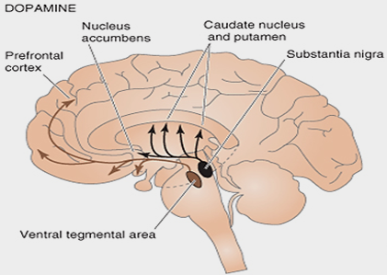
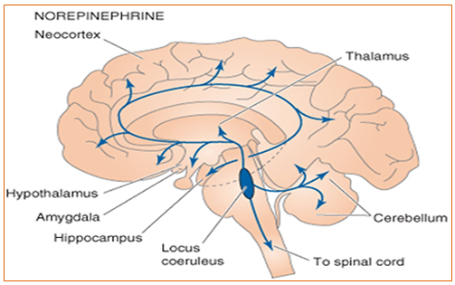
Lecture Recap
Catecholamine (Dopamine, NE and Epi)-continued
Distribution of dopaminergic neurons in CNS
Concentrated in several regions of brain
Dopaminergic neurons in substantia nigra:
Axons project to corpus striatum, coordinating motor function
Degeneration is involved in Parkinson’s disease development
Use of dopamine precursor & agonists for treating Parkinson’s disease
Distribution of noradrenergic neurons in CNS
Located in the locus coeruleus
Axons projected widely to many regions of brain
NE in CNS modulates general excitability of the brain
Low CNS NE levels contribute to development of depressive disorders
Drugs that Increase CNS NE levels are used to treat depression
NE reuptake inhibitors: e.g. serotonin-NE reuptake inhibitors (SNRIs)
NE metabolism inhibitors: e.g. MAO inhibitors

Slide 48
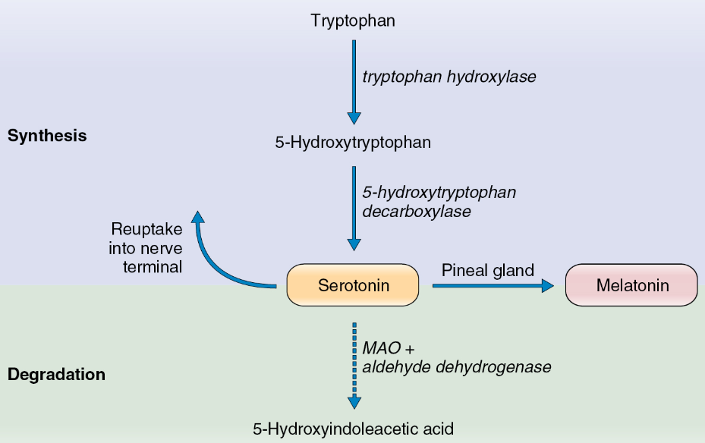
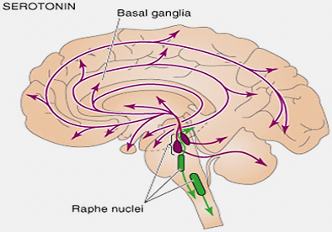
Lecture Recap
Serotonin (5-hydroxytryptamine, 5-HT)
Synthesis and metabolism
Precursor: tryptophan
Rate-limiting enzyme: tryptophan hydroxylase
Cleared mainly by enzymatic degradation and reuptake into nerve terminal
Serotonergic neurons located in raphe nuclei in brainstem
Neuronal axons project widely to many regions of brain
Important in modulating mood, cognition, motivation and reward.
Decreased serotonin level is implicated in depression
MAO inhibitors and serotonin reuptake inhibitors are used for treating depression

Slide 49
> END LECTURE

