Slide 1


Slide 2

FERPA
Family Educational Rights and Privacy Act
Campbell can only provide account details to persons student authorizes to receive information
Students are able to submit the FERPA form Online
https://www.campbell.edu/registrar/family-education-rights-and-privacy-act-ferpa/

Slide 3

Student Email & Self-Service
Access or login information is sent from the
ITS Team (via personal email provided at time
of application)
Email is the primary communication platform used by Student Financial Services
Students should check email weekly

Slide 4
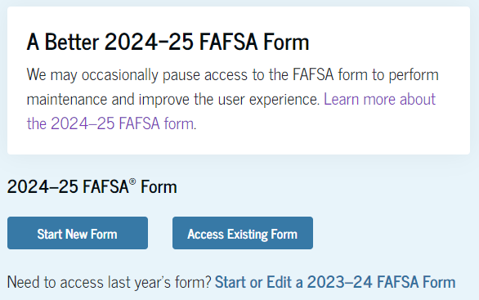
Applying For Financial Aid
Complete the Free Application for Federal Student Aid (FAFSA)
https://studentaid.gov/h/apply-for-aid/fafsa
The FAFSA is free
Apply as early as October 1
Must be completed each academic year

Slide 5
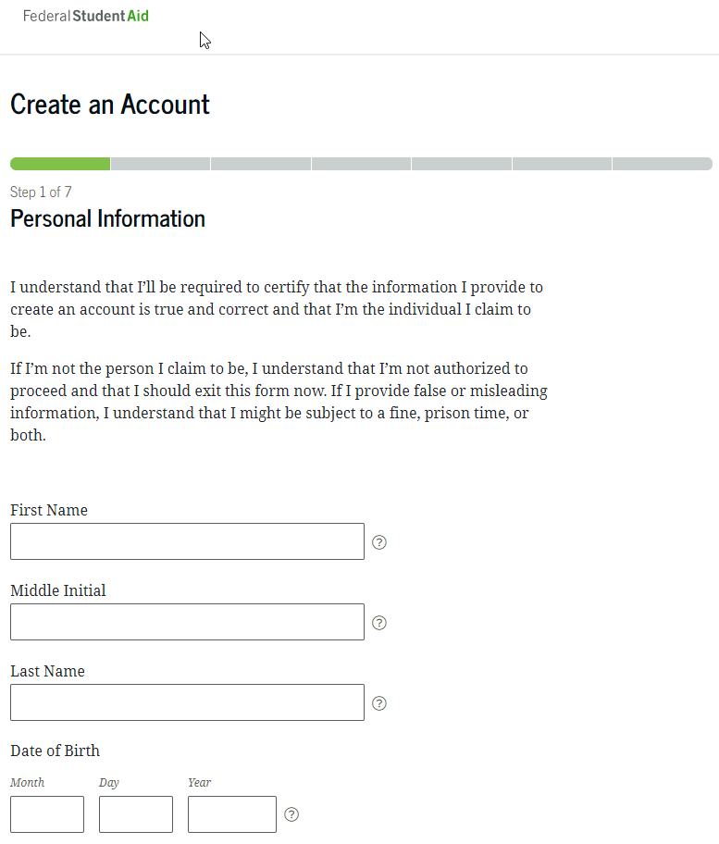
Applying For Financial Aid
Create an FSA ID if you do not already have one
https://studentaid.gov/fsa-id/create-account/launch
We encourage you to use a permanent e-mail address as well as your cell phone number for account recovery
Never share your FSA ID
Invite contributors

Slide 6

Who is a Contributor?
Anyone who is required to provide consent and approval to have federal tax information transferred directly from IRS into the FAFSA form.
Student is a contributor. Another contributor would be a spouse if applicable.
Data needed to invite a contributor:
  Legal name (from their Social Security Card);
  Date of birth;
  Social Security Number (SSN) if they have one;
  Mailing address if they don't have an SSN; and
  Their personal email address.

Slide 7
Financial Aid Process
1
  Submit FAFSA
4
  Student accepts financial aid
2
  School receives FAFSA
5
  Student completes requirements
3
  School determines aid eligibility
6
  Aid disburses to Student Account

Slide 8
Graduate & Professional Students Loans
Federal Unsubsidized Loans
  Accrues interest while enrolled
  Repayment begins 6 months after you leave or drop below half-time
  Accept unsubsidized loan prior to graduate plus
  *23/24 rate is 7.05%
Federal Graduate PLUS Loan
  Accrues interest while enrolled
  Can request in school deferment
  Credit based loan
  *23/24 rate was 8.05%
Alternative Loans
  Rates and terms vary
  https://www.campbell.edu/financial-aid/available-aid/student-loan-options/
*Interest rates update July 1st each year.*

Slide 9
Annual and Aggregate Federal Loan Limits
Graduate Students
Unsubsidized Annual Loan Limit - $20,500
Unsubsidized Aggregate Limit - $138,500 (includes sub/unsub loans from UG study)
The Graduate Plus loan does not have a limit but the school cannot award eligibility over the COA (cost of attendance) per academic year.

Slide 10
View and Accept Financial Aid Awards
You will receive an email notification once aid has been awarded.
To view award package:
◦ Login to the self-service portal
◦ Open the menu in top left corner (3 bars)
◦ Financial Information > Financial Aid > My Awards
◦ Once on My Awards, you may accept or decline financial aid offers.

Slide 11
Accepting Financial Aid Tips
Accept first from any unsubsidized loan eligibility before accepting from the Graduate Plus loan
Use our Federal Loan Calculator found on Financial Aid/Loans webpage to factor processing fees on federal loans
Per federal regulations, loans must be accepted for both fall and spring and in equal disbursements
First time borrowers at Campbell must complete Direct Loan Entrance Counseling and Master Promissory Note (MPN) for the Direct Unsubsidized Loan as well as the Graduate Plus MPN on www.studentaid.gov

Slide 12

Alternative Private Loan Options
• Alternative loans may be taken out in the place of federal loans but may not exceed the cost of attendance (COA)
• Compare Lenders and their incentives from our FASTChoice link
https://choice.fastproducts.org/FastChoice/home/291300

Slide 13
Credit FREEZE?
• If you have a FREEZE on your credit, you will need to lift it before applying
for the Graduate Plus loan or an Alternative Private loan
• Once credit check has been completed, you may reinstate the freeze

Slide 14
Disbursement of Financial Aid
As long as all requirements are met, FA typically disburses to student’s Campbell account within the first week of class
Students will receive an email notification of the disbursement
Once charges are paid, any remaining credit will be sent as a refund by the Bursar’s Office within 14 days of when credit is on account
The fastest and most secure option to receive your refund is to enroll in TouchNet eRefunds.

Slide 15



Slide 16
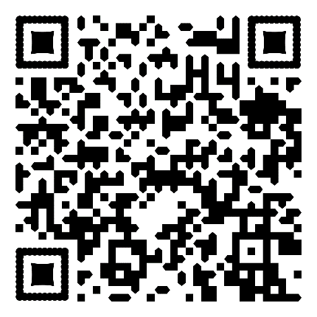
Bill Clearance
Each semester students are required to obtain Bill Clearance from the Bursar’s Office to attend class and/or participate in course related activities, such as rotations, internships, labs, etc. Failure to meet these requirements before the first day of class WILL result in a schedule drop.
These forms are located on our Bill Clearance Page found at the QR Code below
Sign Student Financial Responsibility Agreement (SFRA)
Complete the Student Financial Check-In form.
Make financial arrangements to cover your balance by program deadline
  Fall 2024 financial arrangement deadlines:
    DO1 and DO2: Friday, August 9, 2024
    DO3 and DO4: Thursday, July 11, 2025
  Spring 25 financial arrangement deadlines:
    DO1 and DO2: Tuesday, January 7, 2025
    DO3 and DO4: Friday, November 15, 2024

Slide 17
Financial Arrangements
Federal loans: View/Accept/Decline the loan(s) you choose under your “My Awards” Tab in self-service. Students must complete their MPN (master promissory note) and EC (entrance counseling) for loans to be accepted as a form of payment.
Tuition assistance from a third party scholarship: email your acknowledgement/verification letter to sillsl@campbell.edu.
VA benefits: (Post 9/11 GI bill) email Amanda McRae ( mcraea@cambpell.edu ) to establish benefits or submit your final schedule for certification.
Pay your balance: Make payment in full or set up a TouchNet payment plan and make your first payment on or before the deadline date.
  Financial arrangements are expected to be made as soon as possible after your account has been billed and prior to the first day of class.
  **Students not financially cleared by the appropriate deadline for the semester will be dropped for non-payment and will not be permitted to attend classes or rotations.**

Slide 18
Billing & Payments
Students are billed each semester
On Demand statements are available in TouchNet
Pay online in TouchNet (through Self-Service), at the Bursar’s Office or by mailing a check/money order
Payment plans are available through TouchNet each semester

Slide 19
Payment Plans
Set up in TouchNet each semester
Automatically updates payment amounts if your billing or aid change
$25 late fee for payments made after due date
If a balance is owed after financial aid is factored in and student fails to make payment or set up a payment plan prior to the first day of class, schedule will be dropped.
Plan Option | Fall | Spring
2 Installments $30 set up fee | ½ due August 5th, Remaining on September 30th | ½ due January 5th, Remaining on February 28
4 Installments $50 set up fee | 1/4 due August 5th, remaining on 5th of each month through November | 1/4 due January 5th, remaining on 5th of each month through April
5 Installments $50 set up fee | 1/5 due July 5th, remaining on 5th of each month through November | 1/5 due December 5th, remaining on 5th of each month through April

Slide 20

TouchNet Portal
  Secure online portal with real-time account activity
  View your OnDemand Statement and account balance(s)
  Set up a payment plan
  Make a payment
  Set up eRefunds
  Add Authorized Users

Slide 21
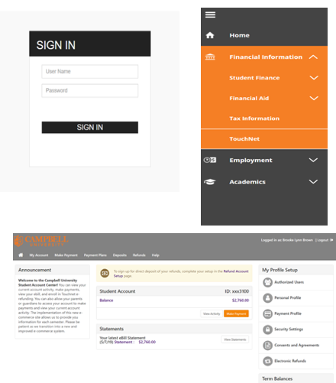
Where is TouchNet located?
Go to the Student Self-Service Portal & login (ss.campbell.edu)
Click the drop-down tab on the top left corner of the screen
Click “Financial Information”
At the bottom of the list, choose “TouchNet” to be redirected to the site

Slide 22
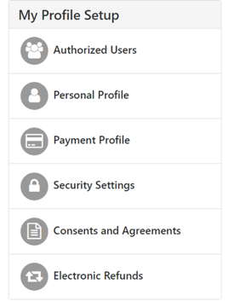
Action Items to Complete
• Authorized Users: Give others access to view your account and make payments. They will have their own username/password to log in.
• Personal Profile: Contains student ID & name on the account.
• Payment Profile: Gives option to add a saved payment method.
• Security Settings: Enroll in the Two-Step Verification to further protect your account.
• Consents & Agreements: Contains any “Promise to Pay” forms.
• Electronic Refunds: Add bank account info and consent to a direct deposit method of refunding.

Slide 23
Enrolling in eRefunds
Electronic Refunds ensure significantly faster receipt of your refund without the risk of a check being lost or returned in the mail. Enroll in TouchNet eRefunds on or before the first day of class.
Students not enrolled in eRefunds by the deadline will receive a paper check by mail to the address we have on file.
Financial aid disbursement dates vary depending on program.
Refunds are processed within 14 days from the date aid is disbursed and a credit balance is created on a student account.

Slide 24
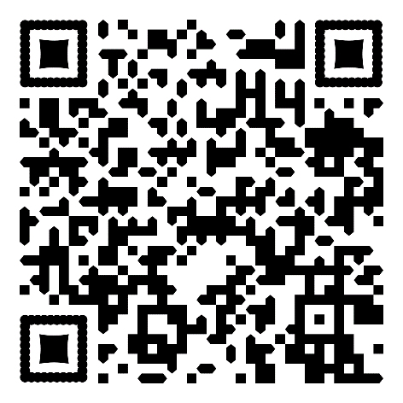
Student Health Insurance
All CPHS students are REQUIRED to have health insurance.
A charge for student insurance is billed to all accounts initially.
Already have insurance?
  Waive online at the QR Code shown between July 1 – August 31
  Charge will be removed if the waiver is approved
Need insurance?
  Enroll online at the QR Code shown
  Charge will remain (another will be billed in spring)
Charges for approved waivers are removed once per week.
If you do not waive or enroll yourself, you will be default enrolled in the student plan & held financially responsible for the premium.
Check our webpage for more info and be on the lookout for emails.
International students are REQUIRED to enroll in the student insurance plan.

Slide 25
Student Health Insurance Questions
Can I add my dependents?
  Yes. Dependents can be added directly through the insurance company at an additional cost paid directly to them directly.
What if I waive and then I lose my insurance?
  You can enroll in the student plan if you have a qualifying life event to take place. (ex: turned 26, job loss, parent retired, etc.) Contact the insurance company for more information.
I already gave my info to CPHS, why am I still getting emails about insurance?
  We do not have access to insurance info provided anywhere else but through the student insurance portal. If you are getting emails from us, please read because action is needed. If the portal does not show an approved waiver, we do not have record of one.

Slide 26
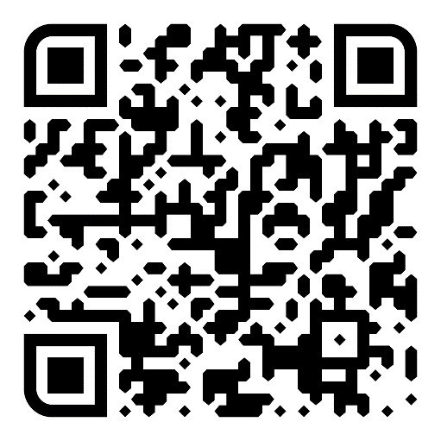
Common Questions
What if I drop a class? How will my bill be adjusted?
  Students may drop classes between days 1-5 (calendar days) and receive a 100% tuition refund.
  After day 5, no adjustments to tuition and fees will be made.
If I want a meal plan, can I sign up for one?
  Yes! Sign up for a meal plan using the form on our webpage and the charge will be billed to your account.
How can I use financial aid to get my books?
  Transfer funds to Book Bucks by using the request form on our webpage.
  If you have an anticipated credit balance, we can move the max credit allowed to your ID card to be used in the Bookstore.
  Unused funds will be reversed and placed back on your student account each semester.

Slide 27





Contact Us!
Campbell University
Student Financial Services
PO Box 36
Buies Creek, NC 27506
Student Financial Services
sfs@campbell.edu
(910) 893-1244
(910) 814-5788
(910) 407-1512 All Students
Loan Team
loanteam@campbell.edu
(910) 893-1314
Refunds
earagon@campbell.edu
(910) 893-1246

