Slide 1
CV Workshop and Research Information
Peer Navigators:
Extracurricular Team

Slide 2
CV
What is it?
Essentially your “resume” as a medical professional
Far more extensive than a resume (multiple pages)
Elaborates on 1) Education and 2) Professional History
Elements such as Teaching History, Research Endeavours, Professional Memberships, Previous Work History, etc
Includes everything from your Undergraduate Careers until present (NO High School!)
Requires more frequent updates than a traditional resume

Slide 3
CV
Why Does it Matter?
Obtaining Research Experience
Obtaining Shadowing Experience
Networking
Residency Applications
Scholarship Applications
Advisors/Mentors
For you to remember everything you have done!

Slide 4
CV
Key Points to Include:
Picture at the top left corner!
Debate on Casual vs Professional (if any doubt, always go Professional)
Most relevant and important information First
Within each section - most recent activities at top and older activities further down
Include Hobbies and Interests!
These are people you’re trying to connect with
There is no strategy here - just tell your story
Make it easy to read
Not the time to use fancy lingo or medical jargon

Slide 5
CV
Let’s see some examples!

Slide 6
Research: Finding Mentors
Look into Duke and UNC
Residents, Attendings
Social media - Twitter (#MedTwitter)
Follow “Inside The Match”
Physicians in the area
Case reports
Campbell
https://medicine.campbell.edu/research/faculty-researchers/
Reach out to faculty within the discipline you are interested in
CU find- all of Campbell
https://cufind.campbell.edu/profiles.html

Slide 7
Research: Cold Emails
Be sure to attach CV and letter of good academic standing
Contact: Ms. Lou Naylor naylor@campbell.edu
Specific to the project
Flexibility
Be willing to work at any time and without stipend
Start early
Winter break is a good time to start (don’t panic if you don’t though)
Don’t get discouraged

Slide 8
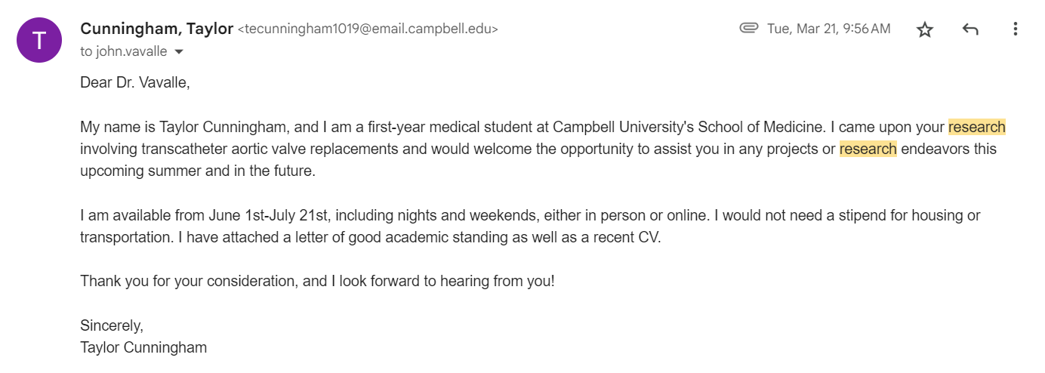
Cold Email- Example

Slide 9
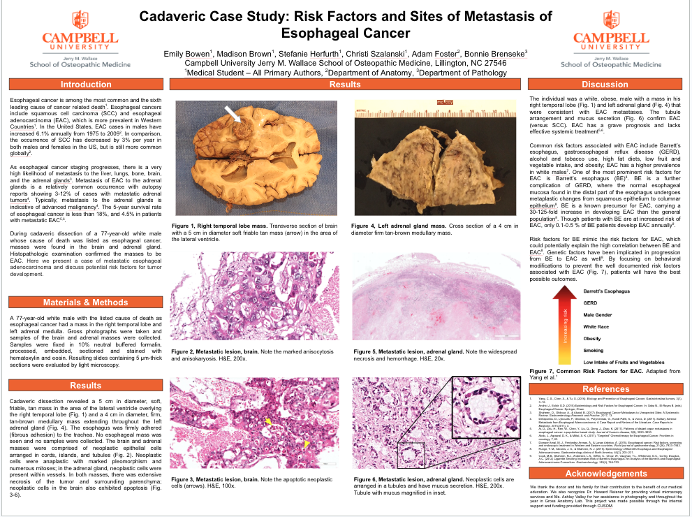
Research: CUSOM Opportunities
Summer Scholars Program- Presentation coming up
Any rising MS2 that is in academic good standing
Dr. Terri Hamrick
hamrick@campbell.edu
Stipend
CAP Project - May
Dr. Bonnie Brenseke
Pathology found in cadavers
Poster presentation
Public Datasets- Research BB page
Do not require IRB approval

Slide 10
Other Research Information
Check the Research BB page
Organizations → CUSOM Research Organization → Student Research
Poster templates
Forms
Case report information
If you are participating in research
Fill out research notification form, before submitting for publication
Along with a draft of your publication
Presenting
CUSOM will pay $500 for travel in NC or any bordering state or $700 for further distances
Poster printing information on CUSOM library website
Free
Be sure to give them at least 3 days notice
Reach out to Clarissa Angeloff if you would like to practice your presentation
cangeloff@campbell.edu

Slide 11
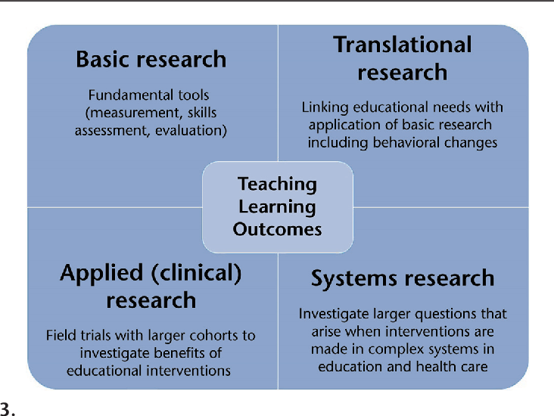
Research Types
Basic Science
Translational
Clinical
Educational/Healthcare Systems
*All are equally sufficient, can result in publications, and show your commitment to advancing the field of medicine!

Slide 12
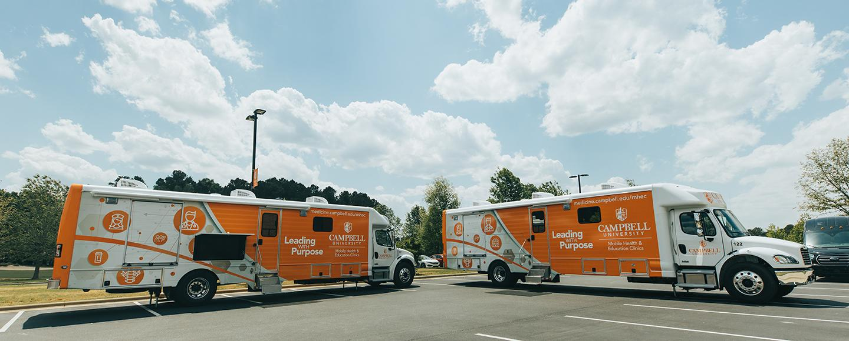
Volunteering:
CUCCC Volunteering
Pros:
Practicing medicine!
Interacting with patients
Giving back to the community
Looks great on CV
Talk with 2nd and 3rd years
Dr. Joe
Cons:
Time consuming
Sometime return very late

Slide 13
Volunteering:
Local Volunteering Opportunities:
Women’s Shelter in Raleigh
Soup Kitchen
Special Olympics
Summer Camps for Special Needs
The Boys and Girls Club
Vaccine Clinics
CUSOM always emailing out more opportunities!

Slide 14
Questions???

Slide 15
Contact Information
Chris Reynolds: cmreynolds0318@email.campbell.edu
Meg Basco: m_basco1013@email.campbell.edu
Sid Patil: s_patil1028@email.campbell.edu
Zach Herro: z_herro1216@email.campbell.edu
Claire O’Neill: c_oneill1120@email.campbell.edu
Taylor Cunningham: tecunningham1019@email.campbell.edu

