Slide 2
Student Email & Self-Service
Access or login information is sent from the
ITS Team (via personal email provided at time
of application)
Email is the primary communication platform used by Student Financial Services
Students should check email weekly

Slide 3
FERPA
Family Educational Rights and Privacy Act
Campbell can only provide account details to persons student authorizes to receive information
Students are able to submit the FERPA form online
https://www.campbell.edu/registrar/family-education-rights-and-privacy-act-ferpa/

Slide 4
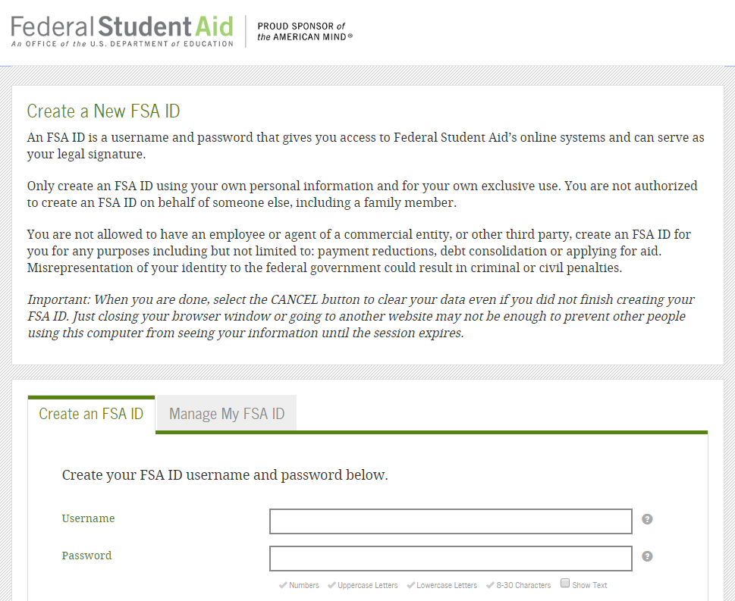
Applying For Financial Aid
Create an FSA ID
Studentaid.gov
We encourage you to use a permanent e-mail address as well as your phone number for account recovery
Never share your FSA ID

Slide 5
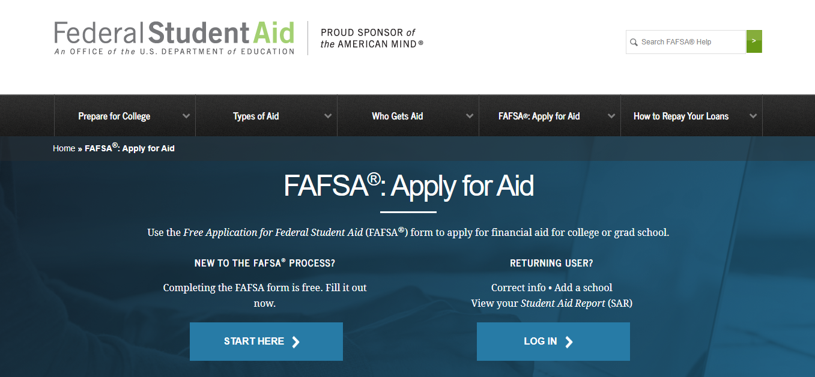
Applying For Financial Aid
Complete the Free Application for Federal Student Aid (FAFSA)
Studentaid.gov
The FAFSA is free
Apply as early as October 1
Must be completed each year

Slide 6
Applying For Financial Aid
Use the IRS Data Retrieval Tool
The 23/24 FAFSA uses 2021 tax data
Data retrieved will read Transferred from the IRS
If you are unable to use the DRT, you can still manually type in your financial information

Slide 7
Financial Aid Process
1
Submit FAFSA
4
Student accepts financial aid
2
School receives FAFSA
5
Student completes requirements
3
School determines aid eligibility
6
Aid disburses to Student Account

Slide 8
Graduate & Professional Students Loans
Federal Unsubsidized Loans
Accrues interest while enrolled
Repayment begins 6 months after you leave or drop below half-time
Accept Unsubsidized loan prior to graduate plus
$40,500 annual eligibility
22/23 rate was 6.54%
NOTE: New interest rates for federal direct loans become published in June for loans disbursed after July 1st each academic year.
Federal Graduate PLUS Loan
Accrues interest while enrolled
Can request in school deferment
Credit based loan
22/23 rate was 7.54%
Alternative Loans
Credit based loan
Rates and terms vary
https://www.campbell.edu/financial-aid/available-aid/student-loan-options/

Slide 9
Annual and Aggregate Federal Loan Limits for CUSOM students
Unsubsidized Annual Loan Limits:
DO1 & DO2 - $40,500
DO3 & DO4 - $47,167
Aggregate loan limits per Federal regulations:
The aggregate amount for the Unsubsidized loan is $224,000 and includes subsidized and unsubsidized loans for undergraduate study.
The Graduate Plus loan does not have a limit but the school cannot award eligibility over the COA (cost of attendance) per academic year.

Slide 10
Viewing Financial Aid Awards
Students will receive an email notification once FA has been awarded
To view award package:
◦ Login to the Self-Service portal
° Select Financial Aid
◦ Select the correct Award Year
° From the 3 bars upper left, then select Financial Information
◦ Select Financial Aid, then My Awards

Slide 11
Accepting Financial Aid
Accept loans from the “My Awards” page
Accept first from any unsubsidized loan eligibility before accepting from the Graduate Plus loan
Use our Federal Loan Calculator found on Financial Aid/Loans webpage to factor processing fees on federal loans
Per federal guidelines, loans must be accepted for both fall and spring and in equal disbursements
First time borrowers at Campbell must complete Direct Loan Entrance Counseling and MPN’s for the Direct Unsubsidized Loan as well as the Graduate Plus MPN on www.studentaid.gov

Slide 12
Temporarily lift any Credit FREEZE
If you have a FREEZE on your credit, you will need to lift it before applying for the Graduate Plus loan or an Alternative loan
Once credit check has been completed, you may reinstate the freeze
Graduate Plus applications, open May 1st for the 23/24 award year

Slide 13
Disbursement of Financial Aid
As long as all requirements are met, FA disburses to student’s Campbell account on/around the first day of class
Students will receive an email notification of disbursement
Once charges are paid, any remaining credit will be sent as a refund by the Bursar’s Office within 14 days
It is recommended that students sign up for the electronic refund on TouchNet for refunds to be sent directly to their personal checking account

Slide 14
Student Financial Services
(910) 893-1244
Student Financial Services
Campbell University
P.O. Box 36
Buies Creek, NC 27506
(910) 814-5788
(910) 407-1512
sfs@campbell.edu
loanteam@campbell.edu

