Slide 1
RC MedReview Biochem/Genetics Review
February 9 – 11, 2024
Campus visit

Slide 2
Live Lectures
Friday February 9, 2024
2p-5p Pharmacology, Enzyme Kinetics and Neuropharm, Biostatistics
Saturday February 10, 2024
9a-noon General Biochem, Lysosomal Storage Disorders, Carbohydrate/Lipid Metabolism and Disorders
1p-5p Nucleotide Metabolism and Disorders, Molecular Biology, Cell Bio and Genetic Disorders
Sunday February 11, 2024
9a-noon Hemoglobin and Porphyrias, Amino Acid Metabolism and Disorders, Urea Cycle, Vitamins and their Deficiencies

Slide 3
Recorded Lectures
Access to recorded lectures
Available through RC Medreview website until July 31, 2024
You will receive an email with username and password (check junk mail)
Login at: https://www.rcmedreview.com/my-account/
Click on “My Courses”

Slide 4
Check out the full course!
COMLEX 1 on-demand course:
Over 90 hours of interactive lectures
Complete study guide in a flip-book format
Hundreds of embedded board-style questions
Time-saving “fast play mode”
6-months access
$200 off for CUSOM students, use discount code: CUSOM1
Sign up here Get 3 hours of one-on-one tutoring

Slide 5
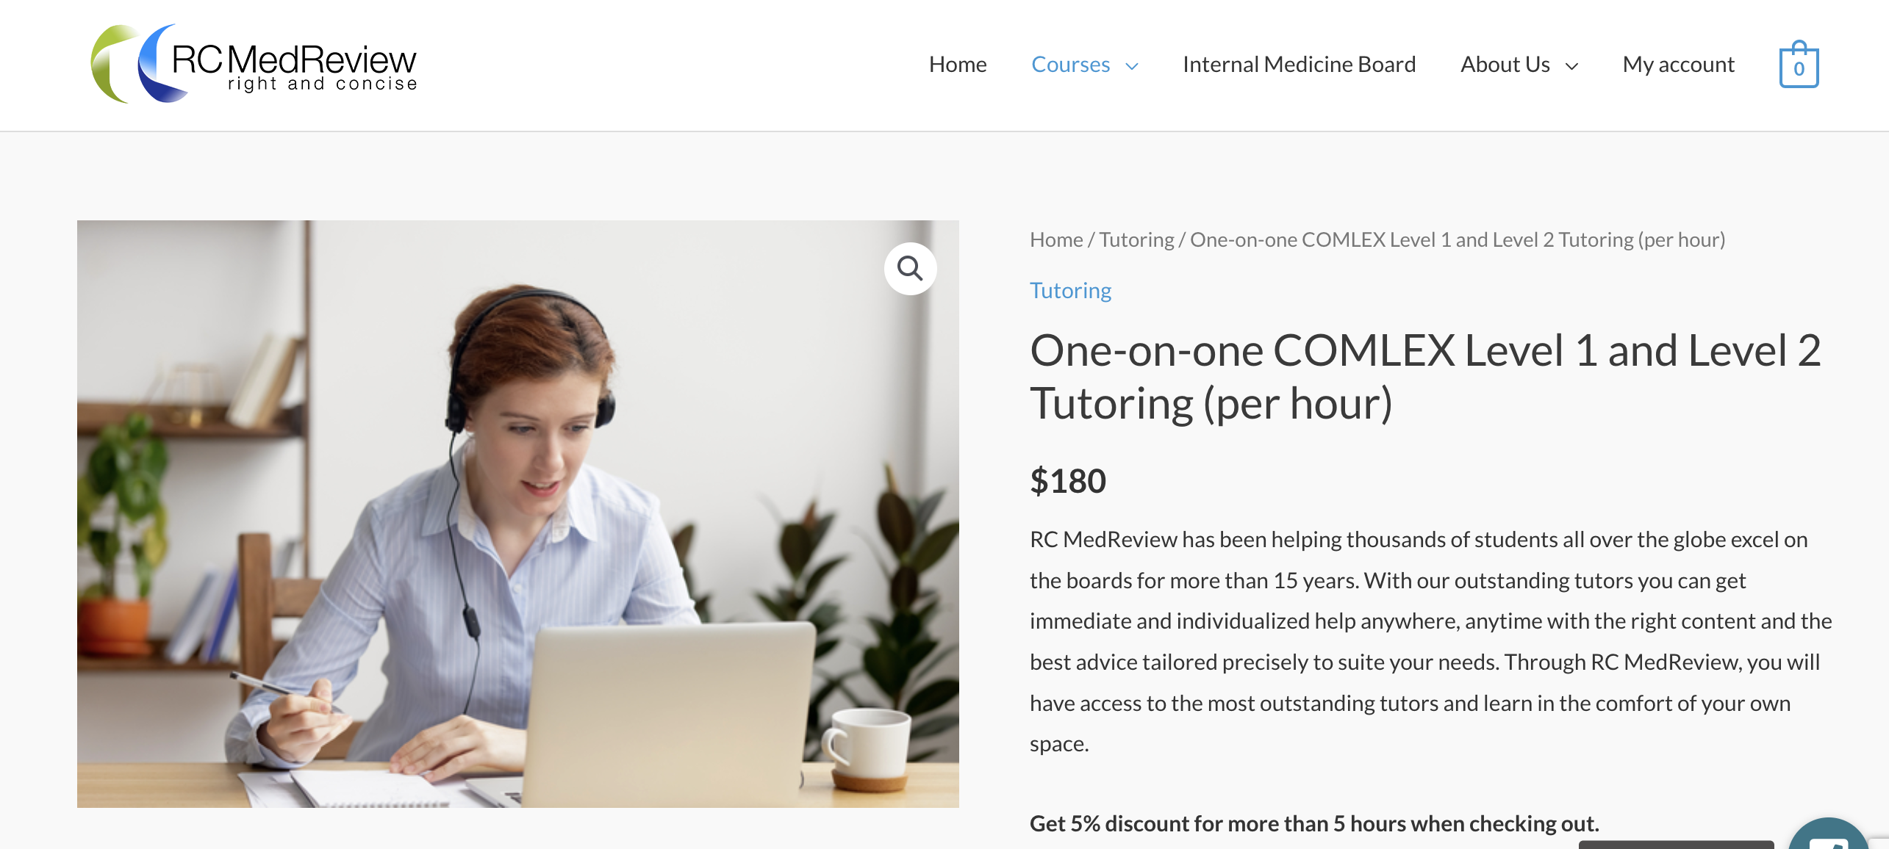
One-on-one tutoring
Get help from experts in COMLEX
Personal attention from outstanding tutors
Connect with our tutors now

Slide 6
Contact us!
Questions or comments
info@rcmedreview.com
Instagram: @RC_Medreview
FaceBook: RC-MedReview
YouTube: RC MedReview

