Slide 1
TOUCH HOURS and VOLUNTEERING
TOUCH (Volunteer) Coordinator
Sarah Comstock
s_comstock0725@email.campbell.edu
PPT Initially made by: Alex Caudill—C/O 2025
and updated as needed.

Slide 2
TOUCH Hours
  Why should you care?
    Goes into your MSPE, colloquially referred to as a ‘Dean’s Letter’
      Find out exactly how CUSOM presents this info here: https://assets.campbell.edu/wp-content/uploads/sites/22/2019/09/MSPE-Final-All-Combined-Document-05042021.pdf
        Ctrl+f the word ‘volunteer’ to find an example.
    Take control of your future—put yourself in the best light possible!
  TOUCH Hour Cycle: May 1st, 2023 – April 30th, 2024
  Must be hours after matriculation into medical school
  Must be logged according to date of service
      Don’t log all of your hours at once

Slide 3
What do I need to do?
A record of completed hours must be submitted on the online submission form → https://www.trackitforward.com/site/cusom
Submissions will be subject to review based on upon the TOUCH Guidelines and Protocols by the Student Service Committee Review
Log your hours even if you do not think you will reach 35 hours because you might surprise yourself and realize that you are almost at 35 by the end of the TOUCH calendar year!
Touch Hour Cycle: May 1st, 2023 – April 30th, 2024
  Please submit hours within 30 days from the event
  Hours must be completed after matriculation into medical school; hours completed by first year medical students during the summer before matriculation are not valid.

Slide 4
What counts as TOUCH hours?
The event must provide a service to the community in order to be TOUCH eligible
Any activity that works to improve the health and wellness of a community outside of the medical school coursework
Services will not count if they are…
Compensated
Self-serving
Directly benefiting medical students or the school
Court mandated “Community Service” does not count towards TOUCH hours
TOUCH Hours:
  Any activity that works to improve the health and wellness of a community.
  AND Incorporates osteopathic tenets, awareness, principles, and practice.
    A "community" includes working to improve the overall health of humans, animals, and the environment.
    The “community” shall be designated as those outside of each institution.

Slide 5
What if it doesn’t count as TOUCH Hours?
SIM labs, small group leadership, peer tutoring, admissions Q&A sessions, staying after shift to continue care outside of academic requirements, time spent on call where no service was provided outside of academic requirements
    You can still get credit! Submit it as volunteer hours, not TOUCH.
Volunteer Hours are any activity that provides service to a community but does not meet TOUCH Hours standards.
  Provides service to others
  Might not incorporate osteopathic tenants
  Might be benefiting CUSOM students

Slide 6
Some Events Just Can’t Be Counted
The following are NOT eligible for TOUCH or Volunteer hours:
  Travel time (including to mobile clinic), sleep or other time spent not in service for overnight service events
  Physician shadowing or clinical rotations
  Conference attendance
  Administrative tasks that do not involve planning hours and that do not take place at the event
  Funds raised for philanthropic causes
    Pledging or collecting pledges (eg Charity Miles)
    Participation in athletic events (eg Fun Runs)
    Mr. CUSOM (New as of 2023-2024!)
  COSGP Silent Auction activities, including acquiring auction items or staffing the auction.
  Funds raised directly to benefit school associated clubs or organizations
  Leadership responsibilities in a College Student Organization
  SIM labs, staying after rotation/clerkships, small group leadership, normal student organization activities (e.g. meetings, bringing in speakers, etc.)
  Research activities

Slide 7
Examples
The following events DO NOT count as TOUCH hours
      Tutoring of classmates/peers
      Staying after shift to continue care outside of academic requirements
      Time spent on call where no service was provided outside of academic requirements
      SIM labs, small group leadership
      DO count as Volunteer hours if the student was not otherwise compensated for the activity
      (note: Service activities performed in conjunction with conference are TOUCH eligible):
      Helping with Mr. CUSOM will count for volunteer hours NOT TOUCH hours

Slide 8
Keep a personal log of your own hours separately from the website (in case of a crash or an error occurs)
If there are any problems with your submission, the TOUCH Coordinator will reach out to you
Don’t panic if your hours are not approved right away, it takes time to review and process each submission!

Slide 9
Service hours
The sum of:
  TOUCH Hours + Volunteer Hours
    Total of all event hours, (TOUCH and Volunteer Hours)
    Total of all planning hours (50%)
    Denied TOUCH Hours

Slide 10
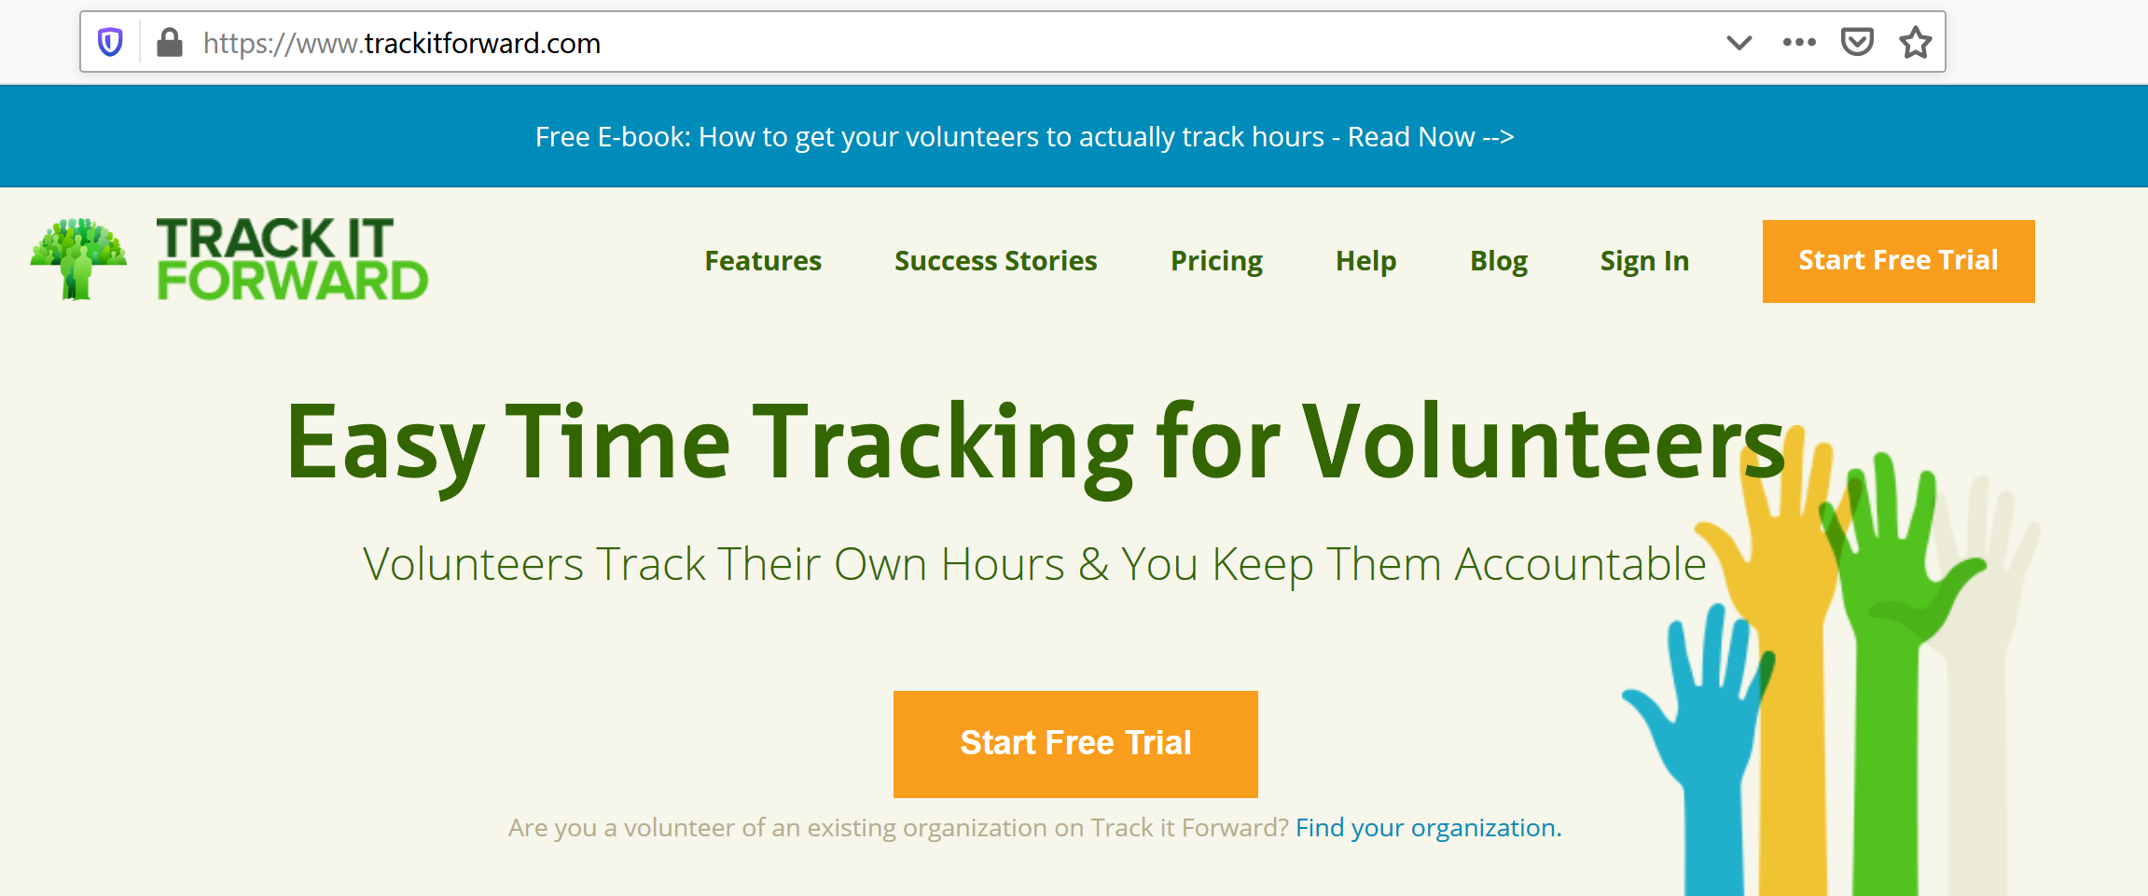
How To Log Hours
Go to this website
https://www.trackitforward.com/site/cusom
https://www.trackitforward.com/site/cusom

Slide 11
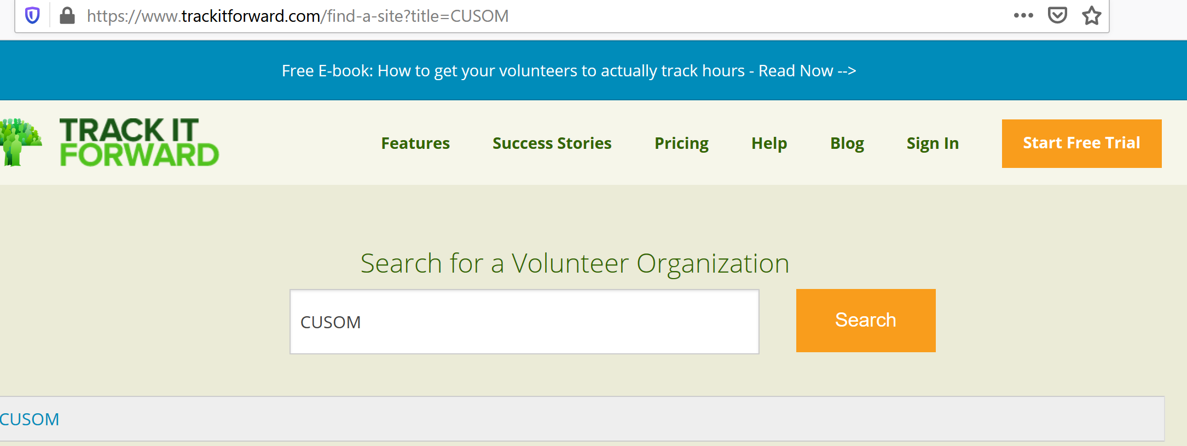
Find Organization
“CUSOM”
https://www.trackitforward.com/site/cusom

Slide 12
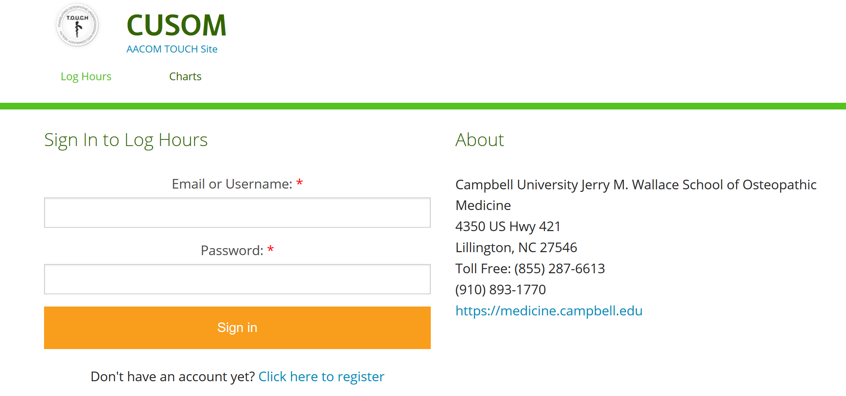
Register→Create an Account
https://www.trackitforward.com/site/cusom

Slide 13
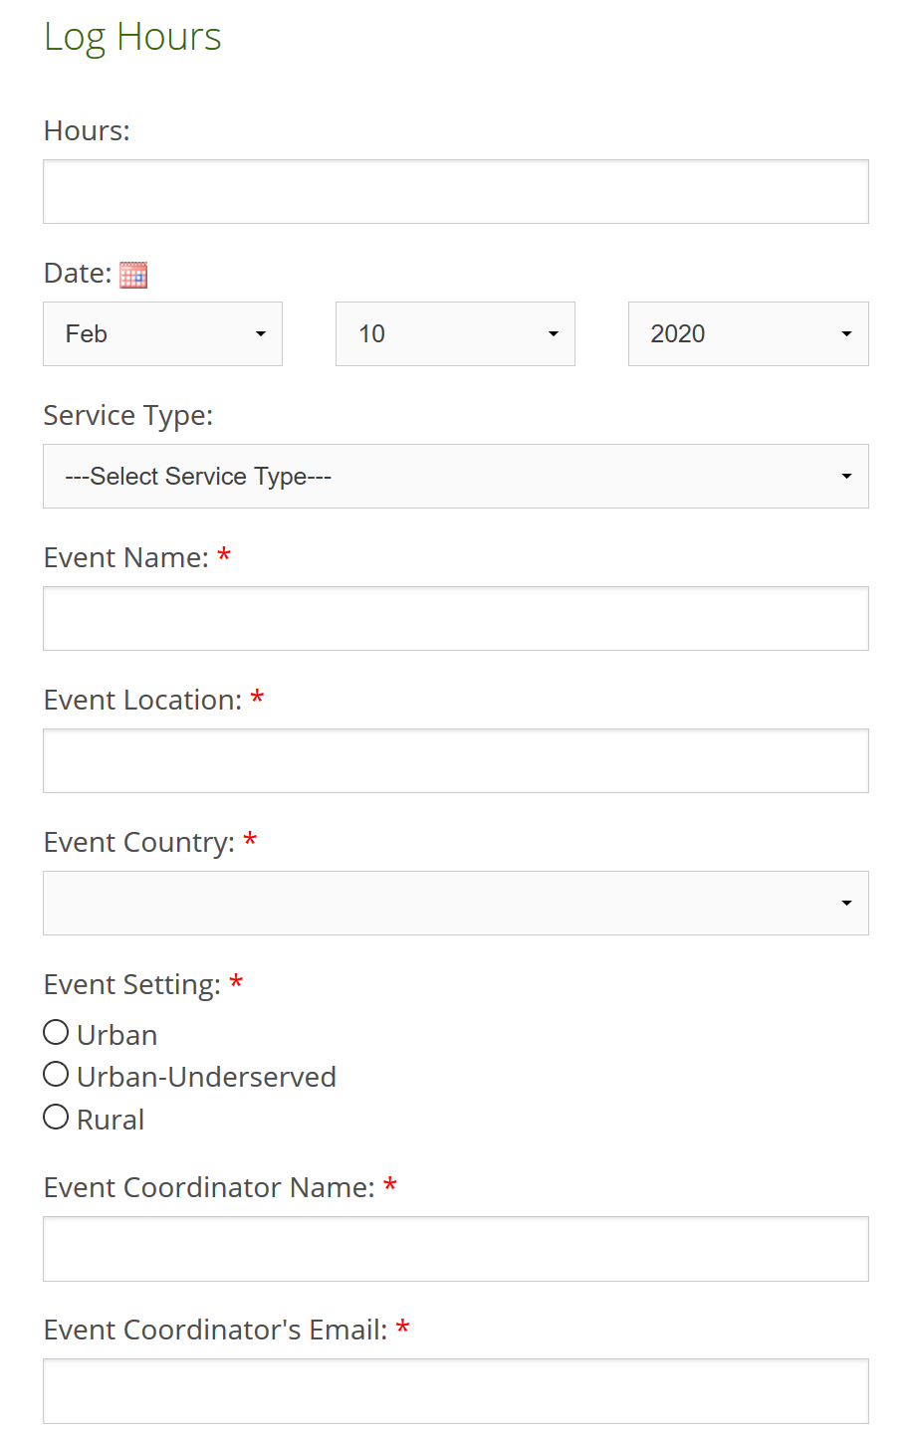
Hours: Total Hours Volunteered
Date of service
Type: TOUCH or Volunteer
Name
Location
Country
Event Coordinator: Who oversaw the event
Email or Phone Number Allowed (if no email)

Slide 14
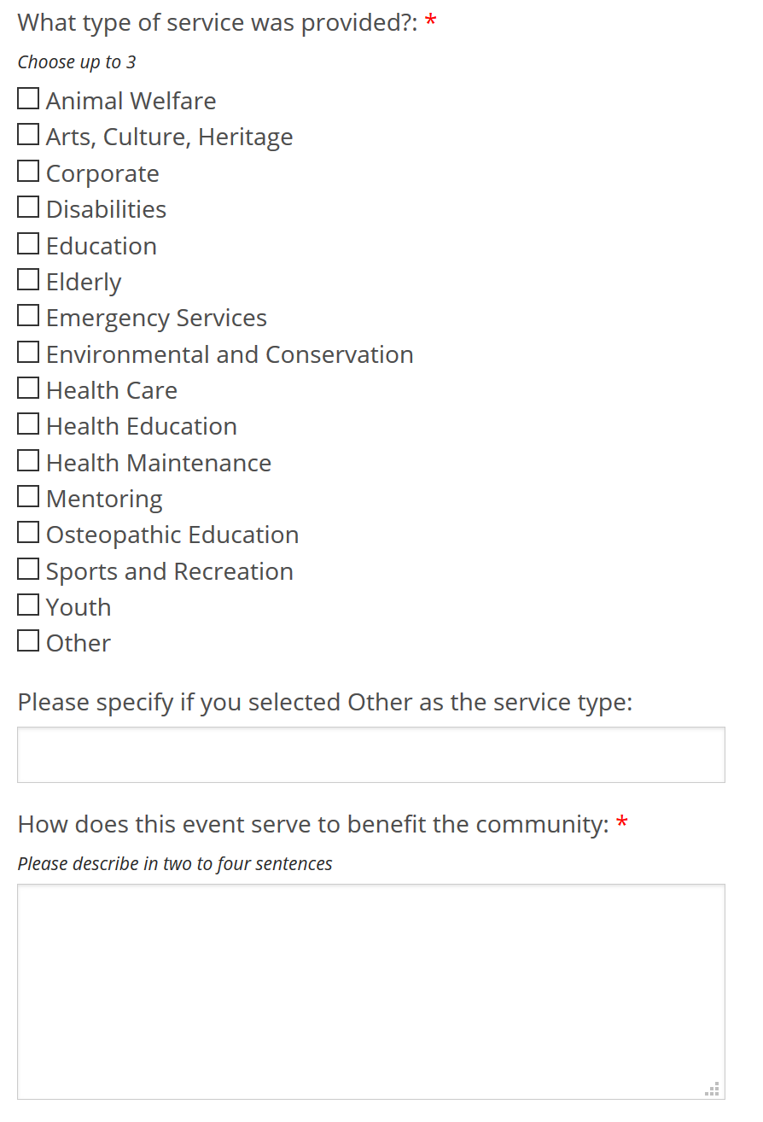
Then Fill Out
The Information
Type: Pick 3 MAX
How does it benefit the community?
  Describe the volunteering you did.
  If you are logging it as TOUCH:
    This is where you will need to make sure the description fits and follows the TOUCH criteria

Slide 15
Timeline to Submit Hours
According to AACOM Hours should be submitted within one month
  This does not mean hours submitted over a month from the date will be denied. Establishing this soft due date will hopefully prevent anyone from missing out on TOUCH hour submissions.
  Hours must be submitted by April 30th 2024 to count for the 2023-2024 cycle
Hours from previous academic years cannot be submitted for the next cycle so be sure to submit everything before you put the year behind you

Slide 16
Award recognition
AWARDS
  Participation recognition
    Students who complete less than 50 approved TOUCH Hours
  Silver-level recognition
    Students who complete 50 but less than 100 approved TOUCH Hours
  Gold-level recognition
    Students who complete 100 or more approved TOUCH Hours
  Platinum-level recognition
    Awarded to the student with the highest number of approved TOUCH Hours

Slide 17
Award Recognition
Recognition may include, but is not limited to: certificates, plaques, trophies, or other materials as deemed appropriate by the COSGP Student Services Committee.
  Campbell TOUCH award certificate(s) and pins
Letter of Commendation
  A Letter of Commendation will be sent to the COM Dean from AACOM suggesting it be included in the student’s commitment to service in his/her Medical Student Performance Evaluation (MSPE)
  Letters of Commendation are sent yearly and are based on students' TOUCH Hours accumulated during one cycle year

Slide 18
For Club Leaders
If you want a club event to count for TOUCH Hours:
  Club President or VP will email me with the event title and description just to let me know what you are planning and to decide if it would count
  If you need help with the event description, please email me
    After everything is in order you can announce the event as TOUCH eligible

Slide 19
Miscellaneous Information
When Submitting for TOUCH:
  Email me (or message via GroupMe, etc.) if you need help determining if your event counts for TOUCH hours
  If it is not counted as TOUCH (but it should have been)
    Please email me with a description of the event (date included)
    After review, reword the “Benefiting the community section” to count for TOUCH.
Only a few submissions have been denied. Typically, this is due to the description not actually meeting TOUCH standards (link for TOUCH Rules & Regs) or the hours were all submitted under one day. Submissions should only be for the day of the event. However, some of you have volunteer positions that make this difficult and I recognize this so don’t worry.

Slide 20
Email with any questions
TOUCH (Volunteer) Coordinator
Sarah Comstock
s_comstock0725@email.campbell.edu

