Slide 1
Maximizing Your Practice Question Experiences:
Tracking Q Bank for an In-depth and Organized Review
Yen-Ping Kuo, PhD
Assistant Dean for Curriculum
Assistant Dean for Academic Success
Oct 26, 2023
Notes:
In this video, I will like share with you ways to track and organize your practice question-driven study utilizing your Q bank.

Slide 2
Factors Impacting your High-Stake, Comprehensive Exam Outcome
Content Know-ledge:
-Actual information
Test-taking skills:
-Problem solving process
-Information retrieval effectiveness
Your Confidence
-Just the right amount
-Application
-Ranked importance
-Time management
-A clear execution plan
Notes:
When it comes to taking a high-stake exam that is comprehensive and time-demanding in nature.
What you know doesn’t account the outcome alone. Rather:
1) What do you know, how is typically presented, and the relative importance of a clinical or biomedical knowledge set the stage
But,
2) Your test-taking skill including your subset skills in problem solving, etc ..the mechanical part of taking an exam can have a huge influence
And, finally, your attitude, whether if you have a good execution plan can shape your confidence and impact the end result significantly.
How do you prepare yourself for all of this while you are doing questions day in and day out?

Slide 3
Phase I: ~BK 5-7
Dig in, fill in the gaps, strengthen with structure
Phase II:
Re-enforce structure and enhance recall
Phase III: ~ 4 weeks
Final dash
Focus:
Do well in current courses
Integrated review
Targeted questions
Small Q set; sharpen test-taking skills
Focus:
Continue structured review
Randomize questions
Recall enforcement
Focus:
Larger, randomized question set
Lots of practice exams
Notes:
Q banks and practice exam play a central role in each phase of your preparation. What can you do so that you are consciously building yourself to cover the three domains I mentioned earlier?

Slide 4
Using Q Bank in Sets of 5-10* Targeted Questions for Practice-Directed Study to: (*work that can be accomplished in 1-2hrs)
Build ORGANIZED content knowledge
Develop strong and consistent problem-solving ability
Using Q Bank in sets of 40* randomized questions for Becoming Test-Ready by: （*Simulation!!)
Practice content retrieval
Develop strong execution routine
Notes:
In Phase I..do small Q set
Your goal is to REVIEW and ORGANIZE the content knowledge while building strong problem-solving skill
In Phase II
You are practicing more and identify your weak spots

Slide 5
Tracking Targeted Question Practice to build a BIG picture
Notes:
Let’s talk about the small, target question set approach

Slide 6
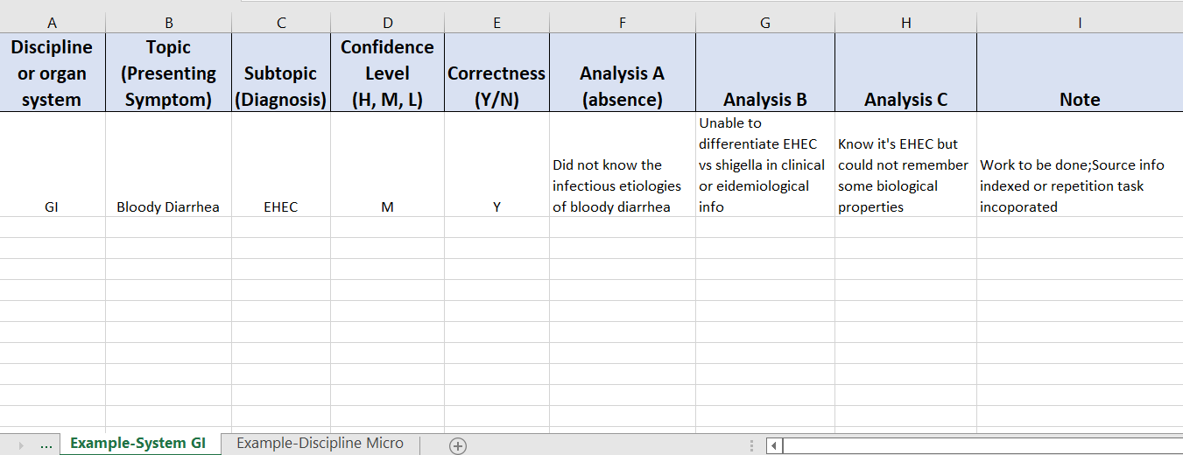
Set up an Excel File with Multiple Worksheets
1. Do questions timed in test mode and mark this during the “test”
2. Fill in the rest during review mode
3. Review next day of the prior day’s topics
4. Review all when “finish” the system by SORTING the Topics
Notes:
Build an Excel sheet like this

Slide 7
Additional tip: You can gradually increase the number of questions in a set during the practice-directed study when you are gaining more proficiency (ex. study time needed reduced, accuracy increased)
Organization and Analysis
*
Repetition
*
Priority Sorting
*

Slide 8
When do you move on to the next system?
When you finish most of the questions in the system, OR
When you are “scoring” really high and needing little review time for the current system.

Slide 9
How to Approach Randomized Q set Study?
Continue logging the questions
Fill in the gaps: Study and Review the gaps identified by questions
Continue STRUCTURED content review!
Take a few practice sets back-to-back or take practice exams time to time. (Simulation!!)

Slide 10
Content Know-ledge:
Test-taking skills:
Your Confidence
Good Luck！

