Slide 1

Autonomic Cardiovascular Physiology I and II
Connecting the Basic Science and Clinical Components
September 21, 2023
© 2023

Slide 2
Class materials (hereafter including PowerPoints, Handouts and Lecture Recordings) are distributed for the exclusive use of students in the Jerry M. Wallace School of Osteopathic Medicine. Student access to and use of materials are conditioned on agreement with the terms and conditions set out below. Any student who does not agree to them is prohibited from accessing or making any use of such materials.
Any student accessing materials (1) acknowledges the faculty members’ intellectual property rights and that distribution of the materials violates the CUSOM Copyright Policy; (2) recognizes the privacy rights of fellow students who speak in class; (3) accepts that distributing, posting, or uploading materials to students or any other third party not authorized to receive them or to those outside CUSOM is an Honor Code violation; and (4) agrees that the materials are to be accessed and used only as directed by the faculty member(s) teaching the course. Students are not permitted to take photographs or screenshots of any screens or projected materials during lectures, exams or quizzes. Audio recording are also not permitted outside of what is provided through the recorded Tegrity sessions.

Slide 3
Case #1

Slide 4
Case #1
A 26-year-old male presents to the ED after taking a handful of unknown pills in a suicide attempt.
On arrival he is lethargic, confused, and unable to provide any medical history.
He was seen at his PCP’s office one week ago and his vital signs at that time were as follows:
Pulse: 88
Blood pressure: 138/84
Respiratory rate: 18.
Clinician

Slide 5
Physical Exam
 | Findings
General Appearance | Lethargic, pale
Vital Signs | Pulse 40; BP 80/46; RR 22; T 98.4; Pox 96%.
HEENT | Mucosa dry, no thyromegaly; pupils midpoint
Cardiovascular | Bradycardia; S1 & S2 noted. No murmurs, rubs or gallops
Pulmonary | Bilateral wheezing
Gastrointestinal | Abdomen soft and non-tender
Extremities | Pale and dry; weak peripheral pulses
Neuro | Lethargic – oriented only to self; cranial nerves intact; moves all 4 extremities with normal strength
Clinician

Slide 6
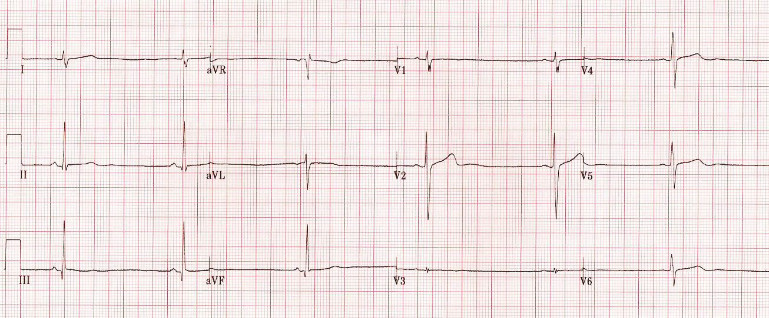
EKG
Interpret the EKG
Clinician
Notes:
Sinus Bradycardia – rate 38

Slide 7
Question 1 What component of the autonomic nervous system is most likely affected?
Parasympathetic
Sympathetic
Enteric
Both parasympathetic and sympathetic
Both parasympathetic and enteric
All

Slide 8
Question 2 What is the most likely agent he ingested?
Calcium channel blocker
Beta blocker
Digoxin
Alpha blocker
Angiotensin receptor blocker
Hydralazine
All

Slide 9
Question 3 A medication is administered and results in the following change in his vitals. What was the most likely agent administered?
 | At PCP one week prior | After ingestion | After medication administration
Pulse | 88 | 40 | 60
Blood Pressure | 138/84 | 80/46 | 90/54
Phenylephrine
Atropine
Dobutamine
Epinephrine
Pharmacology and physiology

Slide 10
Question 4 What medication did the patient most likely ingest?
Atenolol
Esmolol
Metoprolol
Propranolol
Pharmacology and physiology

Slide 11
Question 5 A 2nd medication is given resulting in the following change in his VS. What physiologic mechanism would best explain these effects?
 | After ingestion | After medication #1 administration | After medication #2 administration
Pulse | 40 | 60 | 86
Blood Pressure | 80/46 | 94/54 | 108/65
Independent activation of cellular adenylate cyclase
Increase in cellular cGMP
Dopamine D1 receptor stimulation
Stimulation of nicotinic receptors
Direct inhibition of Na/K ATPase
Pharmacology and physiology

Slide 12
Case #2

Slide 13
Case #2
A 42-y/o male is transported to the ED by EMS for confusion, vomiting, and shortness of breath.
His has a history of hypertension and depression but can’t recall his medications.
His only allergies are to bee stings but otherwise has no other medical problems. He admits to working in the yard earlier in the day and going swimming in a local lake but does not recall any bee stings.
Clinician

Slide 14
Physical Exam
 | Findings
General Appearance | Restless; appears to have difficulty breathing. Vomits and has an episode of diarrhea during triage
Vital Signs | Pulse 42; BP 86/40; RR 24; T 98; Pox 90%
HEENT | Pupils pinpoint with notable tearing. Oropharynx with copious secretions
Cardiovascular | Bradycardia; S1 & S2 noted. No murmurs, rubs or gallops
Pulmonary | Diffuse wheezing with harsh crackles noted at the bases
Gastrointestinal | Abdomen soft with mild diffuse tenderness. Hyperactive bowel sounds noted
Extremities | Pale; weak peripheral pulses
Neuro | CN intact. No focal weakness but fasciculations noted
Clinician

Slide 15
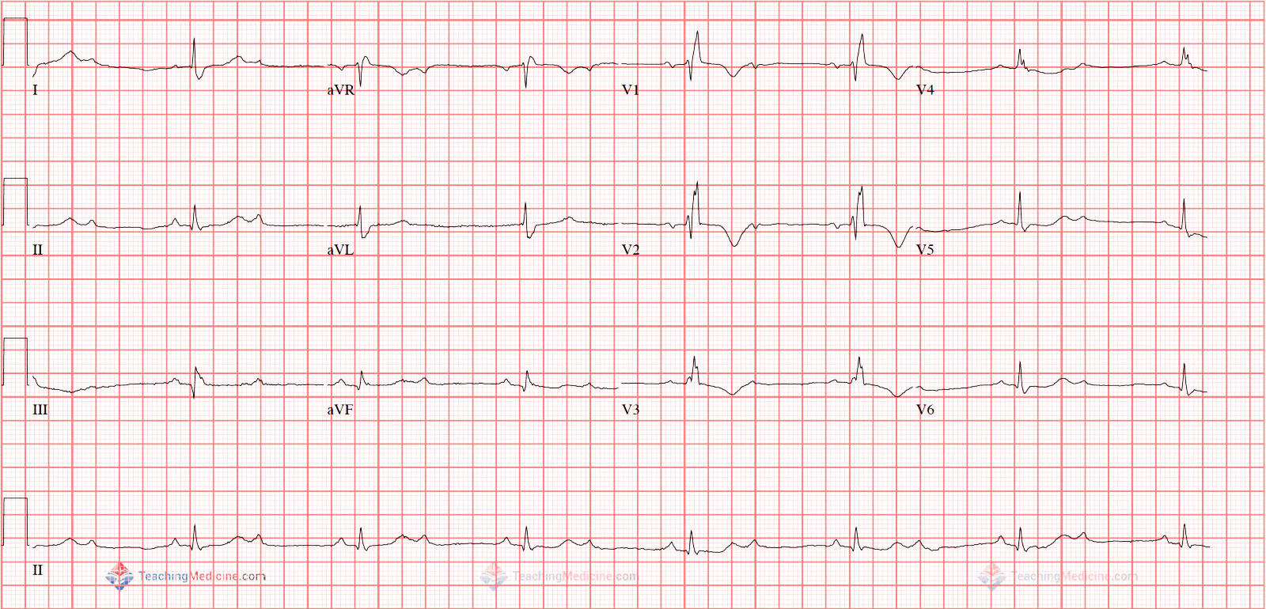
EKG
Interpret the EKG
Clinician
Notes:
Second degree heart block Type II

Slide 16
Question 1 What component of the autonomic nervous system is most likely affected?
Parasympathetic
Sympathetic
Enteric
Both parasympathetic and sympathetic
Both parasympathetic and enteric
All

Slide 17
Question 2 Which of the following agents is most likely to cause his presentation?
Alpha-1 receptor blocker
Clonidine
Cyanide
Organophosphate
Physostigmine
Tricyclic antidepressant
Pharmacology and physiology

Slide 18
Question 3 An agent is administered IV resulting in the following: A decrease in oral secretions & pulmonary crackles and VS changes
 | Before administration | After medication administration
Pulse | 42 | 58
Blood Pressure | 86/40 | 94/50
Which agent was most likely administered?
Flumazenil
Epinephrine
Norepinephrine
Atropine
Edrophonium
Pharmacology and physiology

Slide 19
Question 4 Based on autonomic pathophysiology, what other agent should be administered?
Pralidoxime
Physostigmine
Donepezil
Methyldopa
Diphenhydramine
Pharmacology and physiology

Slide 20
Compare & Contrast Our 2 Cases
 | Cholinergic Crisis 2º to Organophosphates | Beta Blocker Overdose
Pulse | 42 | 40
Blood Pressure | 86/40 | 80/46
Pupils | Pinpoint; tearing | Midpoint
Mucosa | Copious secretions | Dry
Cardiovascular | Bradycardia | Bradycardia
Respiratory | Harsh crackles at bases; wheezing | Wheezing
Gastrointestinal | Mild tenderness; Hyperactive bowel sounds; vomiting; diarrhea | Soft, non-tender
Neuro | Fasciculations | Lethargic, disoriented

Slide 21
Dr. Alekseev’s Slides

Slide 22

Summary of Adrenoreceptors
Receptor | Second messenger | Primary effect
α-1 (peripheral vessel go from relaxed (α) to constricted (I) | ↑ IP3 Sensitive more to NE Produce excitation (contraction/constriction) | Location: vascular smooth muscle of the skin, splanchnic region, GI tract, bladder sphincter, iris Peripheral vasoconstriction Urethral constriction Pupillary dilation
α-2 | ↓cAMP Produce inhibition (dilation/relaxation) | Relaxation or dilation of smooth muscles GI tract ↓ insulin release ↓ intestinal mobility
β-1 organ # 1 HEART | ↑cAMP Very sensitive to NE and E Produce excitation | Located: SA, AV nodes, heart ventricular muscles ↑ Cardiac contractility & HR ↑ renin release by JG cells of the kidney
β-2 (two legs, two hands, two lungs) | ↑cAMP Produce relaxation (dilation) More sensitive to E than to NE | Location: vascular smooth muscle of skeletal muscle, bronchial smooth muscle, walls of GI and bladder Peripheral vasodilation Bronchodilation ↑Glucagon release by alpha cells

Slide 23
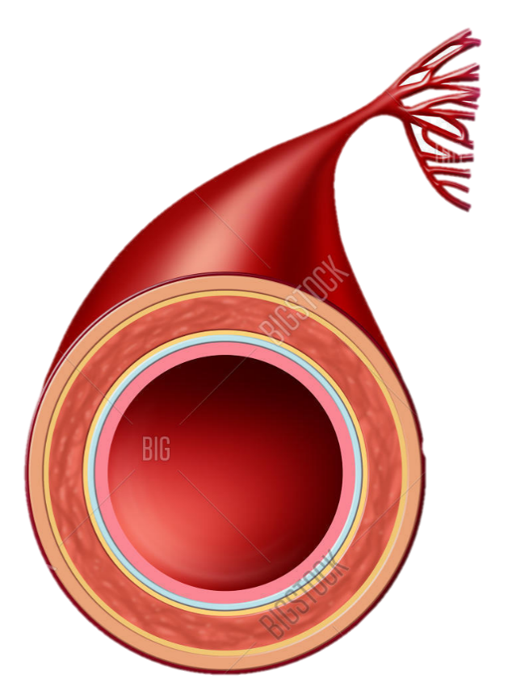
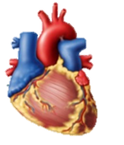
Beta blocker effect
β-blocker
Epinephrine (adrenal gland)
Epinephrine (adrenal gland)
Sympathetic nerve
β₁-receptors
norepinephrine
α1-receptors
β₂-receptors
β₂-receptors: activated by epinephrine
α₁-receptors: require much higher amount of E, mostly under NE
Loss of vasodilation (β2) and presence of vasoconstriction (α1)→ ↑TPR → hypertension
Hypotensive effect
Physiology

Slide 24

Regulation of Smooth Muscle
Reference slide
Endothelin-1
Ca channel blockers, MgSO₄
α-1 antagonists
NO
β-2 blockers
PGI₂
Endothelin antagonists
Ca
NE
NO
PDE inhibitor
L-type Ca channel
PGI₂
E
α-1
β₂
IP₃
Gq coupled receptor
G_{s}
PDE
ET_{A}
↑Guanylyl cyclase
Endothelin-1
CICR →
Ca + CaM
A-Cyclase
GTP → cGMP → GMP
ACE inhibitors
↑MLC kinase
cAMP
↑MLC phosphatase
MLC - Ⓟ
MLC Ⓟ→
α-1 agonists: NE
β-2 agonists: E
α-1 antagonists: prazosin, terazosin, tamsulosin
Ca channel blockers: nifedipine, amlodipine
K channel opener: minoxidil
Endothelin antagonists: bosentan, ambrisentan
ACE inhibitors: enalapril
ARB: losartan
PDE inhibitor: sildenafil (Viagra)
Ang-II
PKG
ARB
actin→ ←myosin
←actin myosin→
K channel opener
K channel
CaM: calmodulin
MLCK: myosin light chain kinase
Ⓟ - phosphate
PDE: phosphodiesterase
PDEi: PDE inhibitor
PGI₂: prostacyclin - Treprostinil
Ca
Physiology
Contraction
Relaxation

Slide 25
Summary of Adrenoreceptors
Receptor | Second messenger | Primary effect
α-1 (peripheral vessel go from relaxed (α) to constricted (I) | ↑ IP3 Sensitive more to NE Produce excitation (contraction/constriction) | Location: vascular smooth muscle of the skin, splanchnic region, GI tract, bladder sphincter, iris Peripheral vasoconstriction Urethral constriction Pupillary dilation
α-2 | ↓cAMP Produce inhibition (dilation/relaxation) | Relaxation or dilation of smooth muscles GI tract ↓ insulin release ↓ intestinal mobility
β-1 organ # 1 HEART | ↑cAMP Very sensitive to NE and E Produce excitation | Located: SA, AV nodes, heart ventricular muscles ↑ Cardiac contractility & HR ↑ renin release by JG cells of the kidney
β-2 (two legs, two hands, two lungs) | ↑cAMP Produce relaxation (dilation) More sensitive to E than to NE | Location: vascular smooth muscle of skeletal muscle, bronchial smooth muscle, walls of GI and bladder Peripheral vasodilation Bronchodilation ↑Glucagon release by alpha cells

Slide 26
Beta blocker effect
β-blocker
Epinephrine (adrenal gland)
Epinephrine (adrenal gland)
Sympathetic nerve
β₁-receptors
norepinephrine
α1-receptors
β₂-receptors
β₂-receptors: activated by epinephrine
α₁-receptors: require much higher amount of E, mostly under NE
Loss of vasodilation (β2) and presence of vasoconstriction (α1)→ ↑TPR → hypertension
Hypotensive effect
Physiology

Slide 27
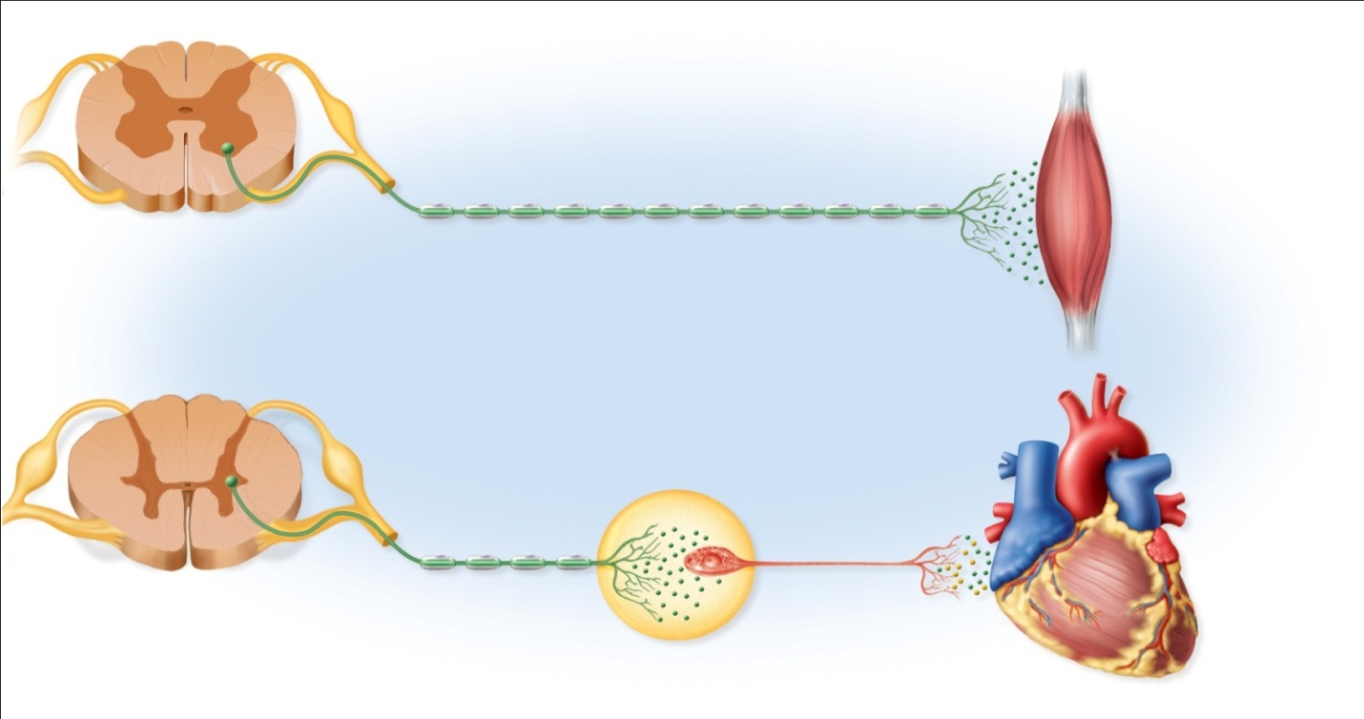
Difference between Somatic and Autonomic Innervation
Somatic efferent innervation
ACh
Myelinated
fiber
Somatic effectors
(skeletal muscles)
Autonomic efferent innervation
ACh
ACh or NE
Myelinated
preganglionic fiber
Unmyelinated
postganglionic fiber
Visceral effectors
(cardiac muscle,
smooth muscle,
glands)
Autonomic
ganglion
Pharmacology and physiology

Slide 28
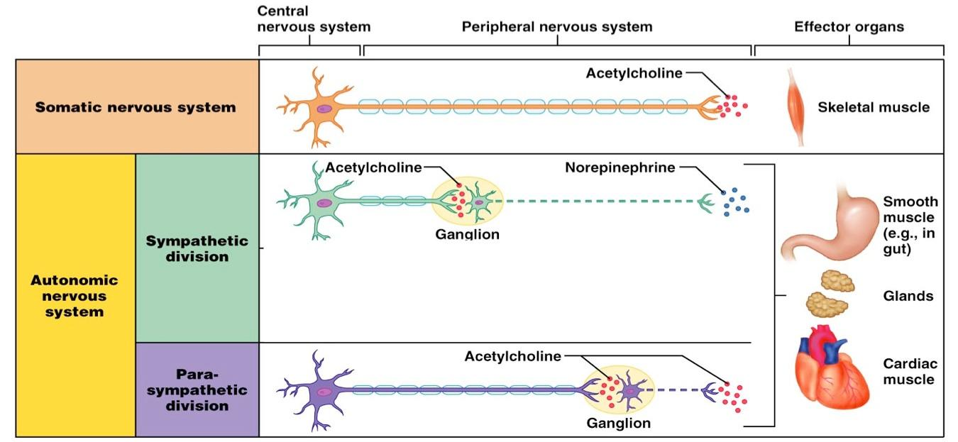
Sympathetic, Parasympathetic, and Somatic Innervation
Pharmacology and physiology

Slide 29
Parasympathetic
Sympathetic
MUSCARINIC VERSUS NICOTINIC STIMULATION
Nicotinic
Muscarinic
Nicotinic
ACh
ACh
ACh
NE
Muscarinic effect signs (activation of parasympathetic system):
Bronchoconstriction
↑ bronchial secretion
Salivation
Lacrimation
Sweating
Nausea
Vomiting
Diarrhea
Miosis (muscarinic sign)
Slow heart rate (?)
SLUDGE: effects indicative of massive discharge of the parasympathetic nervous system (salivation, lacrimation, urinary incontinence, defecation, GI distress, emesis (vomiting)
Nicotinic effect signs (activation both sympathetic and parasympathetic):
Activation both sympathetic and parasympathetic. Manifested by the signs which are originally get more sympathetic innervation
Cyanosis, elevated blood pressure (nicotinic sign)
CNS effect (anxiety, restlessness, confusion, headache)
Nicotinic effect can be achieved by inhibition of acethycholinesterase → stimulation of all types of cholinergic neurons: sympathetic, parasympathetic, somatic
Somatic nervous system effects:
Twitching
Fasciculation
Muscle weakness
Nicotinic
ACh
Pharmacology and physiology

