Slide 1
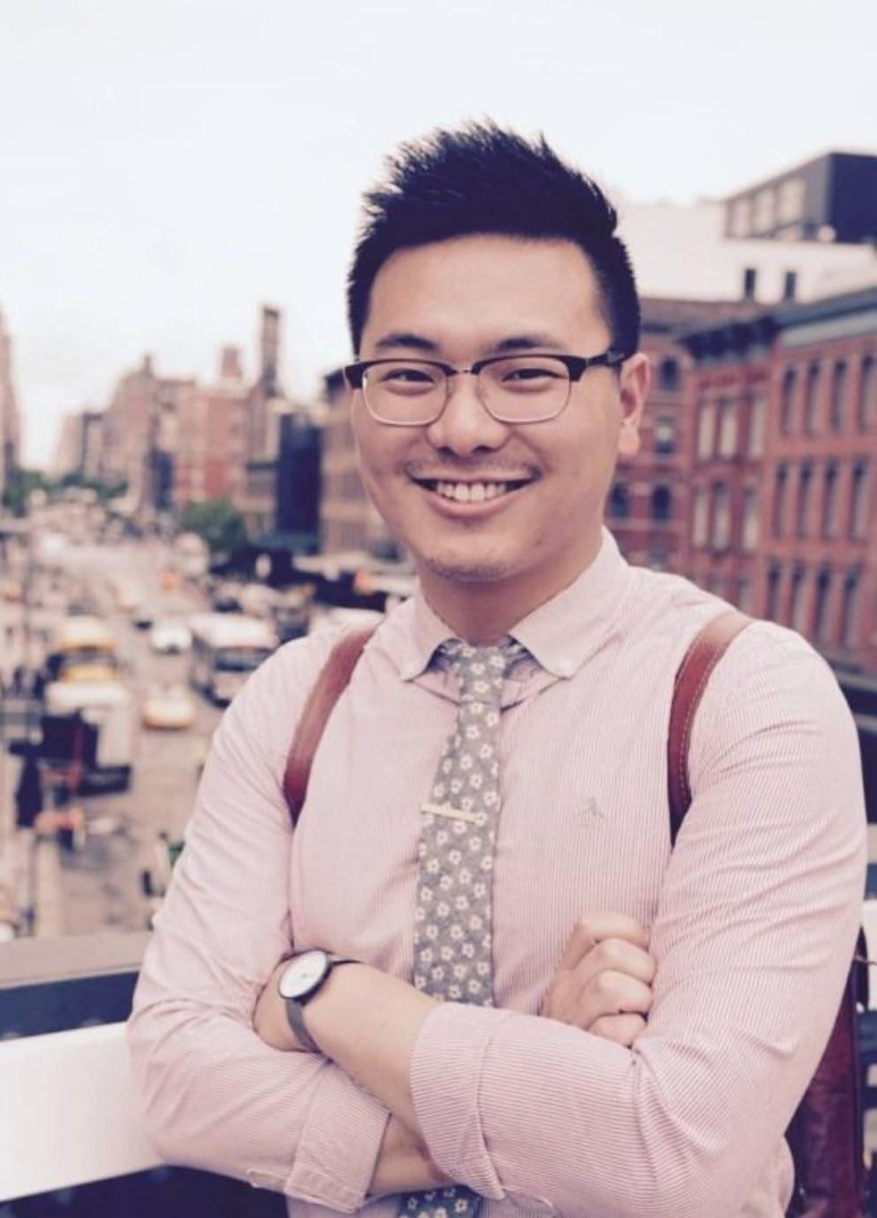
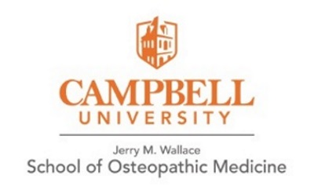
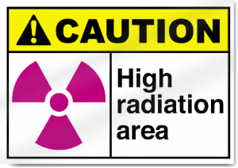
A Hidden Gem in Medicine:
Radiation Oncology
Join us on the Tuesday January 17th 6:30-8:30 pm
Spencer Liu D.O, CUSOM class of 2022
PGY-1, Radiation Oncology
William Beaumont University Hospital, Royal Oak, MI
- What is RadOnc? How does it work?
-What do radiation oncologists do?
-My story of RadOnc starting at CUSOM.
-What will the RadOnc residency look like?
-What does the journey to matching a RadOnc residency look like?
-Is RadOnc a good fit for you? Why should you consider RadOnc?
- Clinical case presentations and research

