Slide 1
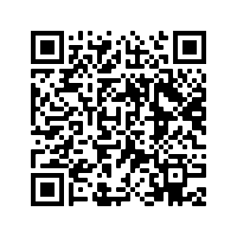
Join the fight against childhood cancer!
St. Jude
Surge
Hosted by Phi Delta Chi Professional Pharmacy Fraternity
Help us reach our goal of raising $1,200 for
St. Jude within 24 hours on *March 9th*!
Donations can be made here:
Touch-Net Link: https://secure.touchnet.net/C20495_ustores/web/store_cat.jsp?STOREID=60&CATID=140&SINGLESTORE=true

