Slide 1
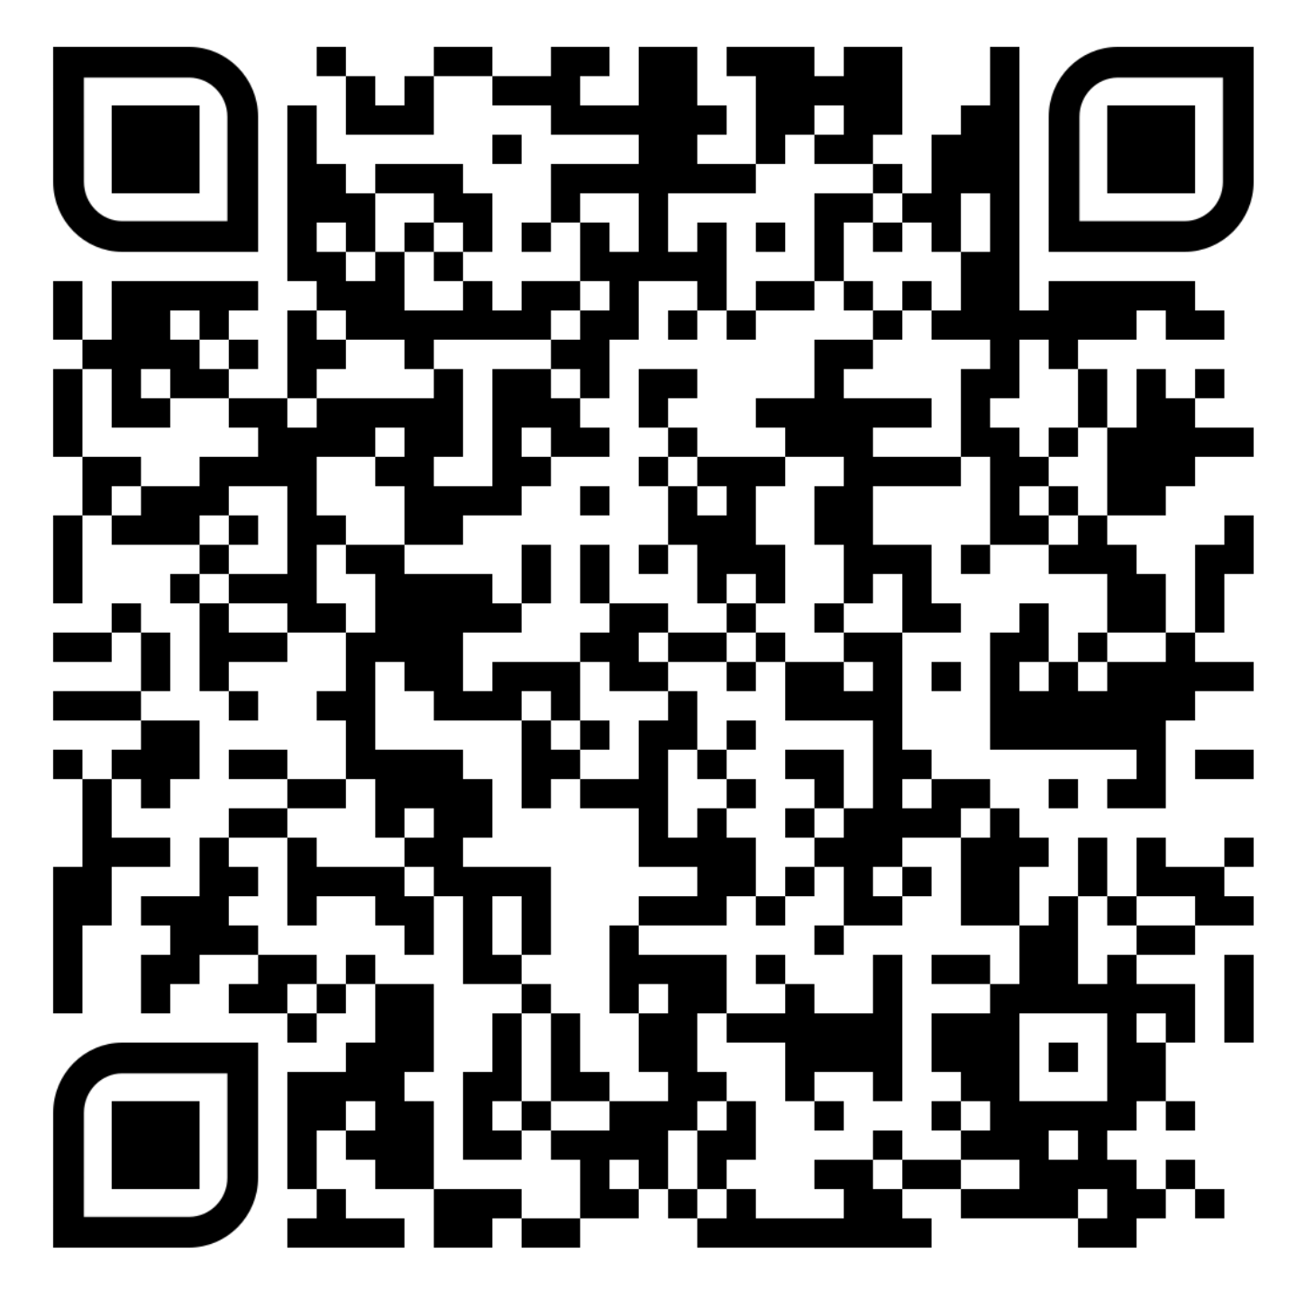
Phi Delta Chi & St. Jude 50/50 Raffle
Feb 22nd – March 8th
$2 per ticket or purchase more for multiple entries!
50% of the proceeds will go to the winner and 50% will go to St. Children's Research Hospital
Previous winners have won more than $1000!
Winner to be announced on March 12th!
Purchase tickets using the Touchnet Link here!
When making a donation, please indicate your name, email, and the name of the PDC brother you are donating through (if applicable).

