Slide 1
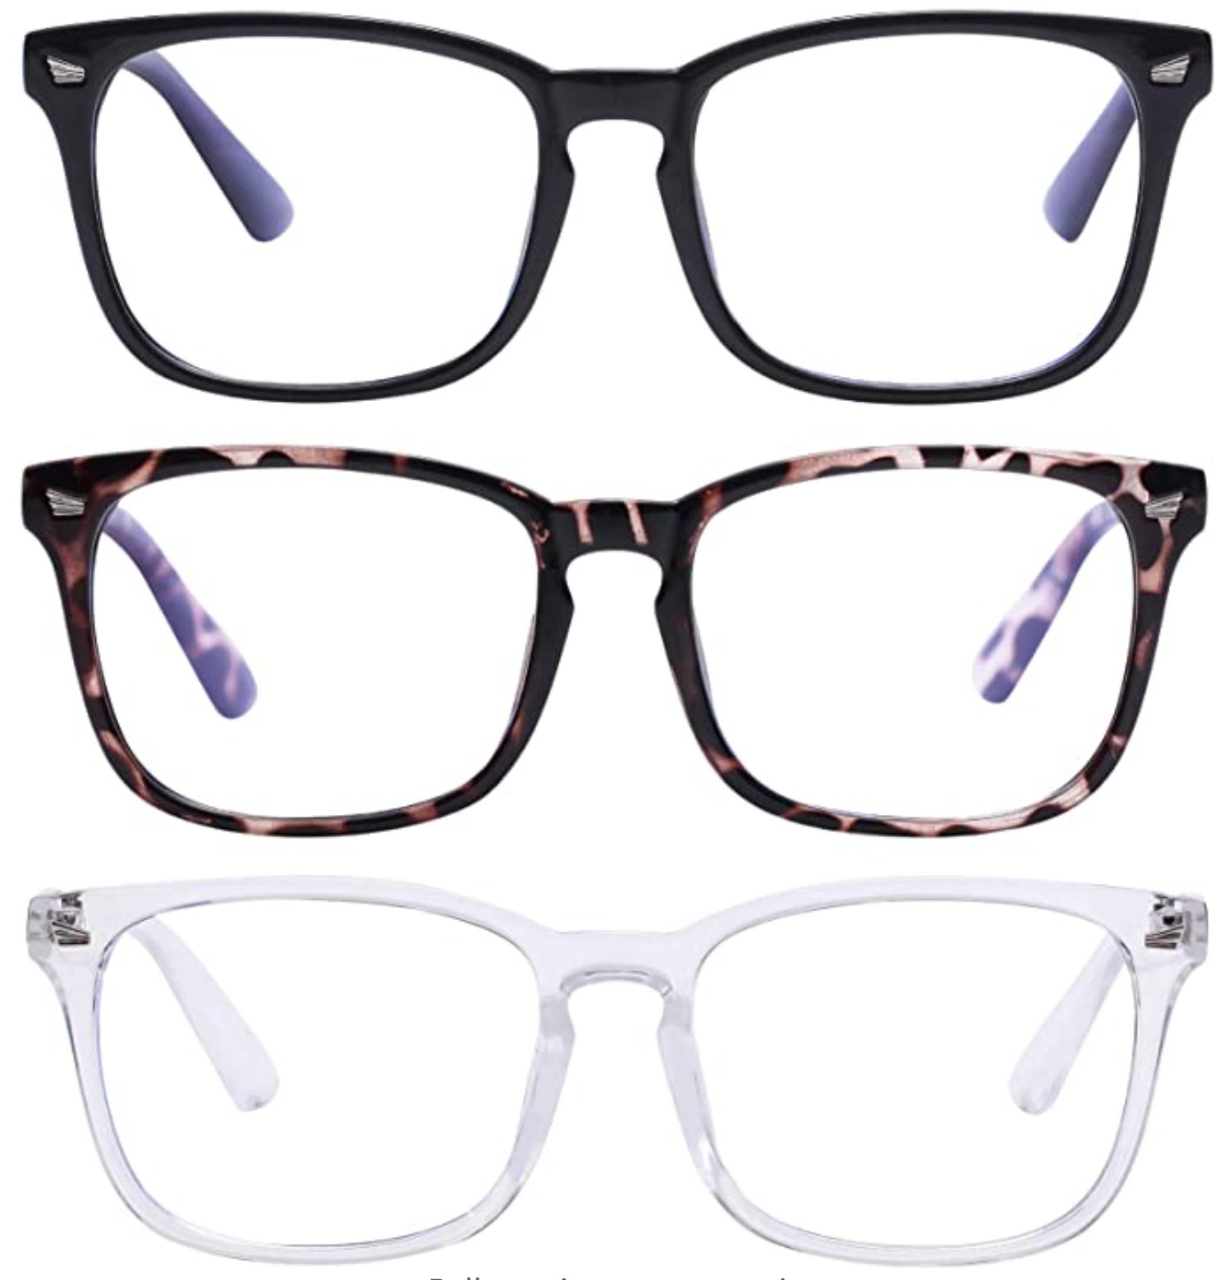
Blue Light Glasses Sale
Blue light glasses can help reduce eye discomfort and digital eye strain by helping filter out blue light emitted from screens.
$10 per pair
Click here to purchase!
~ Sale ends January 29th ~
Color Options
Black
Leopard
White/Clear

