Slide 1
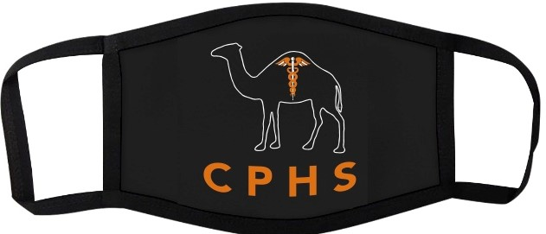
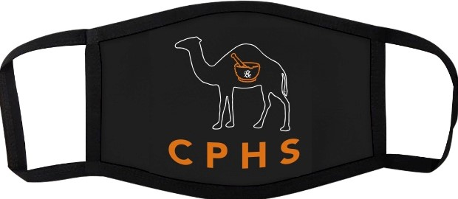
Kappa Epsilon Mask Fundraiser
Stay Campbell safe with KE!
Two designs
Mortar and Pestle
Caduceus logo.
September 28, 2020 - October 12, 2020
Cost: $10 each
Purchase online at this link:
https://secure.touchnet.net/C20495_ustores/web/store_main.jsp?SINGLESTORE=true&STOREID=69

