Slide 1
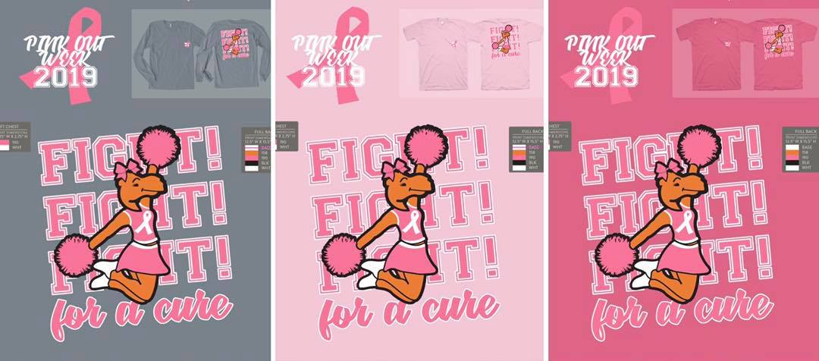
KAPPA EPSILON PINK OUT WEEK T’s
Comfort Colors sizes S-3X
Short-sleeve OR long-sleeve
Gray (“Granite”)
Light Pink (“Blossom”)
Dark Pink (“Crunch Berry”)
Click HERE to order yours!
Payment portal closes midnight October 15

