Slide 1
Student Intro

Slide 2
First Year Event Objective
The First Year Event (FYE) is an interactive event designed to engage first-year students from the health science programs at Campbell to introduce students to IPE concepts and standards, and to begin development of collaborative skills
Building bridges across disciplines
Breaking down silos
Developing interprofessional connections

Slide 3
Participating Programs
Public Health (MSPH)
Physician Assistant (MPAP)
Physical Therapy (DPT)
Pharmacy Practice (PharmD)
Pharmaceutical Sciences (MSPS)
Osteopathic Medicine (DO)
Nursing (BSN)

Slide 4
Activity Goal
Escape Room: Students must use the clues found in their small group room to solve various puzzles, revealing clues along the way that point to the mission that must be accomplished. Only when certain steps are performed is the room “solved.”

Slide 5
Escape Rooms
Team-based
Players collaborate to discover clues
Players work together to solve puzzles
Tasks are accomplished collaboratively in order to achieve specific goals
Limited amount of time
Hints available
Physical and virtual clues
Players may run out of time
CLUES ARE NOT SEQUENTIAL
Go to URL

Slide 6
Event Objectives
After completing in an interprofessional, small-group, escape room experience, students will be able to:
Discuss the importance of IPE and IPCP and identify the four major IPEC Competency domains
Identify at least one new aspect of each profession represented in their small group while identifying at least 1 – 2 specific ways in which their own profession was (or would have been) engaged in the given case
Identify 2 – 3 new acquaintances from other programs; discussing both the benefits of working with students from other programs, and identifying areas of difficulty in communicating and collaborating across disciplines
Identify 2 – 3 ways in which IPCP increases positive patient and/or community health outcomes

Slide 7
Event Outline
Arrive at assigned locations
Gather in Smith Hall lobby before being released to your rooms
Group introductions
Facilitator introductions
Case setup
Escape room scenario
First Year Event debrief

Slide 8
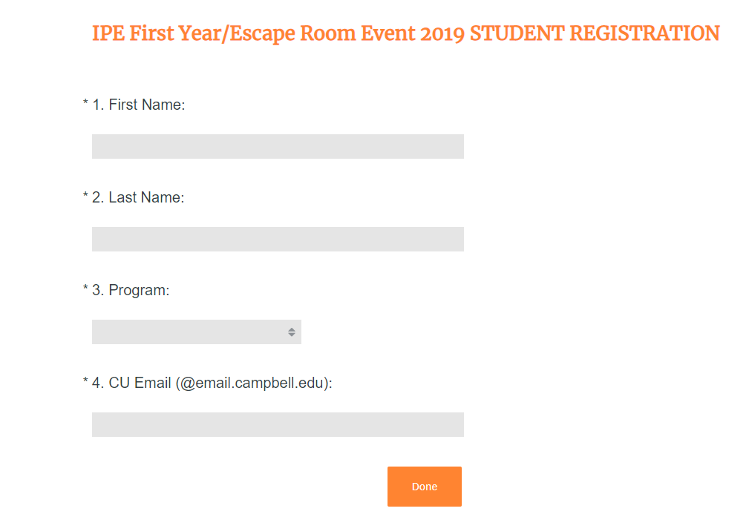
Registration
Email with registration link goes out MONDAY, AUGUST 26.
Deadline for Registration: FRIDAY, AUGUST 30.
Registration lists sent to programs: MONDAY, SEPTEMBER 2.
EVERYONE has to register!

Slide 9
Groups & Facilitators
Students will be sent group assignments (with room locations) by 11:59 PM TUESDAY, SEPTEMBER 3, 2019.
Your group will have about 7-8 other members from other professions than your own
Each group is assigned to one or two facilitators
Some facilitators will be upper-class students, who will always be paired with a faculty facilitator
Facilitators
Set up the scene for the scenario
Provide answers/clues when certain items are “unlocked”
Lead debrief discussion after scenario is completed

Slide 10
Logistics
Monday, September 9th, 2019
Schedule:
Round 1: 1:00 – 2:00 PM
Round 2: 2:20 – 3:20 PM
Round 3: 3:40 – 4:40 PM
Arrival: Upon arrival, you will gather in the lobby of Levine, until you are released to your assigned small group rooms
If travelling from Main Campus, allow for extra time to allow for travelling across 421, finding a parking spot, and finding your room
You’ll be placed in ONE of these

Slide 11
Attendance
Students must check in to the event for their attendance to be recorded
If a name isn’t included in the check-in file, that name is not recorded in attendance
Check-in files are sent to each program
Each program handles student absences, facilitated by CUIPE

Slide 12
Checking In
Students check in to IPE events by scanning a QR code and entering basic information
QR Codes can be scanned using your phone’s QR code reader app or camera
Practice scanning QR codes prior to the event
URLs are given for each QR code in case a student’s device doesn’t scan it
Each group has their own unique Check-In QR code

Slide 13
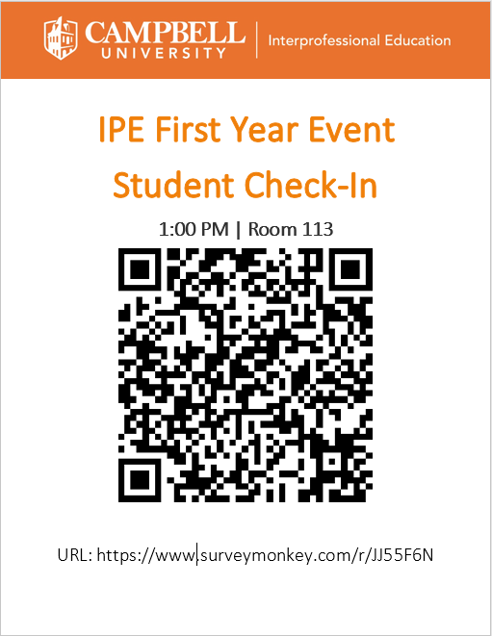
Instructions
Open your QR Code Reader app OR camera
Hover over QR Code
A link to Survey Monkey will pop up
Tap to open
Enter information
Hit SUBMIT
All done!
Practice!

Slide 14
Tips for Success
Individuals must work together in order for the group to succeed in the scenario
Explore everything in the room – all items are fair game!
Come prepared to recognize key aspects about your profession
Buy-in to the scenario like you would a simulation
Read all CUIPE emails to stay updated with any changes or additional details
Make sure you know the following the day before the event:
Group Assignment
Assigned time
Assigned room location
Read over the resources on the next slide to prepare

Slide 15
Resources
IPEC Competencies
Professions Guides:
Nursing: https://explorehealthcareers.org/field/nursing/
Osteopathic Medicine: https://explorehealthcareers.org/career/medicine/osteopathic-physician/
Pharmaceutical Sciences: https://explorehealthcareers.org/career/pharmacology/pharmaceutical-scientist/
Pharmacy Practice: https://explorehealthcareers.org/career/pharmacy/pharmacist/
Physical Therapy: https://explorehealthcareers.org/career/physical-therapy/physical-therapist/
Physician Assistant: https://explorehealthcareers.org/career/medicine/physician-assistant/
Public Health: https://explorehealthcareers.org/many-paths-public-health/

Slide 16
FAQ
What do I do if I have an emergency on September 9th?
Email us at ipe@campbell.edu immediately and copy your assigned facilitator(s) and also your program’s director on the email.
What if my phone has trouble scanning QR codes?
You may use a friend’s phone to scan the code or use the provided URL to check in.
Where do I park?
Parking is available on the Smith and CUSOM sides of the Health Sciences Campus.
What if I have questions about where I need to be on 9/9?
You will have received your group and room assignments by the end of the day of Tuesday, September 3. After September 3, if you do not thing you have received this information, please email us IMMEDIATELY at ipe@campbell.edu.

Slide 17
Contact Us
ipe@campbell.edu
Facebook: @CampbellIPE
Twitter: @CUIPE

