Slide 1
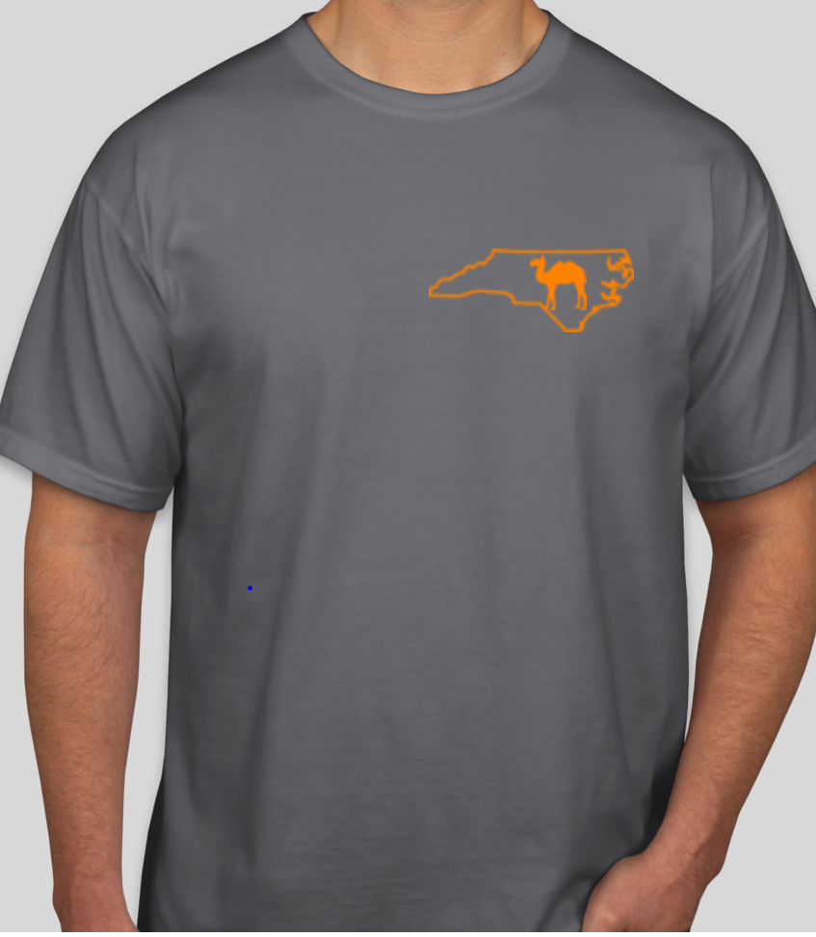
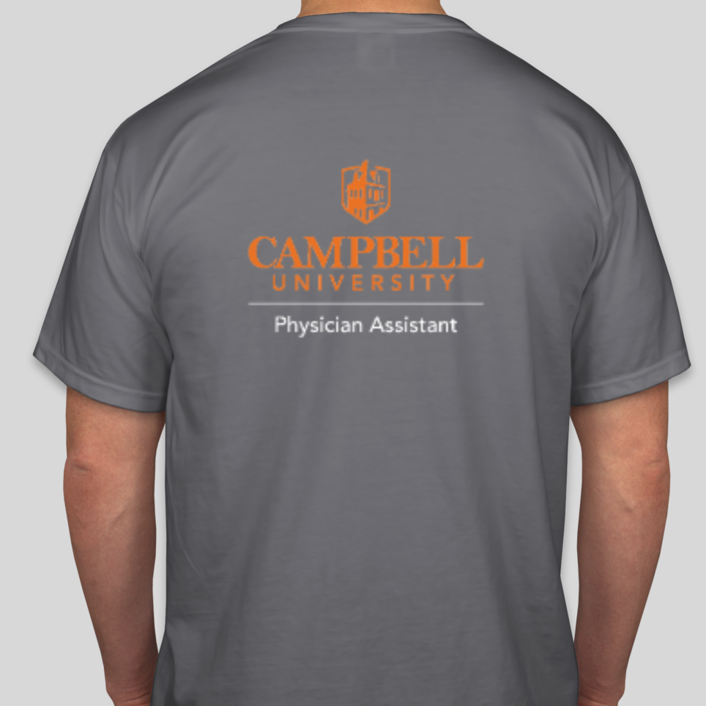
Only $25!
Pharmacy, PA, PT, Public Healthy, & Nursing T Shirts!
Front
Sold by the Physician Assistant Class of 2020
Comfort Color t-shirts in “Denim.” Perfect for yourself or as a gift now that its warmer!
Each t-shirt will have the same design on the front with your program logo on the back.
Order through May 10th!
Back
Shirts can be shipped to you or picked up on campus (select the option at check out).
Order using the following links below, specific for each program:
Nursing: https://www.customink.com/fundraising/campbell-nursing
Pharmacy: https://www.customink.com/fundraising/campbell-pharmacy
Physical Therapy: https://www.customink.com/fundraising/campbell-physical-therapy Physician Assistant: https://www.customink.com/fundraising/
campbell-physician-assistant
Public Health: https://www.customink.com/fundraising/campbell-public-health
Questions? Contact afleviere1016@email.campbell.edu

