Slide 1
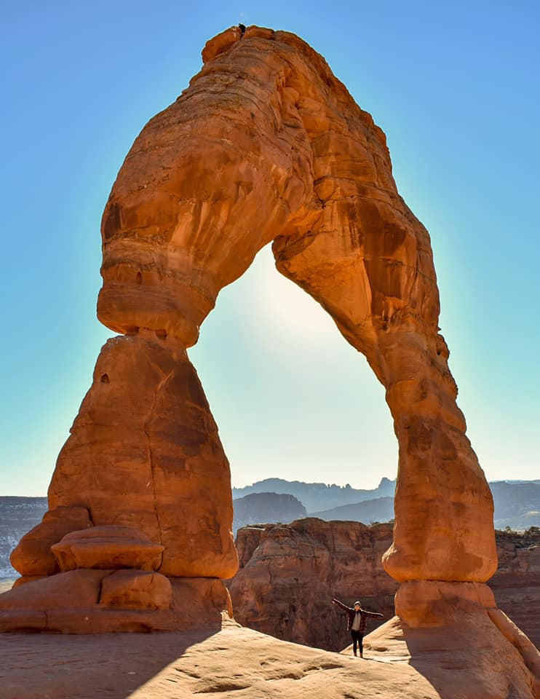
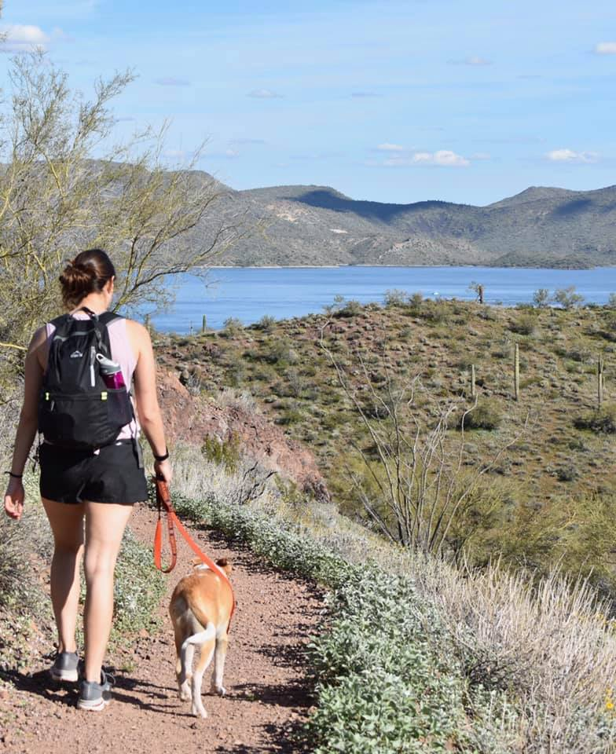
Travel Talk
Allison Wean
Advanced Travel Therapy

Slide 2
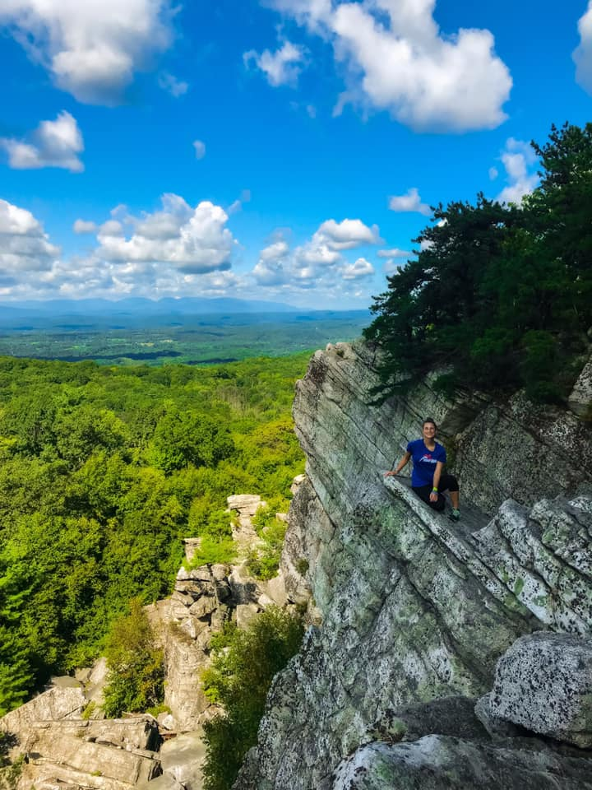
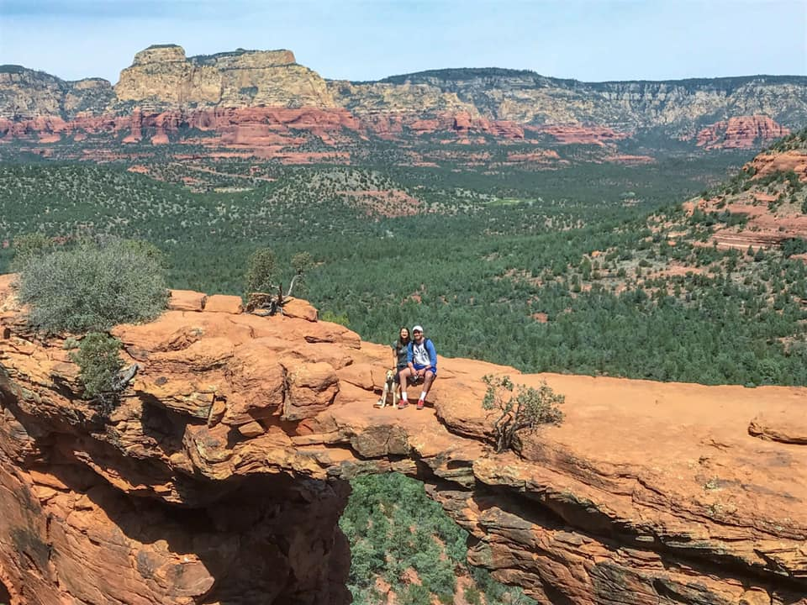
My Experiences Traveling the Country

Slide 3
What is Travel Therapy?
13 Weeks (typically)
Nationwide
Different Settings

Slide 4
Travel as a New Grad?
Similar to level 2 clinical rotations
2 big differences: you get paid and pick where you go (based on job market)
Continue learning a variety of skills
Advanced New Grad Program
Mentorship
CEUs
Tuition Reimbursement
Eligible for full benefits (health, vision, dental, 401K, etc)

Slide 5
CEU’s
Unlimited CEU’s through our online portal
Fully accredited courses
Helps obtain/renew licenses
Resume builders

Slide 6
Tuition Reimbursement
$5,000 total!
$2500 after year 1
$2500 after year 2
Tax free

Slide 7
Mentorship
Mentorship
Partner you with a current/veteran traveler
They are truly the best of the best that we have
How accessible is my mentor?
Call, text, email, skype/facetime, Facebook groups, etc.
How long will I have access to my mentor?
As long as you want to continue the relationship
Will they have experience in the setting I am going into?
Absolutely, and if you step into a setting where they don’t have access, then we partner you with someone else who does
Then you have 2 mentors!

Slide 8
Why Do Travel Therapists Make More Money?
Taxable vs Non Taxable
Stipends are based on cost of living
Taxable ($17-20+/hr)
Lodging Stipend
Meals & Incidental Stipend

Slide 9
Local vs Travel Pay
LOCAL
Commute from your home to work and back every day
Flat taxable rate (no stipends)
TRAVEL
Commuting far enough to work you must duplicate expenses
Qualify for tax free stipends

Slide 10
What about licensing?
Must be licensed in any state you practice in
Processing times vary
Don’t let this be a deterrent- it’s not difficult, just a process
Licenses are reimbursed (1 per assignment)
Can apply for several at a time, or one at a time as you go
Your recruiter can help you know where to get licensed

Slide 11
How Does Housing Work?
Lodging Stipend
Find your own housing! (with your recruiter’s help)
Varies drastically depending on what you need
Many use websites such as AirBNB, VRBO, Craigslist, etc
Company housing
Fully set up by company
No lodging stipend
All-inclusive
Pet friendly

Slide 12
Landing the Job
Search for jobs based on what is most important to you
Setting?
Location?
Money?
Phone Interview
Ask questions that are important for you to know to determine if the facility will be a good fit for YOU
Offer
Acceptance

Slide 13
Process for the next job
We start looking for the assignment early
About halfway through your assignment you will have the conversation about “What’s next?”
This allows for enough time for a new license if needed
Can also extend
Be proactive and don’t wait till the last minute!

Slide 14
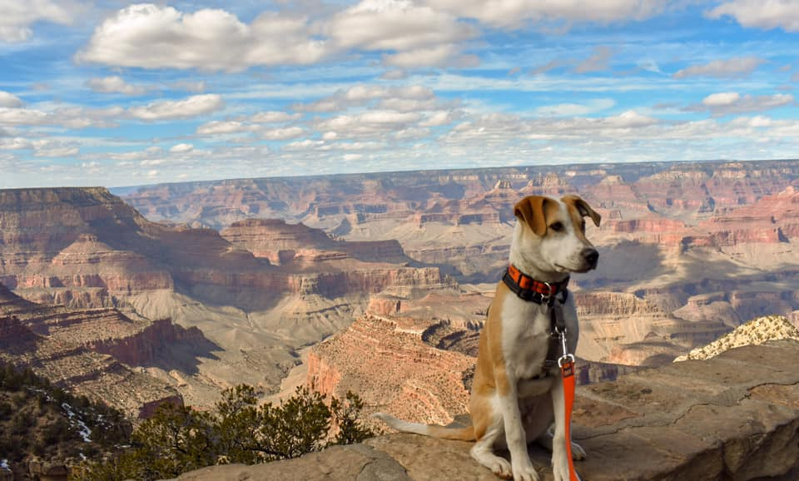
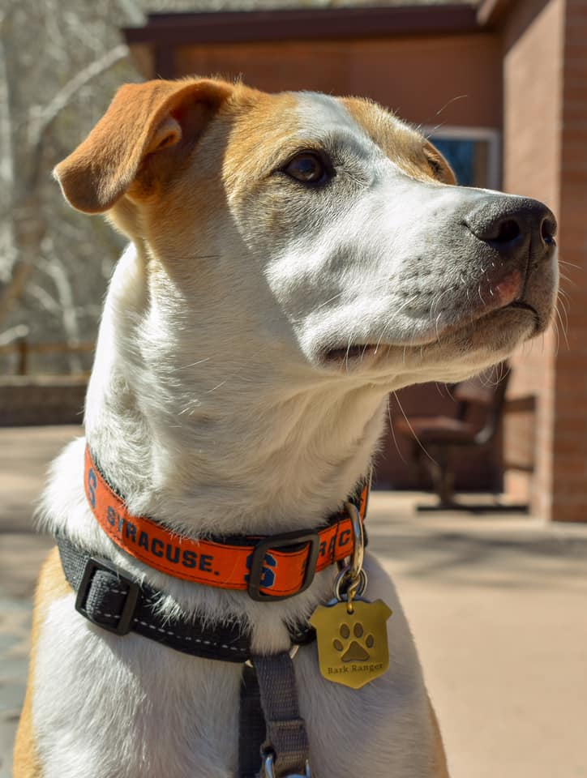
Q&A
Email: jamartin@gowithadvanced.com
allison.wean@gmail.com
www.advancedtraveltherapy.com

