Slide 1
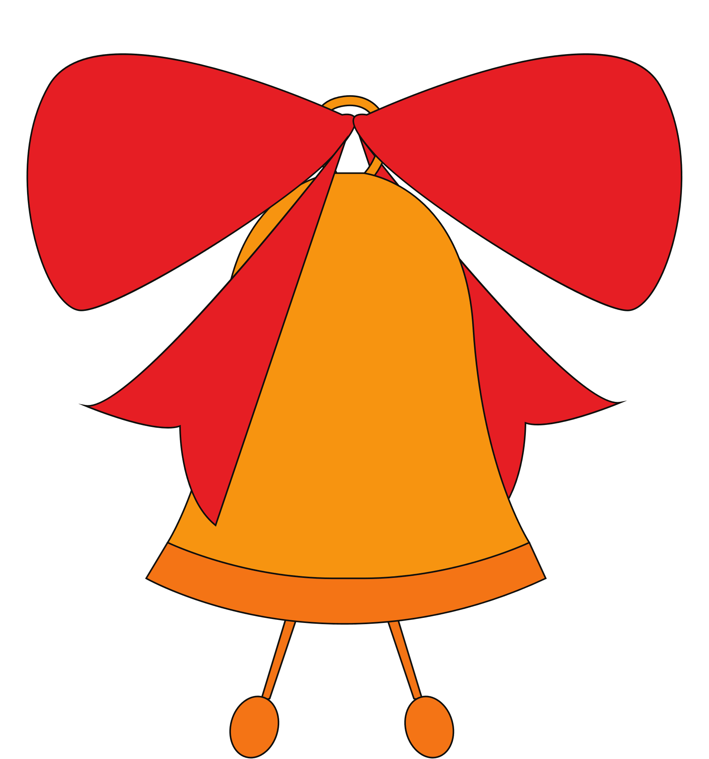
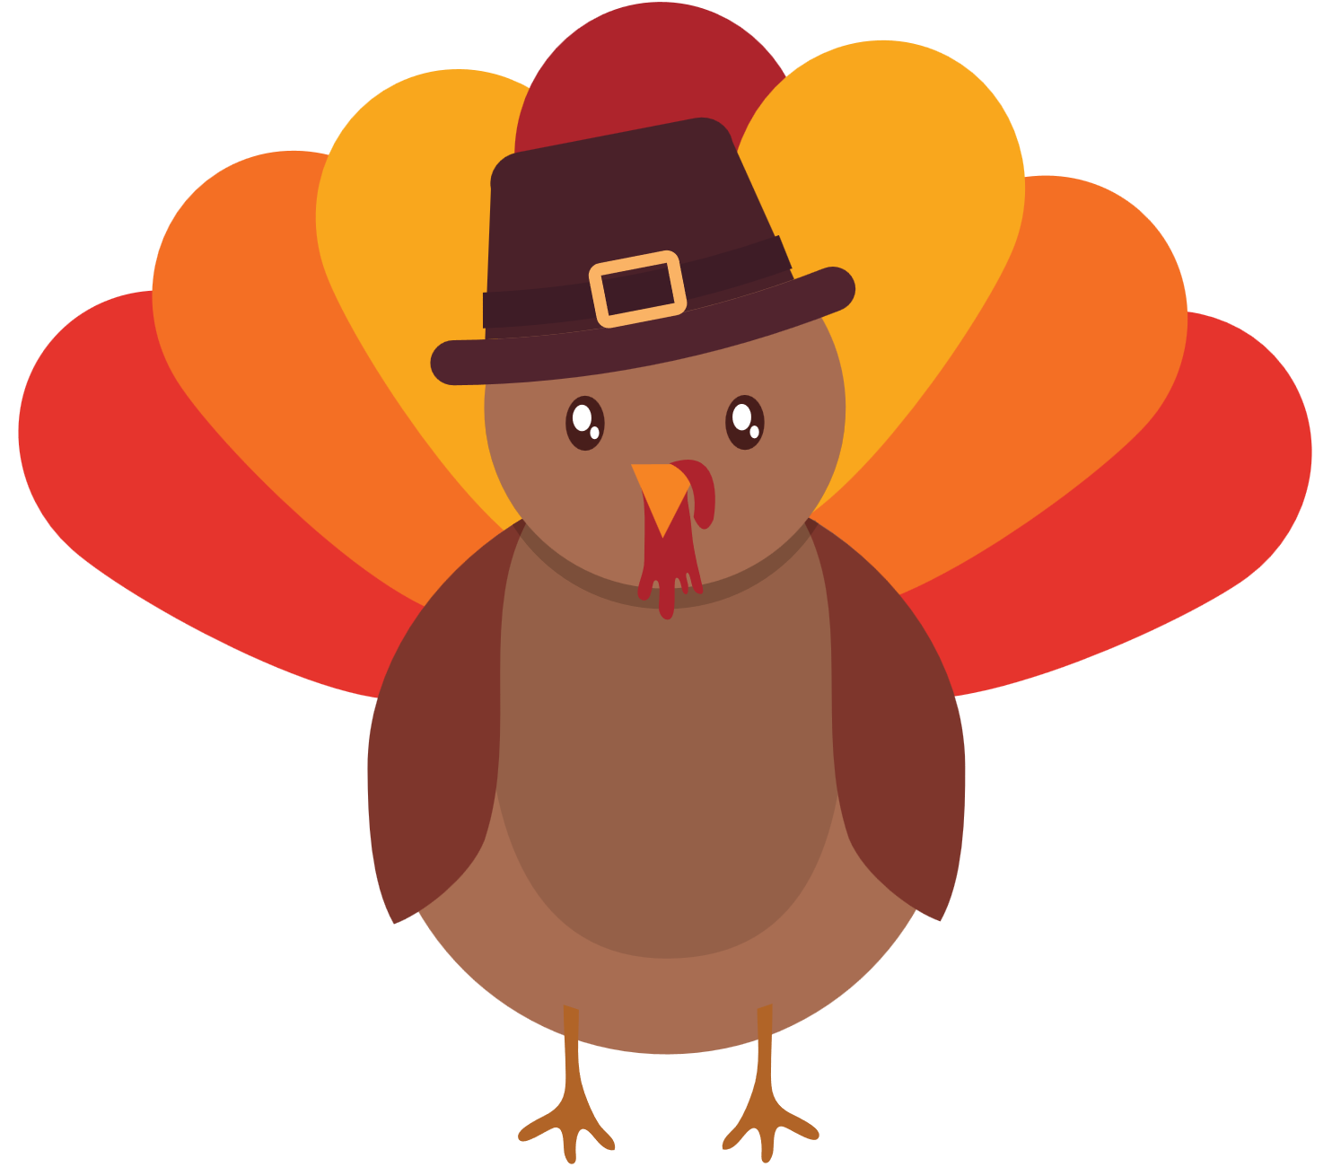
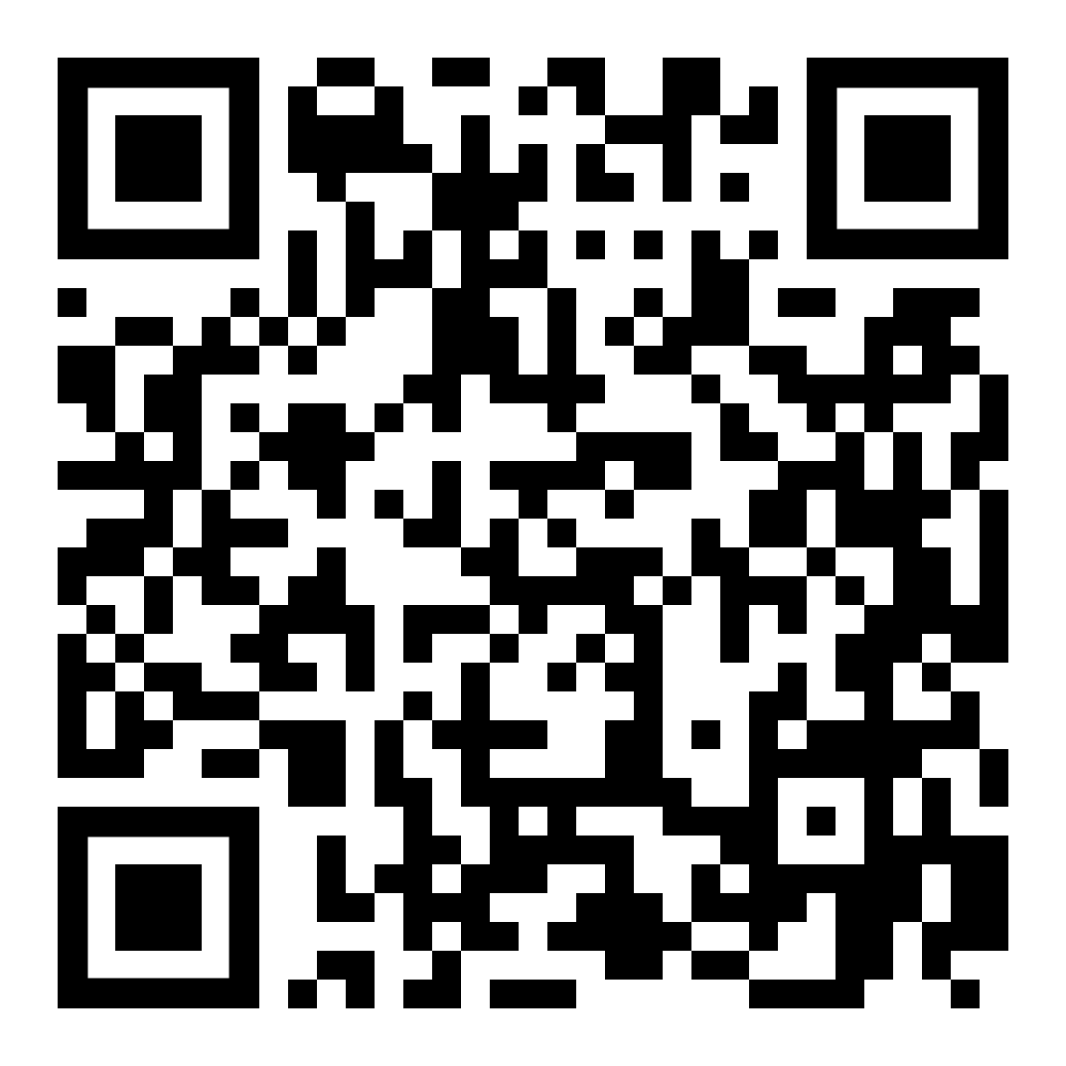
Holiday Ornament
Thank
Mas
Where: Harris Teeter
Lecture Hall
Bell Making
When: November 18, 2022
@ 12:30pm
Cost: Members - Free
Non-Members - $5
Enjoy lunch and a fun afternoon of making ornament bells for the holiday season with friends from diverse backgrounds. All are welcome!
Pay Here By 11-15-22

