Slide 1
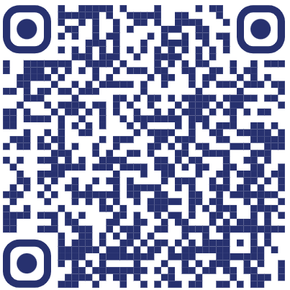
Professional Alumni Student Association (PASA)
Interest Meeting
PASA is a student organization that is for all CPHS students. Our goal is to provide opportunities for professional growth through networking with alumni and other students.
Come learn more about PASA on
August 31st at 1pm in Ed Herring!
Lunch will be provided for those who sign-up!
Have any questions?
Contact Katlyn Womble
krbradford0418@email.campbell.edu
Sign-up here by
August 30th for lunch!

