Slide 1
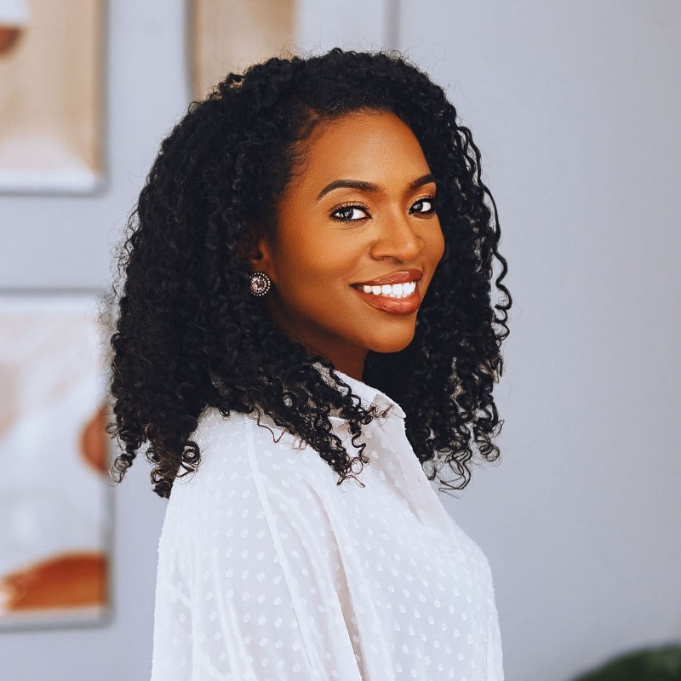
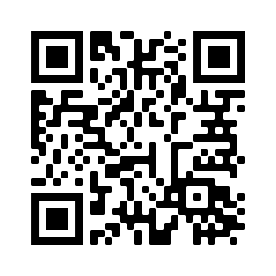
SNPhA's
General Body Meeting
Guest Speaker: Dr. Megan Freeland
Date: November 17,2022
Time: 12-1pm
Location: Zoom Link
(via QR code below)
Dr. Megan Freeland, PharmD
Public Health Pharmacist & Stockrose Creative, LLC Founder

