Slide 1
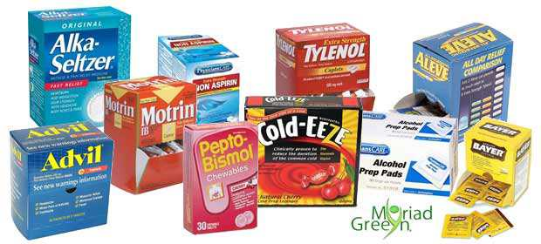
OTC Mock Patient Case Day
Organized by: APhA-ASP OTC Literacy Committee
Monday, November 14th
10 minute slots available from 5pm-7pm
Location: Harris Teeter Lecture Hall
or Rooms 224/228/229
P1’s Sign up here!
https://docs.google.com/spreadsheets/d/1cGX9DMrUem_ytA6VtosGh_YsFepcvugJGZOBpJc8j3c/edit?usp=sharing
P2 and P3 Patient Volunteers sign up here!
https://docs.google.com/spreadsheets/d/15qjaKm1C78T_Tm6jA7gaytnJtZmSAXyQZOlNYqWAPac/edit?usp=sharing

