Slide 1
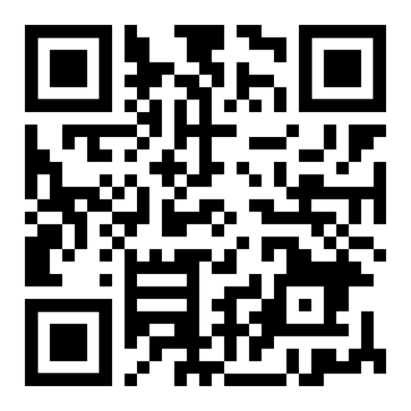
Thanksgiving
Grams
Presented by
D
R
2
Take time to tell a friend or faculty/staff member of CPHS something you are grateful for about them
Cost:
3
$5
5
$8
Grams for
OR
Grams for
Grams are available from
November 1st - November 11, 2022
Grams will be allocated on
November 16th, 2022
D
R
2

