Slide 1
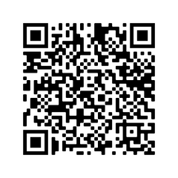
SNPhA's General Body Meeting
Guest Speaker:
Dr. Catherine Wente
Date: October 20, 2022
Time: 12-1pm
Location: Ed Herring Lecture Hall
SIGN UP FOR FOOD BY 10/17 VIA QR CODE

