Slide 1
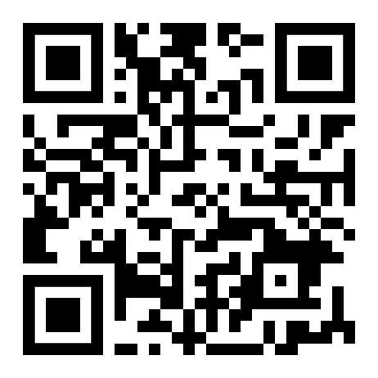
Bake
SALE
OCT
MON
17
2022
UNTIL
FRI
22
2022
USE QR LINK TO PAY OR PAY WITH CASH
AT THE MADDOX TABLE
$5 FOR JEANS DAY + 2 ITEMS

