Slide 1
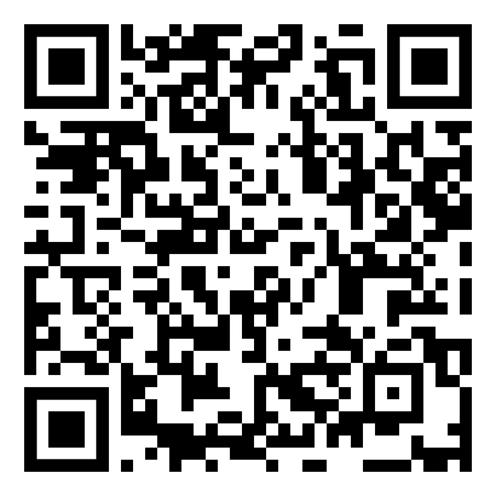
Lunch & Learn
with Dr. Jimmy Pruitt
Date: October 19, 2022
Location: Ed Herring Lecture Hall
Time: 1-2pm
Sign up for food by 10/14 via QR Code
EMERGENCY MEDICINE CLINICIAL PHARMACY SPECIALIST AND
HOST OF "PHARM SO HARD" PODCAST

